Slide 1
20 years R&E monitoring
Ivan Garnizov, BREN
pS DevTeam WP6T3 and pS system engineer for NOC WP9T2 in GÉANT GN5-2
RIPE South East Europe 13th Meeting - Sofia
April 7-8, 2025
Horizon Europe
programme

Slide 2
Paul can we have an agenda slide?
Agenda
Organisation, environment, focus and challenges
The perfSONAR platform and features
Measuring of 400Gb/s and above
A glance in the near future
Resources

Slide 3
The GÉANT Network
Interconnects research, education and innovation communities worldwide, with secure, high-capacity networks.
Total Backbone Trunk Capacity
12.8 Tbps
38 European National Research and Education Networks + NORDUnet ( 5 Nordic NRENs)
over 10,000 institutions and 50 million academic users.

Slide 4
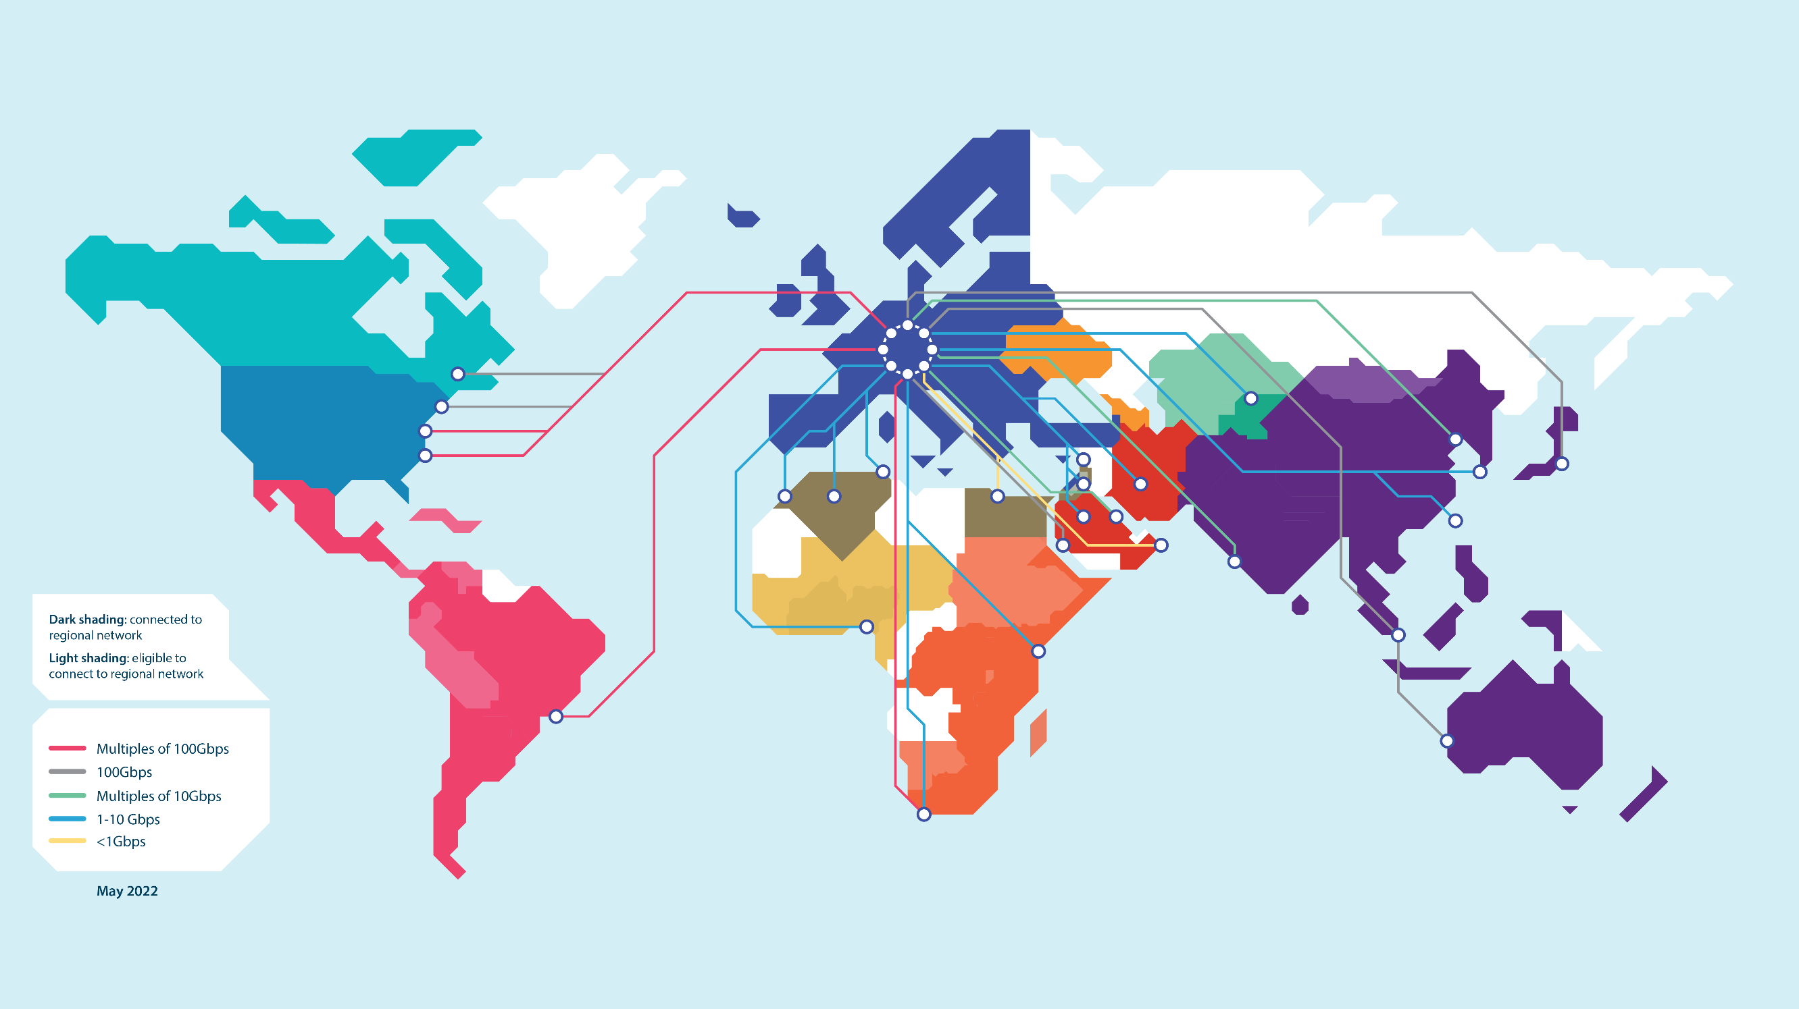
At the heart of global research and education networking
CERN
EOSC
SKAO
PRACE
Belle II
EuroHPC
ITER - Fusion Research

Slide 5
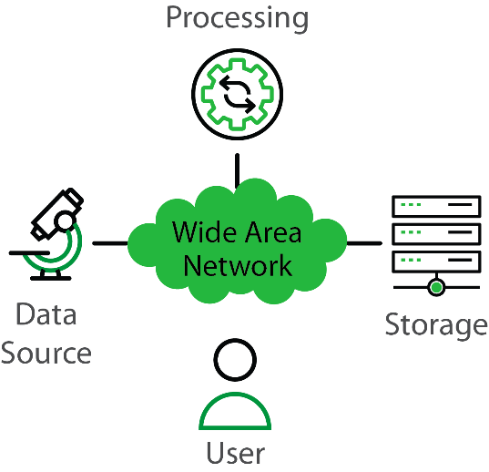
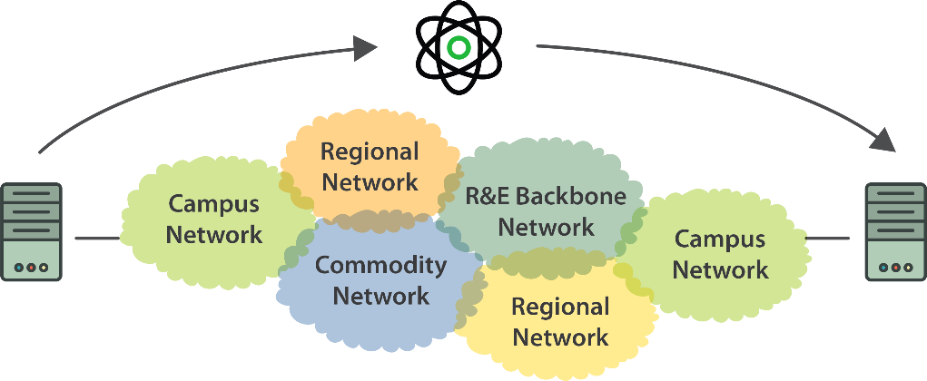
Problem Statement: make data flow
The global Research & Education network ecosystem
This complex, heterogeneous set of networks must operate seamlessly from “end to end”
Data mobility is required

Slide 6
Where Are The Problems?
Congested or faulty links between domains
Latency dependant problems inside domains with small RTT
Source
Campus
Backbone
???
Destination
Campus
???
NREN
Regional
Congested intra- campus links

Slide 7
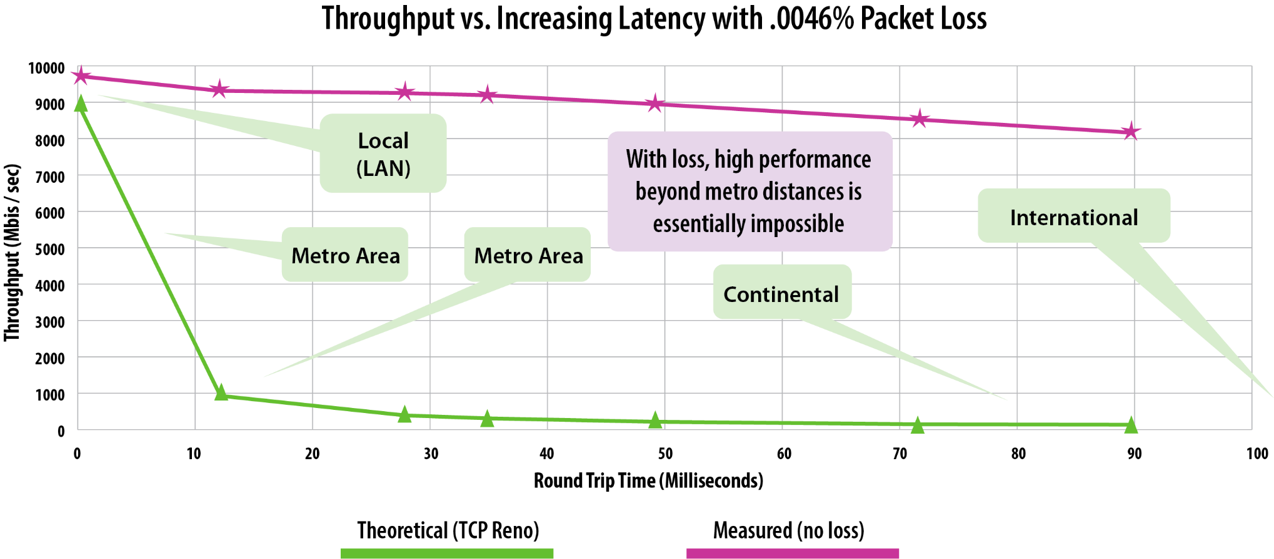
Very small packet loss and TCP performance
Loss of 1 packet per 20.000
No Loss

Slide 8
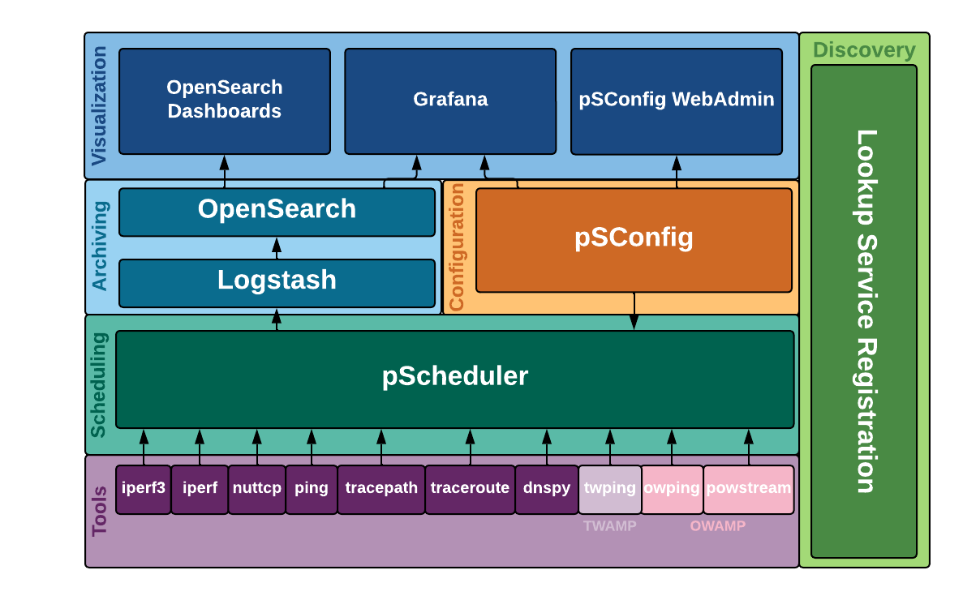
What is perfSONAR?
An open source software collaboration
A platform for network monitoring and measurements across organizations on various quality parameters
Network specific measurements
Throughput
One-way delay
Jitter
Packet Loss
Traceroute
RTT
2 more ?
Network metrics challenge
8

Slide 9
5.1.4
Released October 17 2024
Grafana Interface
Customizable visualization, better integration with other data
Threaded iperf3 Support
Ability to test at 100Gbps+
Python pSConfig
Better maintainability of more modern codebase
Better Instrumentation and Troubleshooting Tools
Makes it easier to identify issues when perfSONAR misbehaves
More recent OS Support
Debian 11, Debian 12 and Ubuntu 22 support. On top of EL9 (Alma, Rocky) and Ubuntu 20.

Slide 10
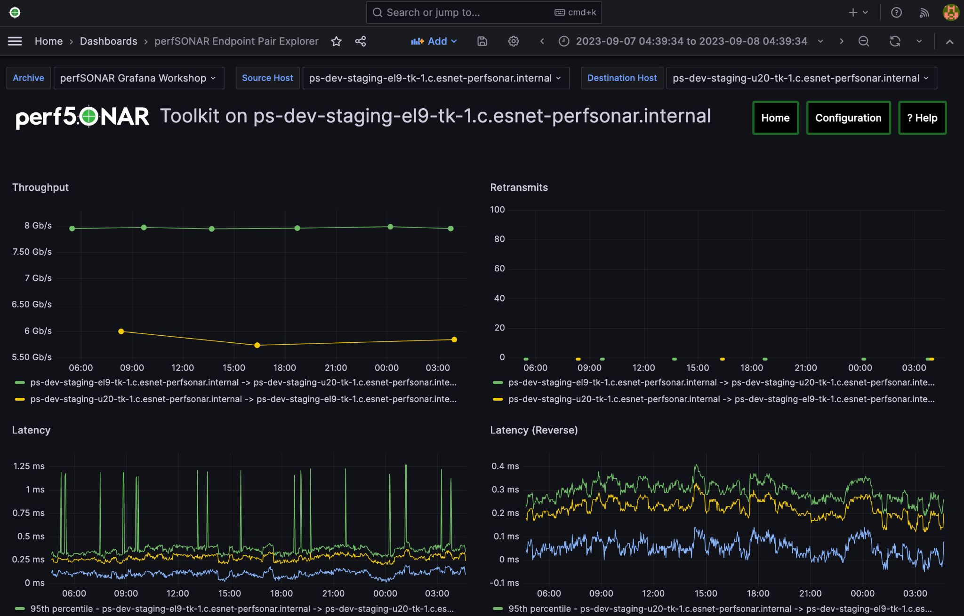
The Fundamentals

Slide 11
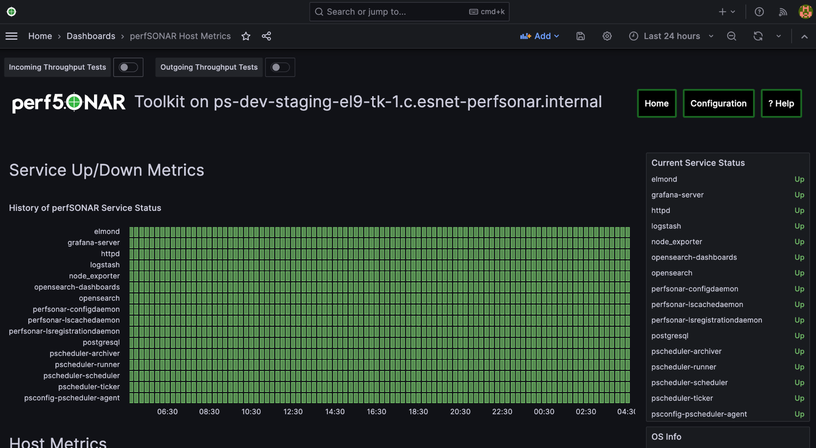
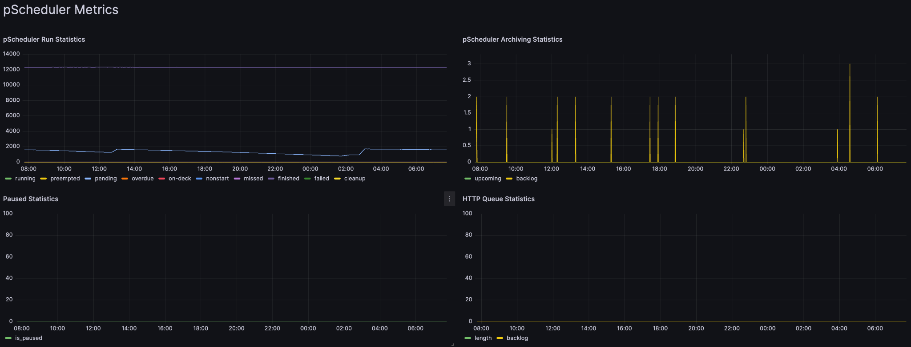
New UI: Instrumentation

Slide 12
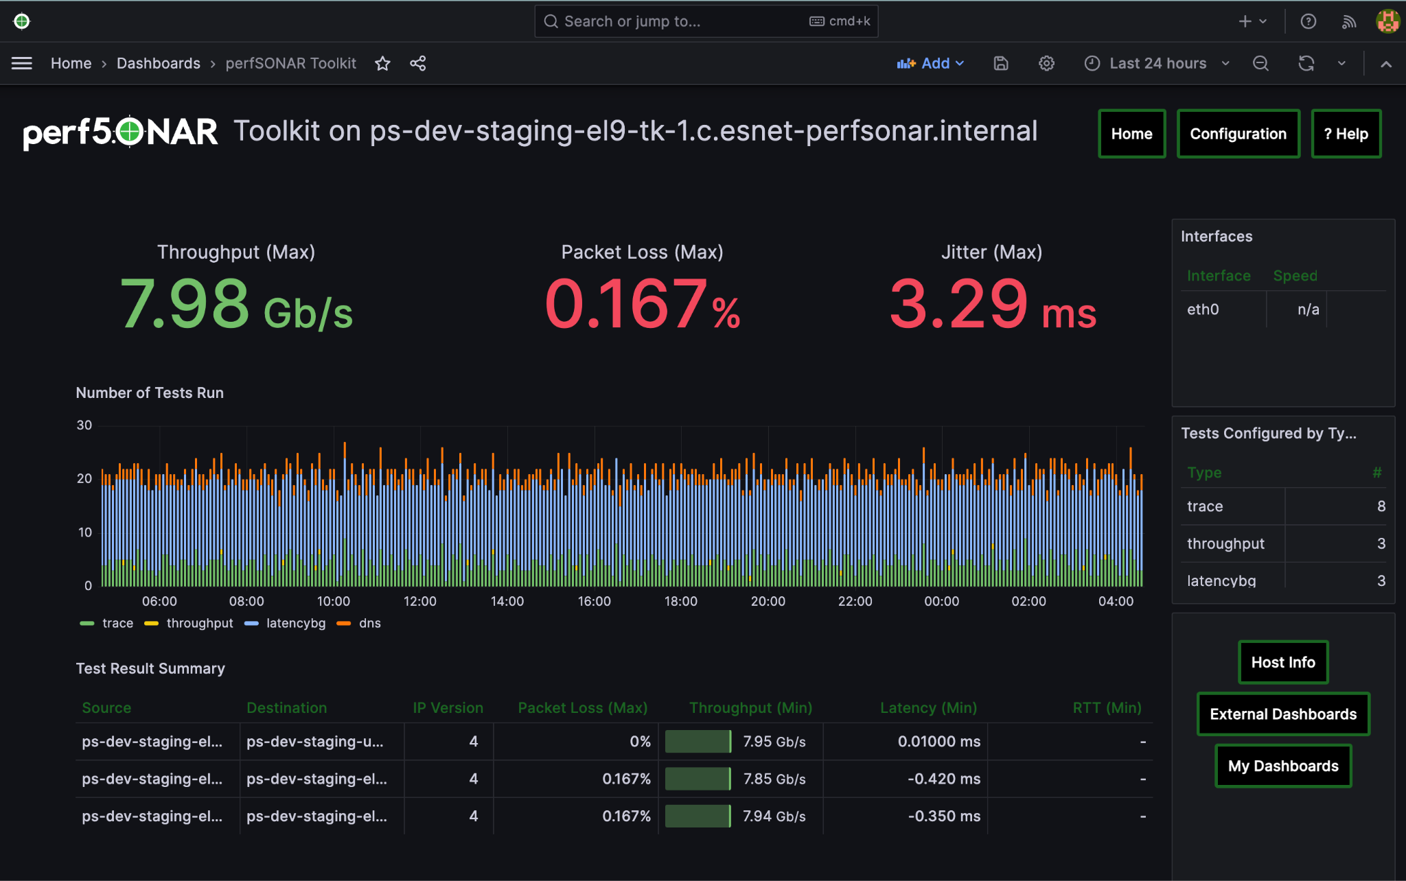
New UI: Focus on Measurements

Slide 13
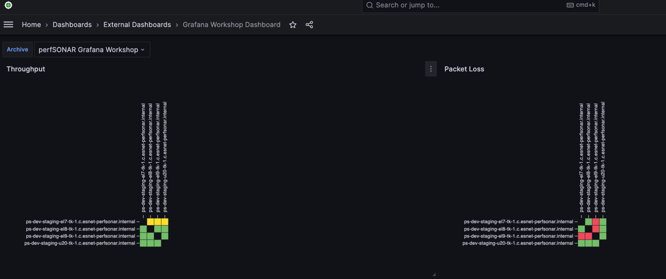
New UI: MaDDash Integration

Slide 14
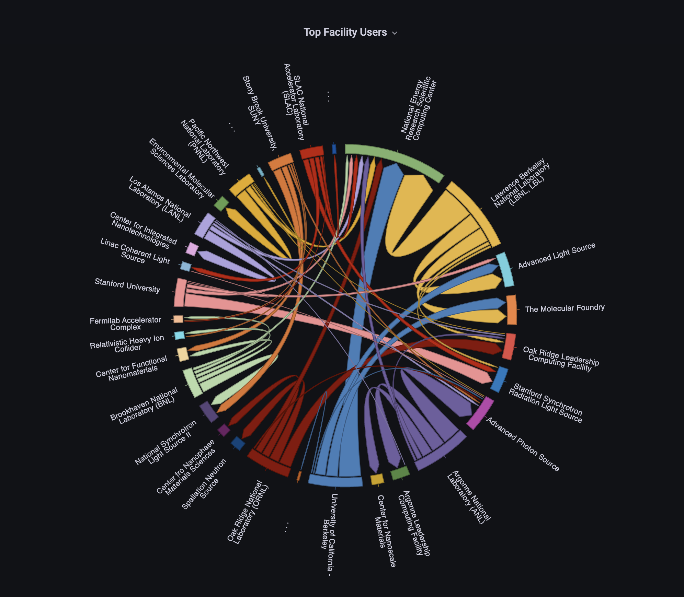
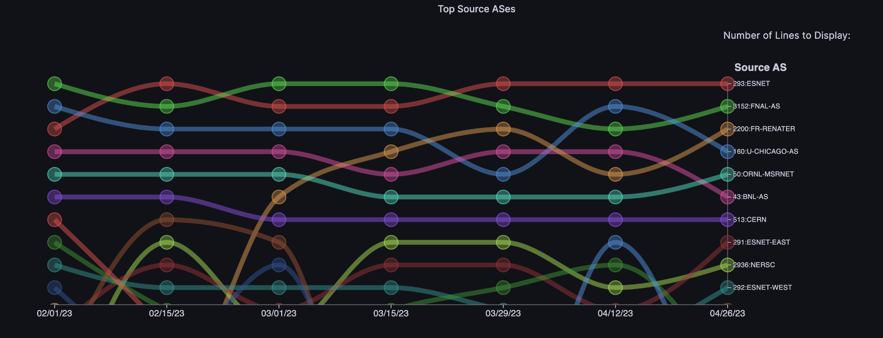
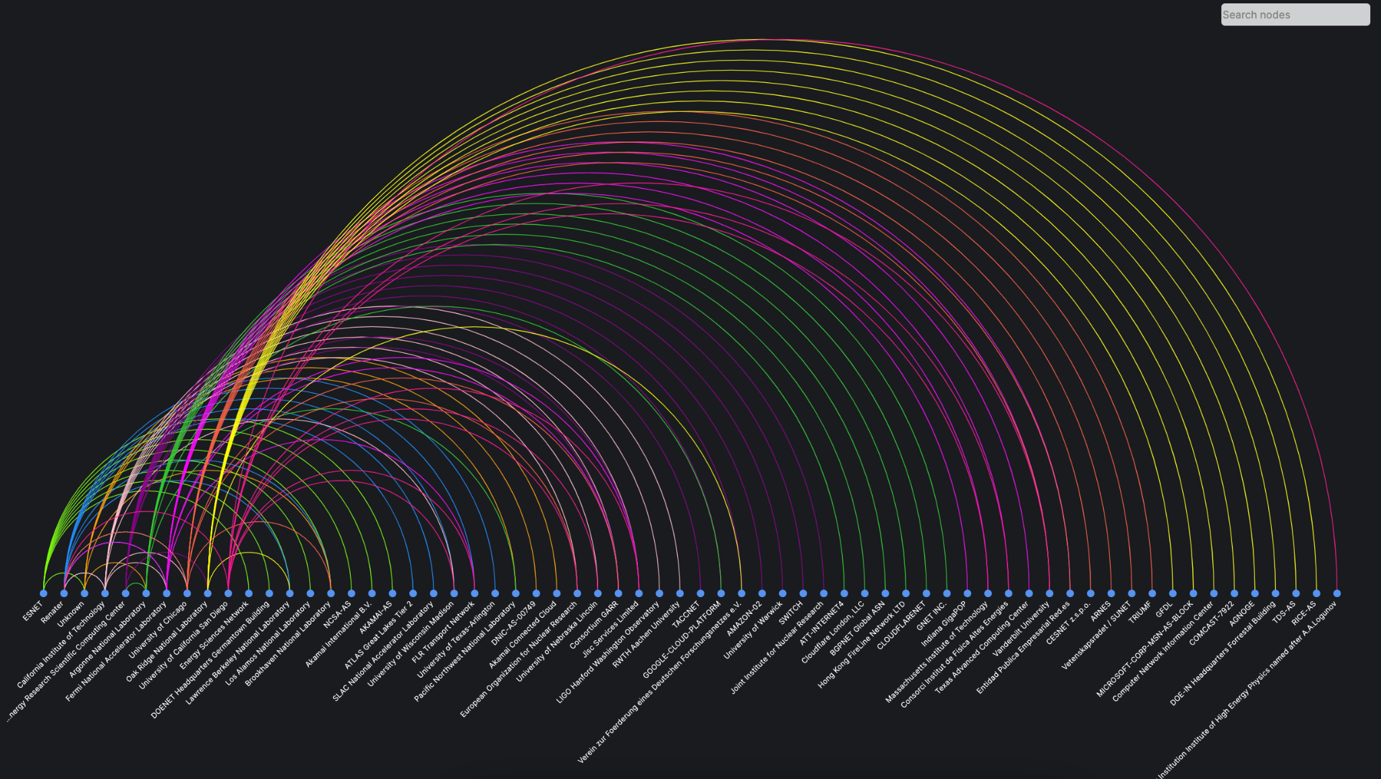
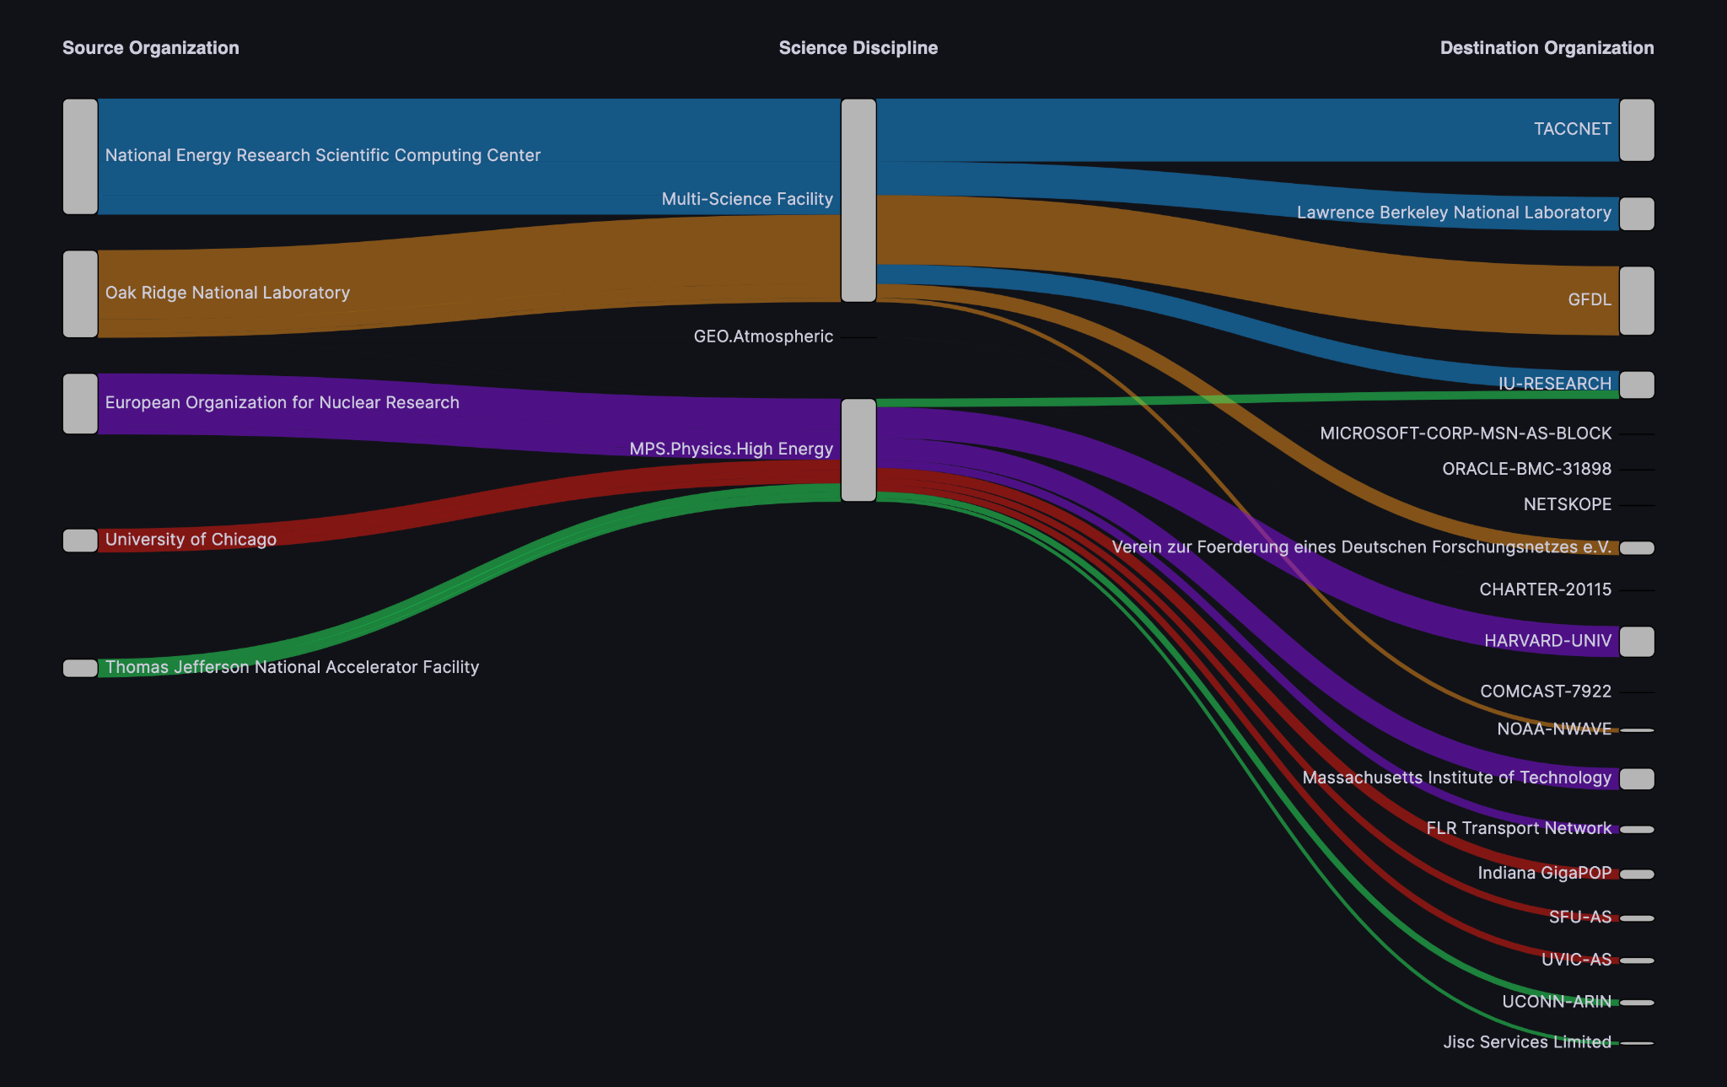
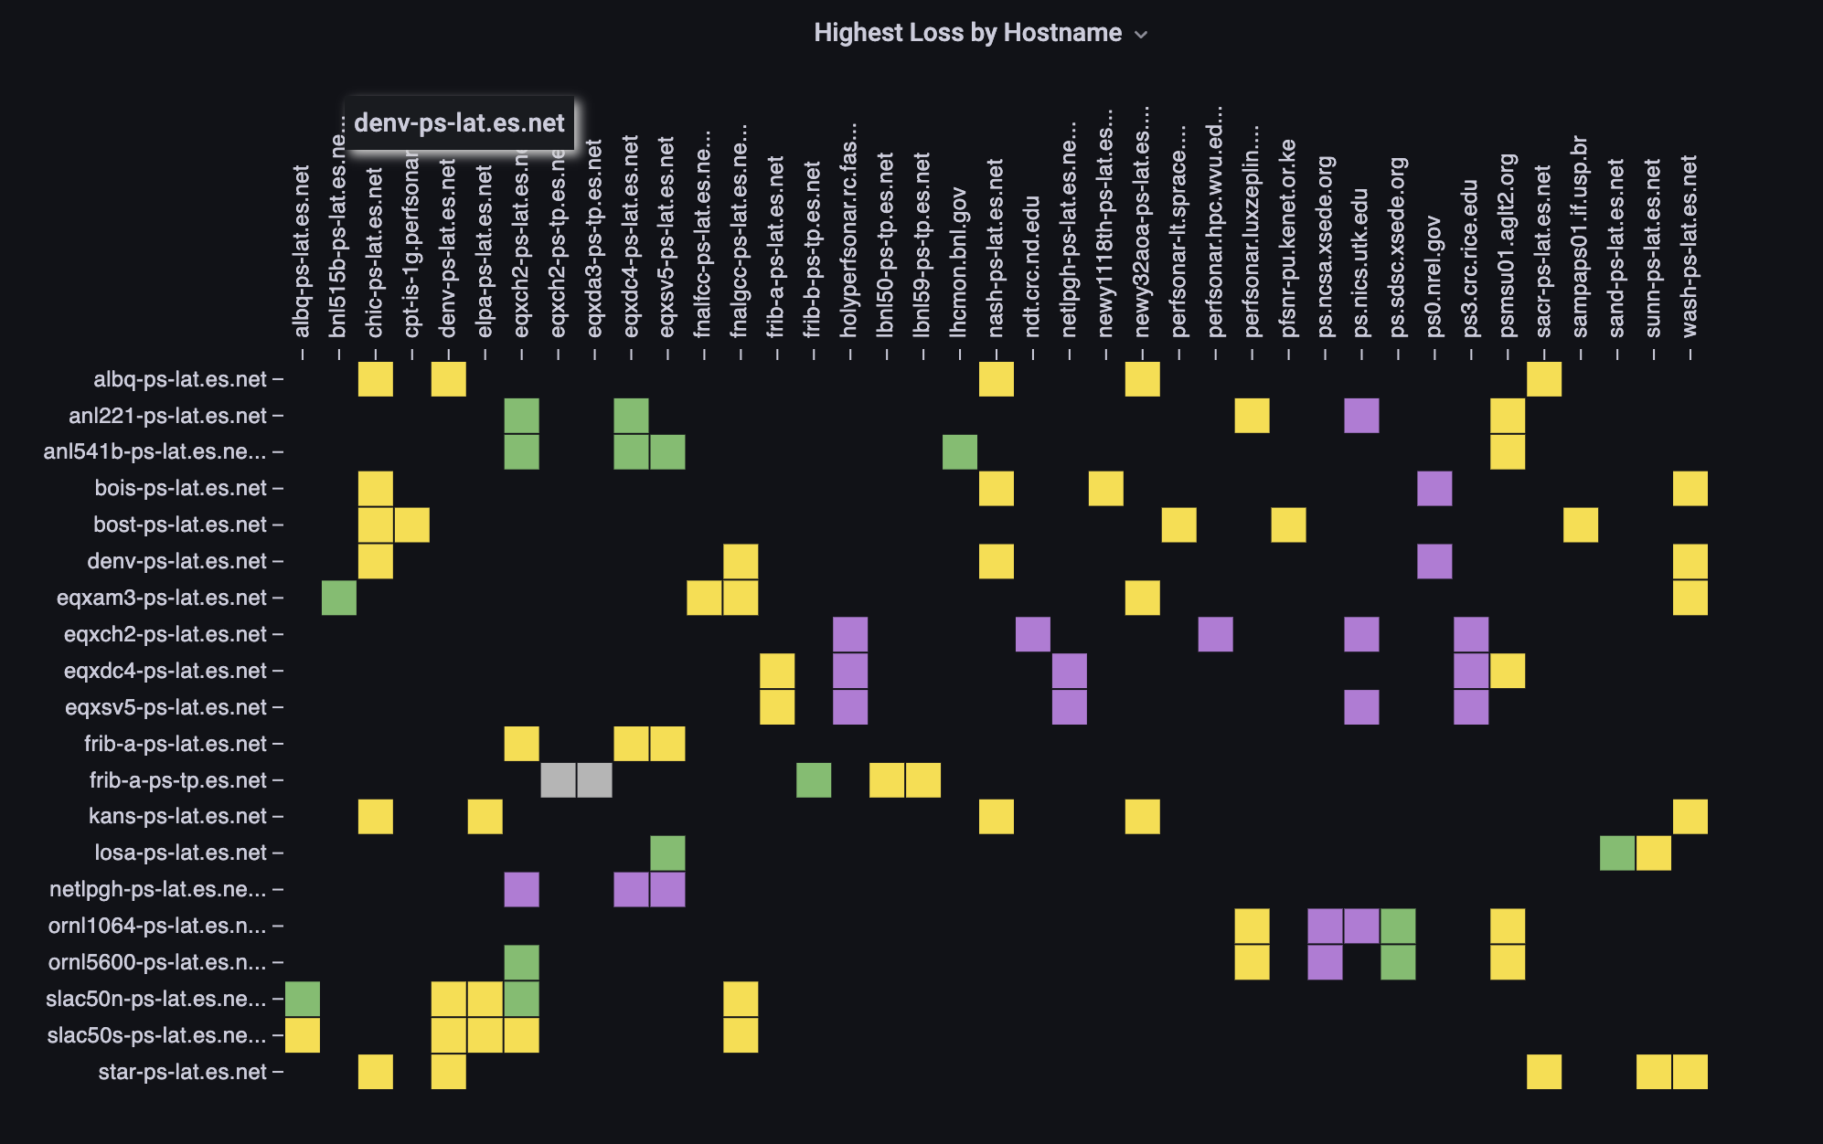
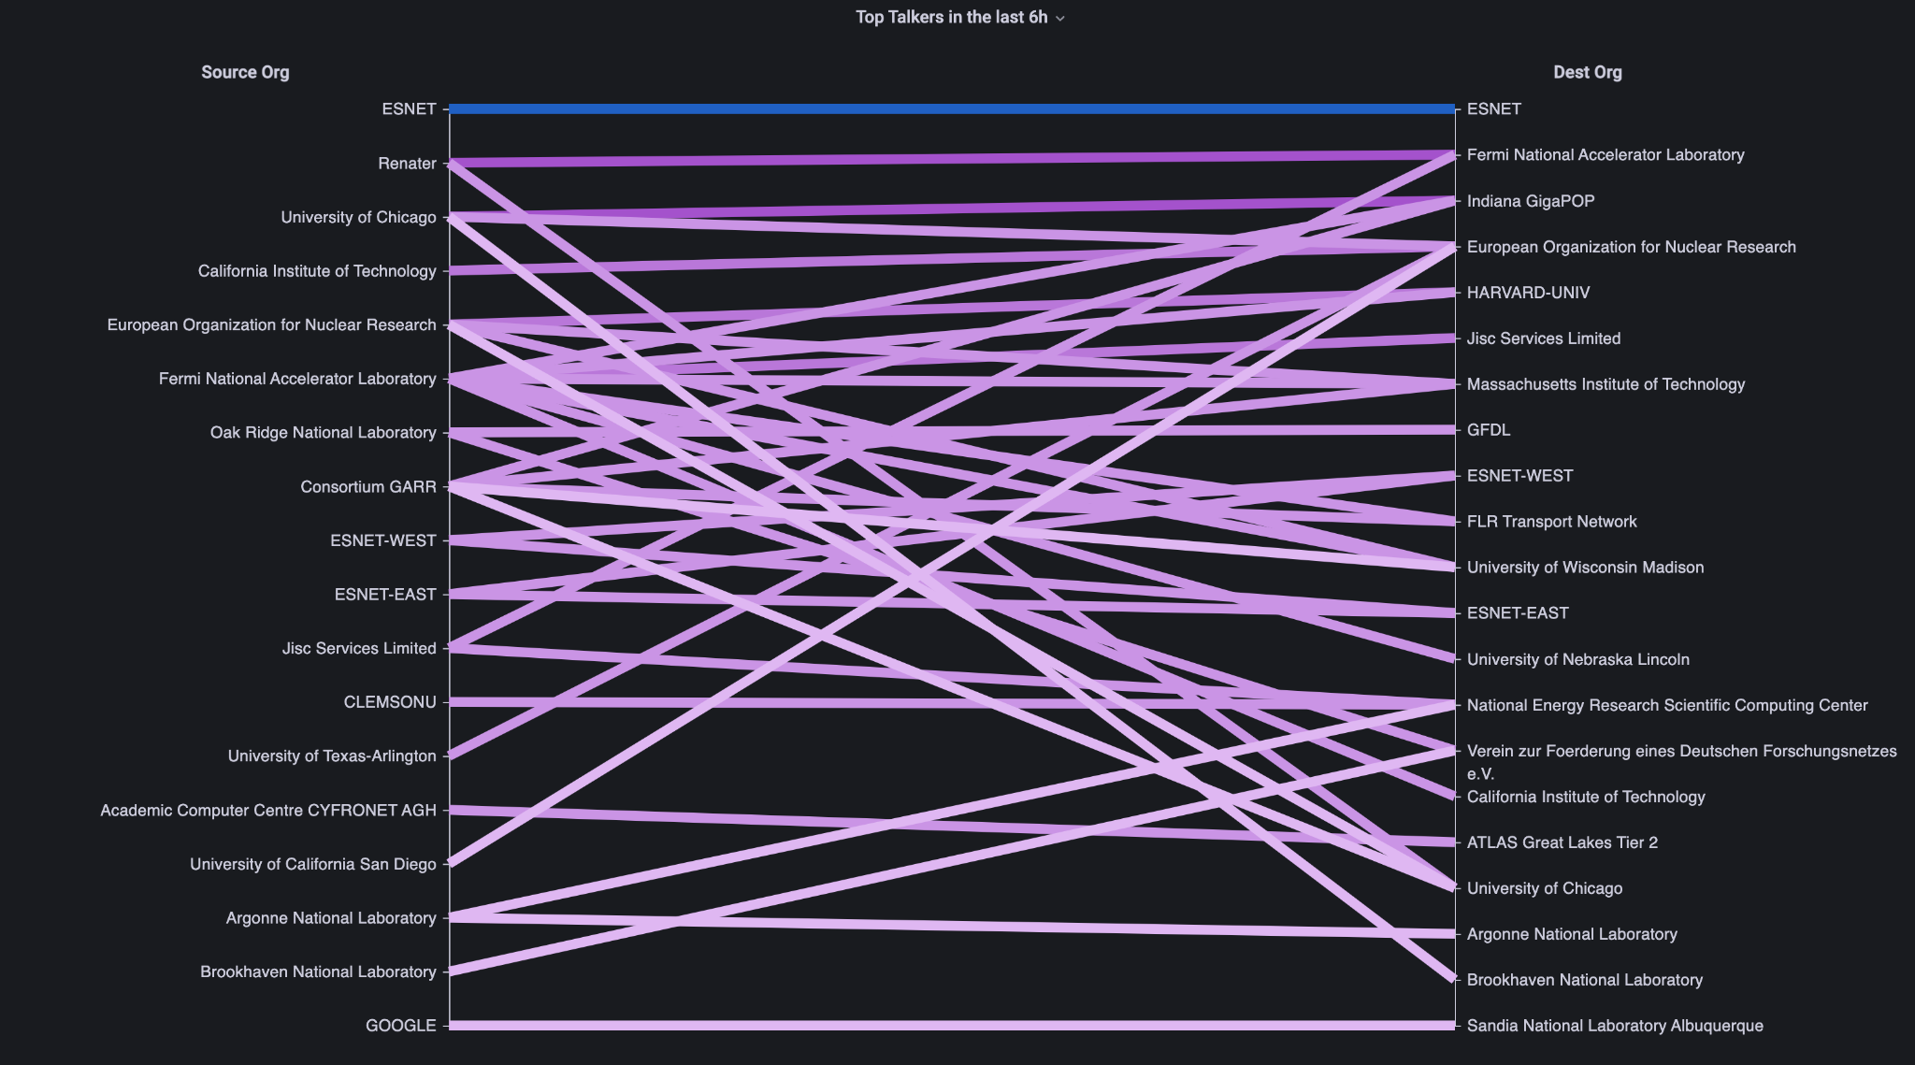
Analytic plugins by NetSage and ESnet

Slide 15
What is iperf3?
iperf3 is an open-source tool that measures network traffic performance between a client and server
It was designed to be used in perfSONAR, but can also be used on its own
Linux, MacOS, and FreeBSD are all officially supported

Slide 16
iperf3 Multi-Threading
Before multi-threading, iperf3 was capable of 30-50 Gbps, with single stream TCP, possibly more with tuning
Many links are faster than iperf3
Site connections: N x 100G
Backbone: 400G +
So what if we want to support connections with higher bandwidth? How do we get more throughput?
The problem: Adding more parallel connections doesn’t increase throughput
Solution: Adding multi-threading to iperf3 to use multiple CPU cores

Slide 17
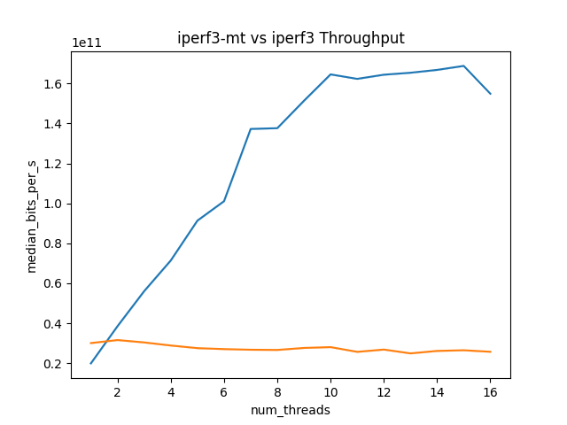
Effects on Performance
Internal testing showed that iperf3-mt has significant improvements in throughput performance over iperf3
iperf3-mt
iperf3

Slide 18
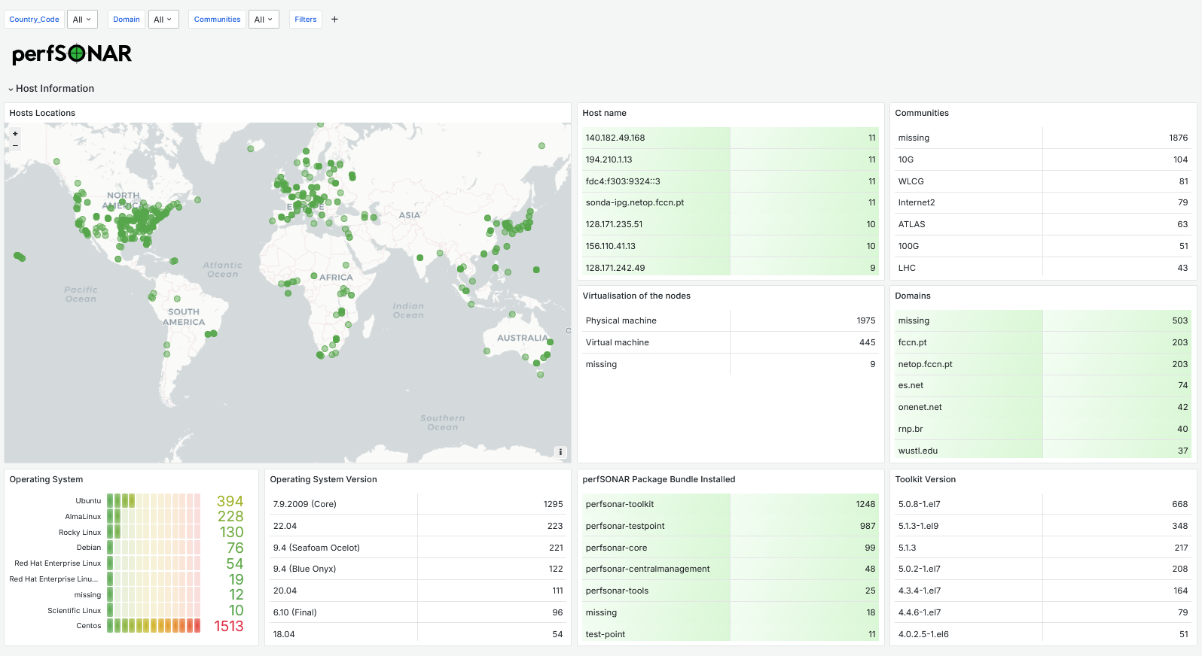
LS dashboard refreshment
https://stats.perfsonar.net/

Slide 19
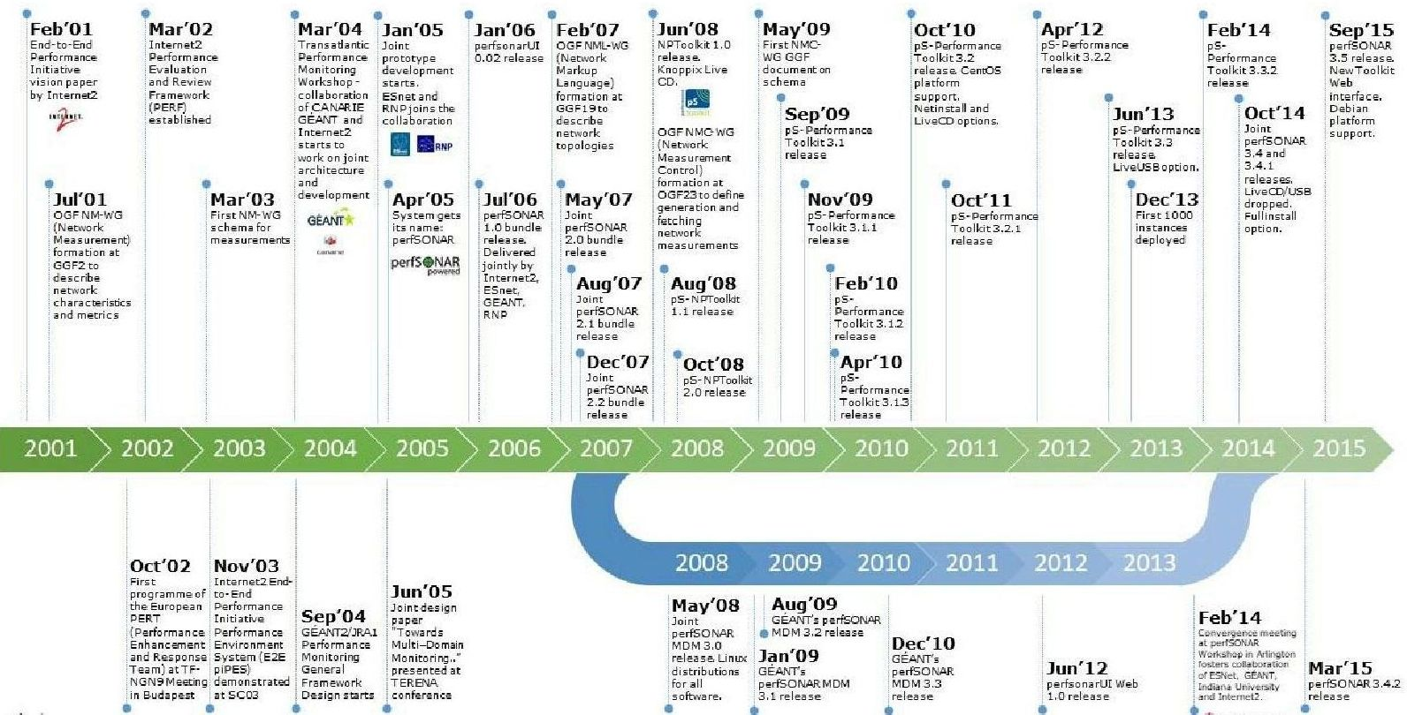
20 years of experience

Slide 20
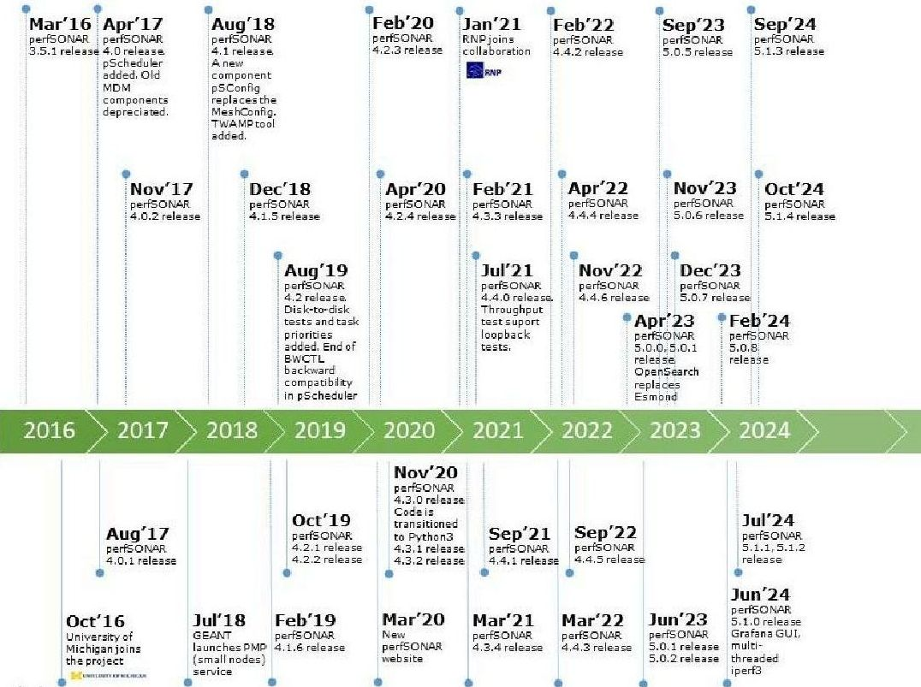
20 years of experience…
April 2025
Source: https://www.perfsonar.net/about_history.html

Slide 21
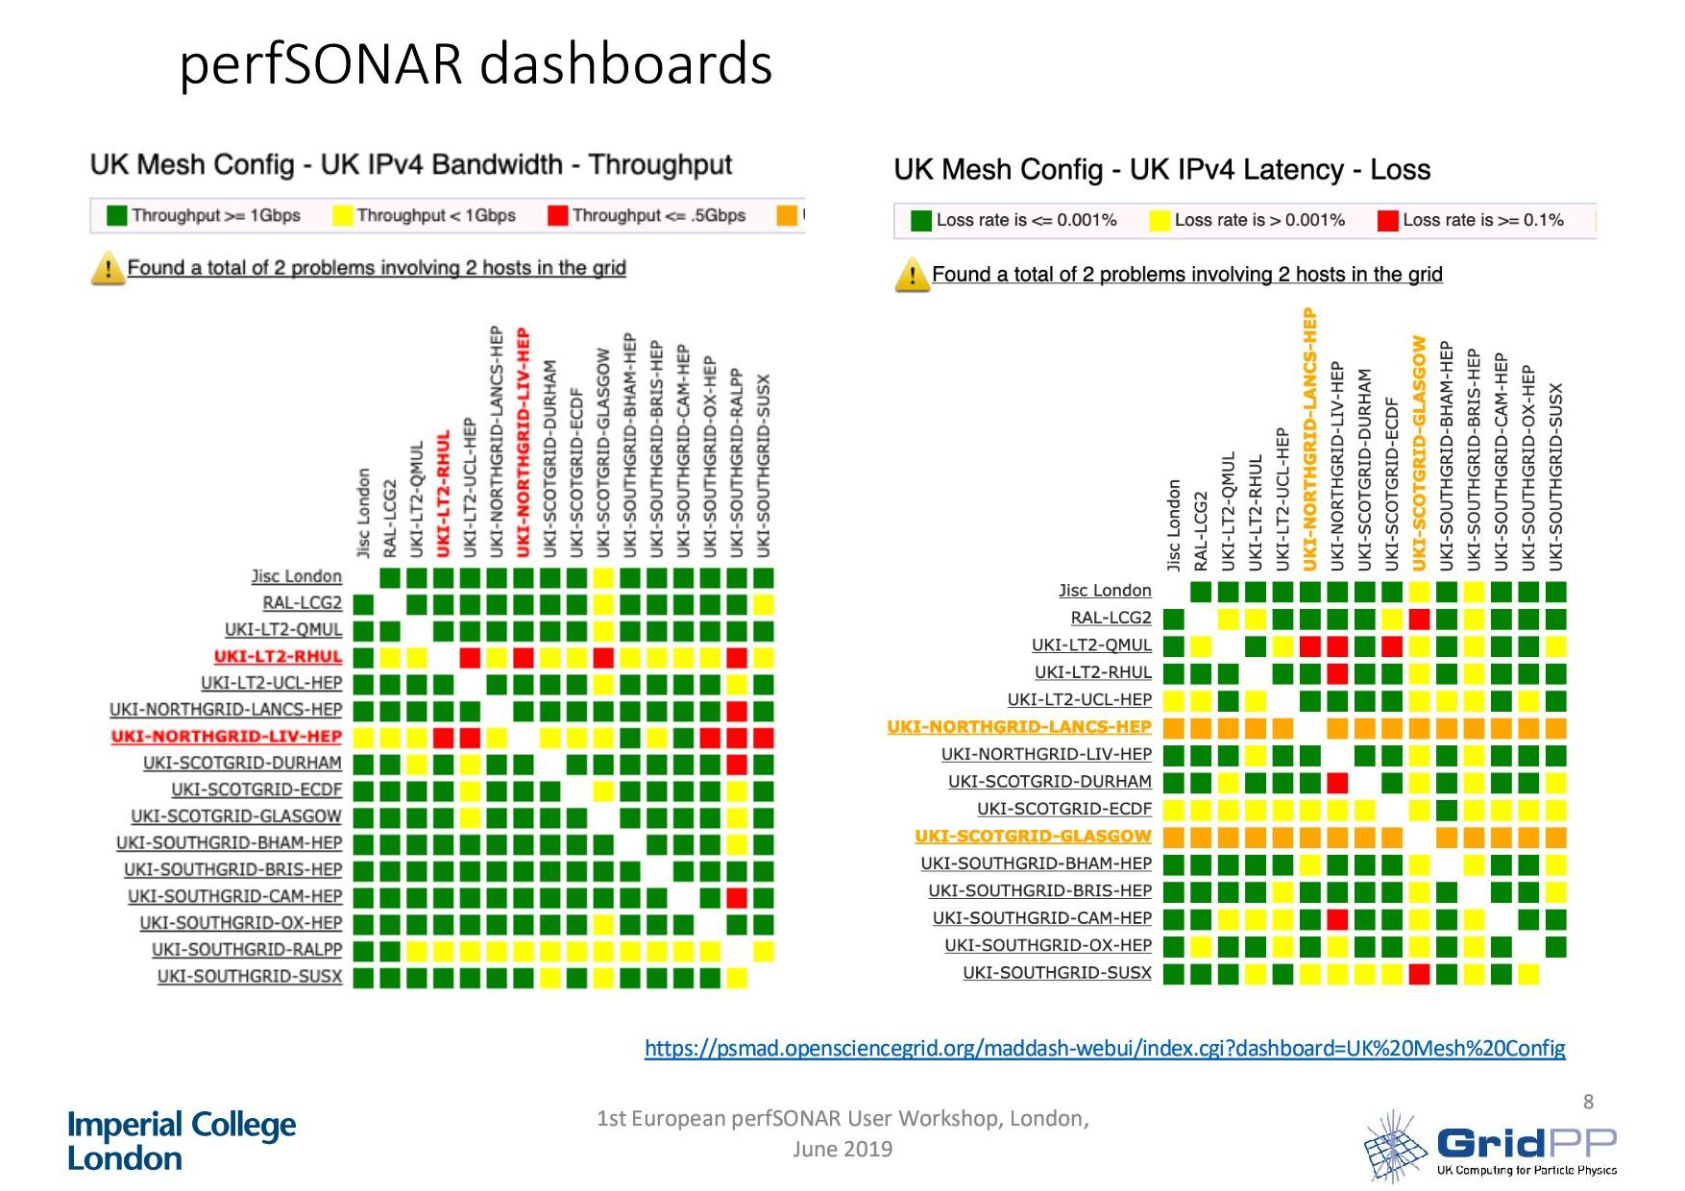
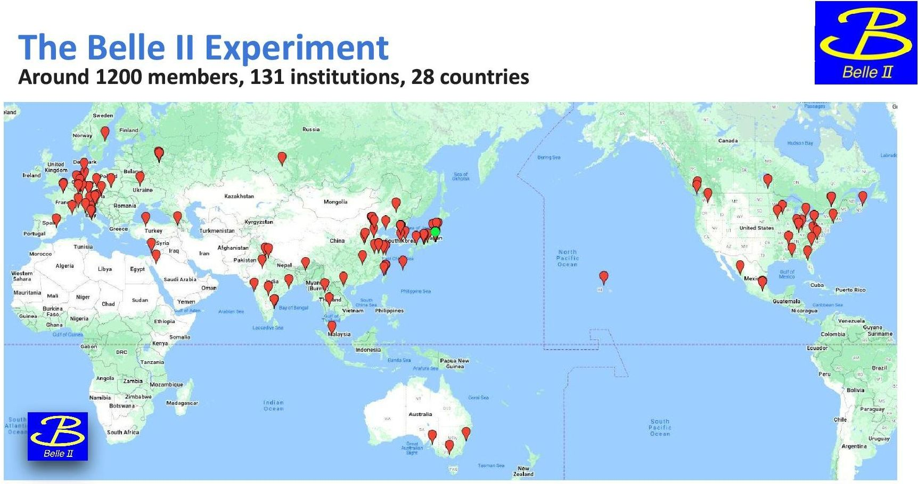
Usecases
Materials used
SKA Regional Centre Network Technical Roadmap- Network needs, Distributed Data Management - Rosie Bolton (Aula Magna) LHCOPN-LHCONE meeting #52 - INFN Catania IT 04.2024
BelleII update - Silvio Pardi (Universita Federico II e INFN Sezione di Napoli (IT) LHCOPN-LHCONE meeting #52 - INFN Catania IT 04.2024
Belle II Network Overview, Malachi Schram1, Silvio Pardi2, Soh Suzuki3, Takanori Hara3 LHCONE Meeting – Berkeley, 06.2015
perfSONAR in the WLCG, Duncan Rand, Imperial College London First European perfSONAR meeting, London, June 2019

Slide 22
The Future of perfSONAR

Slide 23
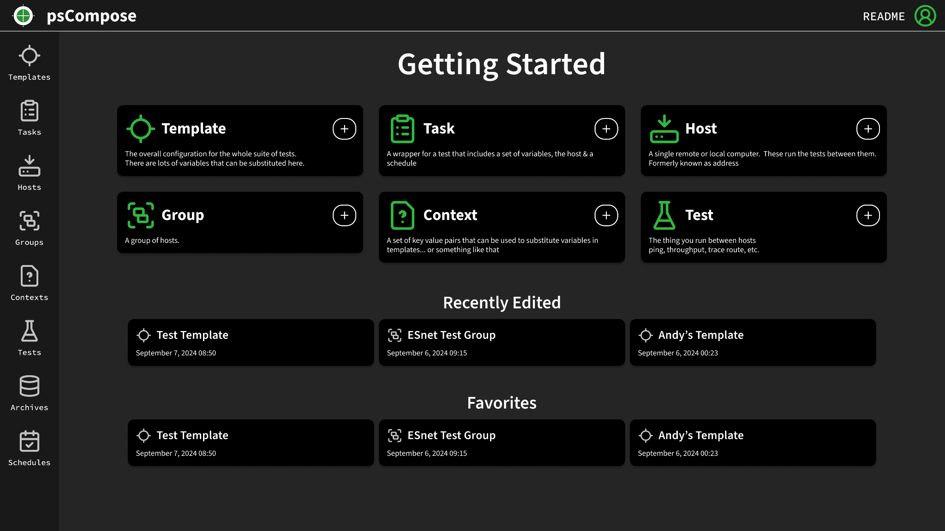
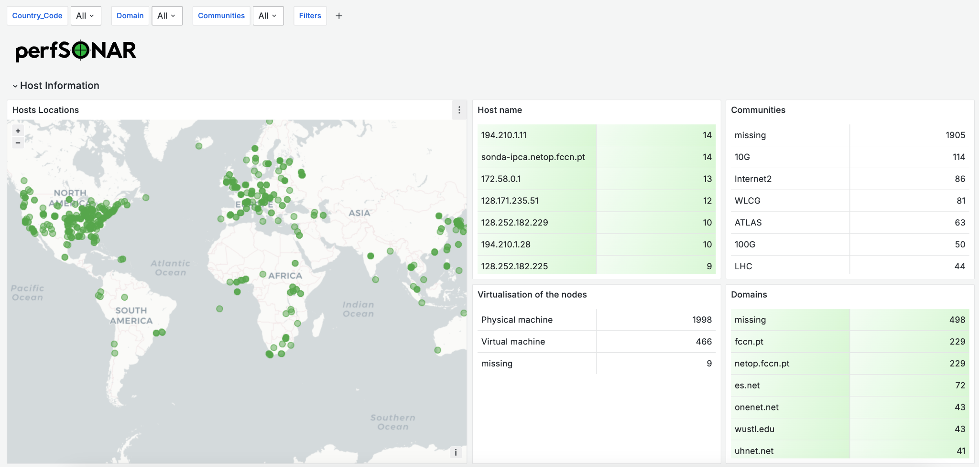
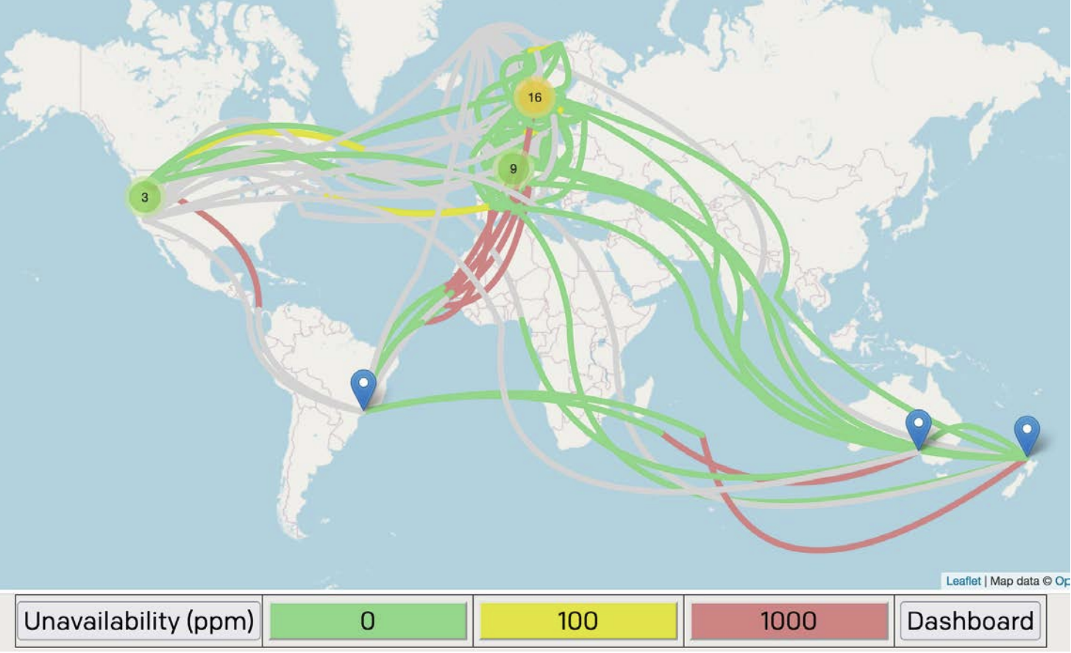
perfSONAR 5.2.0 (April 2025) and 5.3.0 (Q4 2025)
psCompose: Improving test configuration experience
On-demand measurement UI
Lookup service enhancements
Micro-dependency analysis
Support of new Linux distributions

Slide 24
What comes next?
Operational analysis and alarming
Leverage features of current technology stack
Better orchestration of debugging process
Integration with existing data, processes and projects (e.g. MetrANOVA)
Explore possibilities in AIOps for identifying relevant measurements
Training the community on the new generation of perfSONAR
Update our perfSONAR channel on YouTube
Organize workshop events for the community: USA and Europe

Slide 25
Installation quick start
Install Instructions
Install instructions are > here
New install script (to run as root):
Bundle options > here
curl -s https://downloads.perfsonar.net/install | sh -s - toolkit
https://docs.perfsonar.net/install_quick_start

Slide 26
Additional Resources
perfSONAR Website http://www.perfsonar.net/
perfSONAR Documentation http://docs.perfsonar.net/
Lookup Service Dashboard https://stats.perfsonar.net/
YouTube Channel https://www.youtube.com/perfSONARProject
FasterData Knowledge Base http://fasterdata.es.net/

Slide 27
20 years R&E monitoring
Questions?
Ivan Garnizov • BREN / GÉANT WP6T3 and WP9T2 • i.garnizov@cc.bas.bg
Network metrics challenge

