Slide 1
IRR-Based AS Type of Relationship Inference
Yuval Shavitt
Joint work with Tal Shapira

Slide 2
Type of Relationships (ToR) Between Autonomous Systems
Routing on the Internet is governed by BGP policy: it’s the economy!
Economic Type of Relationships (ToRs) between ASNs:
Customer to Provider: The customer pays the provider for connectivity to the Internet
COLT (AS8220) is a customer of Arelion (FKA Telia, AS1299)
Peer to Peer: two networks connect to enable their customers (and customer networks) to connect
Two Bulgarian ISPs: A1 Bulgaria (AS8717) and Vivacom Bulgaria (AS8866)
Siblings: two networks that belong to the same entity
Verizon ASNs: 701, 702, 703, 2828
There is no global repository to learn the ToRs
The Internet Routing Registry (IRR) is a database that holds a lot of routing information
Partial
Not updated
Has conflicting data
How can we mine the IRR to obtain significant data?

Slide 3
Why do we care?
ToR information helps to predict routing paths chosen by BGP
E.g., during failures
It can uncover malicious interference in routing or route leeks.
If a route violates “valley free routing” -- it is anomalous

Slide 4
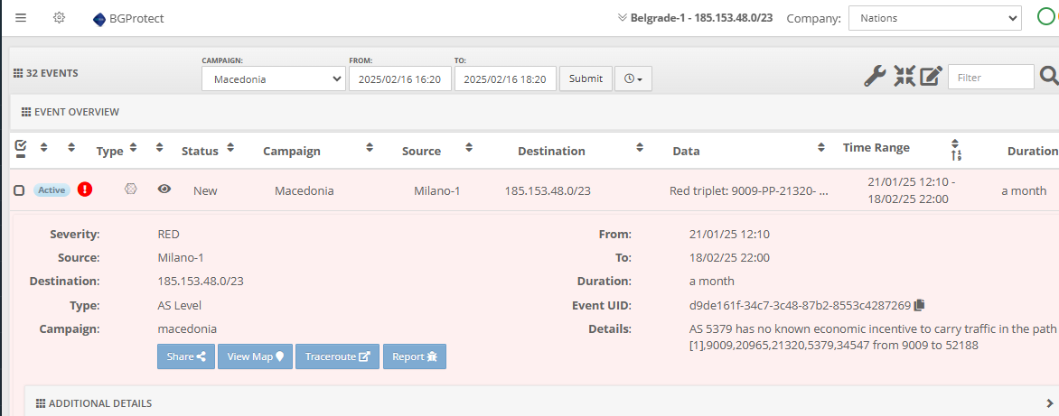
Example: Catching Routing Anomalies

Slide 5
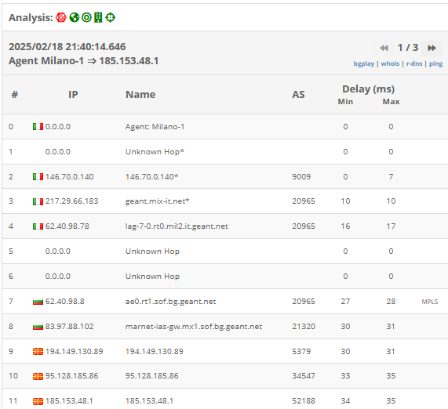

Slide 6
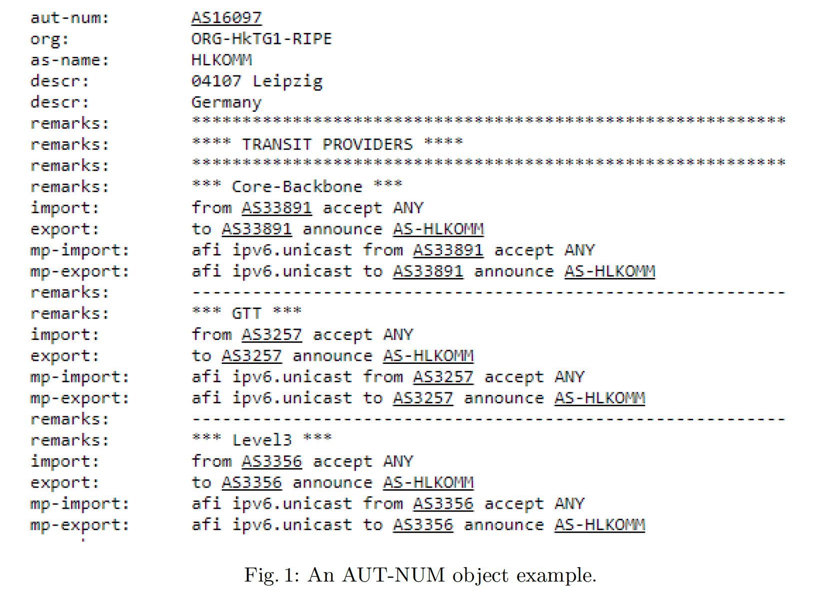
Approach at a Glance
Extract relevant data from the IRR
We mainly use the AUT-NUM object (see Figure 1), but also the AS-SET object.
Apply 3 heuristics:
Import-Export (I/E) Heuristic
Remarks Heuristic
Sets Heuristic
Filter unreliable data
Heuristics Union
Siblings Inference

Slide 7
Datasets
The datasets were collected between January 2018 and December 2021
Raw data – IRR (from 2021) contains 23 routing registries
Labeled dataset -
ToRs are extracted from the proprietary BGProtect ToR database
Mostly populated by analysis scripts, but also contain manually inserted entries
Each entry has a remark with script name or justification for manual entry
Manual IRR 412 ToRs (31 P2P, 381 P2C) that were manually inserted by analysts where the main justification was examining the IRR
Manual Routing 288 manual entries (10 P2P, 278 P2C) where the main justification was routing (either BGP or traceroute, usually from distinct time epochs)
Unified Manual dataset

Slide 8
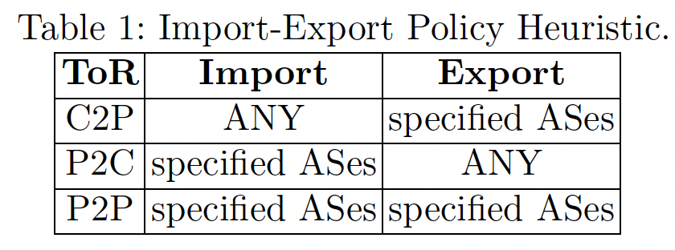
Heuristics
Import-Export (I/E) Heuristic
Remarks Heuristic
Sets Heuristic
e.g., the set "AS247:AS-Customers"

Slide 9
Filter Unreliable Data

Slide 10
Goodness Definitions

Slide 11
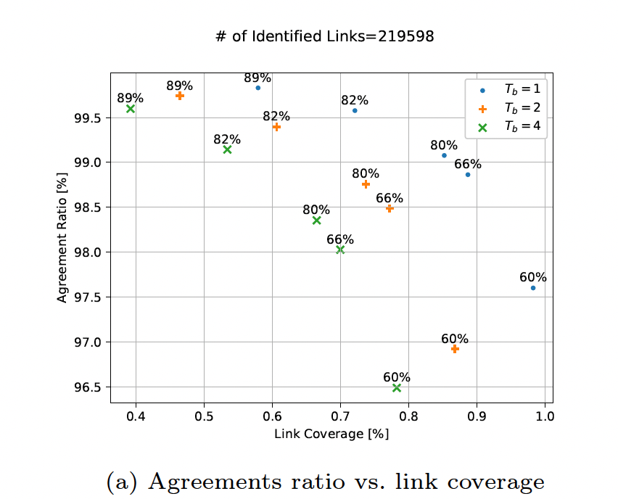
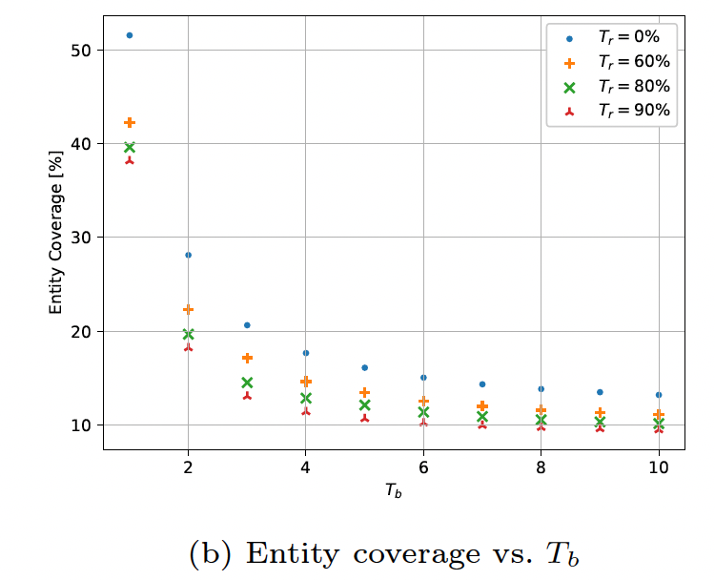
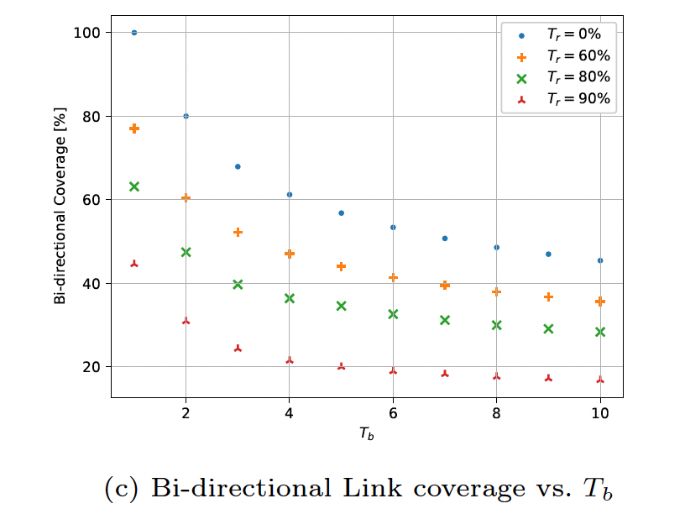
Data Exploration
Notes:
(a) T_r is written above the mark

Slide 12
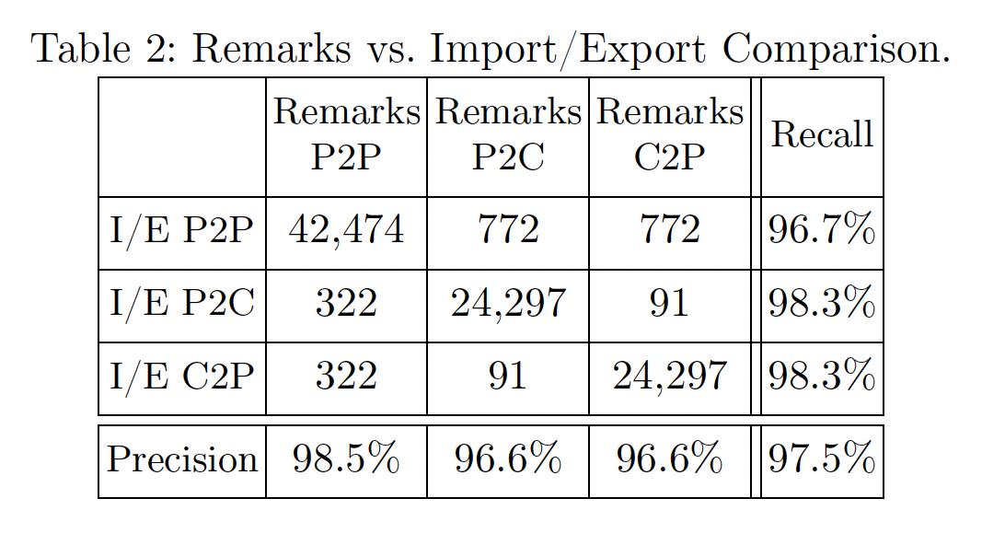
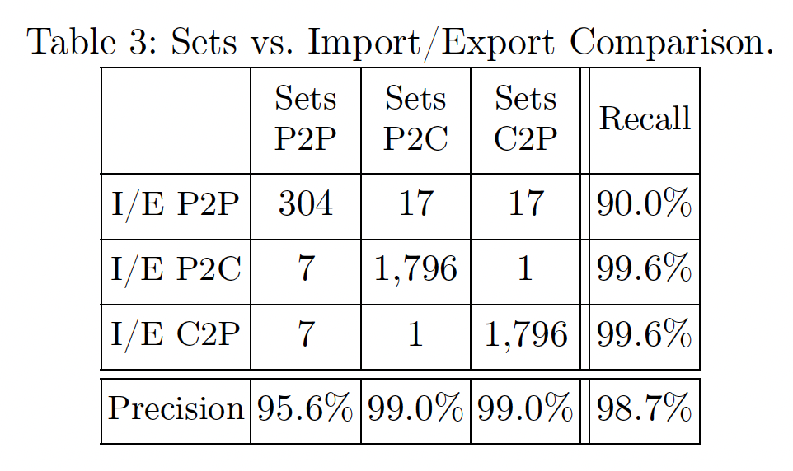
Heuristics Union
We use the following algorithm for the final classification:
Majority vote: if 2 or more heuristics classify a link with the same ToR – we set the reliability score to 1, and choose this ToR.
If none of the heuristics agree, the final classification is the ToR with the highest reliability score. In this case, the final reliability score is the reliability score of that ToR.

Slide 13
Sibling Inference

Slide 14
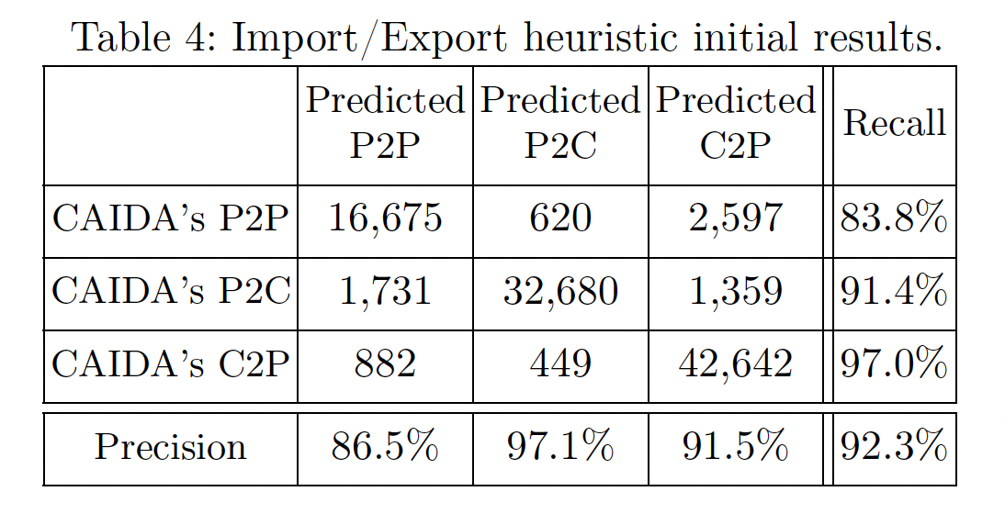
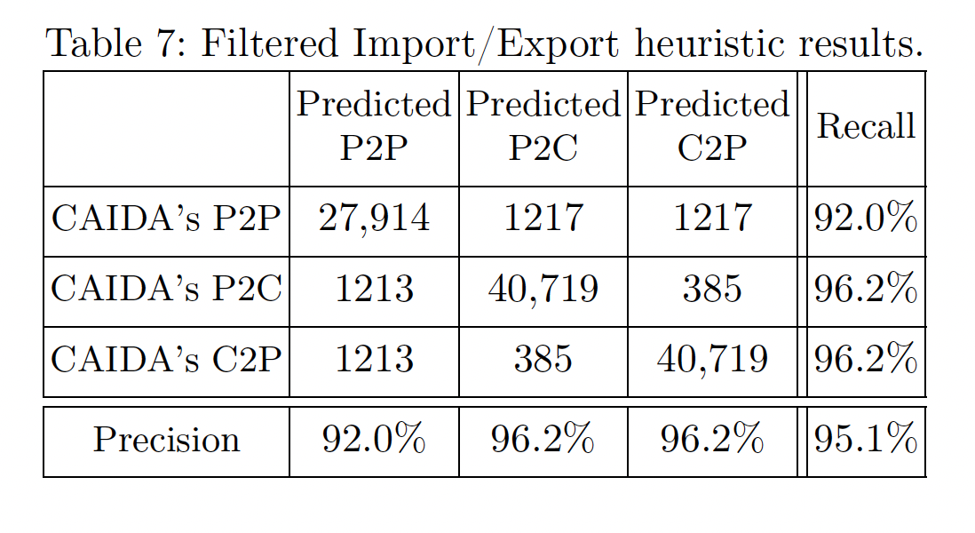
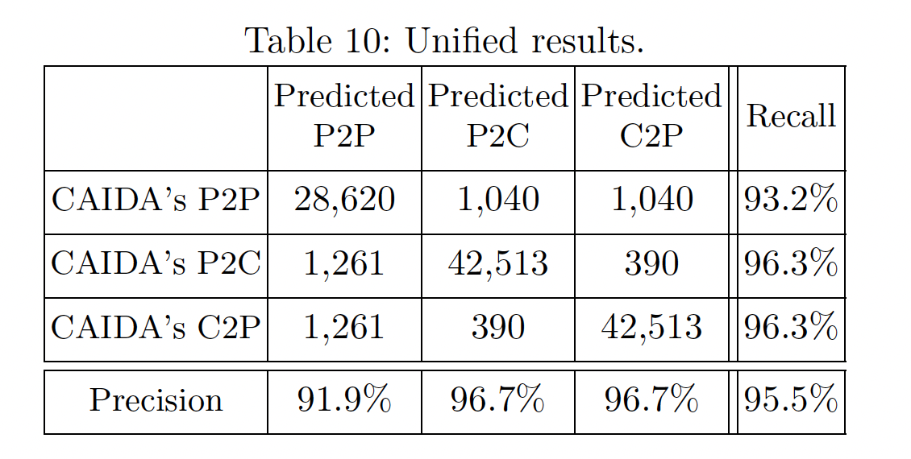
Results Vs. CAIDA

Slide 15
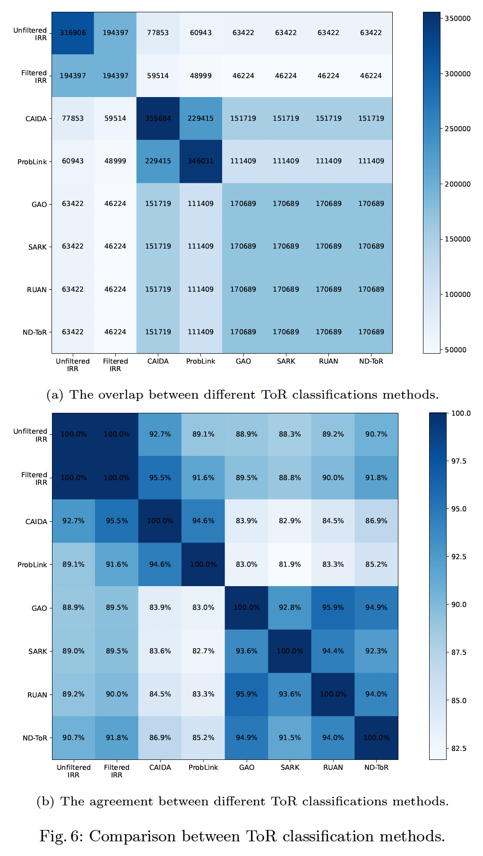
Results

Slide 16
Siblings Results

Slide 17
Summary
We obtained 194,397 P2P and P2C ToRs, and 24,743 siblings with very high reliability (148,847 classifications above 90% reliability).
We show that our results have the highest agreement with all the previously published approaches that we tested, ranging from 89% to 95.5% agreement with the CAIDA AS-relationships dataset.
We also showed that we manages to classify many links that do not appear in the other dataset, or in the RouteViews data that is used by other methods.
In particular, our sibling dataset is an order of magnitude larger than the one published by ProbLink.

Slide 18
THANK YOU FOR YOUR ATTENTION. QUESTIONS?
https://talshapira.github.io/
https://www.eng.tau.ac.il/~shavitt/

