Slide 1
Latency Characterization of Public Cloud Service Platforms
Rita Ingabire, Antonio Bazco-Nogueras, Vincenzo Mancuso, Luis M. Contreras and Jesus Folgueira

Slide 2
AGENDA /OVERVIEW
Motivation
Measurement Campaign
Results
Characterization
Forecasting
Conclusions
Notes:
Lets set out the agenda for this talk
Four main parts –
Motivation for work
Measurements took,
Results,
And conclusions and some takeaways
lets start with the motivation

Slide 3

Motivation
Why are internet users always in the clouds? collaboration, data backups, entertainment
Why is the cloud of interest to Infrastructure Providers? New Killer-apps for next generation of cellular networks
- Latency Constrained
- Computationally demanding
- Connection to public networks
Autonomous vehicles, Extended Reality etc
Notes:
Users are always in the cloud : entertainment, real-time collaboration, and secure data backup.
Therefore their providers must support this and other new apps like immersive reality, autonomous devices, and industrial applications.
New services must be ultra Low latency, requre computational power, constant web connectivity since they most likey will be in the clouds

Slide 4

Motivation
Goal: Understanding Cloud latency
What are the characteristics of the cloud latency w.r.t. time, location, or type of service?
Can we forecast the future state of the network?
Can we understand the results?
through explainable algorithms
Are complex AI algorithms required?
Notes:
What does the Network Provider need to understand about the cloud?
Goal: Characterizing cloud performance
Does the cloud location matter?
Does the cloud owner matter?
Can we predict latency , with what accuracy ?
Can we understand results ?
. So that they can -
Plan network management in advance
Detect route anomalies and make modifications

Slide 5
AGENDA /OVERVIEW
Motivation
Measurement Campaign
Results
Characterization
Forecasting
Conclusions
Notes:
We move on to the next part - the measurements
Are we okay so far?

Slide 6
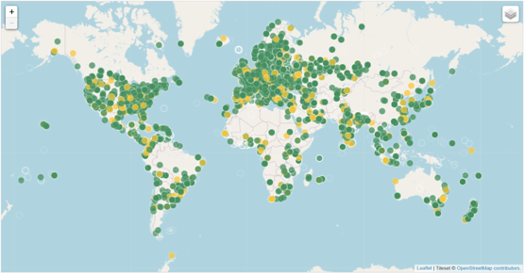
Platform – RIPE ATLAS
RIPE : Internet Registry for Europe, the Middle East, Central Asia.
ATLAS is RIPE’s active measurement platform.
It allows different types of measurements:
Ping
Traceroute
DNS
SSL
HTTP
NTP
Notes:
Is everyone familiar with ripe atlas?
Our campaign was carried out on ATLAS an active measurements platform run by RIPE
ATLAS allows 6 types of network measurements
For this work we used the traceroute measurements

Slide 7

Platform – RIPE ATLAS
A) Credit System
Earn credits and Spend credits
B) Measurements
publicly available at RIPE Atlas Measurements
C) Tools
Magellan: Command Line Interface Toolset
Sagan: Measurement Parsing Library
Cousteau: Python client for the API
…………………… many others
Probe
Notes:
How does ATLAS work.
To participate , install a probe , accumulates credits , take measurements
A lot of measurements are public except a few
ATLAS provides cmd tools , a measurement library and an API for interacting with the measurements

Slide 8
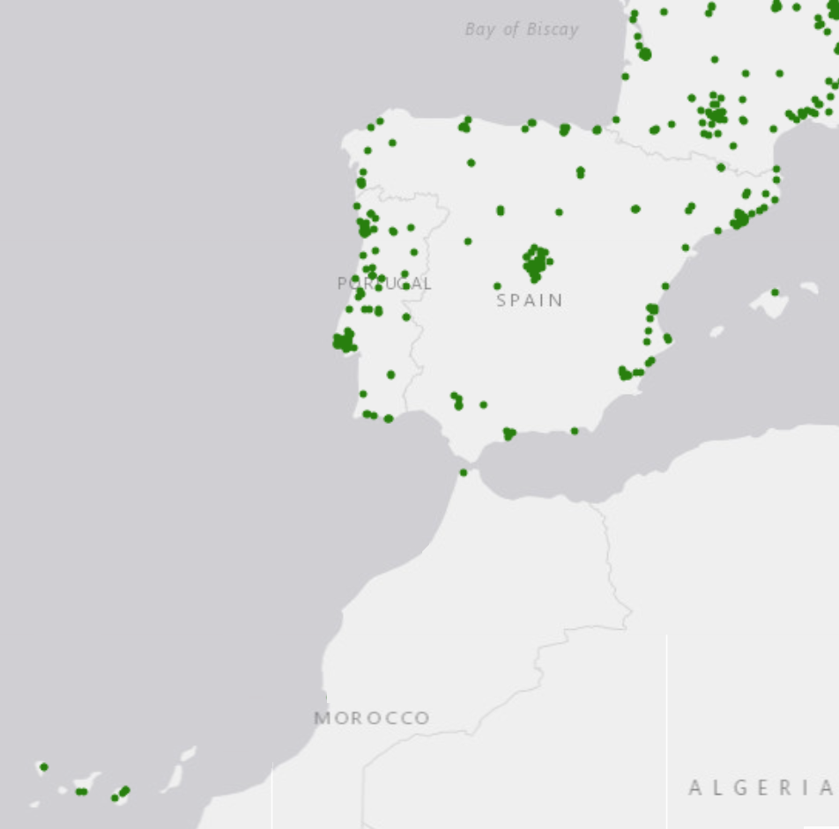
Measurement Campaign – Destinations
Geographic area of Interest: Spain
Probes cover >92% of >40 million Internet users in Spain
224 active probes in Spain
Goal: Characterization of cloud ==> Single ASN IO (Telefónica)
Remove impact of different IOs
Stable probes: Probes that have been:
online at least 99% of last week before campaign,
online at least 99% of last month before the campaign,
and online at least 80% of the time since they were registered in RIPE Atlas
36 probes (32 eventually )
Notes:
This campaign was carried out in Spain
For a single Provider Telefonica
Ideal , Telefonica has over 200 probes (destination), covering most of country
Conditions – Filtered probes that had been online for over 99% of the month before we launched the measurements – 36 in total – eventilly 32 because 4 mostly returned timeouts

Slide 9
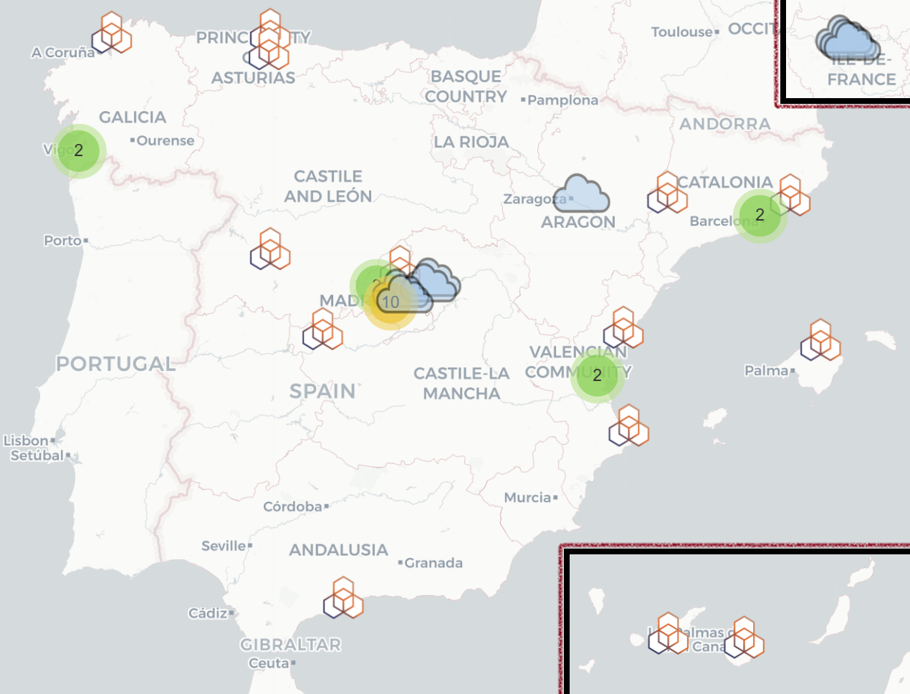
Measurement Campaign - Cloud regions
From cloud to end user probes
Install probes in the cloud regions
Granularity:
For 3 months (Jan. 30--Apr. 24, 2024)
Every 30 minutes
For the 32*8 = 256 links
>4000 TR measurements per link
8 cloud servers from:
AWS, Azure, Google Cloud, Telefónica
Notes:
For the cloud, we chose 8. cloud providers installed probes in them
Experiment run for 3 months with traceroutes every 30 mins from these cloud probes to the Telefonica probes
> 4000 measurements

Slide 10
Measurement Campaign – Cloud regions
Geographic distribution:
5 cloud probes in Spain
4 Madrid
1 Zaragoza
3 cloud probes in France
Paris
Ownership distribution:
3 probes in C1
3 probes in C3
1 probe in C2
1 probe in Telefónica
Notes:
Some further
5 in Spain and 3 in Paris because Azure didn’t have a presence in Spain and nearest was Paris
We were asked to anonymise the cloud ownership ie C1(AWS), C2( Azure) and C3 (Google )

Slide 11
AGENDA /OVERVIEW
Motivation
Measurement Campaign
Results
Characterization
Forecasting
Conclusions
Notes:
Okay now lets analyse the results from the measurements
_ when we xterise we are trying to answer some questions
A) Is the latency stable or variable ?
B) What are the latency bounds for a given source and destination?
C) Does knowing the distinct IPPATH taken aid you in estimating the final latency ?

Slide 12
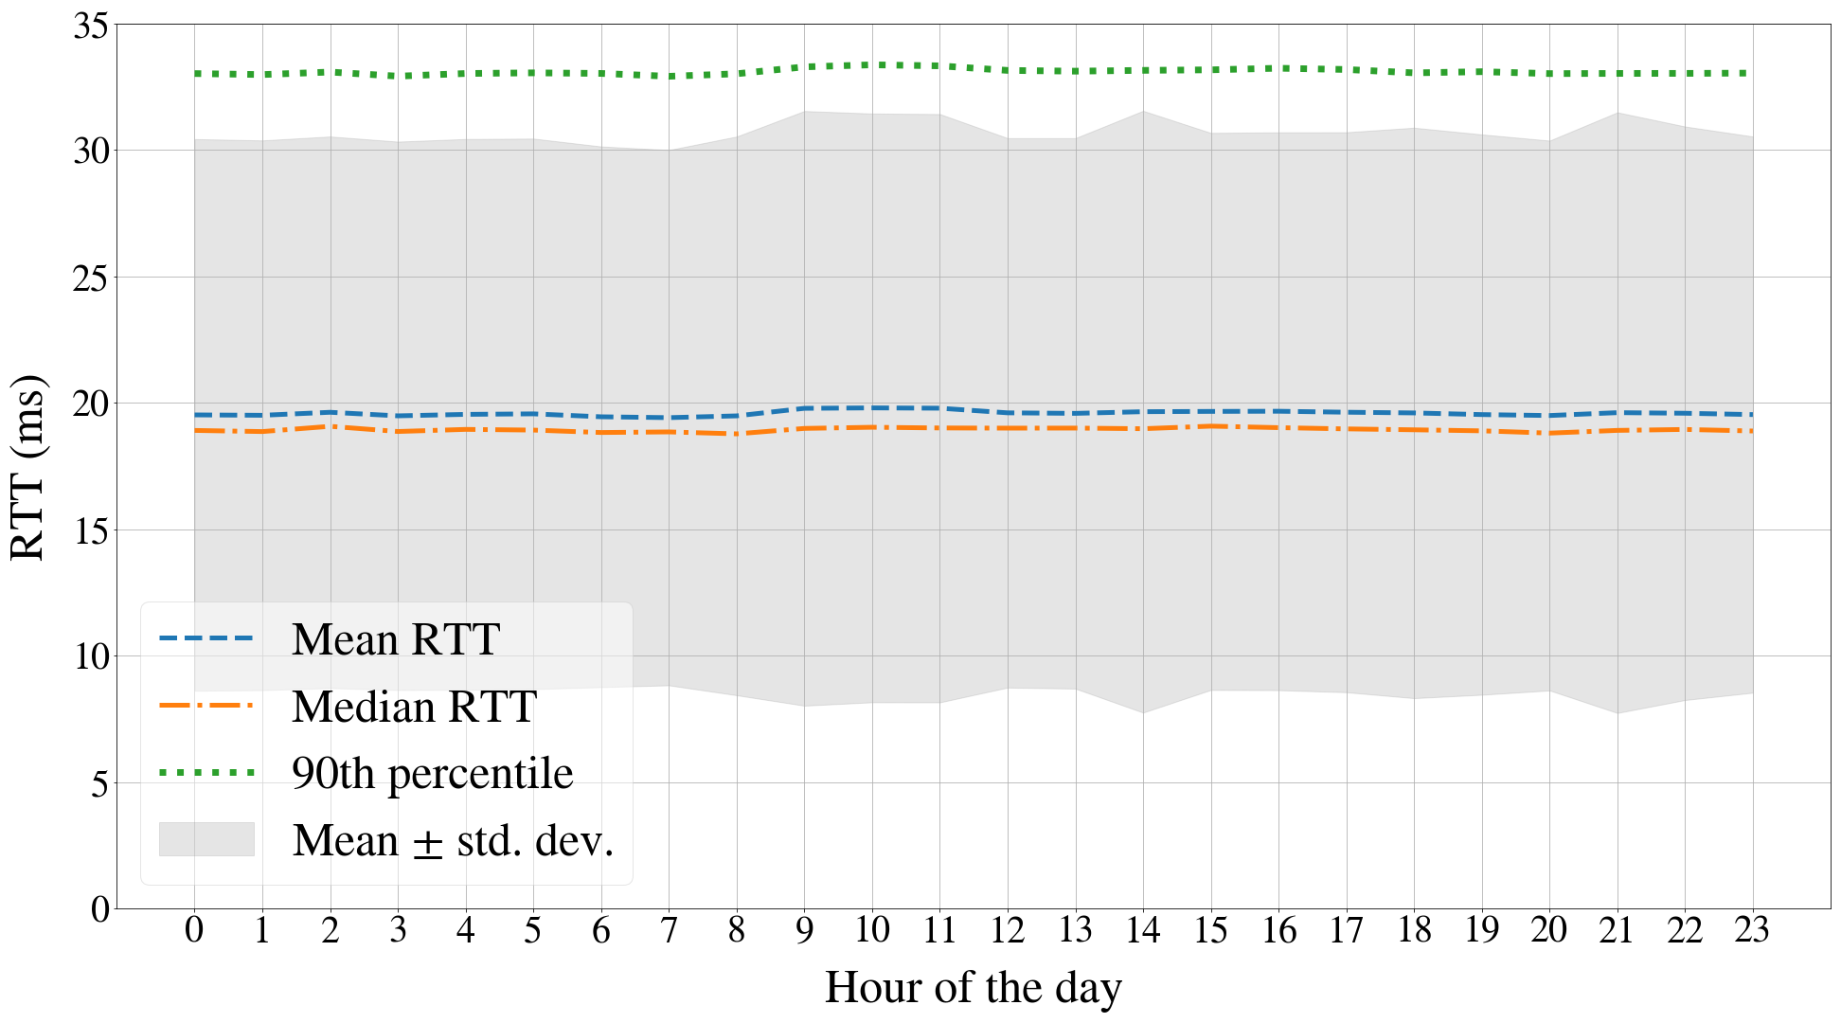
Characterization – Are there daily patterns?
Notes:
Is the latency stable or variable ? – to answer that we examine the daily patterns
cluster all the measurements based on the hour of the day and plotted the mean, median, and 90th percentile each hour of the day over 3 months
Observations
remarkably constant across hours and cloud regions
increases during peak hours of the day
Peak change is only of around 1 or 2 ms

Slide 13
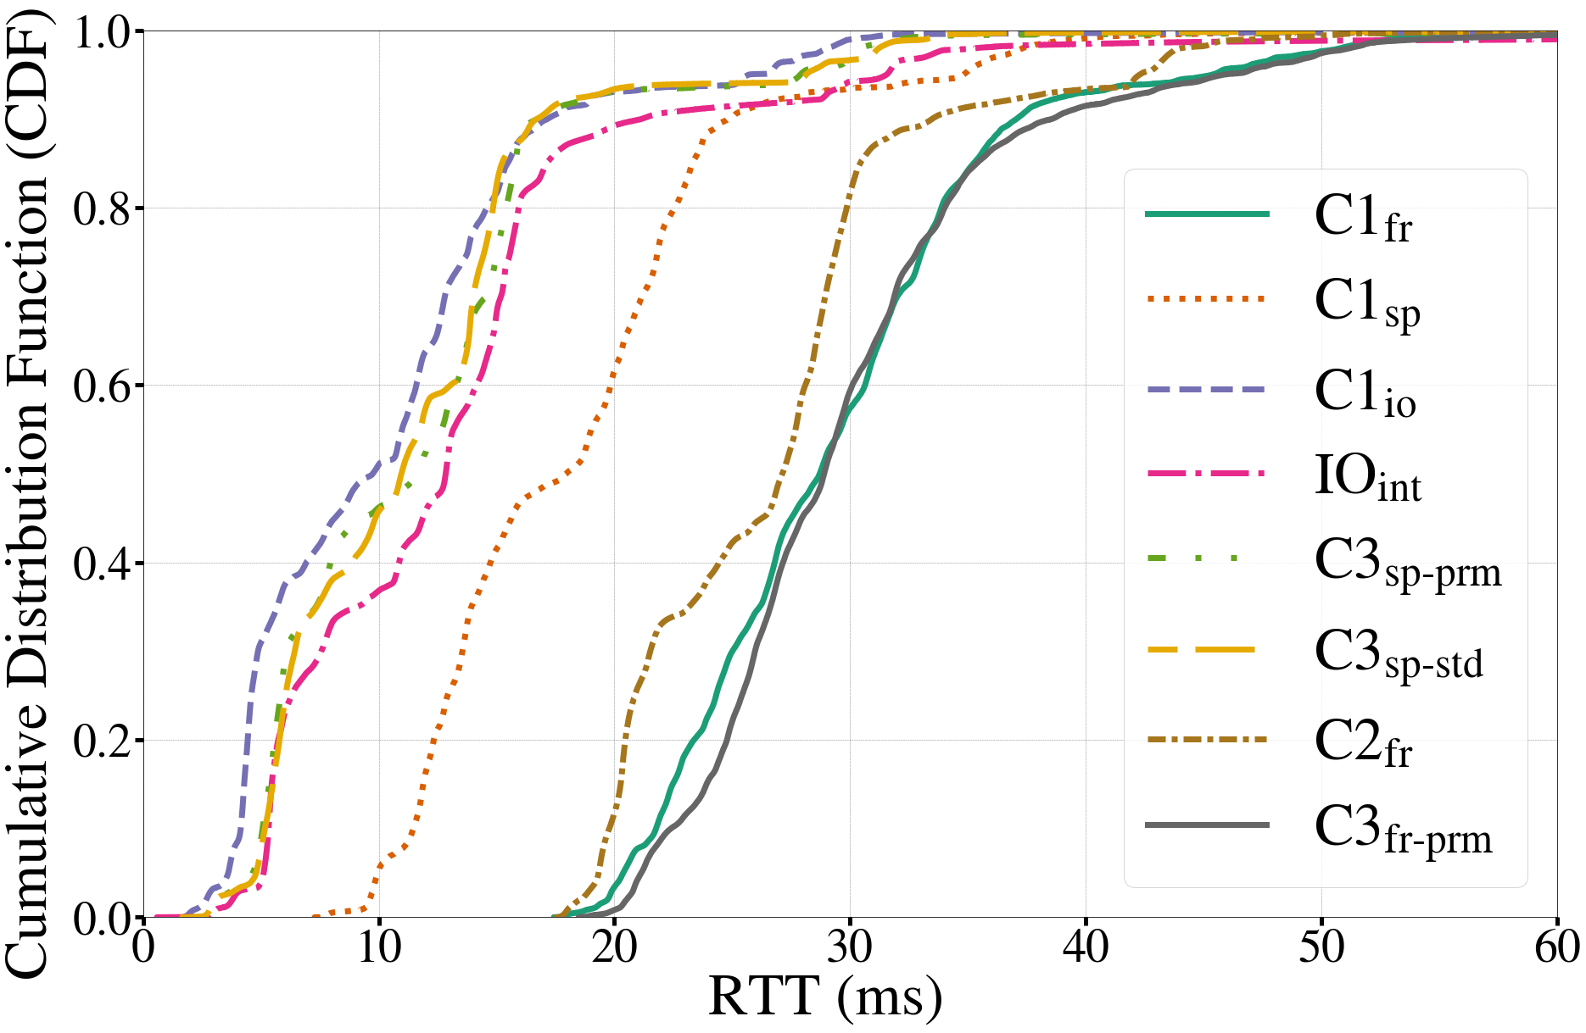
Characterization - RTT CDF per Cloud Region
Notes:
What are the latency bounds for a given source and destination?
CDF of traceroute for each cloud points aggregated over all the destinations
Observations
Most of the clouds can be reached within 50ms from all the destinations
Steep silhouette – rtt values are in a small range
Over all the destinatios the three servers in France are the ones with higher RTT
No difference in premium and standard tiers for cloud provider (c3)

Slide 14
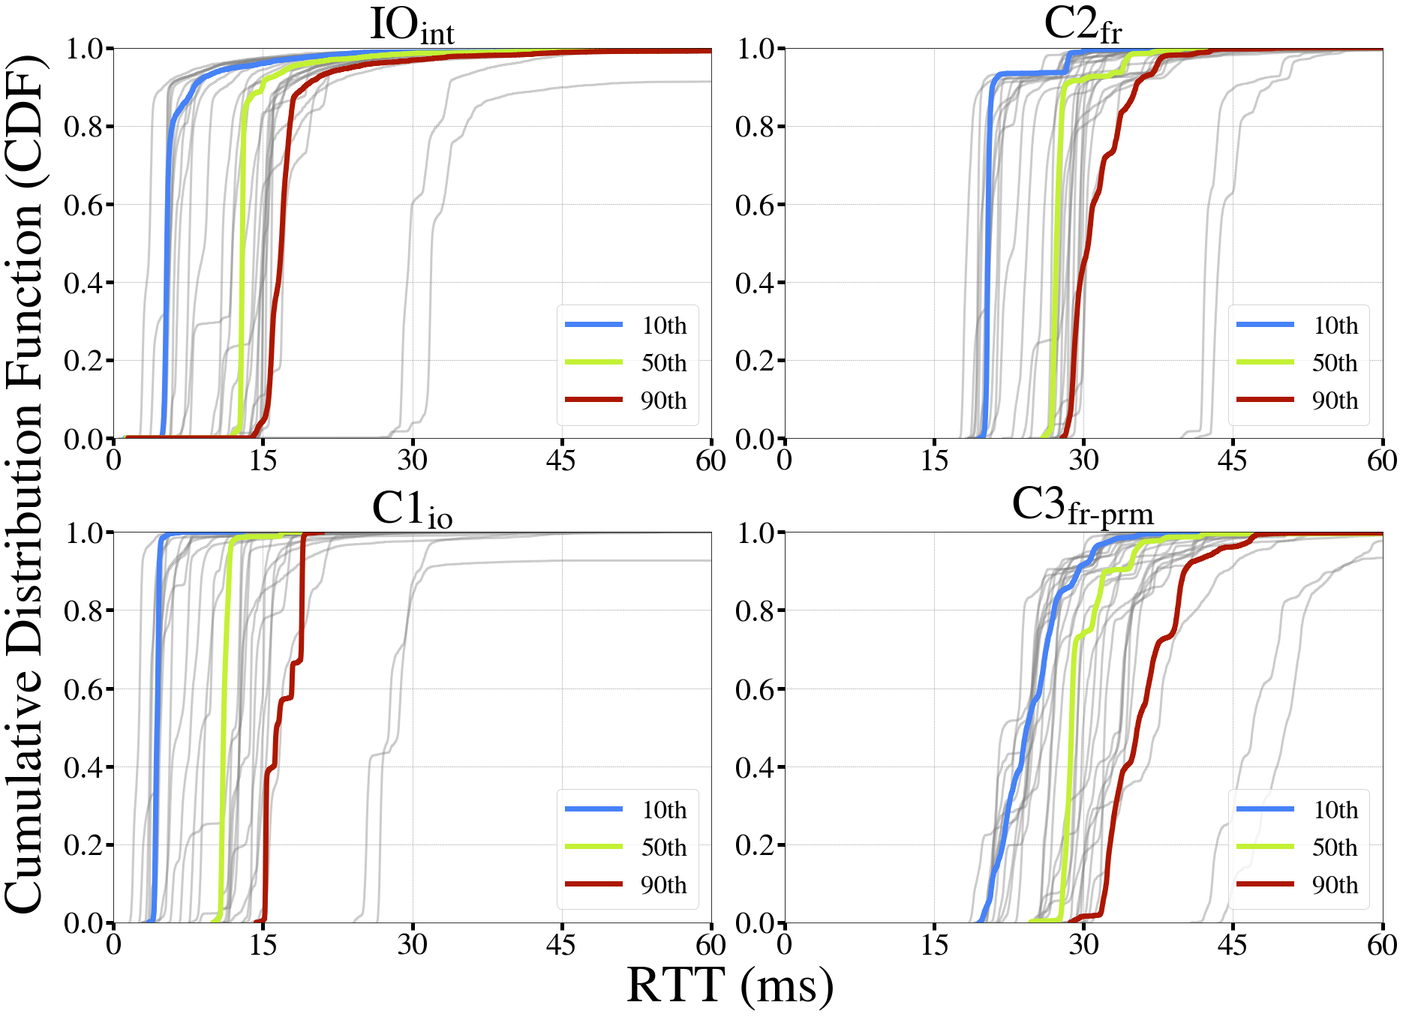

Characterization – RTT CDF per link
CDF from IO_{int} to every destination probe
Highlighted: Probes that occupy the
10th (blue)
50th (green)
90th (red)
percentile of mean RTT among the 32 probes
Notes:
Also if we Pick a single cloud and look at all 32 destination
We see a few things
Observations
the individual CDFs are even steeper than the aggregated one - again stability
rtt in a very narrow range of around 5 ms, (others similar)
Deviant probes are in the Canary Islands - the farthest destination probe from this cloud

Slide 15


Characterization – Insights !
Time of the day does not matter
No daily patterns
Distance is decisive
Notes:
Key takeaways so far from the latency characteristics :-
Time of the day does not matter
Further you are away from the cloud the higher your latency

Slide 16
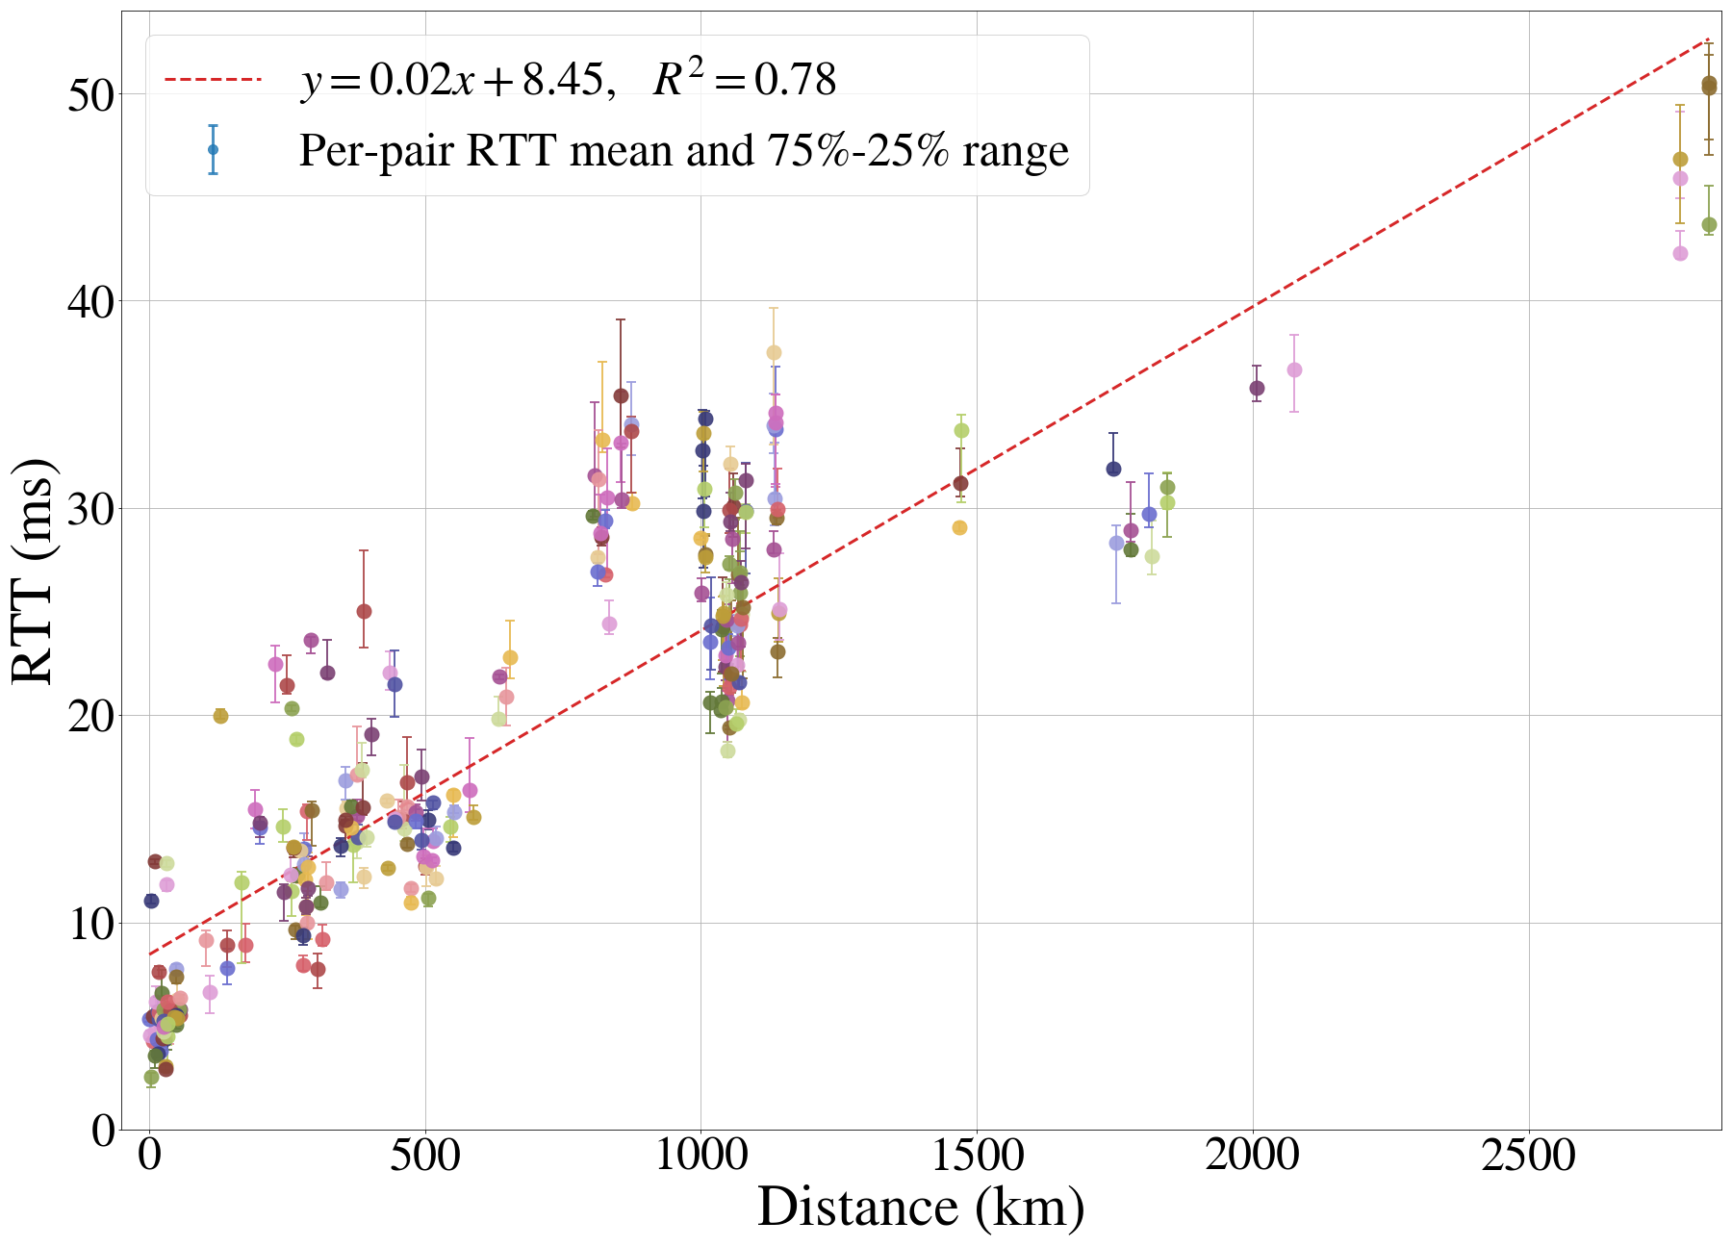
Characterization - Impact of distance
Fitting line:
2ms/100km + min. delay of 8.45 ms.
=> +15 ms from Madrid to Paris
Notes:
Quantitatively what is the Impact of distance ?
Plot the mean RTT for each source-destination pair against distance
Use the least squares method to plot a regression line
Observations
RTT. increases about 2 ms per 100 km with a minimum delay of 8.45 ms.

Slide 17
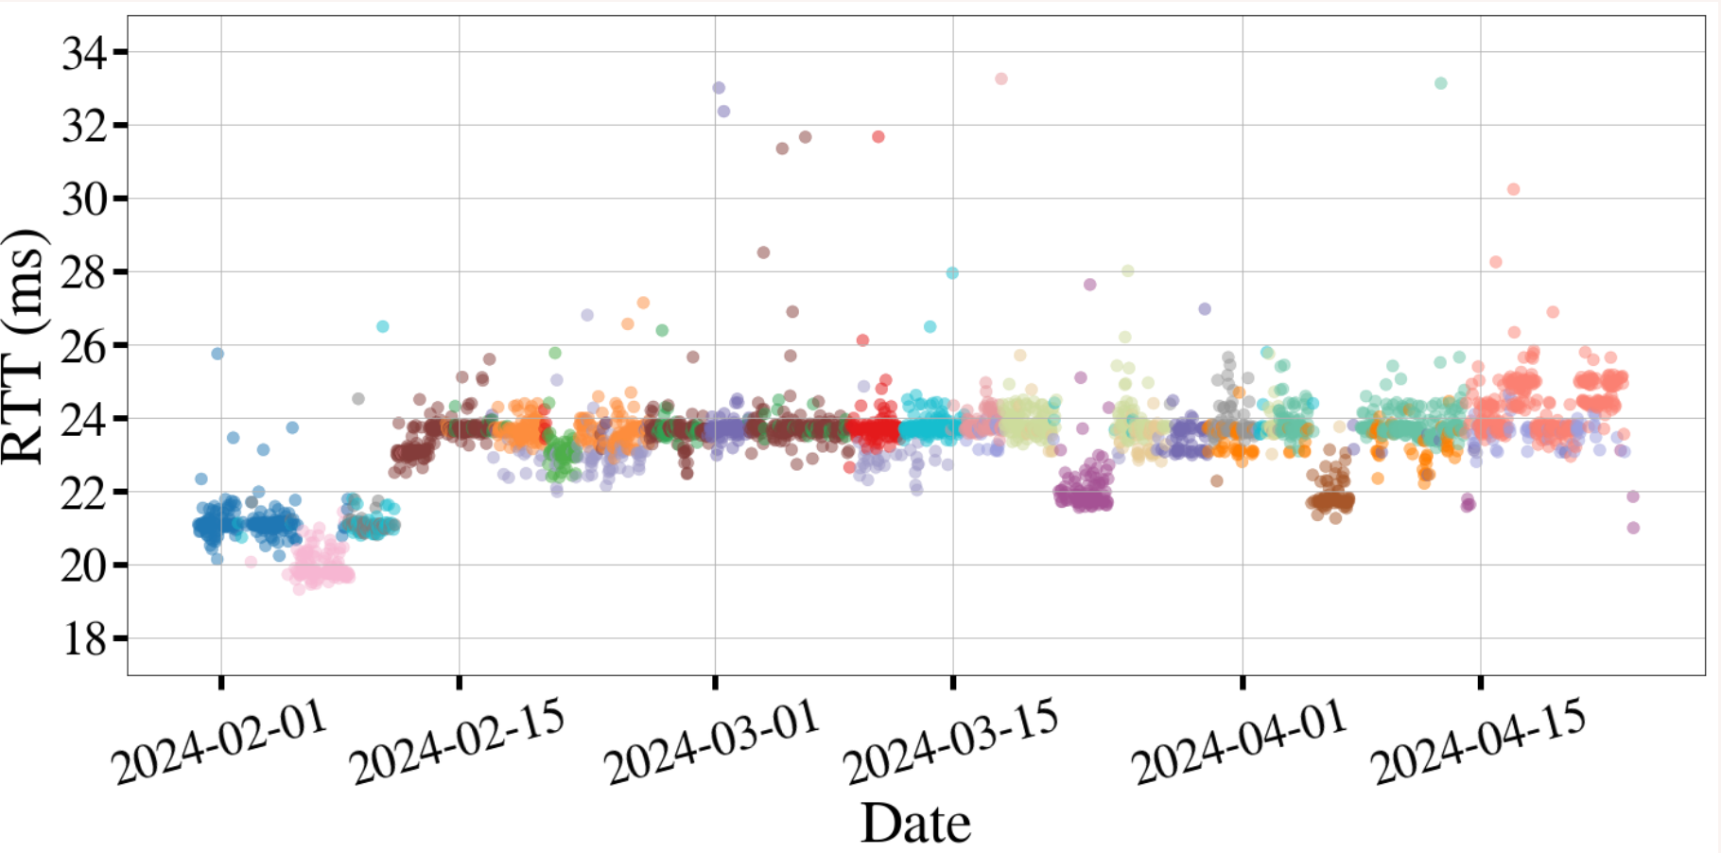
Characterization - Impact of ROUTE
Notes:
Does knowing the distinct IPPATH taken aid you in estimating the final latency ?
We look at a single probe destionation pair
For a single probe destination pair (C1sp to probe 1003090) .
First plot the rtt src dst for each route
We see latency changes according to the path taken

Slide 18
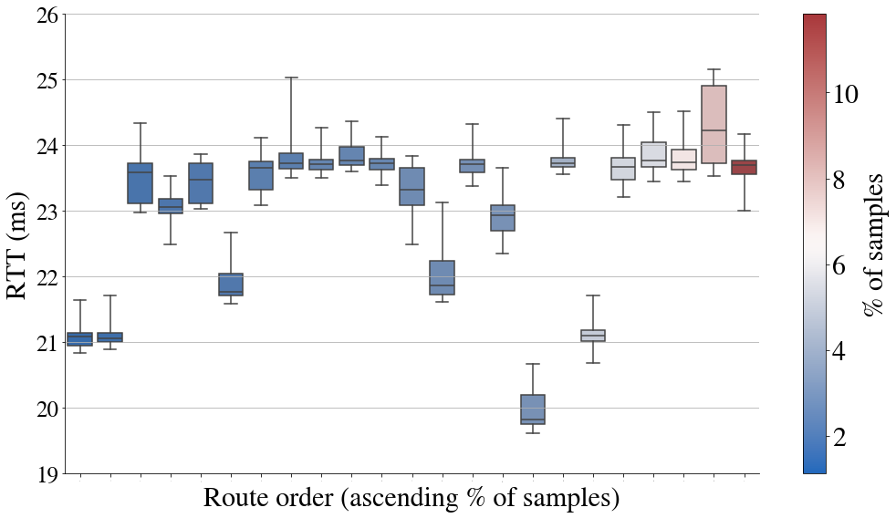
Characterization - Impact of ROUTE
Notes:
Box plot for all the routes with 1% of the samples for same pair we can see that the
unique path matters even more
- Fastest path has mean rtt of 19.5ms and longest 24.5ms
- Therefore diff of 5ms
On average the most popular paths have mean rtt of 23.5ms
While not a very big difference something to consider while planning network paths

Slide 19


Characterization – Insights II
Time of the day does not matter
No daily patterns
Distance is decisive
Route is decisive
RTT Std. dev. over all samples = 2x avg. std. dev. per specific path
the specific IP path does impact the latency
path stability can reduce RTT variability
Notes:
Another set of takeaways at this point is are :-

Slide 20
AGENDA /OVERVIEW
Motivation
Measurement Campaign
Results
Characterization
Forecasting
Conclusions
Notes:
Next we take a look at forecasting
Are there any questions at this point

Slide 21
Forecasting
Time series: Can we forecast the future RTT performance based on the previous values?
Link quality estimation: Can we predict the performance for a new link from the known connections?
Can we infer which features are more important?
Notes:
The measurments can be formatted as a timeseries
In which case we can use two types of algos for predictions
Time series forecasting methods use only previous latency
Supervised ML methods for spatial forecasting using all features available in the measurement
After forecasting can we use XAI to tell which features are important ?

Slide 22
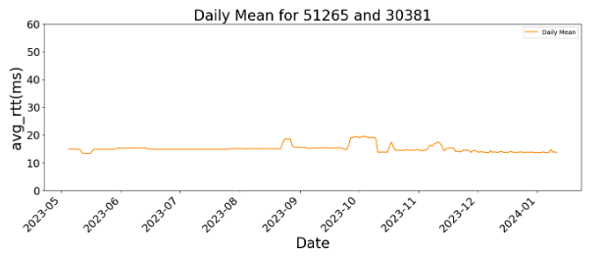
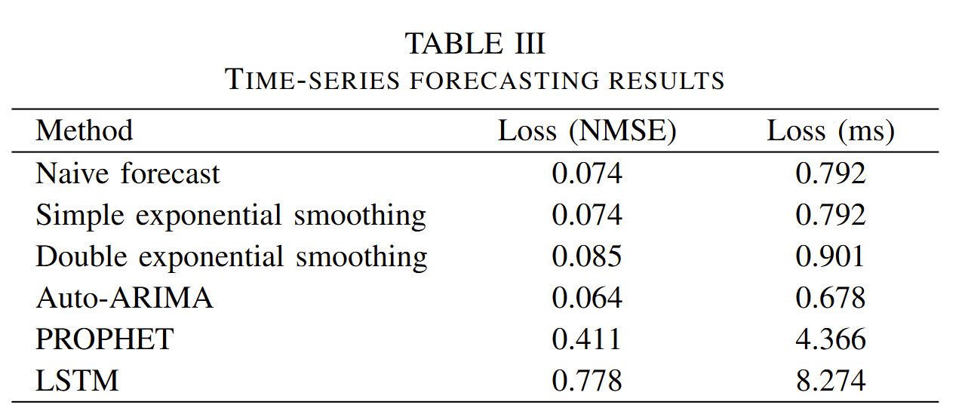
Forecasting – Time series
Simplest algorithms perform the best !!
Notes:
We used a number of time series algos
Observations /TA
Best performing methods were naïve forecast , followed by Exponential smoothing
For ARIMA to perform well you need a lot of computational power
With better tuning LSTM can perform well
This was a simple 3 layer lstm
Latency is quite constant, with spare leaps that are not always predictable
Prophet is a time series forecasting library that decomposes data into trend, seasonality and holiday components using an additive or multiplicative model, with automatic handling of missing values, outliers and changepoints.
LSTM (Long Short-Term Memory) networks are specialized neural networks designed for sequential data that use memory cells and gates (input, forget, output) to learn long-term dependencies in time series data, making them effective for forecasting but requiring significant data and computational resources.
Alpha (α): The smoothing factor or level smoothing parameter
Controls how much weight is given to recent observations vs historical values
Value between 0 and 1
Higher α means more weight on recent data
Lower α means more weight on historical data
Beta (β): The trend smoothing parameter
Used in double exponential smoothing (Holt's method)
Controls how much the trend component is smoothed
Value between 0 and 1
Higher β means trend responds faster to changes
Lower β means more stable trend estimates

Slide 23
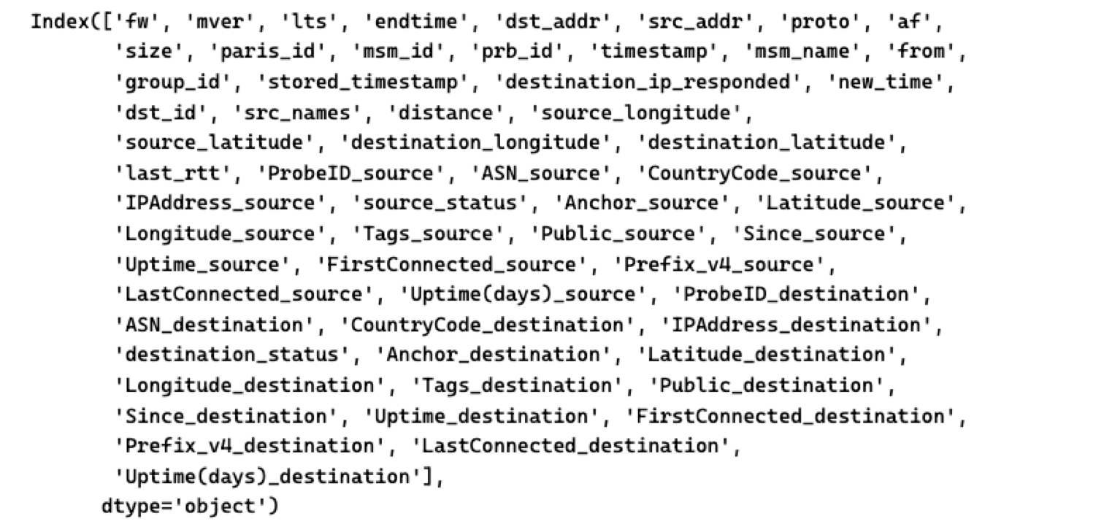
Forecasting - Spatial analysis
Forecast Variable : Latency
Notes:
Our forecast variable will be latency
Our features are all features available in tracert measurement and the probe object

Slide 24
Forecasting - Spatial analysis
Durations : ~ 70 days
Test/Train Split – 80/20
Percentage nans : 3.661839 %
Percentage last hop 255: 19.776974 %
Percentage with rtt > 100ms : 2.226213 %
Notes:
To keep in mind

Slide 25
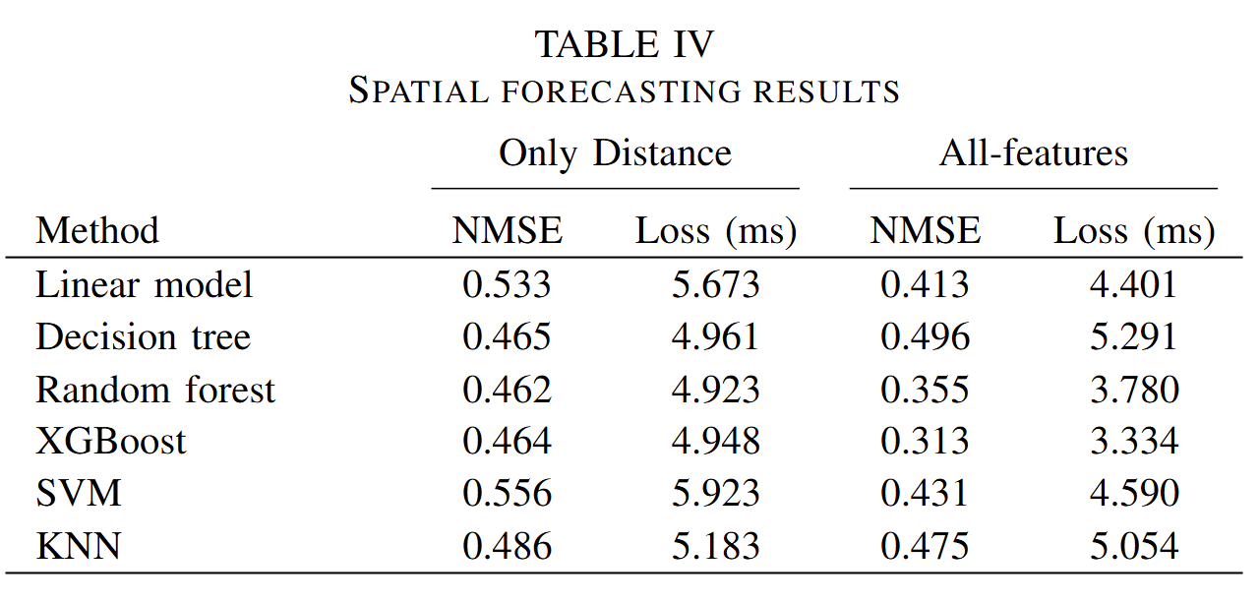
Forecasting – Spatial analysis
Can we predict performance from monitored links?
Two cases:
distance as sole feature
All features are considered
Six algorithms:
Notes:
we chose Two feature cases
Case were distance only
Case with all features
ANd these are the results : -
Observations
Tree based methods performed best
With distance alone you can get quite good results
Improved when all features considered

Slide 26
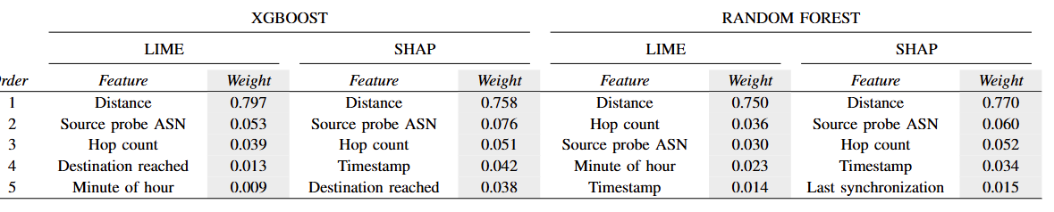
Forecasting – Explainability
Can we evaluate what are the most important parameters?
Two methods:
LIME: Local Interpretable Model-agnostic Explanations
SHAP: Shapley Additive Explanations
For the two best models: XGBOOST and Random Forest
Notes:
which features mattered we use LIME and SHAP
the most commonly used posthoc Explainable algoithms
On best performing
Observations
Distance is most important
Other features way less important
Next features is also important but its an order of importance less

Slide 27
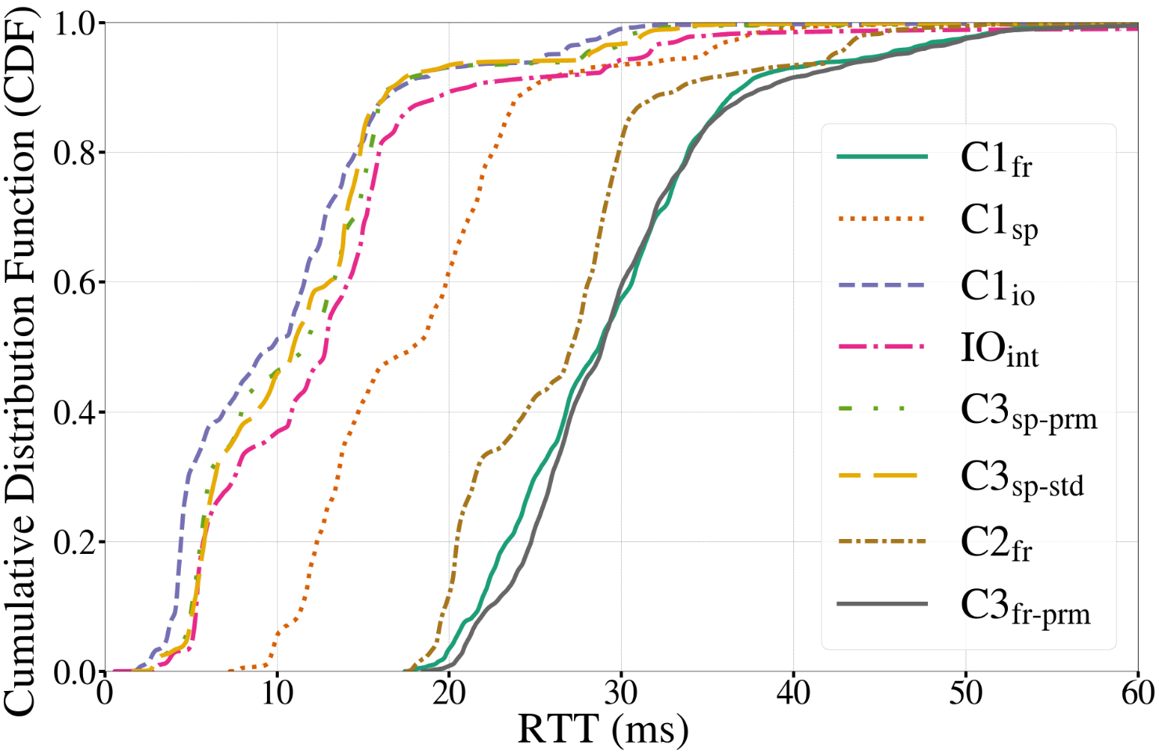
Conclusions and take-away messages
Can we access killer apps everywhere if they are in the cloud?
Notes:
In conclusion
Can the providers users access their apps anywhere in the cloud ?
It depends - which apps work comfortably with rtt of 20ms ?
Probably not the new killer apps the network provider wants to provide in XR , Autonomous vehicles

Slide 28
Conclusions and take-away messages
No daily patterns → similar to (Palumbo 2021)
No difference between premium and standard network service → differs from (Mok 2021)
Can we play cloud gaming everywhere? XR? → NO
Cloud needs to be close. Distance is crucial.
Strong support for Edge Services
Achieving the goals of B5G networks depends on external factors
Cloud developments depend on public networks → lack of control
Characterization
Applications
Cellular
F. Palumbo et al., “Characterization and analysis of cloud-to-user latency: The case of Azure and AWS,” Computer Networks, vol. 184, p. 107693, 2021 R. K. P. Mok et al., “Measuring the network performance of google cloud platform,” Proc. ACM IMC, 2021
Notes:
Other takeaways
No daily patterns
No difference between premium and standard
Need the edge for killer apps
B5G networks need clouds deployed on public networks they don’t control and sjould account for that

Slide 29
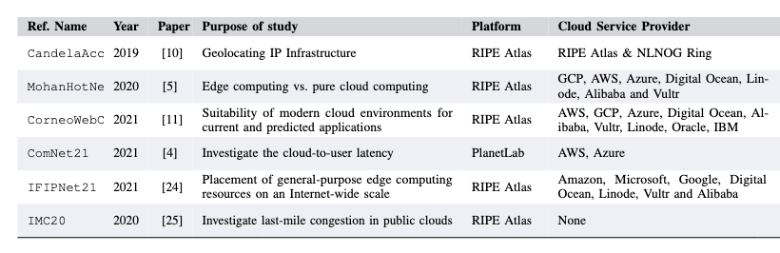
Future Work – Work In Progress
Notes:
Fact checking our methodology
………. Against other RIPE ATLAS datasets
……different granularity and measurement types
…Under review

Slide 30



Thank you!
Questions?
This work is supported by the project AEON-CPS (TSI-063000-2021-38), funded by the Spanish Gov. and the NextGeneration-EU plan
Notes:
I thank you all for your attentions
Any Questions ?

Slide 31
Literature
N. Mohan et al., “Pruning edge research with latency shears”, HotNets, 2020
Measurement and reachability of cloud centers --- Open dataset
7 cloud providers (AWS, Google, Azure, Digital Ocean, Linode, Alibaba, Vultr)
Use RIPE Atlas (as us) -> In Spain, they use 32 probes
Ping every 3 hours, for 9 months, 100 cloud regions
F. Palumbo et al., “Characterization and analysis of cloud-to-user latency: The case of Azure and AWS,” Computer Networks, 2021
AWS and Azure --- Open dataset
Ping every 1 minute, 25 probes, 14 days
Several methods (ICMP, TCP, HTTP), similar results

