Slide 1
netlab Bringing the joy back to virtual networking labs
Ivan Pepelnjak (ip@ipSpace.net) Network Architect ipSpace.net AG

Slide 2
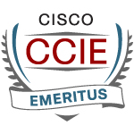
Who is Ivan Pepelnjak (@ioshints)
Past
Kernel programmer, network OS, and web developer
Sysadmin, database admin, network engineer, CCIE
Trainer, course developer, curriculum architect
Team lead, CTO, business owner
Present
Network architect, consultant, blogger, webinar, and book author
Focus
SDN and network automation
Large-scale data centers, clouds, and network virtualization
Scalable application design
Core IP routing/MPLS, IPv6, VPN
Also: I built too many labs for one lifetime, and hated that with passion

Slide 3
Based on a True Story
R1
R2
That should be trivial to test in a lab… However, someone has to build that lab…

Slide 4
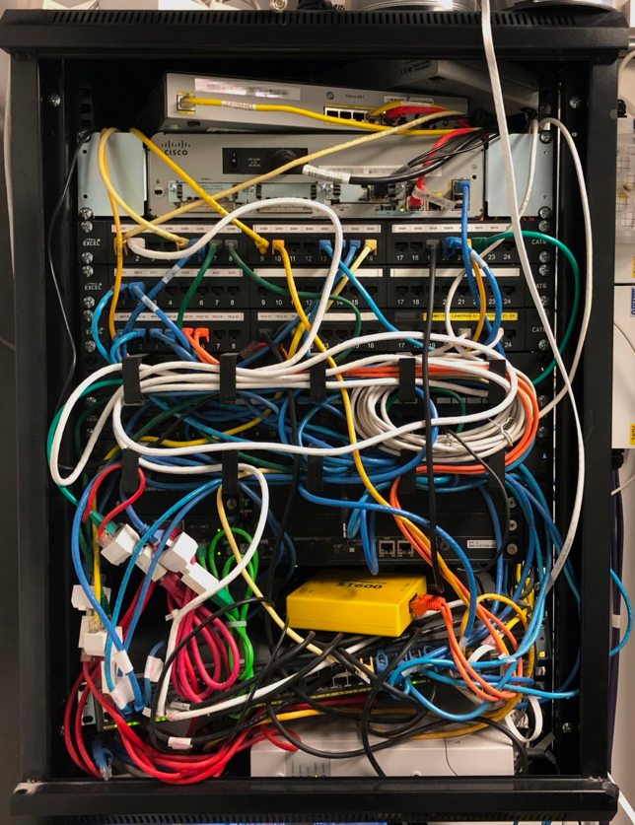
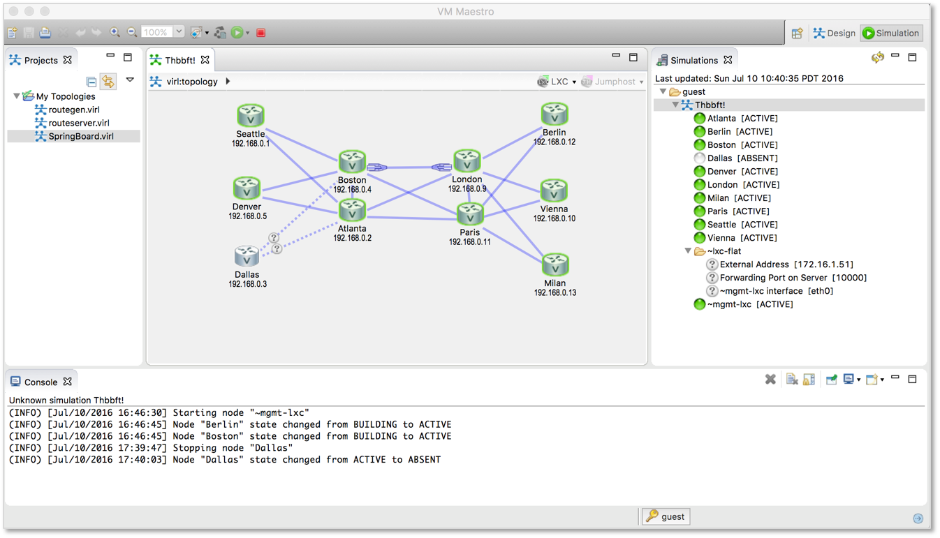
The Reality Intervenes…

Slide 5
A Networking Lab Is Much More than Topology
Build the lab topology
Create addressing plan
Deploy initial device configurations
(Optional) Create virtual interfaces
Design and implement routing protocols
Add network services

Slide 6
And now for something completely different

Slide 7
What Do We Need (in Unicorn Land of Infrastructure-as-Code)
Create a high-level description of the network
Two devices: R1 and R2
Let’s make them Arista EOS containers
They are running OSPF
We need four links (two of them stub LANs)
Oh, we’re running unnumbered links…
Next
Save the file
Execute netlab up and you’ll get a running network (including IP addressing and OSPF)
R1
R2
topology.yml
nodes: [ r1, r2 ]
defaults.device: eos
provider: clab
module: [ ospf ]
links: [ r1, r2, r1-r2, r1-r2 ]
addressing.p2p.ipv4: True

Slide 8
Create configuration files
Start the containers
Start an Ansible playbook
Initial device configuration
Configuring OSPF
Connect to the device
… and we have the answer!

Slide 9
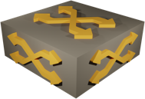
Wait, What Just Happened? netlab up Behind the Scenes
netlab create
Topology file
Plugins
Modules
Defaults
CLI arguments
Data model transformation
Snapshot
Orchestrator configuration
Ansible inventory
Prepare virtual infrastructure
Start the lab
Adjust networking infrastructure
netlab initial
Custom configuration templates
System configuration templates
Ansible playbook

Slide 10
Building a Networking Lab with netlab
Build the lab topology
Initial netlab use case
Create addressing plan
Built-in and custom IPv4 + IPv6 address pools (loopback, P2P, LAN, VLAN, VNI, tunnels), DHCPv4/v6
Deploy initial device configurations
Jinja2 configuration templates + Ansible plays for 20+ platforms
Create virtual interfaces
VLAN, VRF and VXLAN configuration modules
Design and implement routing protocols
OSPF, IS-IS, EIGRP, BGP, MPLS configuration modules
Add network services
EVPN, MPLS/VPN, 6PE configuration modules

Slide 11
Every Lab Is Special
Build the lab topology
Add custom configuration
Static configuration templates
Configuration templates modifying built-in configurations
Multi-vendor and multi-platform support
Modify data transformation with plugins
Modify the built-in transformation rules
Add new functionality (example: IP anycast)
Add new attributes or functionality to existing configuration modules (example: BGP allowas-in)
Create addressing plan
Deploy initial device configurations
Create virtual interfaces
Design and implement routing protocols
Add network services

Slide 12
Current State of netlab (April 2024)
Network devices
Arista vEOS/cEOS
Aruba CX
Cisco ASAv, IOSv, IOS XE (CSR), Nexus OS (9300v), IOS XR/XRd
Cumulus Linux 4.x and 5.x (NVUE)
Dell OS10
Fortinet
FRR
Juniper vSRX 3.0, vMX, vPTX (vEVO)
Mikrotik RouterOS 6 and 7
Nokia SR Linux and SR OS
VyOS 1.4
Hosts and daemons
Generic Linux host or container
BIRD
dnsmasq
Virtualization providers
KVM with libvirt (Vagrant)
Docker (containerlab)
Hardware labs (requires extra interface information)
VirtualBox (Vagrant) (deprecated)
Multi-provider topologies
Combine containers and virtual machines in the same lab
Connect external devices with the virtual lab

Slide 13
Current State of netlab: Behind the Scenes
Network devices
Arista vEOS/cEOS
Aruba CX
Cisco ASAv, IOSv, IOS XE (CSR), Nexus OS (9300v), IOS XR/XRd
Cumulus Linux 4.x and 5.x (NVUE)
Dell OS10
Fortinet
FRR
Juniper vSRX 3.0, vMX, vPTX (vEVO)
Mikrotik RouterOS 6 and 7
Nokia SR Linux and SR OS
VyOS 1.4
The Heroes
Stefano Sasso | Jeroen van Bemmel
Aruba, Junos, Dell OS10, Mikrotik, VyOS | FRR, Nokia SR Linux, Nokia SR OS

Slide 14
Current State of netlab (April 2024)
Addressing
IPv4 + IPv6
Address pools + static prefixes
VLAN-wide subnets
Static interface addresses
Unnumbered IPv4 and IPv6 (LLA) interfaces
Layer-2-only interfaces
DHCP (clients, servers, relays)
Data Plane
VLANs and VRFs
VXLAN (static ingress replication or EVPN)
MPLS including SR-MPLS
SRv6
Tunnel interfaces
Routing Protocols
OSPFv2 and OSPFv3
IS-IS
EIGRP
BGP
BFD
VRRP and anycast gateways
MPLS Control Plane
LDP, BGP-LU, SR-MPLS (OSPF or IS-IS)
Network Virtualization
MPLS L3VPN and 6PE
EVPN (bridging, VLAN bundles, asymmetric and symmetric IRB, most combinations of IGP and BGP)

Slide 15
Sample Platform Support
More @ https://netlab.tools/platforms/

Slide 16
But Wait, There’s More
External Connectivity
Macvtap libvirt interfaces
Macvlan container interfaces
Port forwarding for VMs and containers
External Tools
SuzieQ
Graphite
Ease-of-use
Wiring, addressing, OSPF, and BGP reports (text, Markdown, HTML)
Graphs (Graphviz or D2)
Graphite GUI 🎉 🎉 🎉
Automated validation
Multiple lab instances on a single server
Restore previous configurations
Large topologies
Topology templates
Staggered device start
Link groups

Slide 17
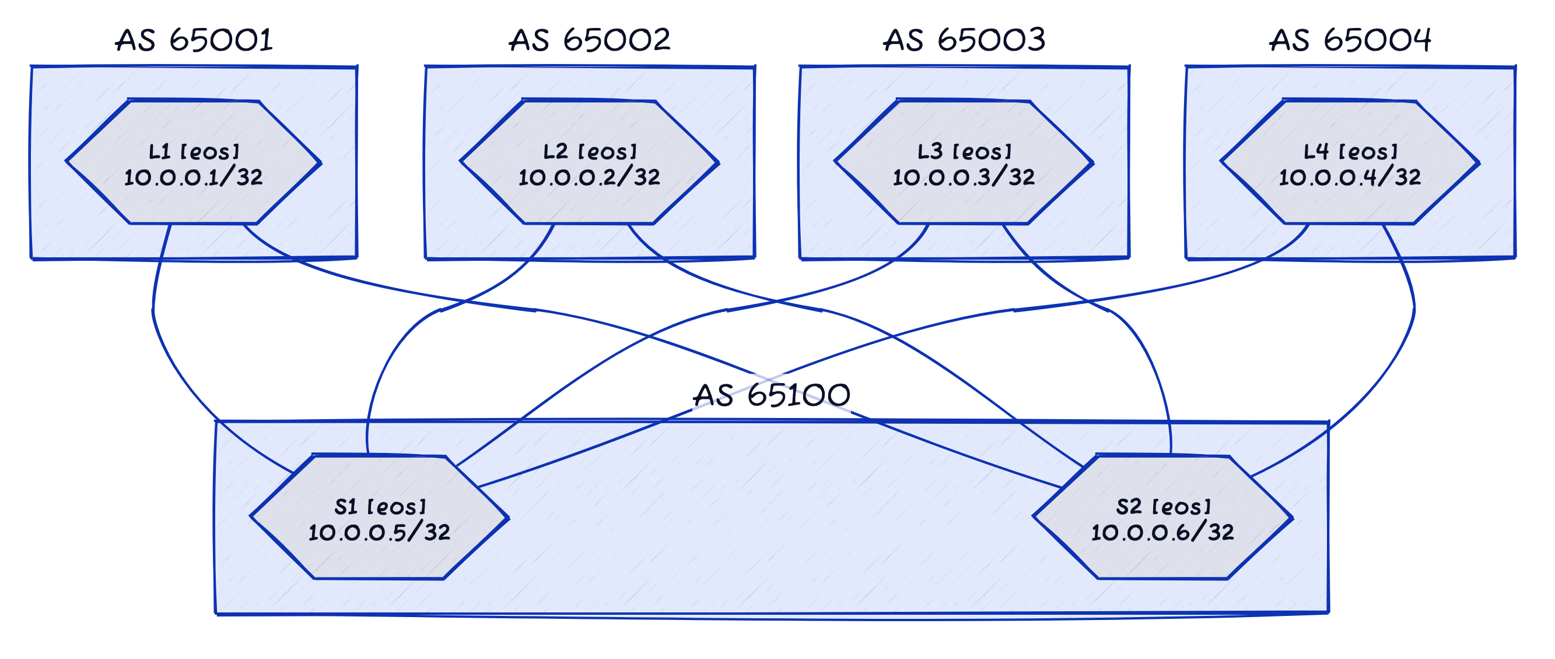
Example: Graph (D2)

Slide 18
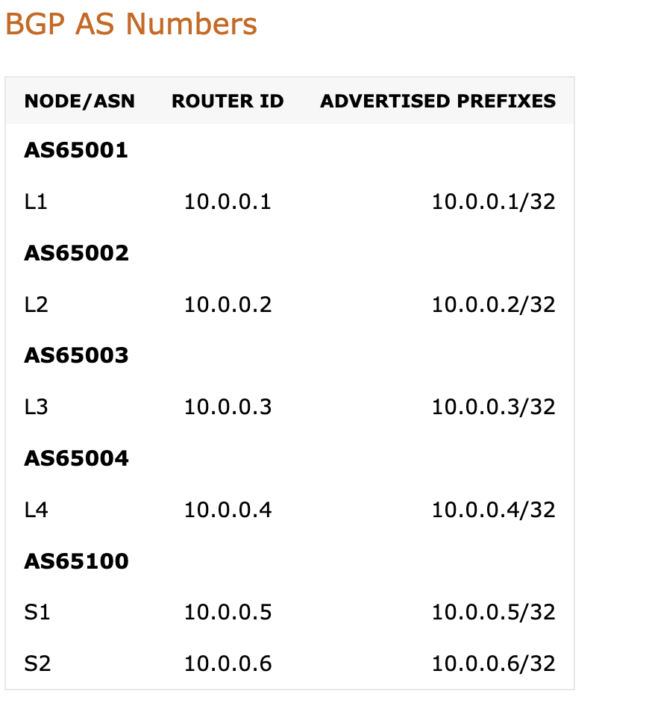
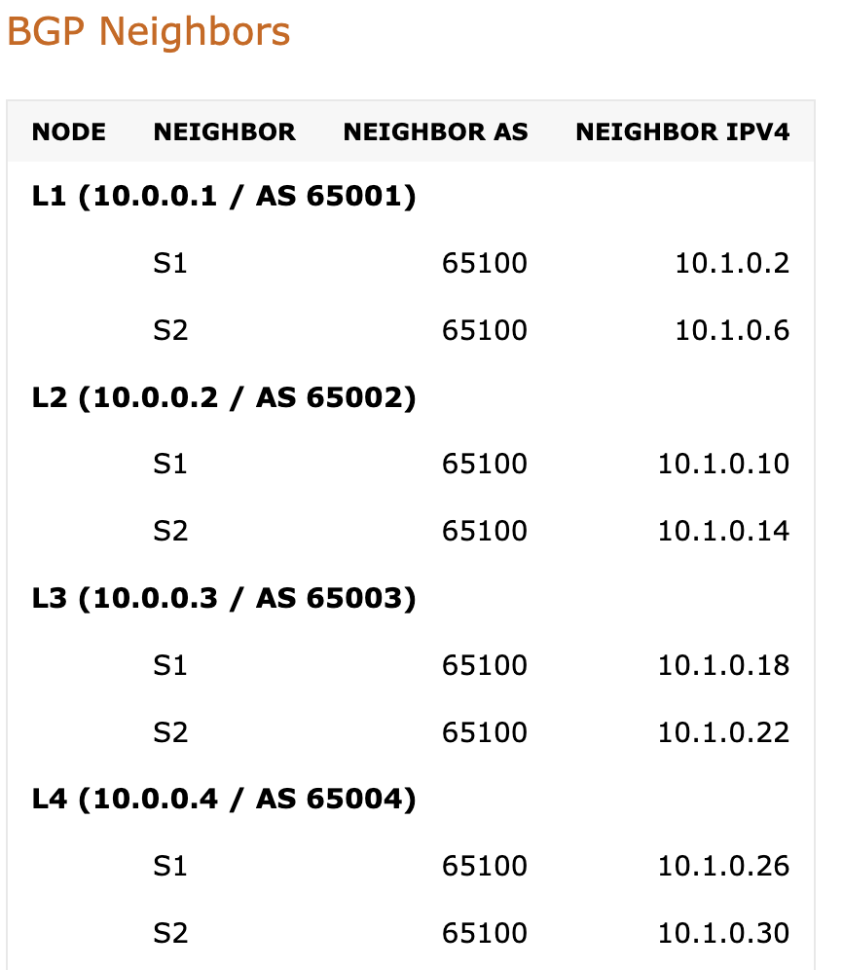
Example: Addressing Report (BGP)

Slide 19
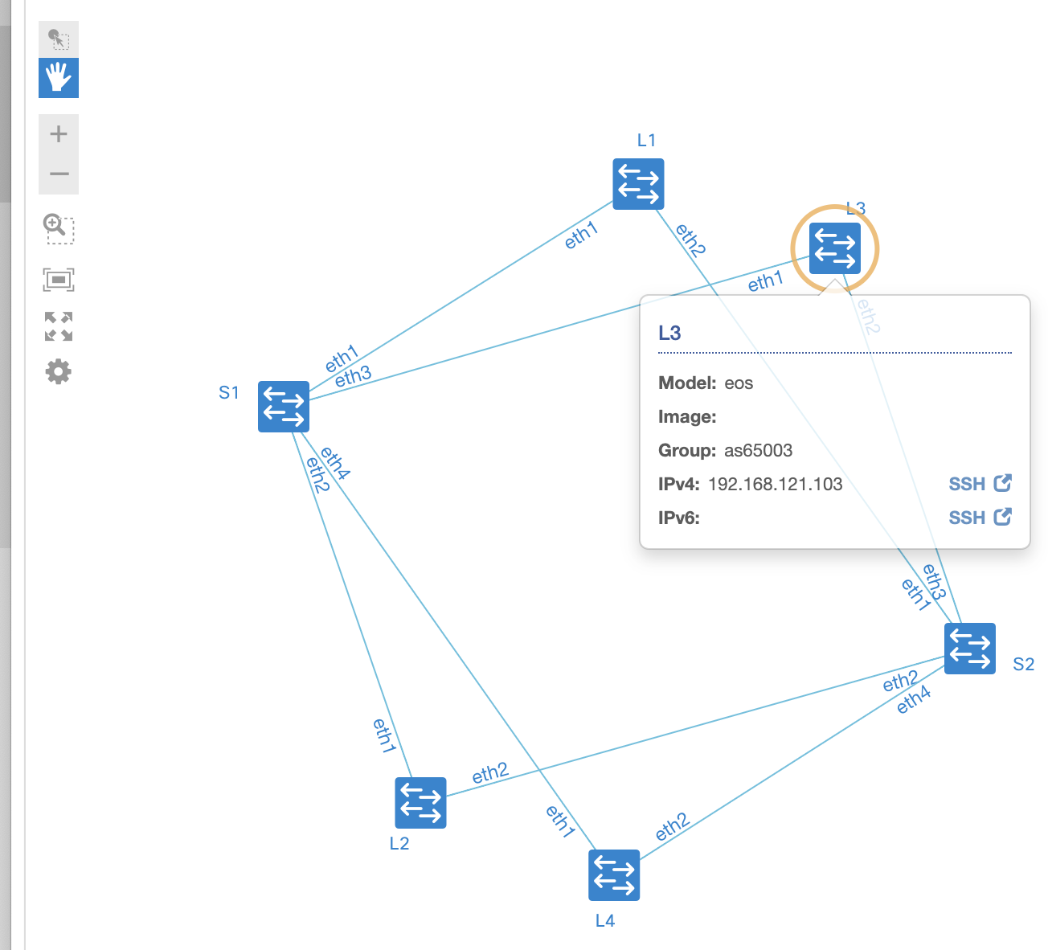
Example: Graphite GUI

Slide 20
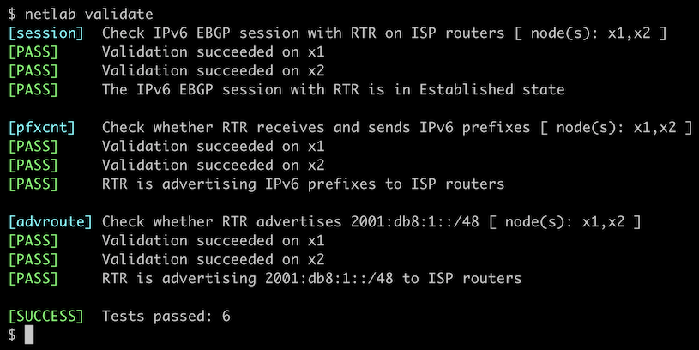
Example: Network Validation

Slide 21
Deployment Scenarios

Slide 22
Recommended: Ubuntu, KVM, libvirt, Docker
Linux (Ubuntu)
Prerequisite software
Python3
Ansible (to configure the devices)
Devices as virtual machines
KVM
libvirt
Vagrant with vagrant-libvirt plugin
Containers
Docker
Containerlab
netlab CLI
Vagrant / containerlab
libvirt / Docker
Ansible
KVM / Containers
Linux bridge

Slide 23
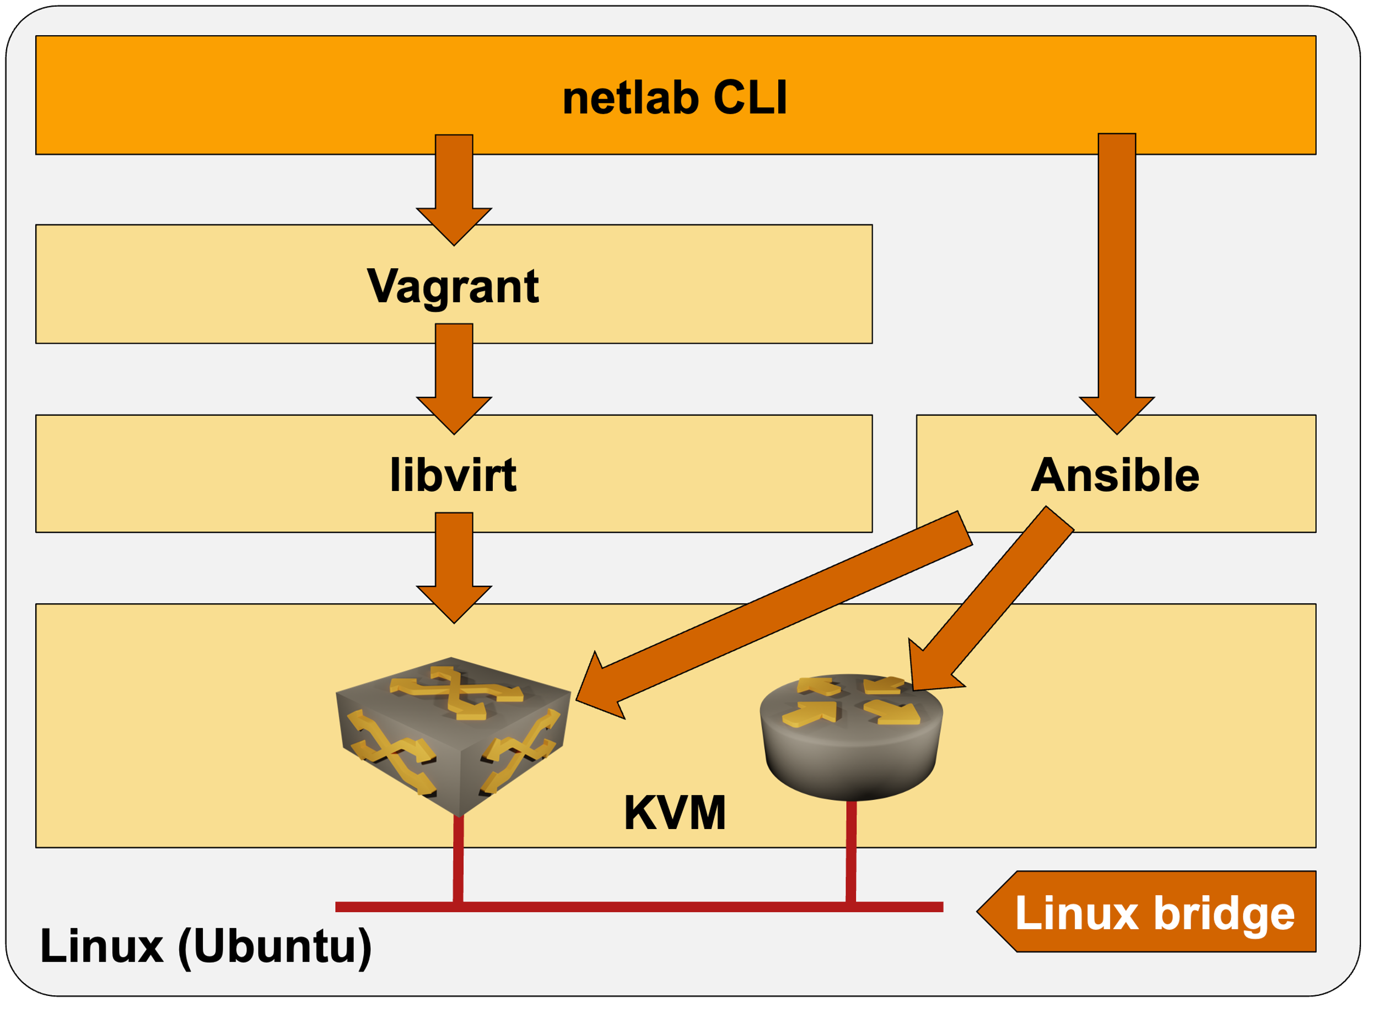
Use Existing x86 Device: Ubuntu VM
MacOS / Windows / Linux
Requirements
You can run containers with any VM virtualization product
Nested virtualization is required to run network device VMs
Virtualization solution with nested virtualization
Hyper-V (WSL)
KVM
VirtualBox
VMware Workstation/Fusion
Optional
Start the VM with Vagrant (simplifies the operations)
Alternative
Cloud deployment
Vagrant
VirtualBox or VMware Workstation/Fusion

Slide 24
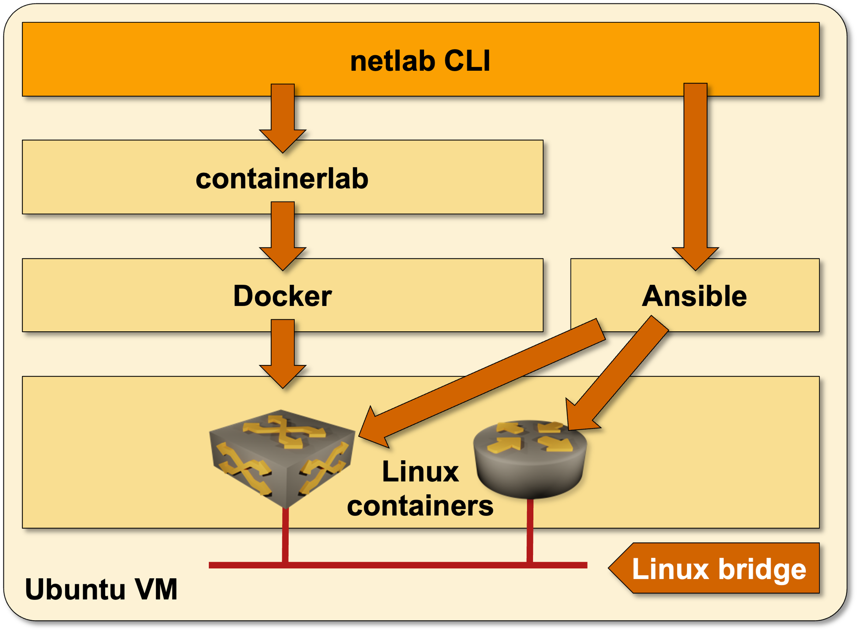
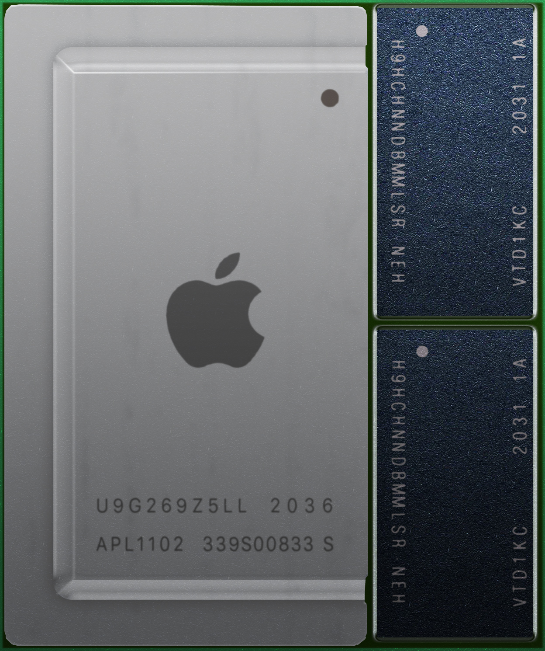
Ubuntu VM on Apple Silicon
MacOS (ARM CPU)
multipass starts an Ubuntu VM on an ARM CPU
Nested virtualization is not supported ➔ containers only
Container images must be built for the ARM CPU ➔ FRRouting only (at the moment)
Interesting use cases
Run BGP, VXLAN, or EVPN labs on your Apple laptop
FRRouting control-plane configuration syntax is pretty close to the industry standard CLI
Multipass

Slide 25
Some Assembly Required (Thank You, Vendors)
Automatically downloadable images and containers
FRR
Cumulus Linux
Nokia SR Linux
VyOS
Easy to download
Juniper vPTX (no registration required)
Most everything else (from bad to worse)
Registration (Arista EOS, Cisco Nexus OS)
Download tied to a valid support contract
Begging your SE
Available only if you know the right dev person

Slide 26
But Wait, That’s Not All
After you download a container image (Arista cEOS)
Unpack and install it (easy)
Virtual machines are a nightmare
Download a virtual disk
It boots without a configuration and expects stuff on serial port
Exception: Junos and ASA can take configuration from a mounted CD-ROM
Building a Vagrant box
What we need to automate lab startup
Start the VM, answer a dozen questions
Copy-paste initial configuration
Save the configuration, shut down the VM
Package as a Vagrant box, hope it works

Slide 27
Getting Started

Slide 28
Getting Started: Hardware
Get decent hardware
Network devices consume between 256MB (Mikrotik) and 12GB (Cisco Nexus 9300v release 10.3) per node
Containers consume between 200MB (FRR) and 1GB (Arista cEOS, Nokia SR Linux)
Decide which deployment architecture you want to use
Existing x86 hardware using Windows/Mac: Linux VM (might need nested virtualization support)
ARM CPU: Linux VM running FRR containers
Standalone Linux server on dedicated hardware: use a fresh copy of Ubuntu
Standalone server recommendations
Intel NUC works great (but is no longer available)
Run containers (Arista, Cumulus, FRRouting) on a VM in the cloud (example: Oracle Cloud Free Tier)
Some cloud providers offer nested virtualization (Google Cloud, Packet, Digital Ocean)

Slide 29
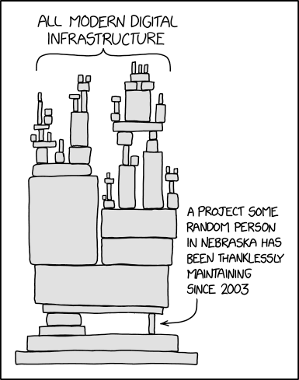
Getting Started: Installation
Ubuntu
Start with a (fresh) Ubuntu VM or a bare-metal server
Install Python3 if needed
Install networklab package with pip
Use netlab installation scripts to install libvirt/KVM, Vagrant, Ansible, Docker, containerlab…
Download or build Vagrant boxes or containers (tons of recipes on netlab.tools/labs/libvirt and netlab.tools/labs/clab)
Other Linux distributions
Everything should work (apart from installation scripts)
Box-building tools have been tested on Ubuntu
We won’t be able to help you 🤷‍♂️

Slide 30
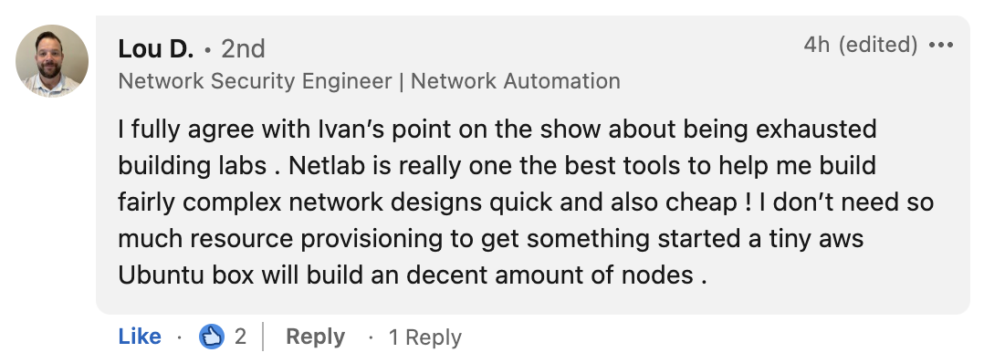
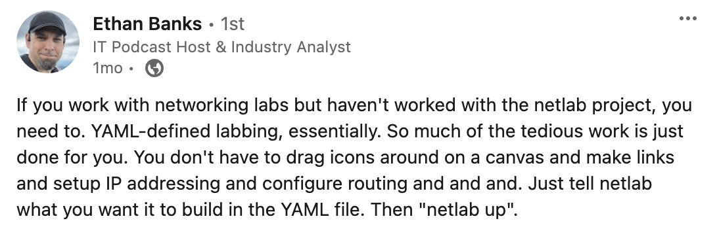
Is It Worth It? What Others Are Saying…

Slide 31
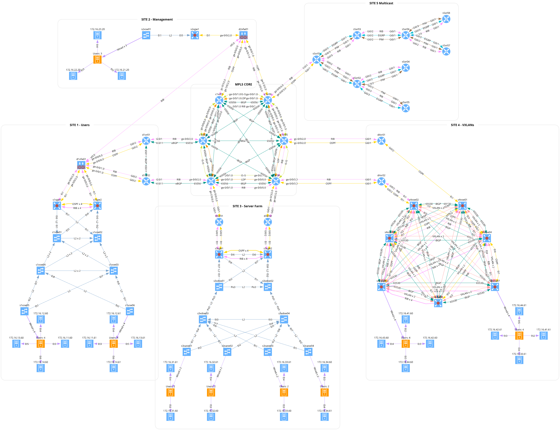
What Others Are Building with netlab

Slide 32
How Can You Help?
Spread the word ;)
Use the tool to build your labs
Ask questions and report bugs
Want to contribute?
Fix documentation
Fix bugs
Add new functionality to existing devices (example: VXLAN on IOS XR or vPTX)
Add new devices
Still not enough?
Develop new plugins (hint: OSPF interface parameters)
Develop new modules (IP multicast, Babel, RIP…)

Slide 33
Questions?
Netlab resources
Documentation: netlab.tools
Blog posts: blog.ipspace.net/tag/netlab.html
Source code: github.com/ipspace/netlab
Examples: github.com/ipspace/netlab-examples
Sample project: bgplabs.net
To reach me
Web: ipSpace.net
Email: ip@ipSpace.net
Use GitHub issues / discussions to ask netlab questions and report challenges

Slide 34
netlab High Level Architecture

Slide 35
High-Level Architecture
Topology file
Plugins
System defaults
netlab CLI
Vagrant
Containerlab
Ansible
VirtualBox
libvirt
Docker
KVM

Slide 36
Data Transformation and Configuration File Creation
Topology file
Plugins
Modules
Defaults
CLI arguments
Data model transformation
Snapshot
Orchestrator configuration
Ansible inventory
External tool configurations

Slide 37
netlab initial – Device Configurations
Ansible inventory
Custom configuration templates
System configuration templates
Ansible playbook
Device-specific configuration
Module-specific configuration
Module-specific task list

