Slide 1
What’s new on PeeringDB?
Livio Morina- Board Member
livio@peeringdb.com
Notes:
Presentation: who am I? How many people do not know or do not have a record on PeeringDB? What is PeeringDB? Its a directory of information related to peering including sites, networks, internet exchanges and other useful information (unique voltage offerings, contact information and other data)

Slide 2
What is PeeringDB?
Mission statement: “PeeringDB, a nonprofit member-based organization, facilitates the exchange of user maintained interconnection related information, primarily for Peering Coordinators and Carrier, Internet Exchange, Facility, and Network Operators.”
A PeeringDB record makes it easy for people to find you, and helps you to establish peering
If you aren’t registered in PeeringDB, you can register at https://www.peeringdb.com/register
We use basic verification for new accounts and require current whois information, so please
Update and maintain your whois information
Register from an email address associated with your ASN /company
?
…
Morina Livio

Slide 3
What is PeeringDB?
Why should my carrier, exchange, network or facility be listed in PeeringDB?
Helps establish new peering more efficiently, with all information easy to find in one place
Maintain all of your contact and connection info
Find other network's peering contact and connection info
Find interconnection facility and IXP info
A PeeringDB record is required by many networks to peer
Can be used for automation to generate router configurations
Initial configuration to setup peering quickly
Update configuration if maximum prefixes change
Morina Livio

Slide 4
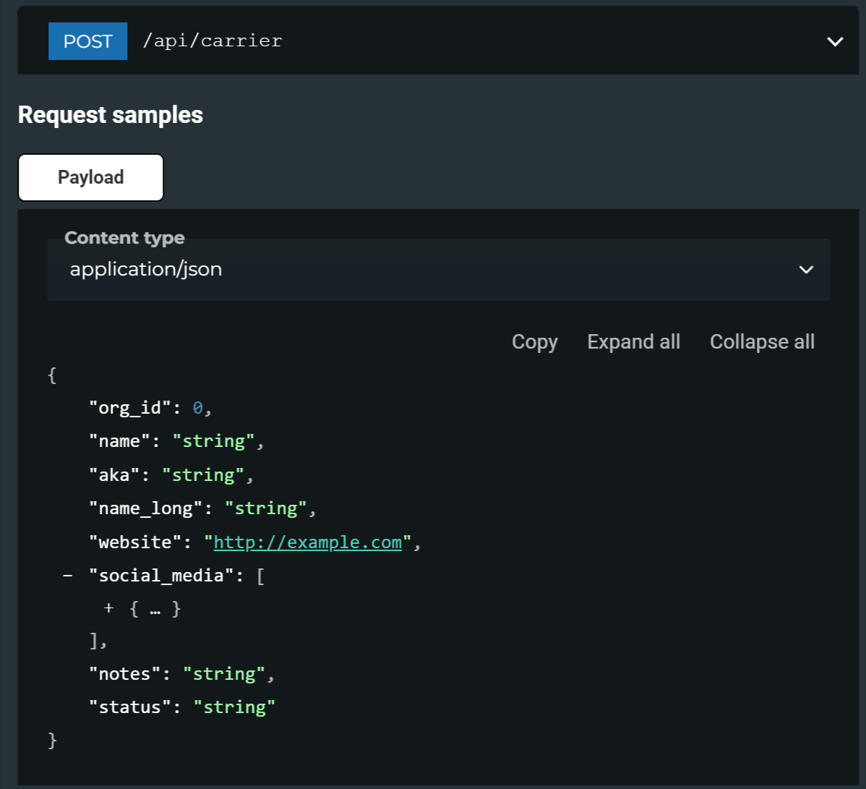
How to access PeeringDB?
Provides a GUI and an API
The GUI nicely puts together what you can retrieve via the API separately
The API is useful for automating and mass info retrieval
See https://www.peeringdb.com/apidocs/ for more information
Morina Livio

Slide 5
Governance and Membership
PeeringDB is a United States 501(c)(6) volunteer organization that is 100% funded by sponsorships
Healthy organization, building financial reserves and executing the long term strategic plan
Membership rules
A corporation, limited liability company, partnership or other legal business entity may be a Member of the Corporation
Membership is determined by having both an active PeeringDB.com account and an individual representative or role subscription to the PeeringDB Governance mailing list
480 addresses subscribed to the Governance mailing list (as of April 15, 2024)
Governance list is at https://lists.peeringdb.com/cgi-bin/mailman/listinfo/pdb-gov
More information available at https://docs.peeringdb.com/gov/
Morina Livio

Slide 6
Board of Directors and Officers
Chris Caputo – Secretary and Treasurer (Officer) | Aaron Hughes – Vice President (Term Expires 2024) | Rahul Makhija – Director (Term Expires 2025)
Christopher Malayter – President (Term Expires 2025) | Livio Morina – Director (Term Expires 2025) | Job Snijders – Director (Term Expires 2024)
Morina Livio

Slide 7
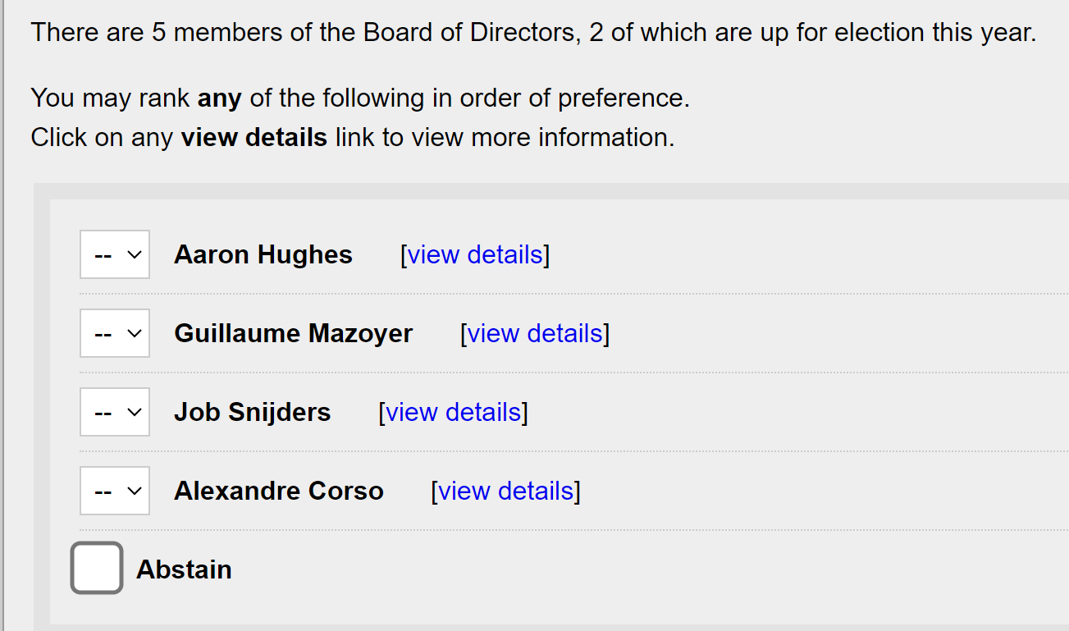
PeeringDB Board Election
The elections end on April 29 at 11.59 pm utc
Morina Livio
Notes:
Ballot example, name are randomized.

Slide 8
How to Vote
Morina Livio
Notes:
How do I become a member?
Make sure you have data in PeeringDB (see other HOWTOs). Join the pdb-gov mailing list. You are now a member.
How can I vote?
Each member is entitled to one vote. Members who are affiliated with each other share a single vote. For instance, if Big Company owns Small Company they may only have one vote between them, not one vote each.
At the start of the election process, the Secretary/Treasurer will ask each member to nominate a single authorized voter. The Secretary will send each authorized voter an invitation to vote.
Election ends April 29th at 23:59 UTC.

Slide 9
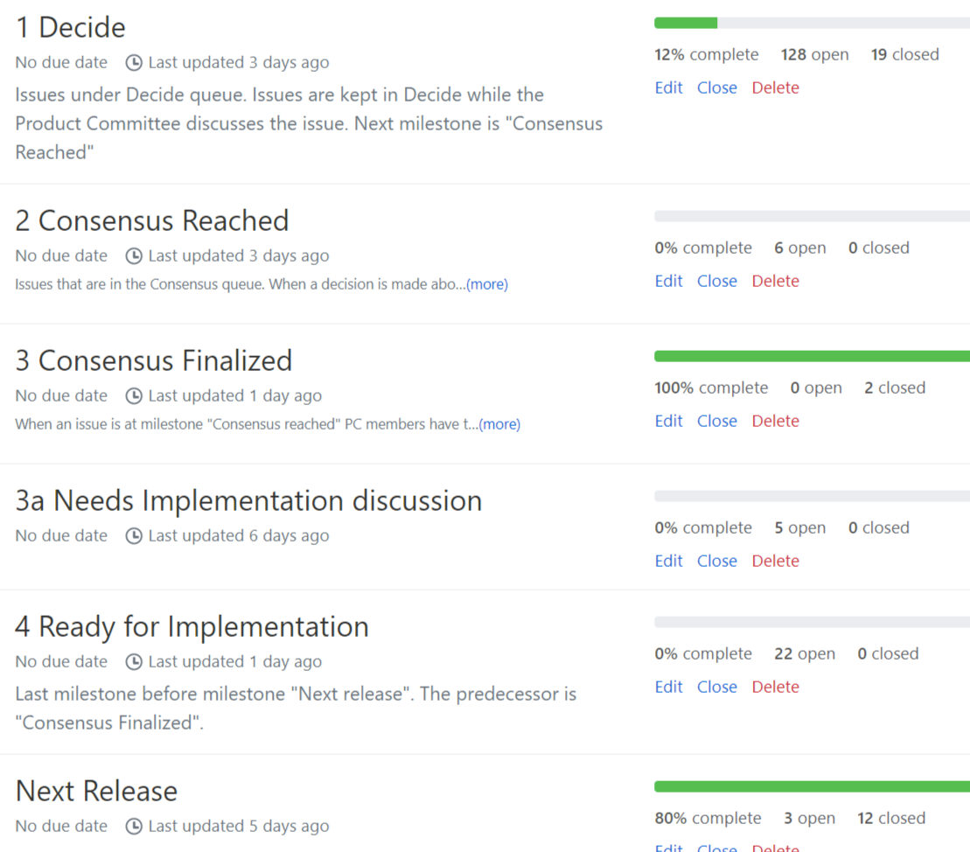
Product Development Workflow
All issues tracked using GitHub at https://github.com/peeringdb/peeringdb/issues
Anyone can open a feature requests or file a bug report
Open and transparent process for product development
Workflow is at http://docs.peeringdb.com/workflow/
Product Committee issue process
Evaluate and prioritize the requests
Request a quote for development costs
Request budget from the board
Manage implementation and scheduling
Your input is needed on features!
Morina Livio

Slide 10
Release Process
Announced at least one week in advance with all changes to give the community notice
Beta site is already running the development version for testing
Announced on PDB Announce list, Twitter, Facebook
Released on Wednesdays at 0400Z and avoids
Mondays and Fridays
International holidays
Large conferences and events (APRICOT, EPF, GPF, NANOG, RIPE, etc.)
List of current changes (release notes) for each version are on GitHub at https://github.com/peeringdb/peeringdb/milestones
Morina Livio

Slide 11
Beta Development
Beta server
Available at https://beta.peeringdb.com/
Runs the latest beta software version
Full access over HTTP and the API
Database is local to the beta server only, changes are not reflected on the production servers
Latest changes
Available at https://beta.peeringdb.com/changes
Redirects to the list of issues on GitHub
Documents all of the changes in the current beta version
Anyone can log bugs and feature requests in GitHub at https://github.com/peeringdb/peeringdb/issues
Morina Livio

Slide 12
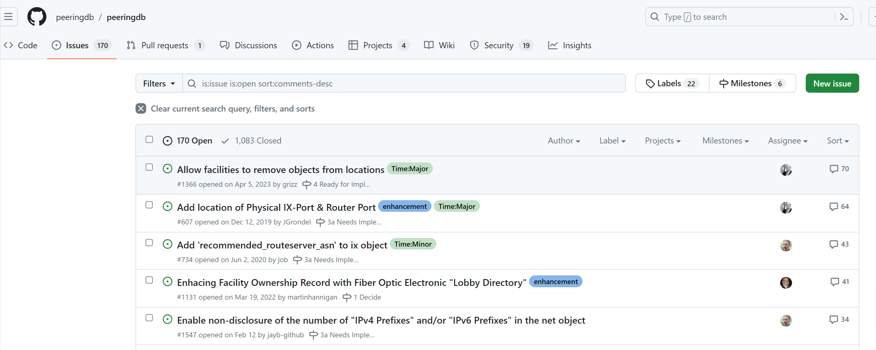
Updates
News from the Frontlines
Web UI design changes
New KMZ export feature
Improved search
Beta testing
Call for Volunteers
Morina Livio
Notes:
Web UI summary changes
Facility data to KMZ!
Search functionality - why that’s important
Beta testers
CFV

Slide 13
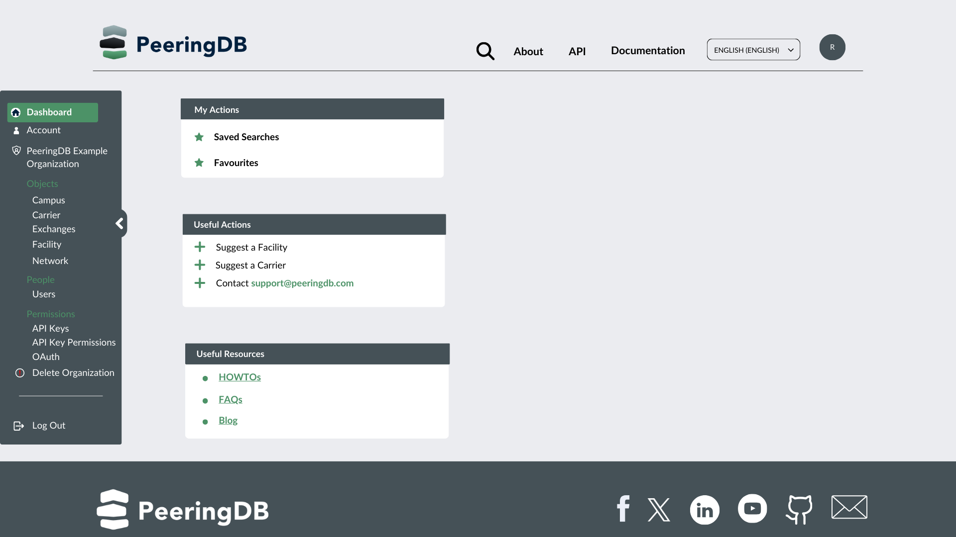
Web UI
Planned Improvements
Better device presentation
Dashboard options
Lazy loading
Morina Livio
Notes:
Screens will be more consistent across devices
Dashboards and other personalization
Lazy loading for faster choice recognition
Improved overall presentation attributes

Slide 14
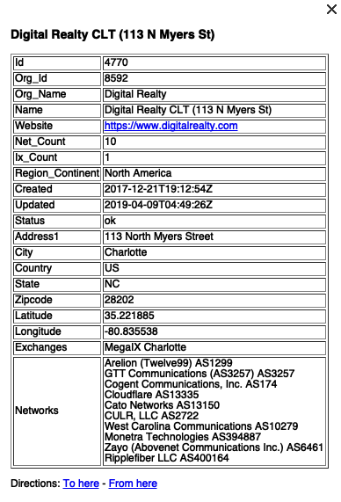
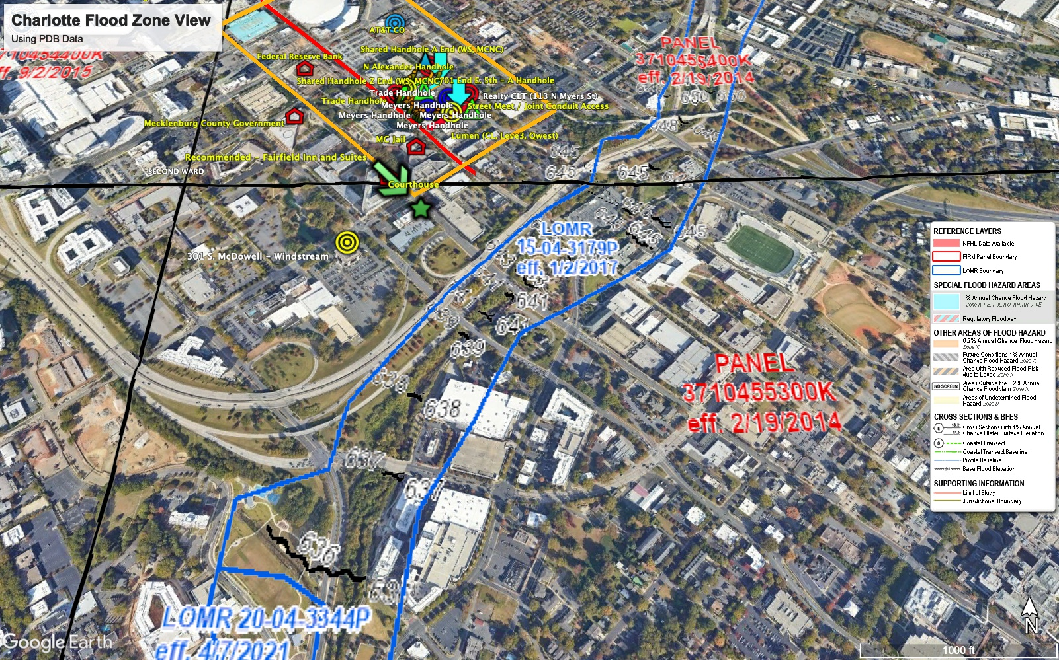
New KMZ Features
Facility Data
Locations and metadata
Exported daily
Importable to Google Maps
Later this year
Export searches to KMZ
Improved visual attributes
Morina Livio
Notes:
KMZ being auto generated once a day.
Contains useful record metadata (Thank you to our Sponsor Digital Realty)
Powerful uses, FEMA, quake, near facilities (Thanks Digital – and they’re safe)
Other very cool uses aligned with personal data

Slide 15
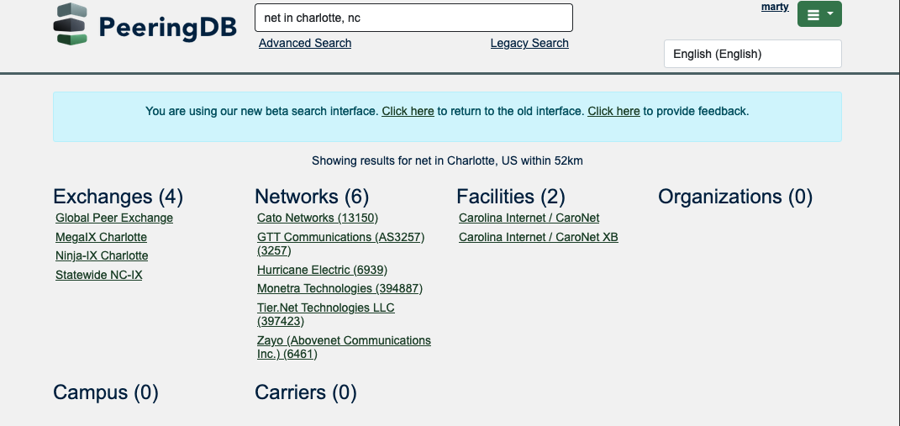
Search (pending release)
Search is getting better
Location support
Object type searching
Boolean operators
Refined results
Morina Livio
Notes:
Location support includes ….
Simple search knows about objects to move at user speed
We have more work to do, but we’ll be retiring legacy simple search in the near future

Slide 16
We Need Beta Testers
Consider using the Beta environment as default
Just over half a percent of users visit beta.peeringdb.com each month
We recognize that there are good and bad reasons for this!
As of release 2.57.0, beta.peeringdb.com refreshes once an hour
Early access to improvements
Easy feedback mechanism
Try it at https://beta.peeringdb.com
Contact us at pc@peeringdb.com with any questions
Morina Livio
Notes:
On the good side, people are pretty happy with www.peeringdb.com. But on the bad side, we only used to refresh the data in beta.peeringdb.com once a month.

Slide 17
Call for Volunteers
Admin Committee
Answer user support questions
Suggest improvements based on experience
Only apply if you have free slots at least four days the week for 20 minutes
Email us at admincom@lists.peeringdb.com for more info.
Morina Livio
Notes:
PeeringDB runs on volunteers
- need AC volunteers
- good global exposure
-get to know people (ticket submitters! Hah!)
- great experience learning about PDB
-about a 1 HR commit per week

Slide 18
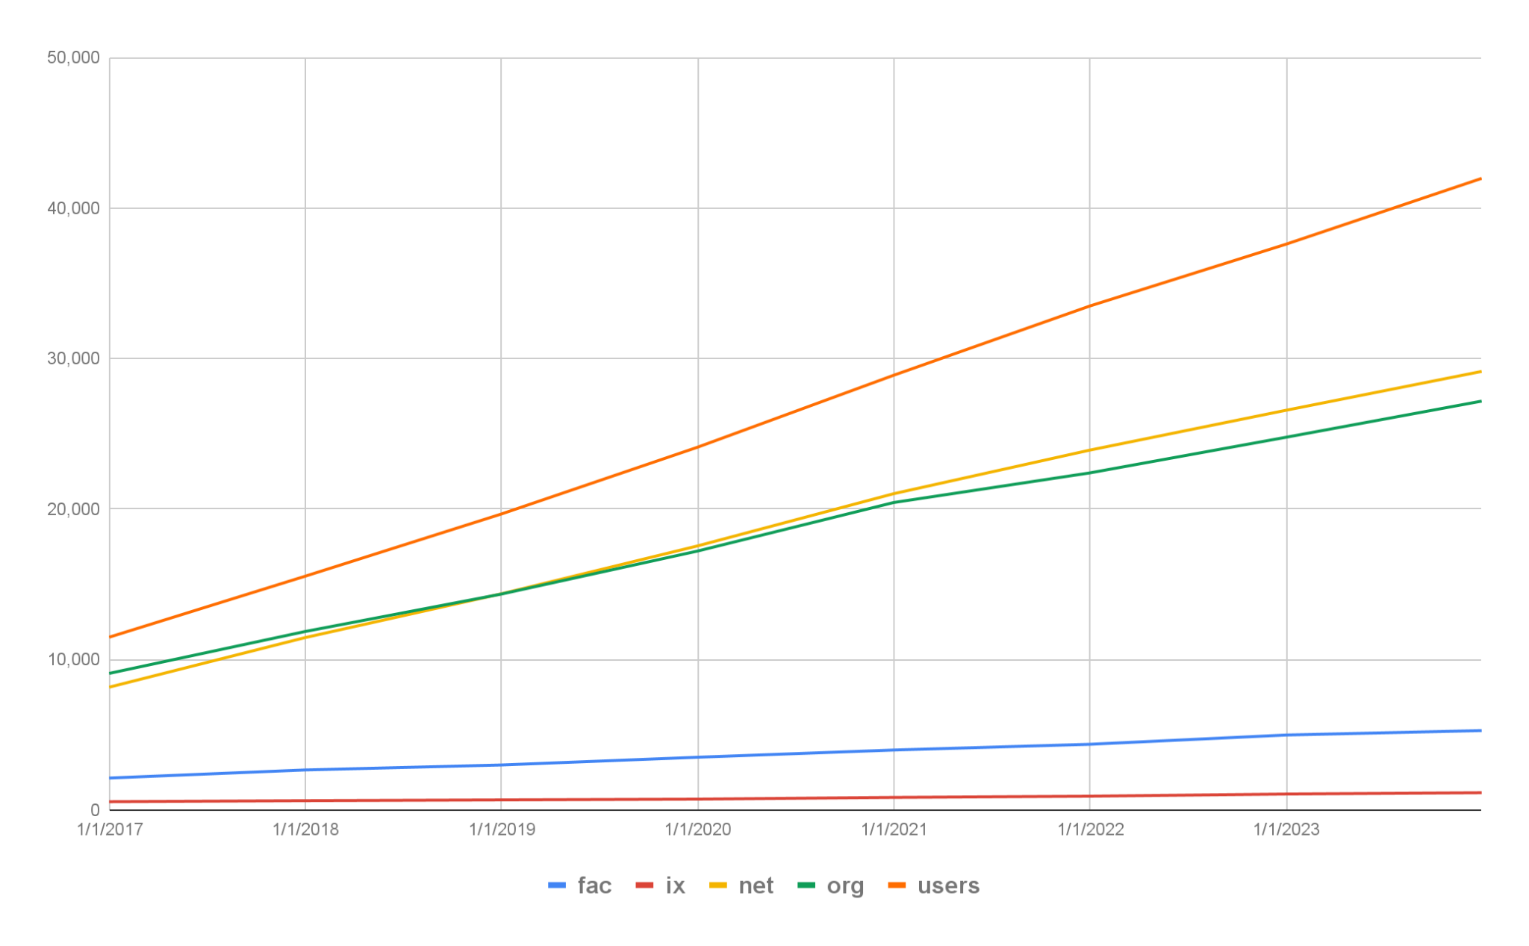
Tracking Growth
End of 2023, and growth on 2022
Facilities: 5,282
6% increase
IXs: 1,152
8% increase
Networks: 29,148
10% increase
Orgs: 27,174
10% increase
Users: 41,975
10% increase
Morina Livio
Notes:
PeeringDB runs on volunteers
- need AC volunteers
- good global exposure
-get to know people (ticket submitters! Hah!)
- great experience learning about PDB
-about a 1 HR commit per week

Slide 19
Thank you to our sponsors!
Diamond Sponsor
Platinum Sponsors
Gold Sponsors
Silver Sponsors
Morina Livio
Notes:
Logo height proportions: 100%, 85%, 65%, 40%

