Slide 1
RIPE NCC Days Sofia, 28 June 2023
QoS and DDoS mitigation in IXP

Slide 2
Quality of Service
Different traffic treatment for different services
Best-effort - default
Assured forwarding - reserved bandwidth
Expedited forwarding - low latency (priority)
Network Control - priority and reserved bandwidth
Input classification and output queueing
What it has to do in neutral IXP infrastructure

Slide 3
QoS on Peering only Member port
Output Queueing
Best effort for everything
Network Control for BGP (and ARP)

Slide 4
QoS on Peering + Multicast
Multicast is used for real-time Audio/Video transport
Highly sensitive for packet loss and variable delay (jitter)
Output Queueing
Best effort for Peering
Network Control for BGP
Expedited forwarding for Multicast

Slide 5
QoS on Multi-service Member port
Private VLANs normally carry more important traffic than peering
Output Queueing
Best effort for Peering
Network Control for BGP
Expedited forwarding for Multicast Assured forwarding for Private VLANs

Slide 6
QoS with DDoS mitigation
Reserve zero bandwidth for possible DDoS traffic
Output Queueing
Best effort for possible DDoS
Assured forwarding for other Peering
Network Control for BGP
Expedited forwarding for Multicast Assured forwarding for Private VLANs

Slide 7
Congestions on Member ports
Routing change
policy
public peering as backup of private peering
Increased traffic
live events
software updates
DDoS attacks

Slide 8
Detecting Congestion Cause
SFlow / Port Mirroring
PMacct ElasticSearch
Zabbix

Slide 9
DDoS Attacks
Low-and-Slow DDoS attack
protocol and application layer
High packet rate DDoS attacks
TCP syn, DNS, HTTP/S
spoofed traffic
Solutions: hardware/software solutions, BCP.38
Volumetric DDoS attack
overflow transport links to the victim
Amplification
Bot networks

Slide 10
DDoS Patterns
Application | Protocol | Port
Invalid | UDP | 0
Chargen | UDP | 19
DNS | UDP | 53
NTP | UDP | 123
SNMP | UDP | 161
U Discovery | UDP | 10001
Memcache | UDP | 11211
SSDP | UDP | 19000
Amplification
Request from spoofed IP address of the victim
Large response to target
Most attacks last less than 2 minutes Multiple protocols

Slide 11
DNS DDoS attacks
DNS is important but low bandwidth traffic
(Less than 10 Mbps on whole IXP)
Multiple Gbps during attack
Solution: Policing
Classify UDP with source 53 exceeding 50 Mbps on all ports as potential DDoS
Same solution for other patterns

Slide 12
DDoS attack w/o congestion

Slide 13
DDoS attack causing congestion

Slide 14
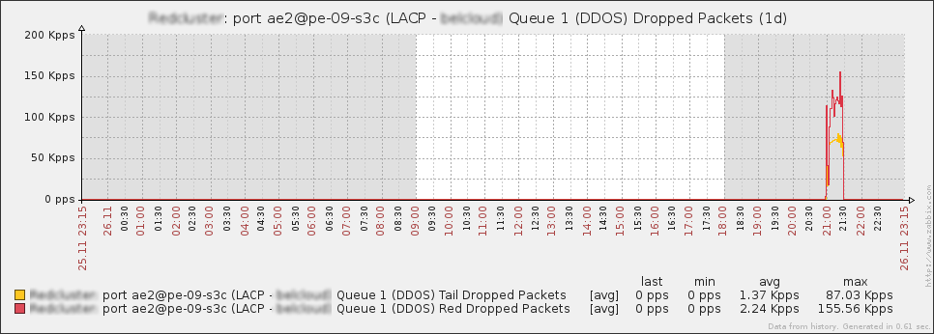
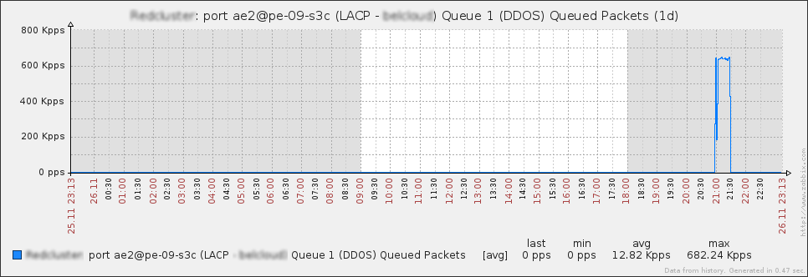
Real Attack in Monitoring
DDoS Queue Dropped in pps
DDoS Queue Queued in pps

Slide 15
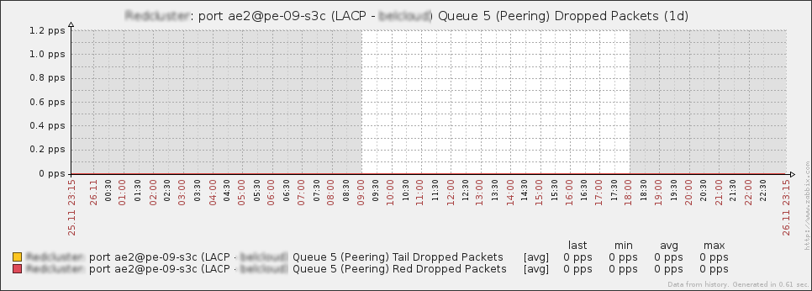
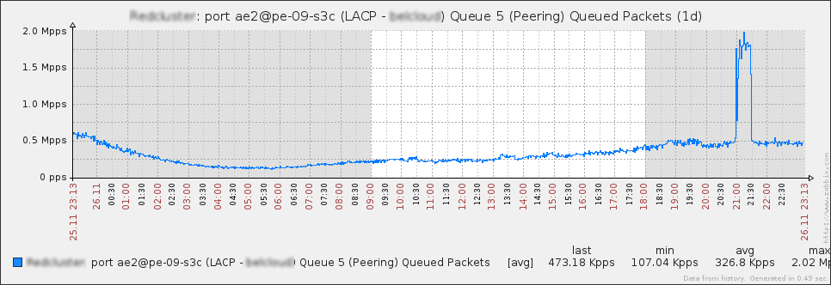
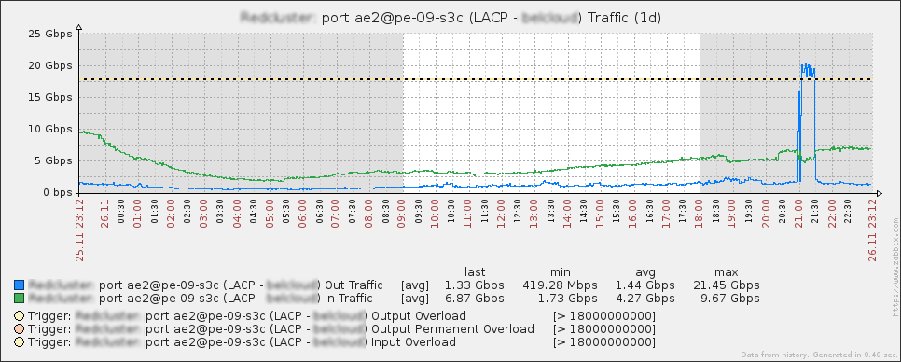
Real Attack in Monitoring
Peering Queue Dropped in pps - 0
Peering Queue Queued in pps
Peering Queue traffic in Gbps

Slide 16
Peering;
DDoS
Solution
Pros & Cons

Slide 17
+
DDoS solution pros
Always on, works for shot time frame attacks
Whole network protected, including core links
Dot1p mark on output traffic

Slide 18
-
DDoS solution cons
Minimal possibility for classifying useful traffic as DDoS
Zero-day DDoS Attacks
Output Queue on Reseller ports
(Applied on port not VLAN)
Remote Peering Ports with lower speed than port speed

Slide 19
-
DDoS solution future development Ideas
Whitelisting
Calculate IP Address reputation
Per-VLAN queueing on Carrier/Reseller ports
Port speed shaping (Member configured in my.bix.bg)

Slide 20
Peering;
Thank you!
Q&A
www.BIX.BG
harry@bix.bg

