Slide 1
Building monitoring infrastructure
RIPE NCC Days Tashkent, 22 Sep 2022
Gael Hernandez

Slide 2
Agenda
What we do
Node deployment strategy
BGP route collector infrastructure
Final considerations

Slide 3
OUR MISSION
Empower
To empower teams to own the digital experience of their users by providing unparalleled visibility and insight into their complex digital ecosystem.

Slide 4
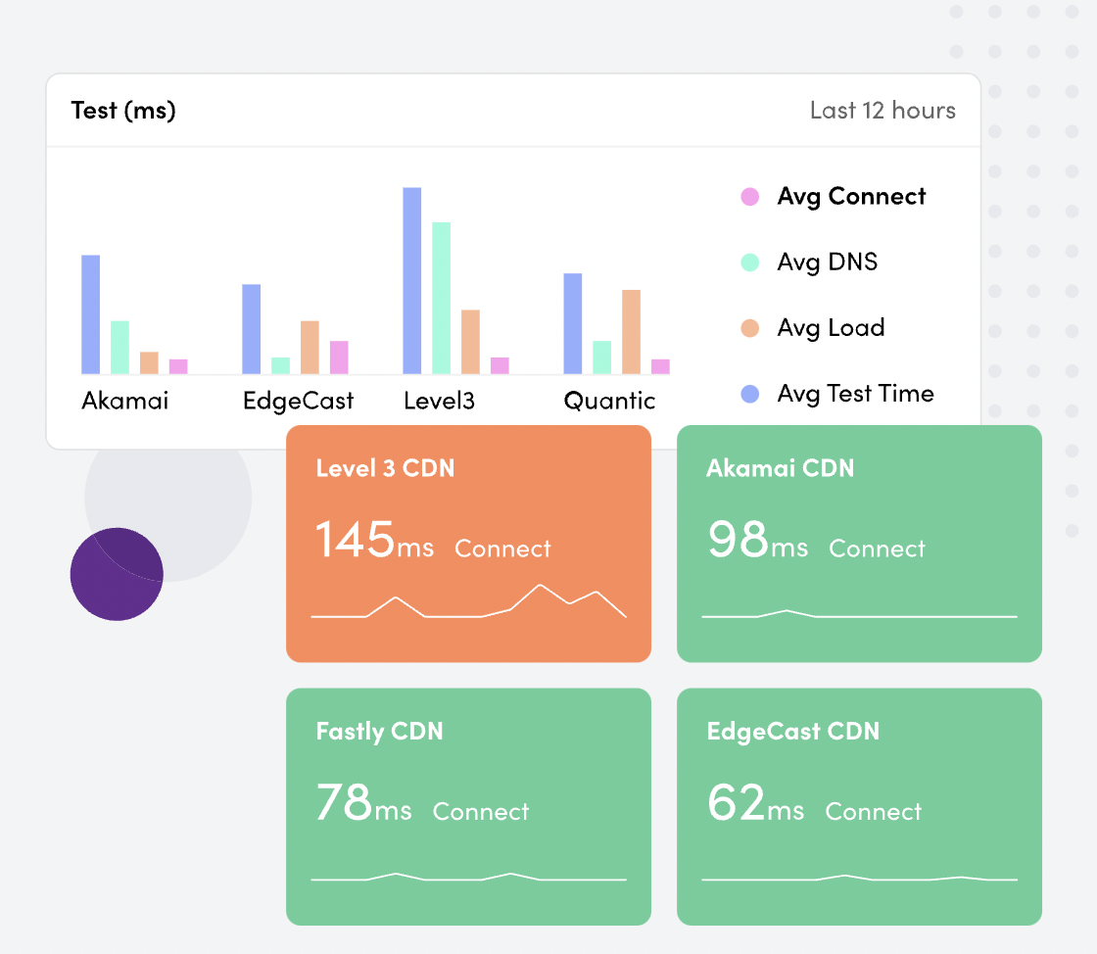
What we offer to our customers
Our customers schedule different type of tests on our nodes to monitor the performance of their suppliers: ISPs, CDNs, DNS, Cloud, SAS services, etc.​
They need our observability nodes to be connected to​
B2C ISPs: our e-commerce, social networks and online banking customers need to monitor how their users access their platforms.
B2B ISPs: our corporate customers need to check how they interact with their HDQ, suppliers like Sales Force, SAP, Office365.

Slide 5
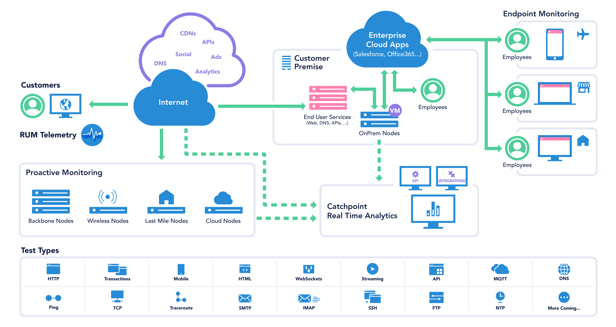
Catchpoint infrastructure overview

Slide 6
Node Deployment Strategy

Slide 7
LARGEST GLOBAL
ACTIVE MONITORING NETWORK IN THE WORLD
1066
327
Public Locations
Providers
88
270
Countries
Cities
1181
2,066 Vantage Locations Around the World
392
BGP Peers
BGP ASNs
CLOUD NODES
183 Locations
9 Providers
BACKBONE NODES
726 Locations
254 Providers
LAST MILE NODES
116 Locations
73 Providers
WIRELESS NODES
41 Locations
15 Providers
BGP PEERS
1181 Peers
392 ASNs Providers
ENTERPRISE NODES
On demand
ENDPOINT DEVICES
On demand
7

Slide 8
Node deployment strategy
We are expanding the locations
New cities
New countries
We are expanding the type of nodes
More IPv6 nodes
More wireless nodes 3G/4G/5G
We are building route collector infrastructure
We need more real time data in addition to public sources (Route Views and RIPE RIS)

Slide 9
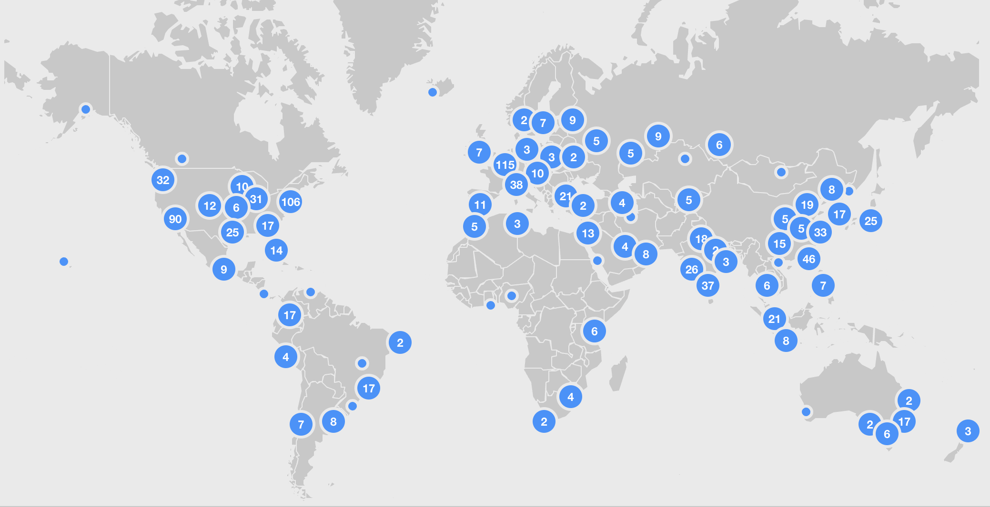
Catchpoint node infrastructure overview
14 Synthetic nodes in Central Asia
Afghanistan, 1 node
Armenia, 1 node
Azerbaijan, 2 nodes
Georgia, 1 node
Iran, 1 node
Kazakhstan, 2 nodes
Kyrgyzstan, 1 node
Pakistan, 2 nodes
Tajikistan, 1 node
Turkmenistan, -
Uzbekistan, 2 nodes

Slide 10
Synthetic nodes
No multihomed to provide a real view from a particular ISP.
Some locations have multiple nodes per city
We can use dedicated hardware or virtual private servers
Description​ | VPS | Physical servers
Hardware Specifications​ | 4 Core 16 GB RAMs​ 120 GB Storage​ | 8 Core/16 Threads, 2.1 /2.4 Ghz Intel​ 64 GB RAMs​ 512 GB Storage SSD​
OS​ | Centos 7.9​ (soon OL8) | Centos 7.9​ (soon OL8)
Notes​ | 1 VM per node (usually 2 VMS for IPV4 and one VM for IPV6)​ | 1 Server → 3VMs (But can’t have on the same physical Server IPV4 and IPV6)​

Slide 11
Synthetic nodes: network and connectivity
Requirements per ISP ​
10 to 50Mbps (we can start with 10)​
IPV4 and IPV6​
IPv4 assigned from ISP​
/30 per server, NAT w/KVM​
Or /29, /28, or /27 preferred dependent on # VMs​
ISP = default gateway​
IPv6 - /64 or /48 (or whatever they assign)​
We need PUBLIC IPs on the same AS as the selected ISP​
IPs need to be Properly Geo-Mapped (Country / City)​
Set-up
No NAT or firewalls due to the many types of tests we run, incl. ICMP/UDP and TCP traceroutes

Slide 12
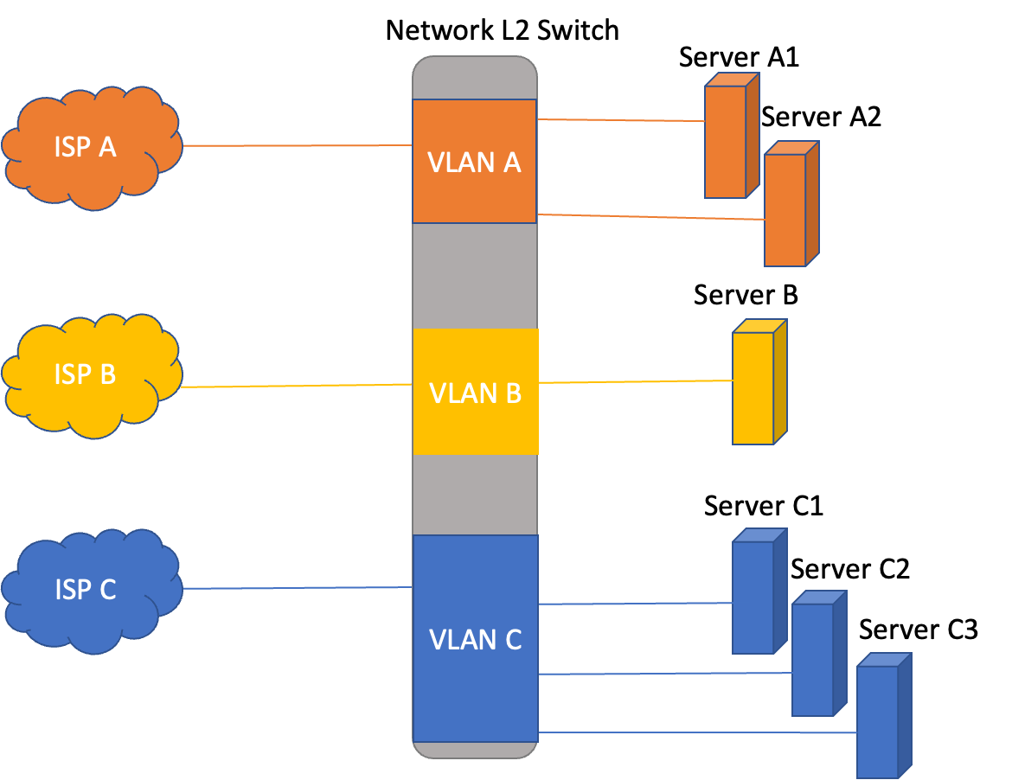
Backbone node deployment
Preferred Base Server Specs
8 cores/16 threads
CPU 2.1-2.4GHZ clock speed
64GB of Mem
Preferred ISP Setup for New Site
X Mbps commitment, burstable
Preferred 1Gb eth interface (copper/Fiber) or 100Mb eth
IPv4 assigned from ISP
/30 per server, NAT w/KVM
Or /29, /28, or /27 preferred dependent on # VMs
ISP = default gateway
IPv6 - /64 or /48 (or whatever they assign)
Network Switch
10/100/1000 Ethernet ports
Copper & Fiber ports available (ISP dependent)
Adding Capacity
Option 1: Virtualize server (KVM)
4 vcores/16 GB mem
4 VMs per server
Option 2: Upgrade Machine
16 Cores/32 threads
128GB of mem

Slide 13
Node expansion strategy
Node review
Distribution of Tier1 ISPs
Tier2 and Tier3 ISPs incorporating asks by customers
Identify “easy” wins in countries without nodes
Serbia, Latvia, Lithuania, Qatar
Not so easy: Bolivia, Paraguay, Nicaragua, Belize, Panama, Guatemala
Focus on Middle East, Africa and Latin America for rest of 2022 and 2023

Slide 14
BGP route collector infrastructure

Slide 15
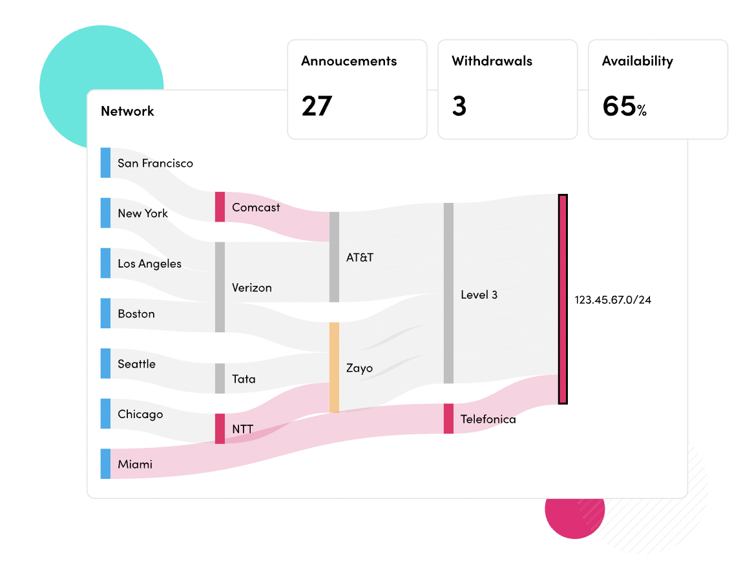
BGP monitoring product
Allows customers assess the routing health of their network, providing them with information which enables them to determine the stability of their networks and potential risks
Improve routing and reachability
We monitor prefixes of their choices and alert them in case of a path change.
Detect and alert in real time on hijacks, leaks, and misconfigurations
We rely on 3 sources: Route Views, RIPE RIS service and our own Catchpoint bgp collectors (only real time data set).

Slide 16
Status of BGP network infrastructure – July 2022
32
Catchpoint route collectors
25
Route Views route collectors
22
RIPE RIS
route collectors
Global RC
Las Vegas, US

Slide 17
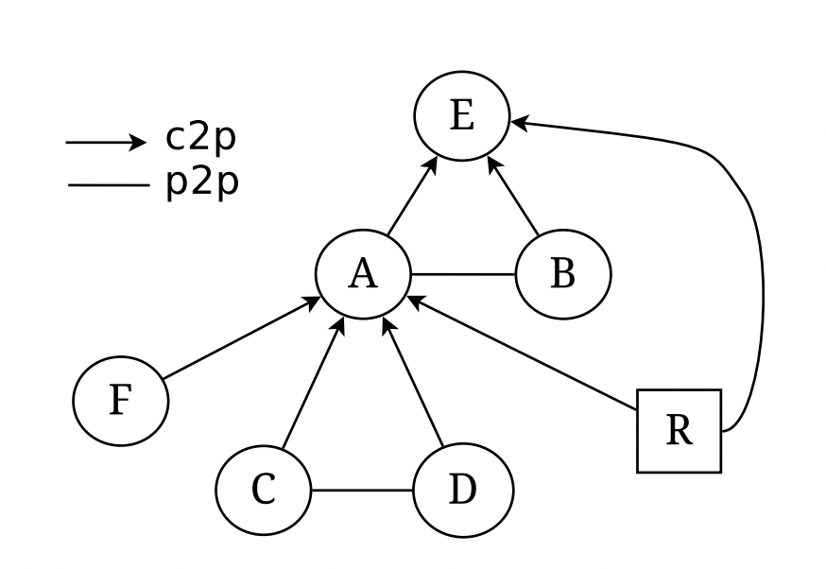
Your BGP feed is important to us!
Catchpoint is looking to improve its BGP monitoring product by adding interesting ASNs to our analysis.
Interesting means that your relative view of the Internet provides us with additional insights than other ASNs
Internal tools: Valley-free ranking and C2P ranking
We would like to consume your full routing table
> 900k v4 prefixes and >100k v6 prefixes
BGP session against our route collector. We do not advertise any prefixes.
Easy to setup, no maintenance required
Several options to provide us with the feed.

Slide 18
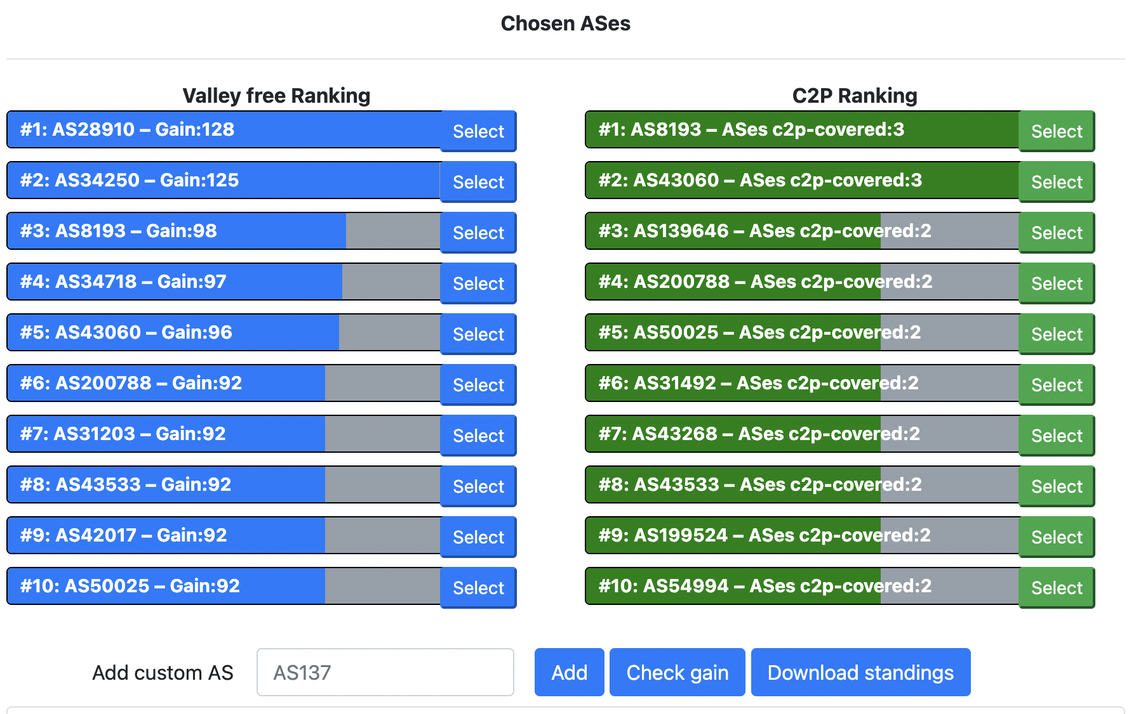
Internal tooling: Valley free and C2P ranking
Engineering has developed tools to help prioritize which ASNs we should get feeds from
Valley free ranking
Top ASNs that allow us to discover new ASNs thanks to applying the valley-free property
AS28910, AS34250, AS8193 Uzbektelekom
AS34718 TEXNOPROSISTEM
AS43060 IPLUS
C2P ranking
Top ASNs that allow us to discover new C2P relationships
AS8193 Uzbektelekom
AS43060 IPLUS

Slide 19
Option 1: Multi-hop BGP session
Internet
Catchpoint Platform
AS
Catchpoint
BGP Collector
Multi-hop bgp session
ASN 397601
IPv4: 64.79.149.244
IPv6: 2001:1898:2400:3000:8000::105
If your network supports multi-hop bgp, you can simply setup a session with our global BGP collector located in Las Vegas, US.
Easy to setup, no need for physical interconnection

Slide 20
Option 1: Multi-hop BGP session
Global RC
Las Vegas, US

Slide 21
Option 1: Multi-hop BGP session
Sample setup Cisco:
switch# configure terminal
switch(config)# router bgp <YOUR_ASN>
switch(config-router)# neighbor 64.79.149.244 remote-as AS 397601
switch(config-router-neighbor)# ebgp-multihop 5
switch(config-router-neighbor)# description Catchpoint RouteCollectorv4
switch(config-router-neighbor)# address-family ipv4 unicast

Slide 22
Option 2: Bilateral BGP session over an IX
Internet Exchange L2 fabric
AS1
Catchpoint Platform
BGP Collector
AS2
AS3
We can setup a bgp session over the IX switching fabric
We are present at PITChile Santiago in Chile
DE-CIX, SGIX, INX Johannesburg to come in 2023!

Slide 23
Option 2: Bilateral BGP session over an IX

Slide 24
Option 3: Local hosting and direct BGP session
VM hosted by AS
Catchpoint Platform
BGP Collector
AS
BGP session
You can host our BGP collector on a VM.
We can setup a BGP session against your router.

Slide 25
Final considerations
Monitoring and observability is becoming an essential service
Reduces the Mean-time-to-recovery (MTTR)
Enables different teams to observe and act before the incident has an impact on customers
BGP monitoring is becoming more important in a complex Internet ecosystem
Deploying infrastructure in some regions is challenging
Difficult and/or expensive to deploy nodes in certain regions i.e. Africa, South America, Central Asia
Catchpoint is actively looking for node partners and bgp peers in Central Asia

