Slide 1

From Local LANs to a Distributed IX
Lessons from Romania’s Internet Evolution
Eric Andrei Băleanu | RIPE NCC Days Baltics | 4 June 2026

Slide 2
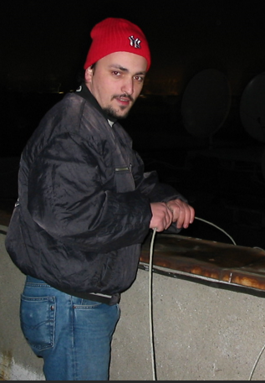
The beginning
User-built networks
In the late 1990s and early 2000s, many networks in Romania were built by users themselves, inside apartment buildings and neighbourhoods.
People connected their computers using Ethernet cables, often running them between apartments or across buildings. These networks were used mainly for gaming, chatting and sharing files.
At that time, these were not Internet service providers. They were simply local communities building their own networks to communicate and exchange content.
Eric Andrei Băleanu | RIPE NCC Days Baltics | 4 June 2026

Slide 3
Internet comes later
From local networks to Internet access
Internet access was limited and expensive. Most users relied on dial-up connections, charged per minute. Permanent connections existed, but they were typically available only to companies and were very costly.
In this context, users started sharing a single Internet connection across their local networks. A leased line or cable connection would be distributed to tens or even hundreds of users.
As a result, these local networks gradually became platforms for Internet access, not just local communication.
Eric Andrei Băleanu | RIPE NCC Days Baltics | 4 June 2026

Slide 4
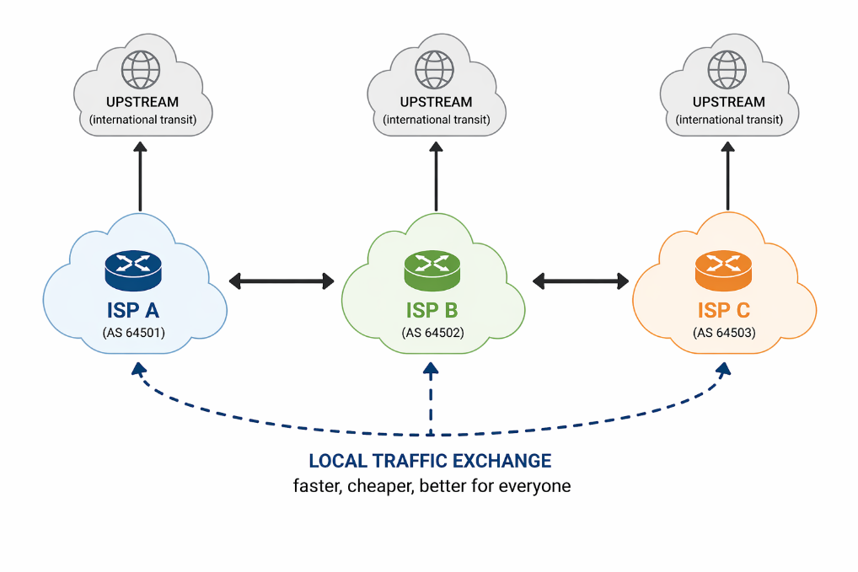
First interconnections
Local traffic exchange
As these networks grew, many of them became small Internet service providers.
At some point, operators realised that a large part of their traffic was local and could be exchanged directly. Instead of sending traffic through upstream providers, they began connecting their networks to each other.
Eric Andrei Băleanu | RIPE NCC Days Baltics | 4 June 2026

Slide 5
First interconnections
These early interconnections were informal and built on practical needs, not on formal design.
We were effectively building an Internet Exchange, without knowing the term at the time.
Eric Andrei Băleanu | RIPE NCC Days Baltics | 4 June 2026

Slide 6
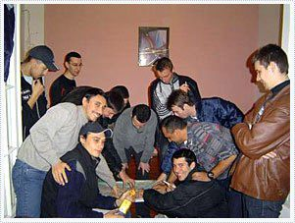
Birth of InterLAN
Initial interconnection platform
In the early 2000s, around 20 local operators in Bucharest decided to interconnect their networks in a more organised way.
This initiative became InterLAN.
The name comes from “Interconnecting Local Area Networks”, which reflects exactly how it started.
At that time, we had little understanding of how Internet Exchanges were supposed to operate. The system evolved step by step, based on experience.
Eric Andrei Băleanu | RIPE NCC Days Baltics | 4 June 2026

Slide 7
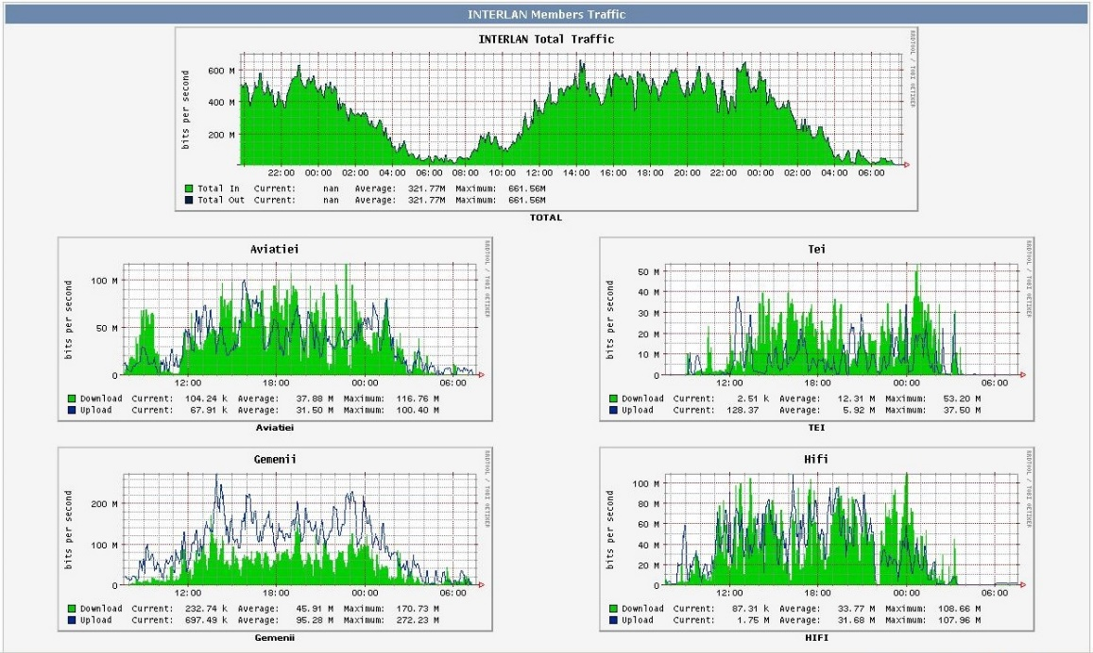
Growth of ISPs
A highly fragmented market
Between 2002 and 2006, the number of Internet service providers in Romania grew rapidly, reaching more than one thousand.
Many of these operators were small, local or regional networks, often originating from the same types of community-built infrastructures.
This created a very dynamic but also highly fragmented market, with many independent players.
InterLAN-IX traffic in 2005
Eric Andrei Băleanu | RIPE NCC Days Baltics | 4 June 2026

Slide 8
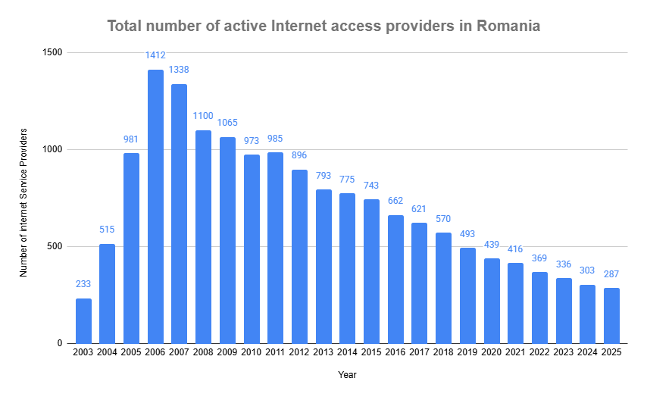
Market transformation
From fragmentation to concentration
Over time, the market changed
The number of Internet service providers dropped sharply, by almost 80% compared to the peak years.
Today, the market is highly concentrated. The top three operators control more than 98% of fixed Internet connections.
source: ANCOM (Romanian Telecom Regulation Authority)
Eric Andrei Băleanu | RIPE NCC Days Baltics | 4 June 2026

Slide 9
Market transformation
This shift changed the role and position of smaller and regional operators.
This change also forced us to better understand how interconnection should work.
source: ANCOM (Romanian Telecom Regulation Authority)
Eric Andrei Băleanu | RIPE NCC Days Baltics | 4 June 2026

Slide 10
Learning phase
Learning how IXs operate
In the early stages, we built the exchange based on practical needs, without a clear understanding of how Internet Exchanges should operate.
In 2008, we joined Euro-IX.
This is where we learned how an Internet Exchange is actually built and run.
Later, through RIPE Meetings and other events, we became more connected to the broader Internet community.
Eric Andrei Băleanu | RIPE NCC Days Baltics | 4 June 2026

Slide 11
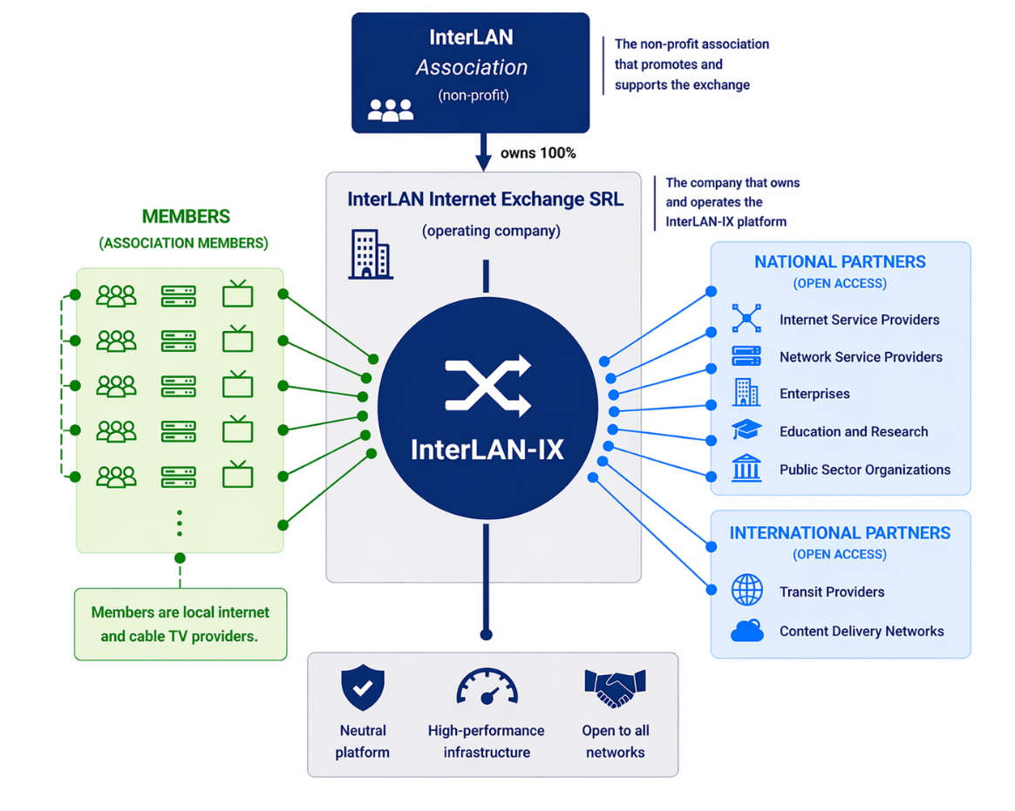
InterLAN-IX model
Membership-based model
InterLAN-IX is owned by an association of network operators.
Local and regional operators can become members and access the exchange through membership.
Larger operators cannot become members, but can connect to InterLAN-IX based on commercial agreements.
Eric Andrei Băleanu | RIPE NCC Days Baltics | 4 June 2026

Slide 12
Expansion beyond Bucharest
Operators outside Bucharest join
As the community grew, more operators from outside Bucharest started to join InterLAN.
This made it clear that not all networks could be physically present in the capital.
At the same time, most interconnection was still taking place in Bucharest.
For these operators, participating in the exchange required a different approach.
Eric Andrei Băleanu | RIPE NCC Days Baltics | 4 June 2026

Slide 13
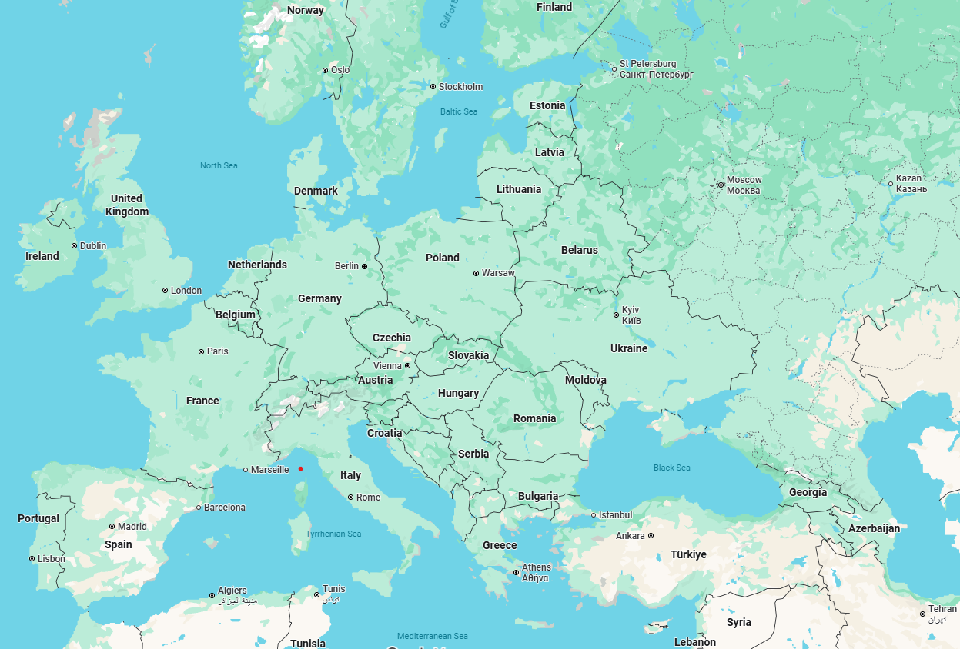
Distance matters
Eric Andrei Băleanu | RIPE NCC Days Baltics | 4 June 2026

Slide 14
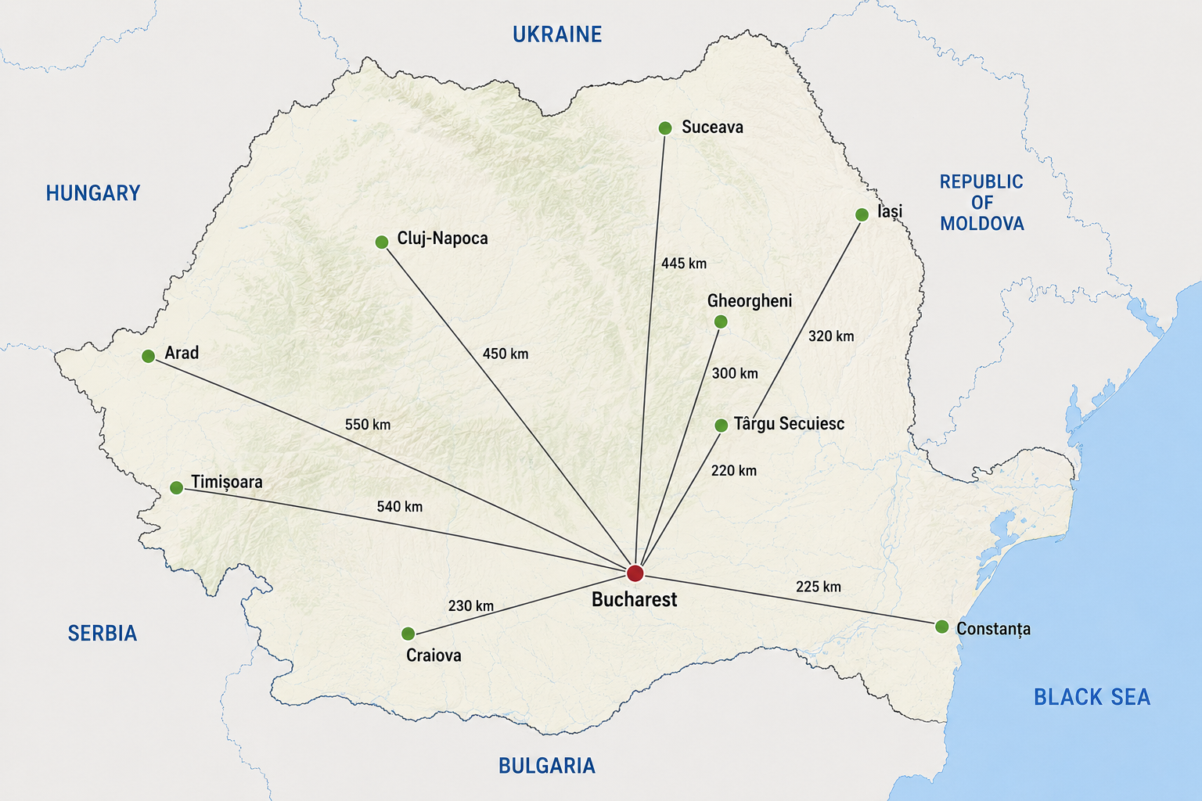
Distance matters
Geographic constraints
Romania is a relatively large country, with a surface of around 238,000 square kilometres.
Its major cities are spread across long distances, often hundreds of kilometres apart.
For operators outside Bucharest, participating in the main interconnection ecosystem required building long-distance connections.
Eric Andrei Băleanu | RIPE NCC Days Baltics | 4 June 2026

Slide 15
A practical limitation
Limited connectivity options
Operators from outside Bucharest had limited options.
They could either build long-distance connections to the capital or rely on upstream providers for traffic exchange.
Both options increased costs and reduced the benefits of direct interconnection.
Eric Andrei Băleanu | RIPE NCC Days Baltics | 4 June 2026

Slide 16
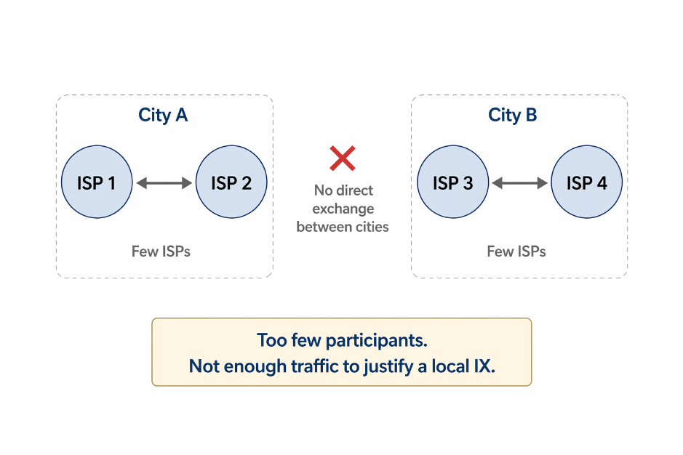
Why not local IXs
Limited local scale
One possible approach would have been to build local Internet Exchanges in several cities.
In practice, this was not a strong option.
In many places, there were only a few operators, and the amount of local traffic was too small to justify a separate exchange.
Eric Andrei Băleanu | RIPE NCC Days Baltics | 4 June 2026

Slide 17
Chosen approach
Extending InterLAN-IX
Instead of building multiple small exchanges, we chose to extend InterLAN-IX.
We created additional points of presence in other cities, allowing operators to connect locally while remaining part of the same exchange.
The goal was to provide access to the existing ecosystem, not to fragment it.
Eric Andrei Băleanu | RIPE NCC Days Baltics | 4 June 2026

Slide 18
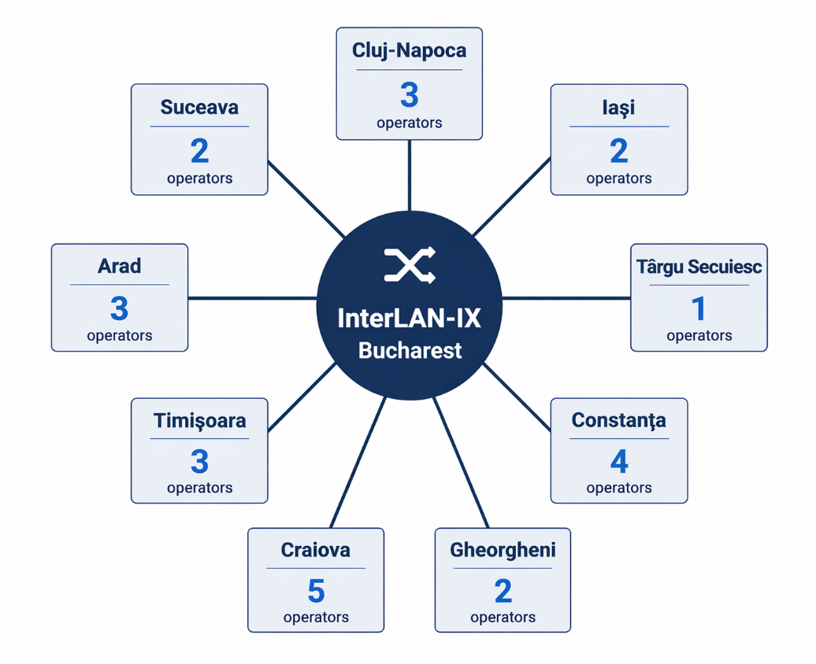
One exchange, multiple locations
Distributed layer 2 platform.
It includes multiple points of presence connected as part of the same exchange.
Participants in different cities are part of the same interconnection environment, regardless of their physical location.
Eric Andrei Băleanu | RIPE NCC Days Baltics | 4 June 2026

Slide 19
Results
Growth and regional reach
Over time, this approach allowed InterLAN-IX to expand beyond its initial presence in Bucharest.
Today, InterLAN-IX connects more than 140 network and content operators.
Participants are not only from Romania, but also from our neighbouring countries: Moldova, Bulgaria, Hungary, Serbia and Ukraine.
Eric Andrei Băleanu | RIPE NCC Days Baltics | 4 June 2026

Slide 20
Impact
Supporting smaller operators
The platform helps smaller and regional operators remain part of the interconnection ecosystem.
It lowers the barrier to participation and allows more networks to exchange traffic directly.
At the same time, the presence of many local operators makes the exchange more attractive for transit providers and content networks.
Eric Andrei Băleanu | RIPE NCC Days Baltics | 4 June 2026

Slide 21
Combined effect
Scale with broad participation
The model allows a large number of smaller networks to remain active.
At the same time, it creates an environment that is relevant for larger operators and content providers.
This combination increases the overall value of the exchange.
Eric Andrei Băleanu | RIPE NCC Days Baltics | 4 June 2026

Slide 22
Lessons learned
Adapting to local conditions
The InterLAN-IX model was shaped by the specific conditions of the Romanian market.
It reflects a country with large distances between cities and strong concentration of interconnection in the capital.
In this context, extending one exchange proved more effective than building multiple smaller ones.
Eric Andrei Băleanu | RIPE NCC Days Baltics | 4 June 2026

Slide 23
Summary
Evolution of InterLAN-IX
InterLAN started as a group of local networks solving practical problems.
InterLAN-IX emerged later as the structured form of that community.
Its distributed architecture was not the result of a single design decision, but of continuous adaptation to the way the network evolved.
Eric Andrei Băleanu | RIPE NCC Days Baltics | 4 June 2026

Slide 24
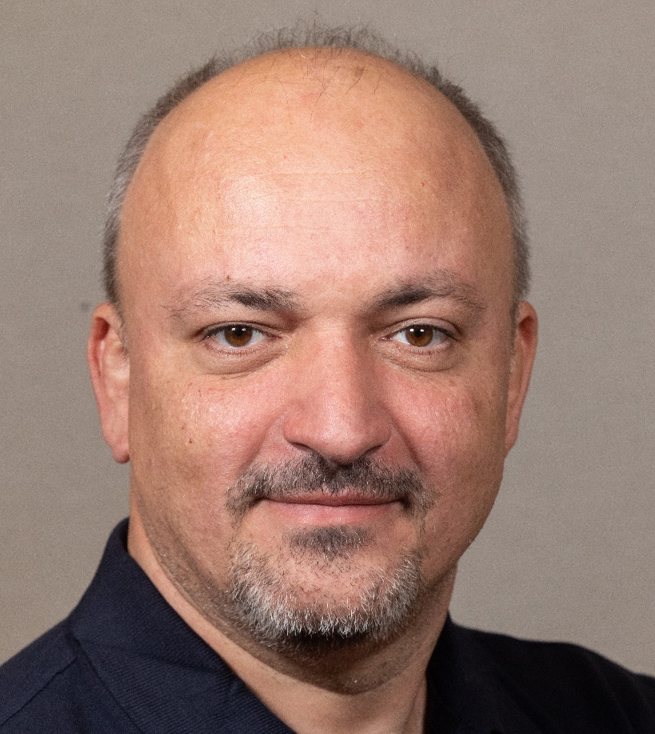
Eric Andrei Băleanu | RIPE NCC Days Baltics | 4 June 2026

Slide 25
Eric Andrei Băleanu | RIPE NCC Days Baltics | 4 June 2026

