Slide 1
BEREC Cybersecurity and Resilience WG
RIPE NCC Days

Slide 2

BEREC CSR WG mission
Promotion of secure, resilient electronic communications networks to full gigabit connectivity
NRAs’ day-to-day oversight and operator engagement to strengthen national network resilience
Collaboration with member-state authorities, NIS CG, ENISA, the EC

Slide 3
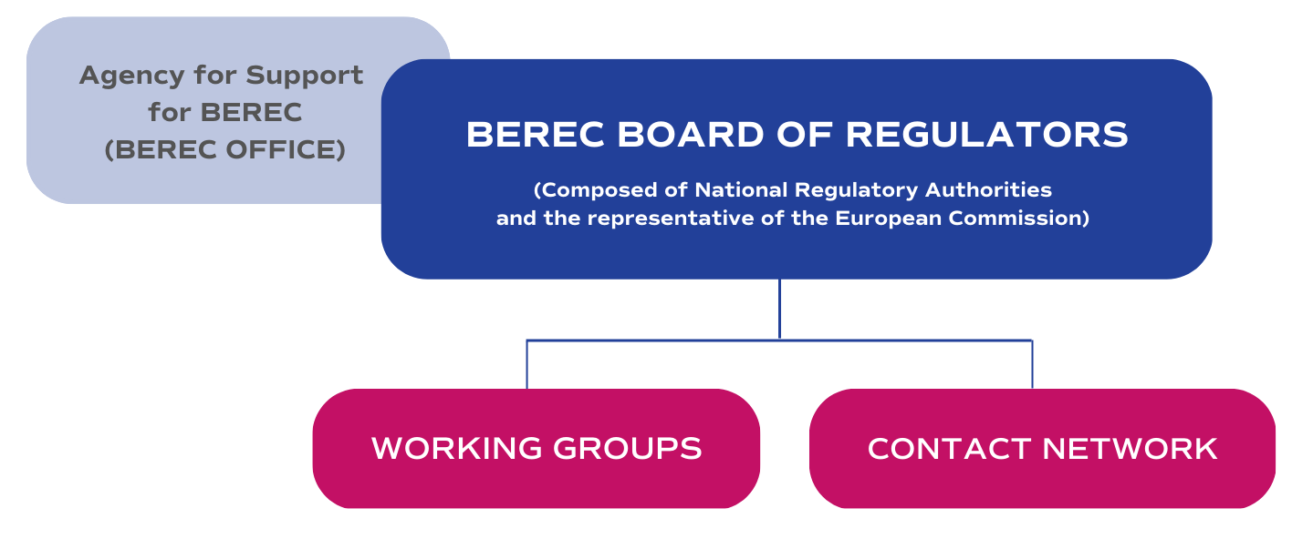
The Body of European Regulators for Electronic Communications

Slide 4
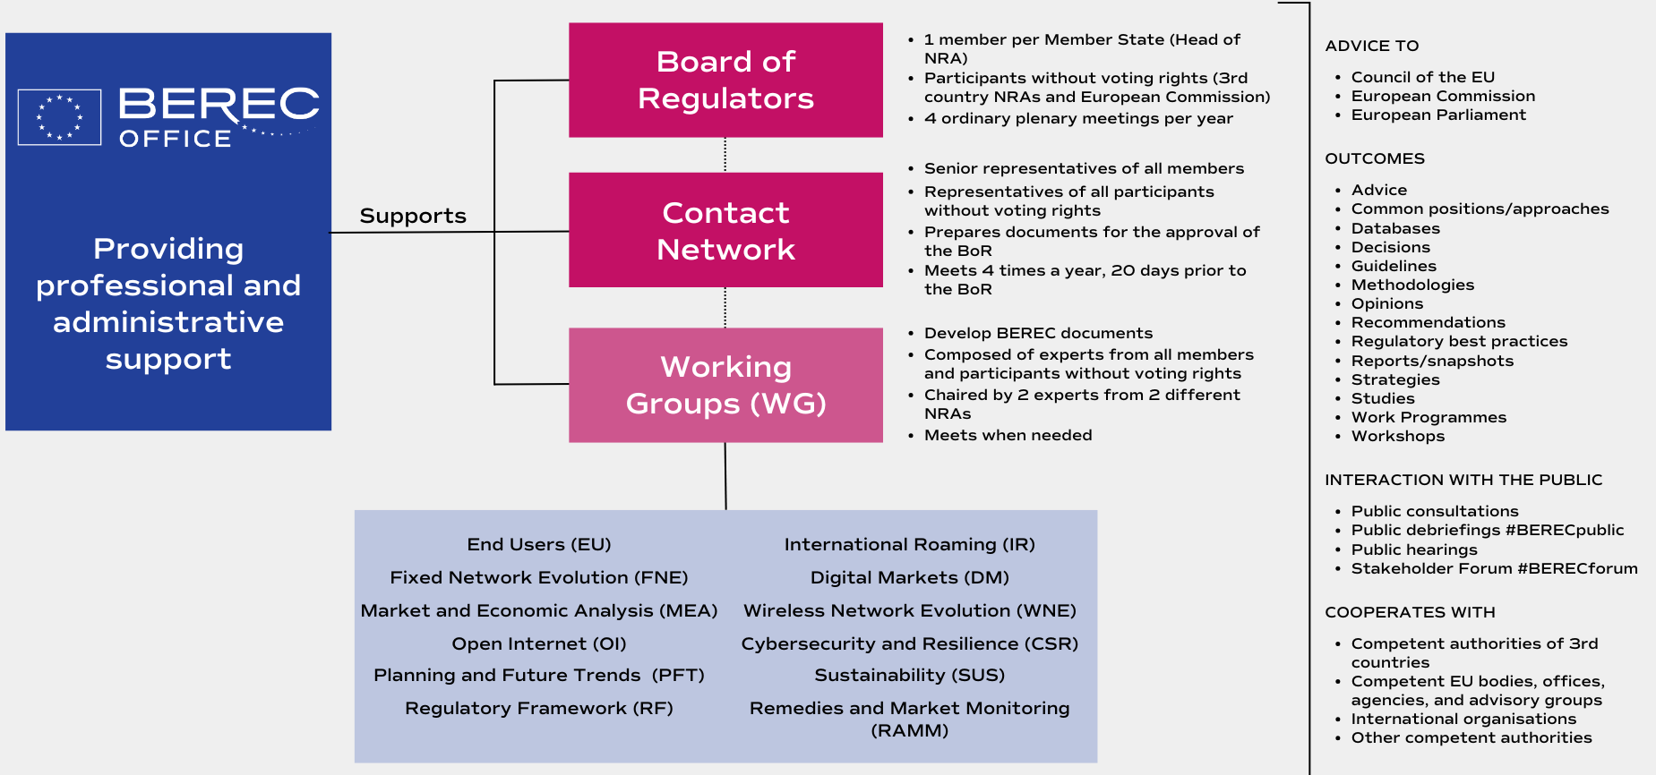
Organisation and tasks of BEREC

Slide 5
BEREC CSR WG Members 2026
Members (150 + 2 Co-chairs)
Active Drafters (14+ Co-chairs)
+ EU Commission
+ BEREC Office Supporters
Country | NRA
AUSTRIA | RTR
BELGIUM | BIPT
BOSNIA HERZEGOVINA | RAK
BULGARIA | CRC
CROATIA | HAKOM
CYPRUS | OCECPR
CZECH REPUBLIC | CTU
DENMARK | DBA
ESTONIA | TTJA
FINLAND | TRAFICOM
FRANCE | ARCEP
GERMANY | BNetzA
GREECE | EETT
HUNGARY | NMHH
ICELAND | FJARSKIPTASTOFA
IRELAND | COMREG
ITALY | AGCOM
LATVIA | SPRK
LIECHTENSTEIN | AK
LITHUANIA | RRT
LUXEMBOURG | ILR
MALTA | MCA
MONTENEGRO | EKIP
NETHERLANDS | ACM
NORWAY | Nkom
POLAND | UKE
PORTUGAL | ANACOM
ROMANIA | ANCOM
SERBIA | RATEL
SLOVAK REPUBLIC | RÚ
SLOVENIA | AKOS
SPAIN | CNMC
SWEDEN | PTS
SWITCERLAND | BAKOM
TURKEY | BTK
Country | NRA
AUSTRIA | RTR
BELGIUM | BIPT
CROATIA | HAKOM
GERMANY | BNetzA
IRELAND | COMREG
ITALY | AGCOM
MALTA | MCA
ROMANIA | ANCOM
SERBIA | RATEL
SLOVENIA | AKOS

Slide 6



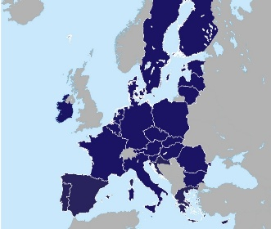


Working together in Europe
EU Member States
CSR WG
2 Co-Chairs
25 Active Drafters
185 Full Group Members
BEREC Office Support
Support and input to
on-going initiatives

Slide 7

Main achievements/activities in 2025
Public Reports
Summary of the BEREC WS on Network Resilience
Workshops
BEREC sessions at ENISA Telecom and Digital Infrastructure Security Forum 2025
Surveys and Data
Internal BEREC – NIS CG Survey on the Supplier Landscape and Supply Chain of European Fixed and Satellite Communications Networks 2025 (internal report in Q1/2026)
Summary of the BEREC sessions at the ENISA Telecom and Digital Infrastructure Security Forum

Slide 8









BEREC Stakeholder Workshop on Network Resilience Summary Report
Participants (160): NRAs, operators and stakeholder associations
Speakers from:

Slide 9
BEREC Stakeholder Workshop on Network Resilience Summary Report
Purpose: raise awareness of the current resilience and security related challenges among NRAs, operators and other stakeholders
Main topics (identified in stakeholder survey conducted in April 2024):
National strategies to increase resilience of the sector
Technical and operational solutions used by operators
Disaster response and collaboration between operators and authorities
Emergency communication

Slide 10
CSR WG in 2026
Ad hoc work on EU’s cybersecurity capabilities
Data collection, anonymisation and analysis of data from market players
Enhancing Network Resilience
Mapping of NRAs roles and competences in the area of network resilience
Combating fraud
External Workshops on Combating Fraud with relevant stakeholders; summary report
Workshops/meetings with other EU or international institutions and stakeholders
Report on the Supplier Landscape for fixed and satellite networks (BEREC and NIS CG only)
Providing input for BEREC position related to the DNA proposal
Providing input for BEREC position on the CSA2 proposal
Joint document with ECASEC: “Best practices on combating fraud”

Slide 11
CSR WG in 2026
Enhancing Network Resilience
  Mapping of NRAs roles and competences in the area of network resilience
  Providing input for BEREC position related to the DNA proposal
    Union Preparedness Plan for Digital Infrastructures
  Providing input for BEREC position on the CSA2 proposal
    Questions about national security, interaction with the DNA

Slide 12
Thank you!
Zdravko Jukić, BEREC CSR WG Co-Chair
zdravko.jukic@hakom.hr

