Slide 1

Lighting Up the Dark Addressing Visibility Challenges in Fixed Networks
MENOG24 -OMAN
Rishad Karkala
NETSCOUT
Notes:
It has been a quite a long day with a lot of interesting topics, facts & figures presented by my fellow presenters. Likewise, today, I am going to talk about the visibility challenges in fixed networks and how to address the same.

Slide 2
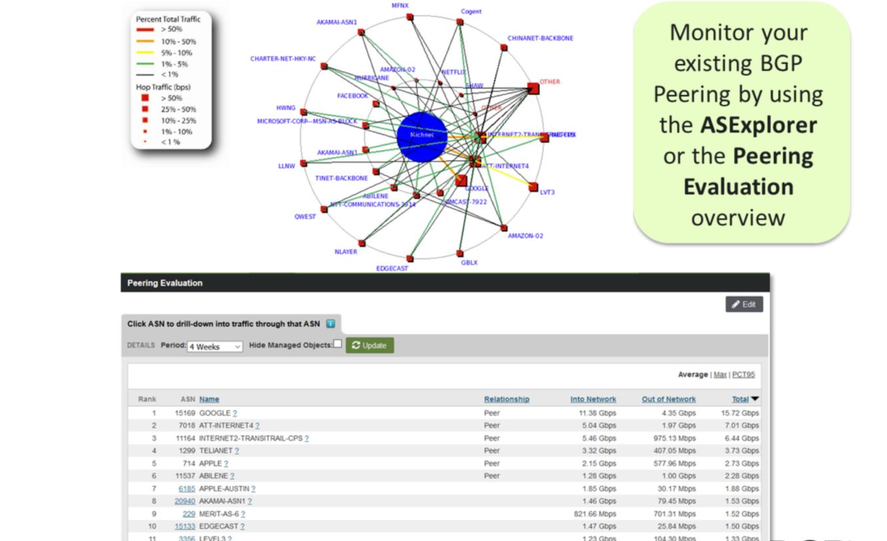
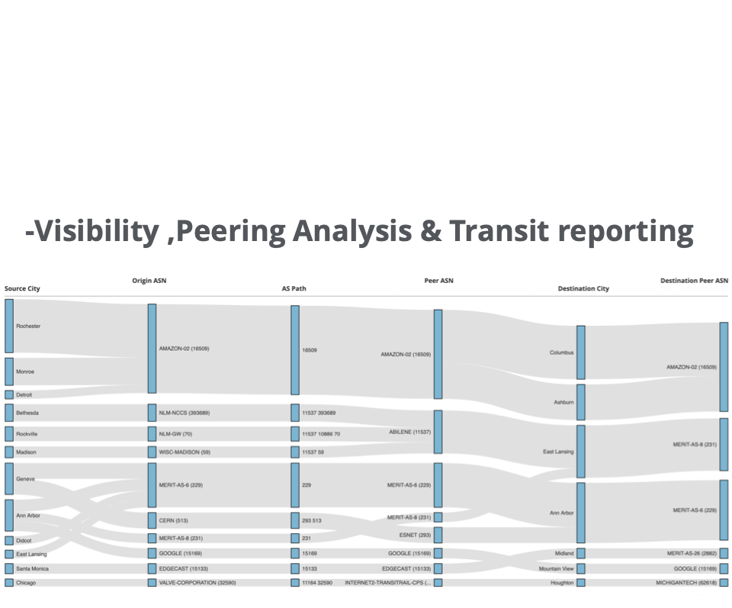
Visibility Techniques
SNMP
Flows
Packets
Notes:
MY FIRST SLIDE SHOWS ABOUT VARIOUS VISIBILITY TECHNIQUES OR METHODOLOGIES.
IF WE TALK ABOUT SNMP, SNMP PROVIDES VISIBILITY ABOUT OVERALL TRAFFIC VOLUME/THORUHGPUT without any info.
IF WE NEED TO KNOW MORE ABOUT THE SOURCE/DESTINATION OF TRAFFIC, OVERALL TRAFFIC CONTENTS, ROUTING INFORMATION SUCH AS BGP, ASN’s, ASN PATH, CDN INFO, THEN FLOWS CAN PROVIDE THIS INFORMATION. This is up to L4. WE CAN EVEN SEE SOME INFO RELATED TO TRAFFIC CATEGORIES, ETC.
IF WE NEED TO KNOW MORE ABOUT THE TRAFFIC CLASSIFICATION, SUB TRAFFIC APPS, ISSUES RELATED TO ANY SERVICES WITH REGARDS TO FAILURES, SESSIONS, ETC. THEN PACKETS WILL PROVDIE THIS VISIBILITY…..TODAYS SESSION WILL PROVIDE MORE INSIGHTS ABOUT PACKET BASED VISIBILITY METHODOLOGY….

Slide 3
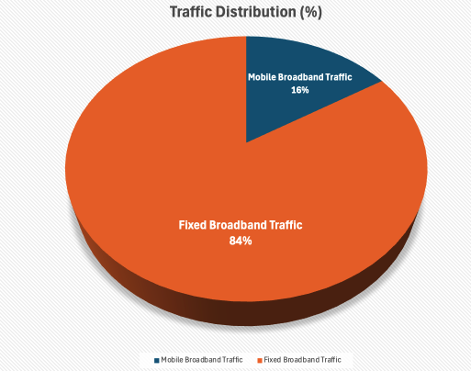
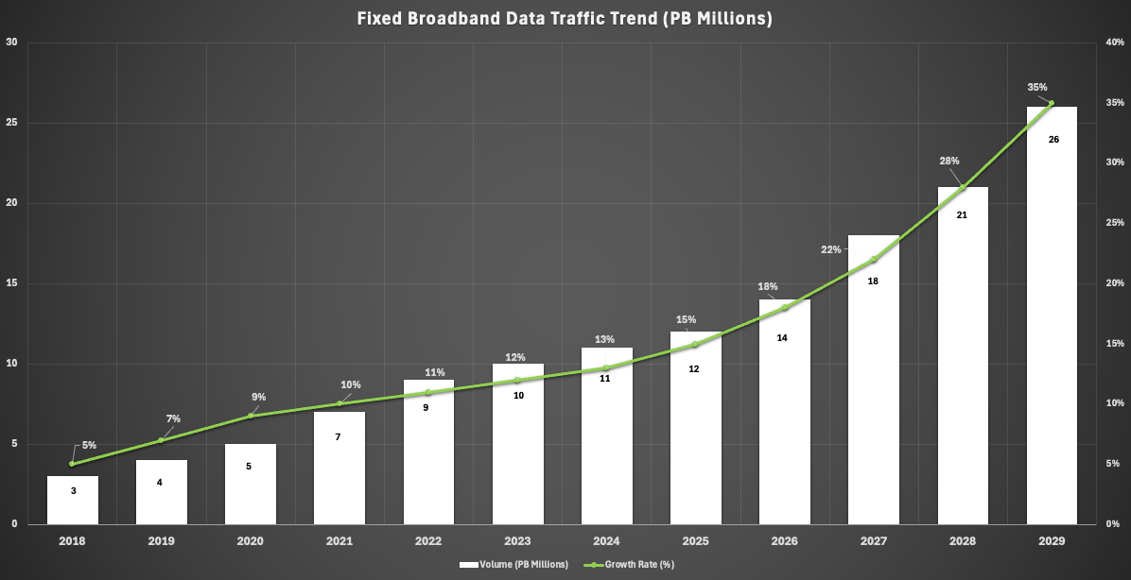
Current Trends Shaping the FTTX Networks
Source : ITU
Source : Ookla
Source : Statista
Fixed Broadband Traffic is 5 times of Mobile Broadband Traffic
Global Median Download Throughput Trend (Mbps) approaching 100Mbps
Fixed Broadband Data Traffic Trend (PB Millions) is currently at 11 Million PB and the forecasted volume is around 26 Million PB by 2029 (an approx. increase by 2.5 times !!!)
Notes:
FBB is 5 times of MBB
Global median throughput is approaching 100 Mbps
FBB traffic volume currently stands at 11M PB and is only growing to reach an estimated 26M PB in the next 5 years.

Slide 4
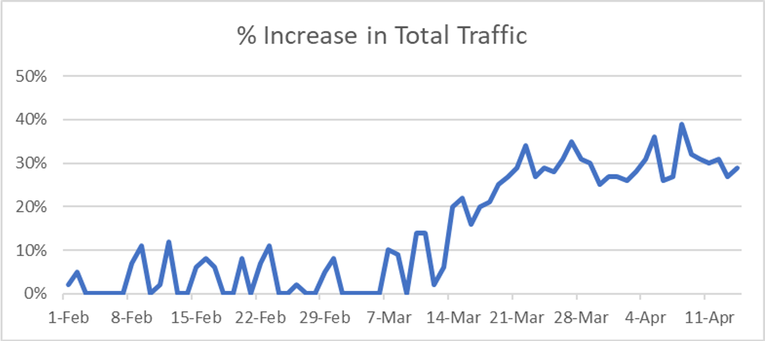
Why monitor FTTX?
During and after COVID era, WFH, online learning, corporate VPN based traffic became the NEW NORM.
Unprecedented traffic surge (global average traffic increased from 10% to 35% ~ 40%)
Most of the traffic shifted to FTTX network (especially FTTH).
Complex network deployment & expansions
Lot of quality related issues encountered during this period. For instance:
WFH & online learning related applications especially UC&C like Microsoft Teams, Cisco Webex, corporate VPN, etc.
High bandwidth utilization because of traffic surge
Slow / Limited expansion of FTTX network as compared to traffic growth (Node utilization, etc.)
Issues with well-known applications like latency, jitter, packet loss, audio gaps, mute ratio, congestion, etc.
Notes:
WFH, online learning, corporate VPN based traffic is the new norm.
Unprecedented traffic surge as most of the traffic has shifted to FTTX especially FTTH.
Complex network deployment and expansions to cater to the needs of the growing traffic.
Loads of quality issues encountered :
Quality of WFH, UC&C apps, etc.
High BW utilization
Slow or limited expansions. I WOULD LIKE TO TOUCHBASE UPON THESE ISSUES IN DETAIL

Slide 5


The Complexity Challenge...
SDN Control Ansible
Policy Kubernetes
Automation
Kubernetes
Puppet Chef
ONAP
ETSI MANO
Orchestration & Management
Virtualized
Services
Service Chains
Microservices
VMs/Containers
NFV:
AMF, SMF, UPF, PCF, ...
Overlay Networks
Virtual
HW & SW
Increased
E/W Traffic
Leaf/Spine
Edge
uCPE
OpenStack
VMware K8s
Virtual Service Infrastructure
Physical
Elements
2G/3G/4G/5G
Core/Aggregation/Access
DC
FBB
MPLS
Ethernet WIFI
Underlay Networks
The Software Defined Data Center - NFV
How do you Assure End-to-End, Multi-layer, Multi-domain Services?
Notes:
COMPLEX NETWORK DEPLOYMENTS COUPLED WITH LIMITED EXPANSIONS AS COMPARED TO TRAFFIC GROWTH

Slide 6



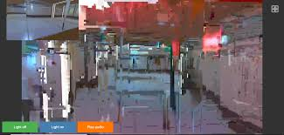




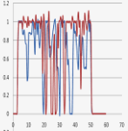

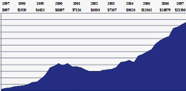

“Blind Spots” Impact Services
Problems can exist in multiple domains with multiple owners
Increased latency or jitter or packet loss
Incomplete procedures suggesting traffic feeds quality issues
Poor video quality
Work From Home
Bandwidth utilization based on links, VLAN’s
Voice quality issues such as gaps, muting ratio,
Silent calls,
One-way calls
TopN applications usage
Corporates
Traffic pattern
Subscriber based application usage,
throughput, cell, region,
throughput / volume
Communities

Slide 7
“Blind Spots” Impact Services (Latency as an example)
Source : Ookla
Source : Operator A
Traffic
Latency
Jitter / PL
Notes:
AS TRAFFIC INCREASES, LATENCY ALSO INCREASES

Slide 8

The Blame Game
It’s the network
Or maybe the cloud
No way!!! It’s the application
MTTR
Information
Knowledge
Fix
Validate
Notes:
LONGER MTTR DUE TO TIME TAKEN TO FIND THE ROOT CAUSE OR DEMARCATION OF THE PROBLEM

Slide 9

KEY For Any Network Operators Advanced Visibility & Analytics is a MUST
The Turning Point
Automation
SDN Control Ansible
Policy
Kubernetes
Puppet Chef
ONAP
ETSI MANO
Advanced Visibility & Analytics
Orchestration & Management
Virtualized
Services
Service Chains
Microservices
VMs/Containers
End-to-End
Service/App Monitoring
NFV: AMF, SMF, UPF, PCF, ...
Overlay Networks
N/S/E/W Visibility
Virtual
HW & SW
Increased
E/W Traffic
Leaf/Spine
Edge
uCPE
META DATA
OpenStack
VMware K8s
Multi-Cloud Visibility
Virtual Service Infrastructure
Physical
Elements
Automation/Orchestration
2G/3G/4G/5G
Core/Aggregation/Access
DC
FBB
MPLS
Ethernet WIFI
Multi-Layer, Multi-Domain Monitoring
Underlay Networks
Long MTTR
Shortened MTTR
Information
Knowledge
Fix
Validate
Information
Knowledge
Fix
Validate
Notes:
KEY IS TO HAVE VISIBILITY & ANALYTICS METHODOLOGY WHICH CAN SHORTEN THE MTTR BY REDUCING THE MEAN TIME TO KNOWLEDGE COMPONENT
MTTF – Mean time to Fix
MTTV – Mean time to Verify

Slide 10
Network Monitoring Methodology MUST be Network-Wide, Vendor Agnostic, Unrestricted Visibility
Any network
5G
Open RAN
3G/4G
WiFi
Cable
Fixed
...
Any Vendor
Ericsson
Mavinir
Nokia
Cisco
Huawei
AltioStar
F5
...
ANY NETWORK
ANY VENDOR
Any CLOUD
Kubernetes
Edge/MEC
OpenStack
VMware
Public
...
Any Service
Enterprise 5G
EPS Fallback / VoNR
VoLTE/VoIP
OTT
Video
IoT
...
ANY CLOUD
ANY SERVICE
This gives the Admin the Confidence To Innovate
Notes:
THE MONITORING METHODOLOGY MUST ENSURE THAT IT CAN MONITOR ANY NETWORK, BE IT ANY TECHNOLOGY ON ANY CLOULD WHETHER PRIVATE, PUBLIC, ON-PREM OR EVEN HYBRID FOR THAT MATTER.
THE METHODOLOGY MUST ENSURE THAT IT IS VENDOR AGNOSTIC TO ENSURE ALL VENDORS ARE TREATED EQUALLY AND OFCOURSE MONITORING ANY SERVICE.

Slide 11


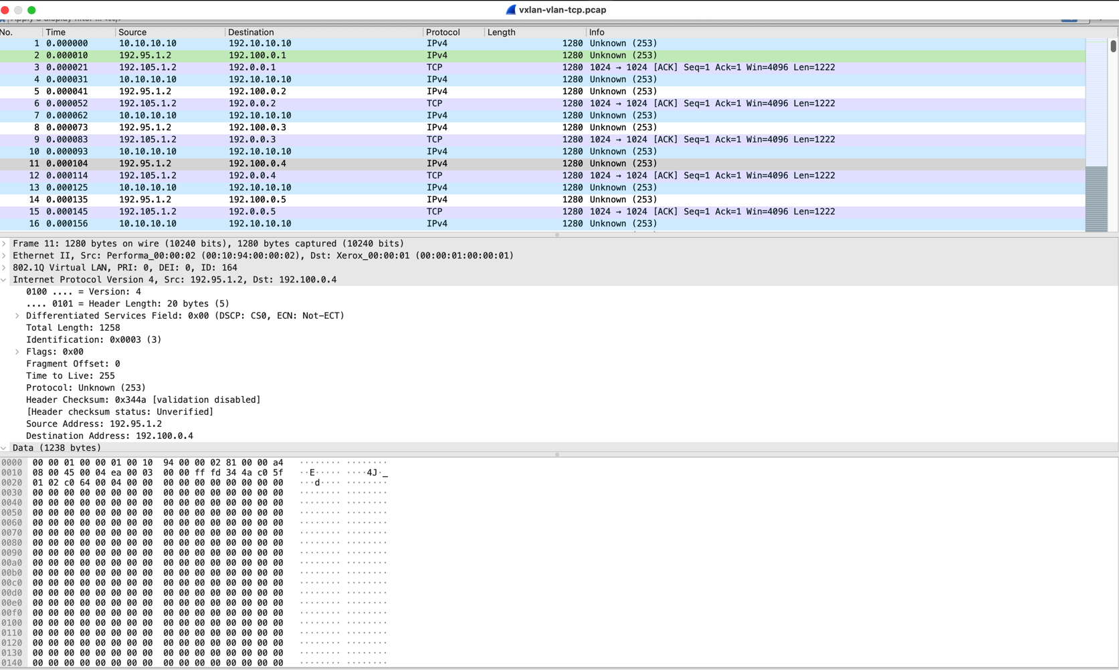
Packets Don’t Lie
How to achieve Advanced Visibility & Analytics
Ultimate source of truth
Packets
Ultra-HD information
No sampling
Notes:
COMING TO THE MAIN QUESTION – HOW CAN WE ACHIEVE THIS VISIBILITY & ANALYTICS…..KEY PARAMETER TO MONITOR IS PACKET. THIS IS THE ULTIMATE SOURCE OF TRUTH AS THEY FLOW ON YOUR NETWORK’S WIRES. NOT ONLY THAT, PACKETS DON’T LIE. I CALL THIS “ULTRA HD INFORMATION”. MORE IMPORTANTLY, THERE IS NO SAMPLING IN THE SENSE, EACH AND EVERY PACKET CAN BE MONITORED.

Slide 12
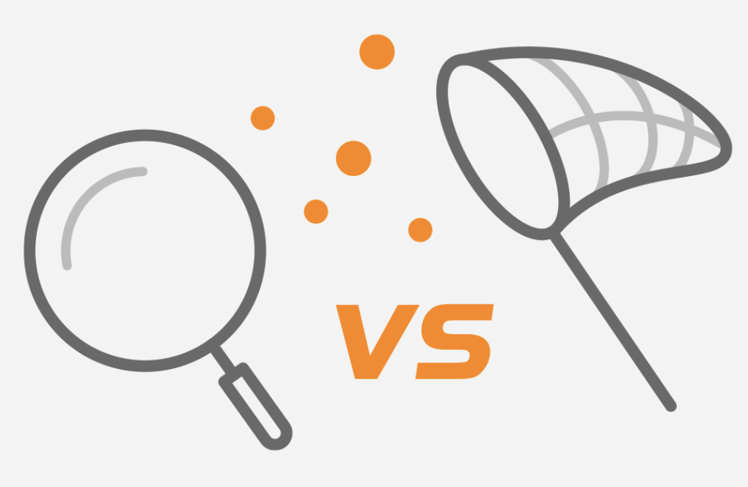
Why Packets?
Packet based | Other data sources based (Flows / SNMP)
Provides continuous monitoring and analysis of the telco networks, be it any domain (mobile or fixed) | Provides monitoring and analysis based on sampling wherein interface parameters are collected at intervals (every 5 minutes or 10 minutes)
Packets are a complete record of actual network activity, including the actual data (packet payloads that are transferred across the network. It also includes packet header information that can provide extremely useful data - particularly for security investigations - even if packet payloads are encrypted and can't be decrypted for inspection. | Other sources of data provides a metadata-based view of activity on the network.
Provides analysis related to: - User experience - Traffic analysis per link - Application traffic identification, performance & errors - Multi-hop analysis to pinpoint or demarcate issues related to particular nodes or links - Session analysis - Packet analysis - Identification of traffic anomalies & security threats | Provides analysis related to: - Device health - Interface utilization - Routing changes - Overall traffic identification
Provides granular level of details such as: - Application level traffic - Error codes or Cause codes related to per application / protocols - Per VLAN or site location or QoS based traffic - TCP / UDP / any other protocol based statistics of every transactions - Each KPI (success rate / failure rate) per messages exchanged between nodes for any protocol or technology interfaces (2G/3G/LTE/5G) - Precise view of network events | Provides a summary view of: - Network activity - Overall traffic identification - Network infrastructure health details
Notes:
WHY PACKETS?
PROVIDES CONTINOUS MONITORING & ANALYSIS AS THEY ARE NOT SAMPLED. ALL PACKETS ARE MONITORED.
PACKETS PROVIDE A COMPLETE RECORD OF ACTUAL NETWORK ACTIVITY. THIS IS VERY IMPORTANT SINCE IT PROVIDES EXTREMELY USEFUL DATA FOR MONITORING AND EVEN FOR SECURITY RELATED USE CASES.
WITH PACKETS, YOU CAN ANALYSE USER EXPERIENCE, TRAFFIC ANALYTICS, ISSUES RELATED TO SERVICES,APPS, SESSION BASED ANALYSIS & IDENTIFICATION OF TRAFFIC ANOMALIES & SECURITY THREATS.
PACKETS PROVIDE GRANULAR LEVEL OF DETAILS SUCH AS ERROR CODES, CAUSE CODES, QOS BASED TRAFFIC, PROTOCL BASED STATS, KPI’S & MOST IMPORTANTLY PRECISE VIEW OF NETWORK EVENTS.

Slide 13


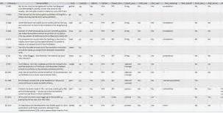
How to achieve Advanced Visibility & Analytics
Packets → Meta Data
Meta Data
Packets
Notes:
HOW TO WE MONITOR PACKETS TO ACHIEVE ADVANCED VISIBILITY & ANALYTICS → META DATA (EXTRACT JUICE OF PACKETS)

Slide 14
What is Meta Data?
Ultra-HD Insights
Derived from the Source of Truth - Packets, Universally Available
Multi Generational Network Intelligence - Fixed, 5G, 4G, 3G, 2G, WiFi
Consumer, HVA, IoT
Subscriber
Per Subscriber - Per session insights
Meta
Video, OTT, URLLC
Fixed, WIFI, Mobile
Multi Dimensional - Service, handset, device, cell, location, network,...
SERVICES
Technology
Data
Rich App/Network Metrics - Errors, latency, throughput, audio gaps, video quality,...
NETWORK
Full Visibility - Physical and virtual, Open APIs
Physical, Virtual, Hybrid
Notes:
ULTRA-HD INSIGHTS OR VISIBILITY SINCE ITS DERIVED FROM PACKETS.
ANY TECHNOLOGY, ANY NETWORK
PER SUBSCRIBER INSIGHTS BASED ON MULTI DIMENSIONAL PARAMETERS
PROVIDE FULL VISIBILITY IN TERMS OF NETWORK ITSELF AND NETWORK OR APPS METRICS

Slide 15
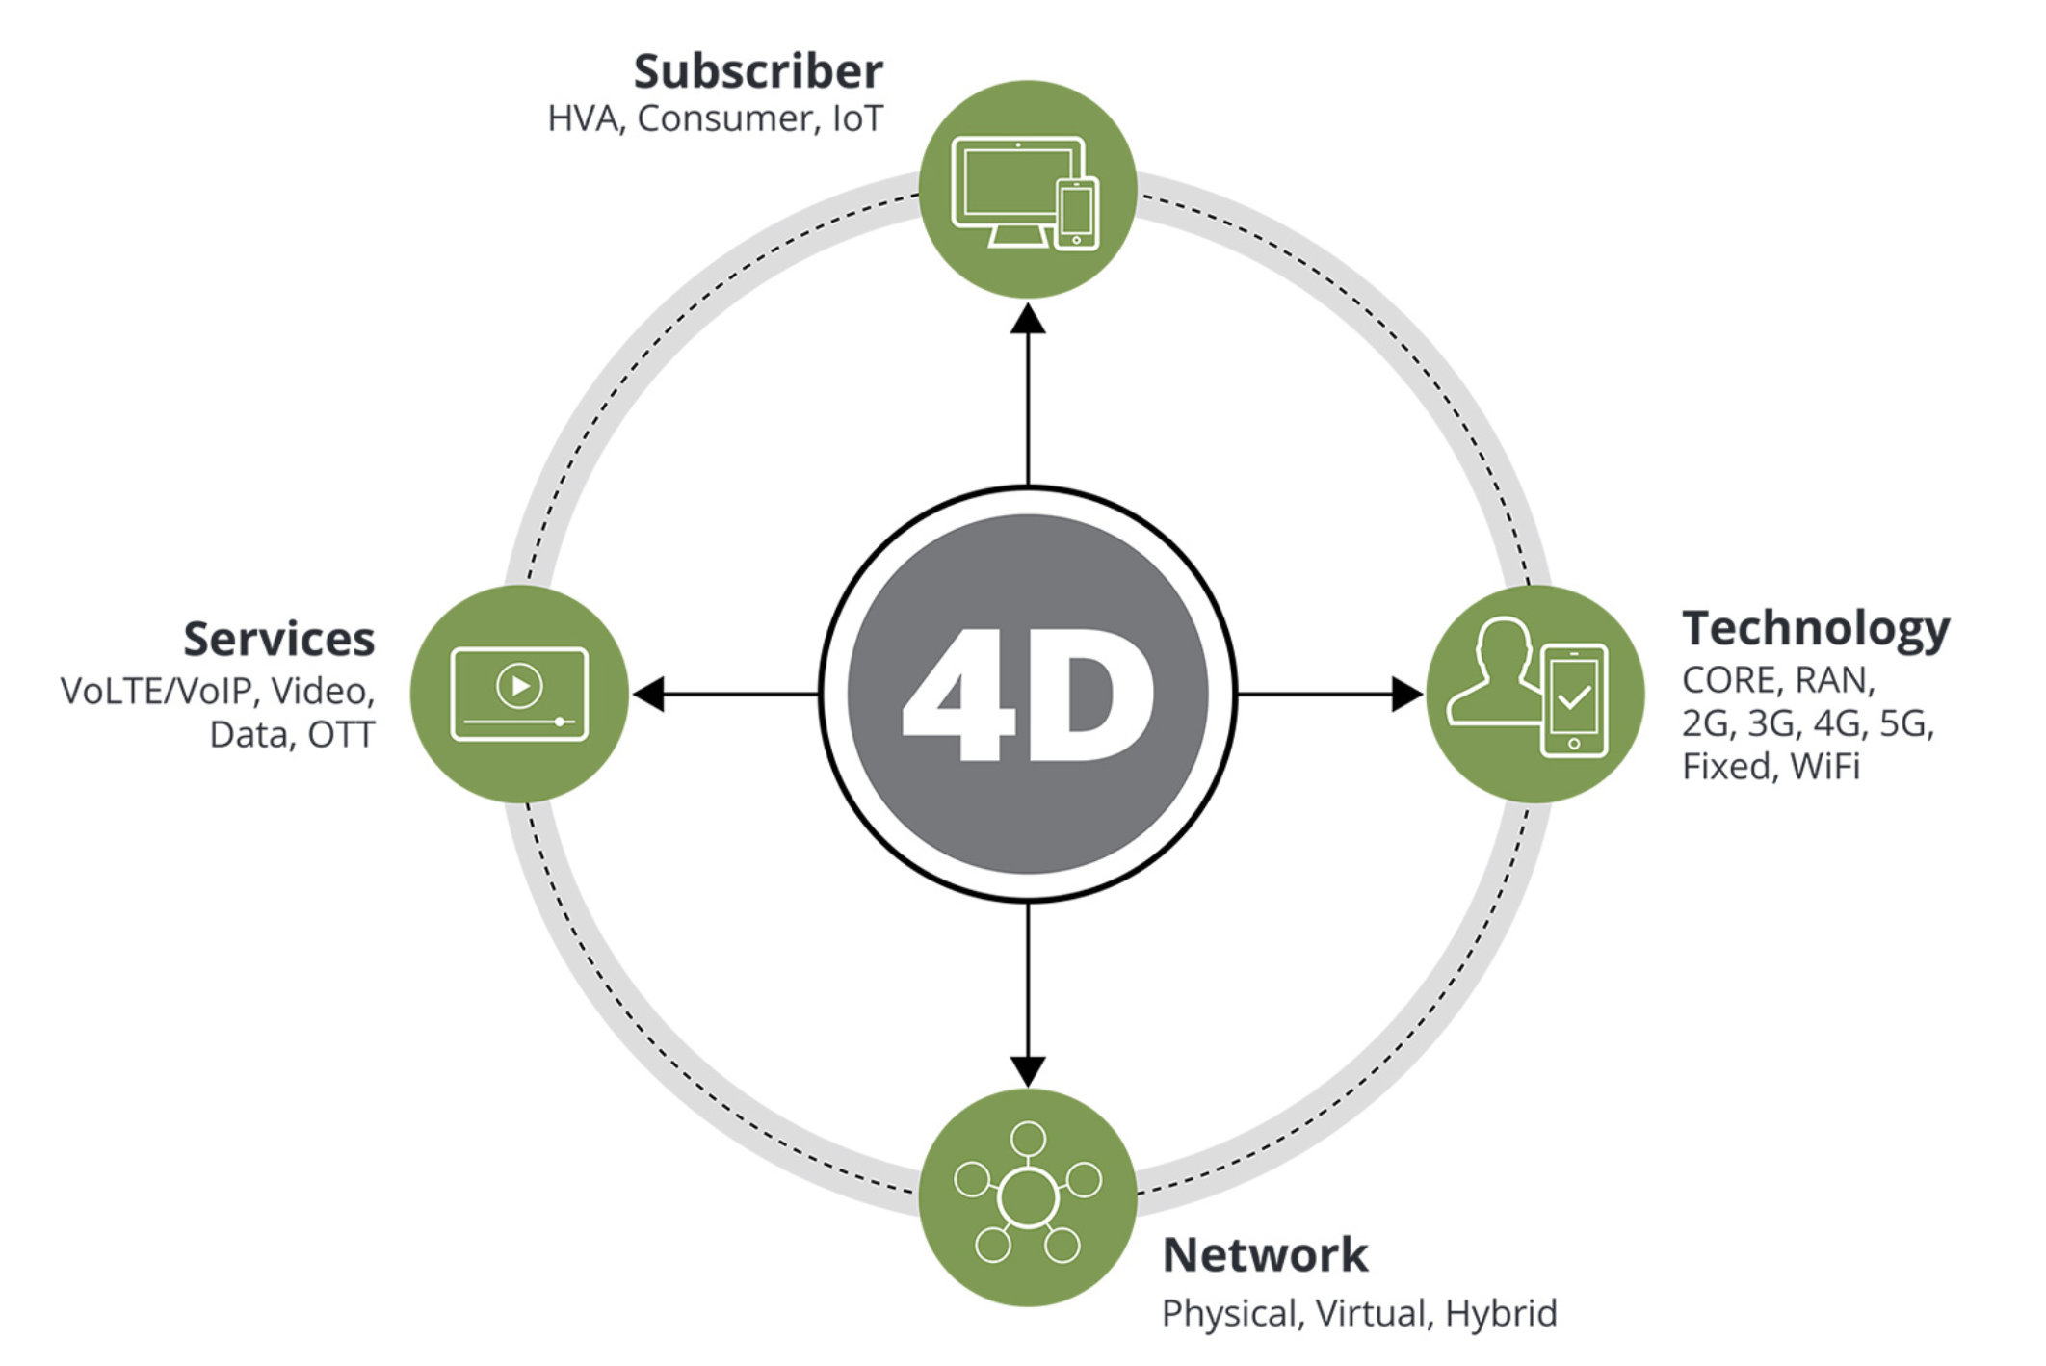
The Power of Meta Data
Rich Contextual Information: Metadata provides insights into network behavior, application performance, and security threats.
Real-Time Monitoring: Enables real-time visibility into network traffic, allowing for proactive issue identification and resolution.
Historical Analysis: Facilitates trend analysis and capacity planning by examining historical network data.
Security Intelligence: Helps identify and mitigate security threats by detecting anomalous traffic patterns and malicious activity.
Key Components:
Timestamps
Source and Destination IP Addresses
Port Numbers
Protocol Types
Applications (HTTP, HTTPS, FTP, SMTP, Social Media, Games, etc.)
Notes:
BASED ON KEY COMPONENTS, META DATA PROVIDES RICH CONTEXTUAL INFO SUCH AS INSIGHTS INTO NETWORK BEHAVIOR, APPS PERFORMANCE & EVEN SECURITY THREATS FOR THAT MATTER.
REAL TIME MONITORING OR NEAR REAL TIME MONITORING FOR PROACTIVE DETECTION, IDENTIFICATION AND RESOLUTION OF ISSUES.
META DATA ALSO PROVIDES AN OVER THE TIME ANALYSIS OR HISTORICAL ANALYSIS FOR CAPACITY PLANNING, MONETIZATION, AND A PLETHORA OF USE CASES.
IDENTIFICATION AND MITIGATION OF SECURITY THREATS BY DETECTING ANOMALOUS TRAFFIC PATTERNS & MALICIOUS ACTIVITIES.

Slide 16



Building Blocks for FTTX network
Customer Experience Journey is through all the building blocks
ONT
OLT
BRAS/BNG
www
AAA
DHCP
DNS
AG3
CDN
Notes:
WHAT SHOULD BE THE INSTRUMENTATION POINTS? WE KNOW THE BUILDING BLOCKS OF A FTTX NETWORK STARTING FROM CPE THROUGH THE ACCESS COMPRISING OF ONT/OLT AND THEN THROUGH THE CORE BNG TO THE AGGREGATORS. NOT TO FORGET THE SERVICE ENABLERS SUCH AS THE AAA, DNS, DHCP…..

Slide 17
Recommended Instrumentation Points
OLT
Per User / Per Node / Per Geograhical location Analytics
ONT
Customer Experience Journey is through all the building blocks
ONT
ONT
OLT
BRAS / BNG
DataCenter
AGG
AAA
DHCP
ONT
BRAS/BNG
ONT
DNS
ONT
www
ONT
OLT
AAA
DHCP
DNS
AG3
ONT
BRAS / BNG
AGG
ONT
OLT
ACCESS
CORE
AGGREGATION

Slide 18
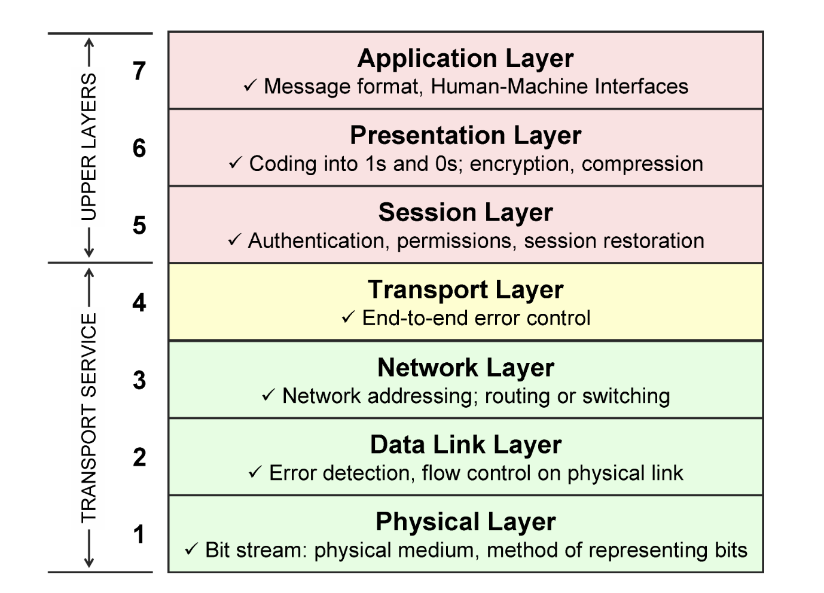
What is important to be monitored?
Notes:
WHAT IS REQURED TO BE MONITORED……CONTROL PLANE & USER PLANE….WHEN I SAY CONTROL PLANE, IM TALKING ABOUT PROTOCOLS, SIGNALING ASPECT, ETC. HOW MANY REQUESTS SENT, HOW MANY RESPONSES RECEIVED, ANY FAILURES AND WHAT ARE THOSE FAILURES? WAS THERE ANY DELAY IN RECEIVING THE RESPONSES, ETC?
USER PLANE – APPS USAGE, TOP APPS, NETWORK WIDE AND PER SUBSCRIBER, HOWS THE PERFORMANCE OF THESE APPS, GAMING, ETC.

Slide 19


Monitor and Improve-User Experience
The monitoring methodology nowadays is highly recommended to use Meta data with AI/ML driven insights, if applicable, to proactively improve user experience and to help the admin to understand the traffic inside the network!
Fixed Networks
Machine learning and AI empowering the analyzes of vast amounts of data in real-time, identifying patterns and anomalies that traditional methods miss, providing crucial insights for proactive decision-making and optimization.
Improve Network
Improve User Experience
Solution
Edge to Core
Actionable Data
Notes:
ONE OF THE MOST IMPORTANT TOPICS THESE DAYS IS TO PROVIDE CRUCIAL INSIGHTS FOR PROACTIVE DECISION MAKING VIA A CLOSE LOOP CONTROL WHERREIN ISSUES ARE DETECTED OR LET’S SAY WE HAVE THE ACTIONABLE DATA AND IT IS NOW REQUIRED TO IMPROVE THE USER EXPERIENCE OR NETWORK PERFORMANCE….VIA THE AI/ML…..SO BASICALLY THE MONITORING METHODOLOGY SHOULD ALSO CONSIDER AI/ML BASED DRIVEN INSIGHTS….

Slide 20
what are the advantages of monitoring the FTTX “4D Visibility”
01
02
03
04
Application
Access
Application Experience
Accessibility
Analytics
Tracking DNS, DHCP and Radius Services
TCP Performance
Application Latencies
HTTP Performance,
Voice, Access
L7, OTT Video
Experience,
STB Experience
Voice experience
Multi-dimensional
Analytics of
Usage and
Experience
Notes:
4D VISIBILITY RELATED TO FTTX MONITORING…THIS IS AN E2E MONITORING METHODOLOGY

Slide 21
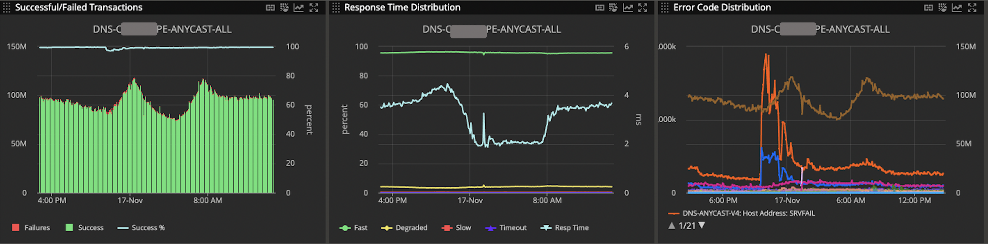
How to track User Experience?
Example :- USE CASE- DNS Proactive Monitoring is mandatory for all Network Operators
DNS
DNS Service impact is for multiple subscribers/ complete network
Need to provide proactive Monitoring
Latency for DNS
Operator’s DNS vs Google DNS vs Open DNS
01
Accessibility
Tracking DNS, DHCP and Radius Services
Total Transactions
Response Time
Error Codes
Monitoring the core service and understanding of the behavior and subscribers is required to keep the high performance of the core services

Slide 22
Tracking User Experience
Example :- Superior TCP Analysis to understand Application Access Experience
02
FTTX solution needs to provide TCP and HTTP metrics on the complete network level and individual STB level. The key metrics being
Re-Transmissions : Provides per STB, per application retransmissions enabling to identify if the issue is STB specific or across network
Server and Network Latencies: Enabling to check if the delay is in access network or core
TCP handshake issues: Enabling to identify if the there are any issues for users to access applications
TCP Window size: This is shown at network level and helps to understand if the Application can handle the load.
HTTP Success Rate, Error code distribution and responsiveness
Application
Access
TCP Performance
Application Latencies
HTTP Performance,
Voice Access

Slide 23
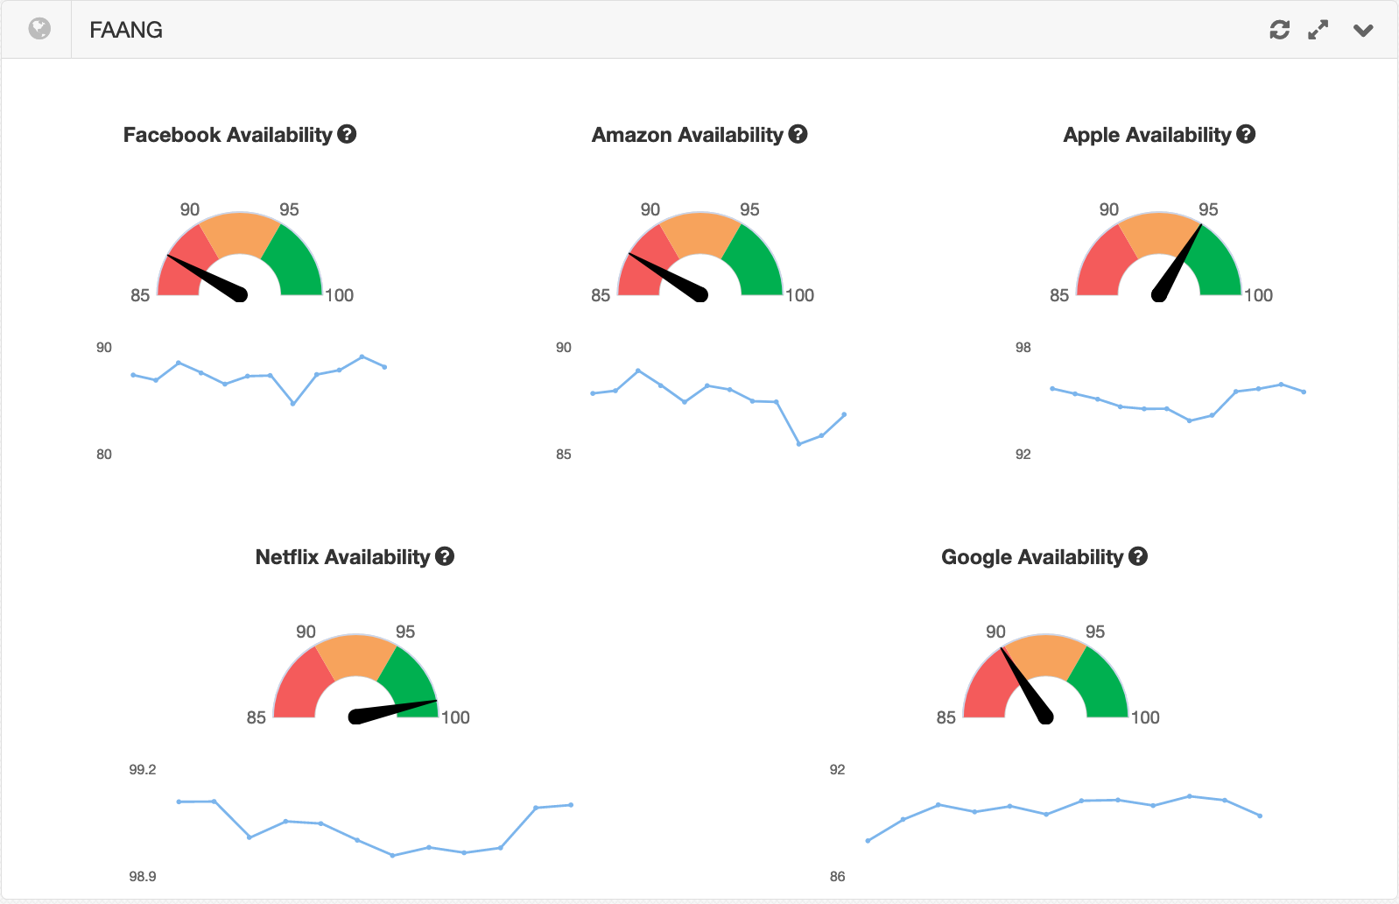
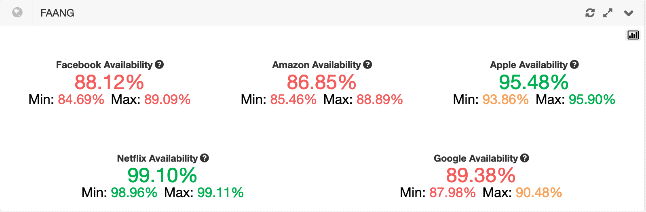
Tracking User Experience
Example :- - Per ONT/ User Application Experience Monitoring is a must
03
Monitors the experience for each ONT for each application.
To set experience thresholds for type of service and show for which service the user got good or bad experience
Some of the example that can be included like:-
FAANG User Experience Score
Customer Experience Index score card
Application Experience
L7, OTT Video
Experience,
Voice Experience
Notes:
FAANG – FB+AMAZON+APPLE+NETFLIX+GOOGLE

Slide 24
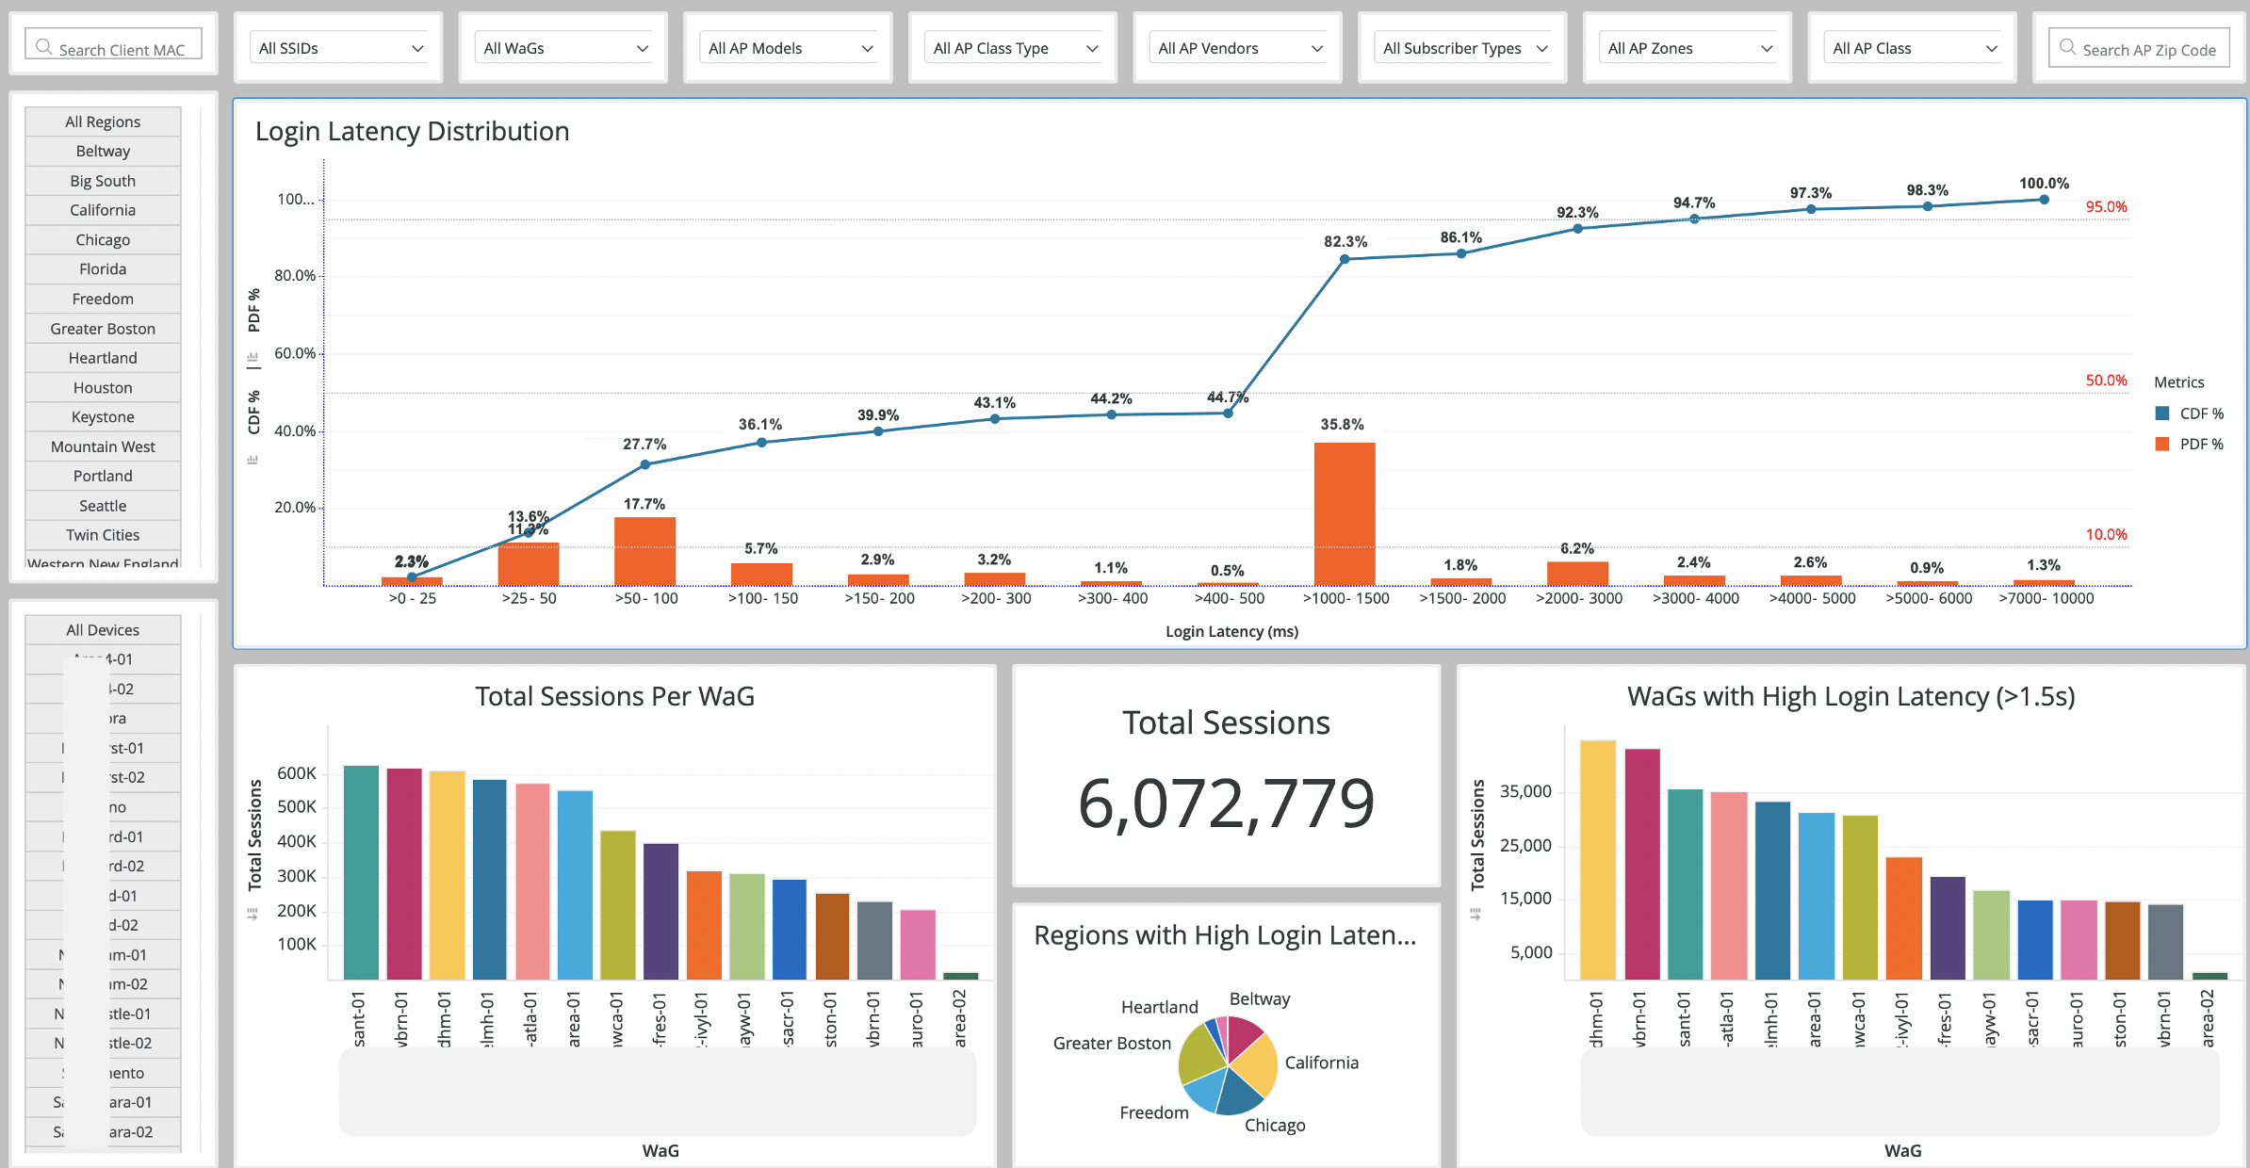
Analyzing User Experience
Leveraging metadata collected from diverse network sources enables the generation of comprehensive, multi-dimensional analytics, and can be used to provide unprecedented insights and empowering informed decision-making for the network administrators
04
NetScout solution provides rich analytics reports which unable to understand customer experience based on
Usage
Location
Analytics
Multi-dimensional
Analytics of
Usage and
Experience
KPI View by ONT, OLT, CPE Model, SW Ver, Regions, Markets
Google like data mining, Custom KPI & Dashboards, Flexible reporting & Data export

Slide 25
Use-Case: Gaming - Experience in Fixed Networks

Slide 26







Analyzing User Experience - Gaming
Protocol dependent
Latency
Packet Loss
Jitter
Throughput

Slide 27
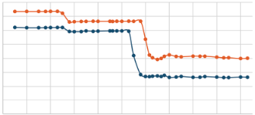

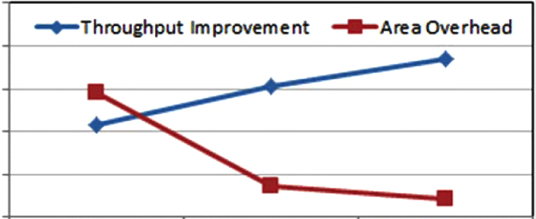
Outcomes - Gaming
Improved latency
Montized gaming packages
Improved throughput

Slide 28







Deployments

Slide 29

Key Takeaways
Visibility is the key aspect for manageability
With the increased data speeds, complex networks & issues, the legacy approach is not enough to manage the networks.
Network performance User experience
Monitoring of the Core Network Services like DNS, RADIUS, DHCP is not an option to maintain the performance and / or quality of services.
Packet data source based analysis provides a more accurate and comprehensive understanding of user experiences compared to relying solely on network element data.
Packet based metadata empowers organizations to gain a deep understanding of network behavior, identify performance bottlenecks, and proactively address potential issues.
Packet based monitoring solutions is recmmnded to utilize ML/AI that empowering the analyzes of vast amounts of data in real-time, identifying patterns and anomalies that traditional methods miss, providing crucial insights for proactive decision-making and optimization.

Slide 30
Thank You

