Slide 1
Internet Resilience in the MENA region An overview
Aftab Siddiqui
siddiqui@isoc.org

Slide 2
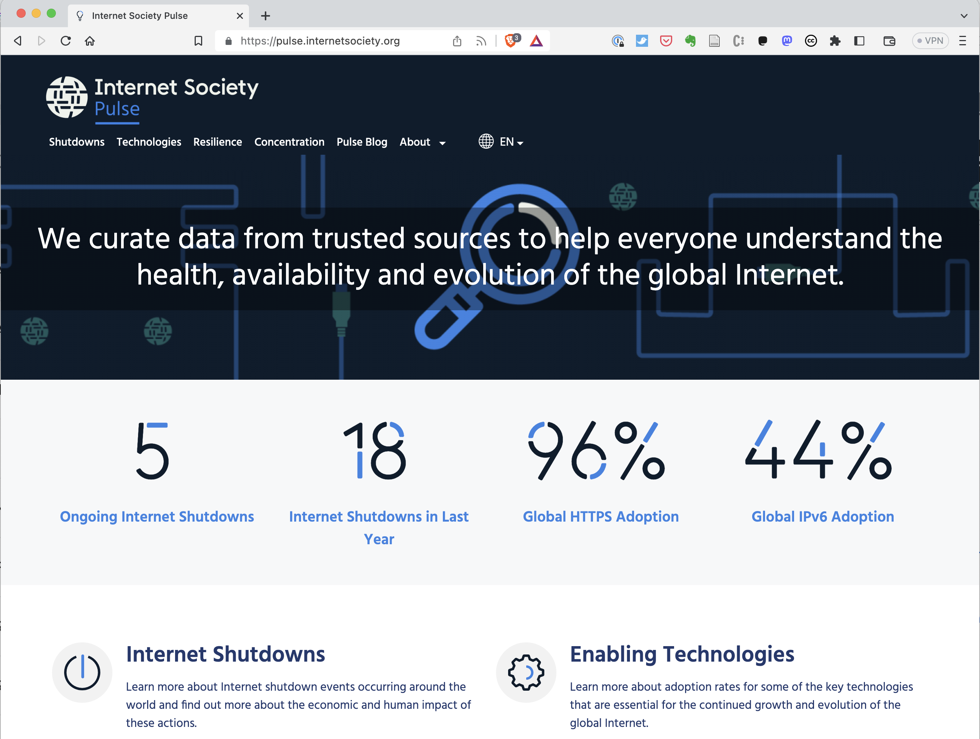
pulse.internetsociety.org
Your Data Dashboard

Slide 3
Internet Resilience Index (IRI)

Slide 4
The Internet Resiliency Index (IRI)
The framework collates around 30 sets of public metric data that relate to four pillars of a resilient Internet:
.
Infrastructure
The existence and availability of physical infrastructure that provides Internet connectivity.
Performance
The ability of the network to provide end-users with seamless and reliable access to Internet services.
Security
The ability of the network to resist intentional or unintentional disruptions through the adoption of security technologies and best practices.
Market Readiness
The ability of the market to self-regulate and provide affordable prices to end-users by maintaining a diverse and competitive market.
Methodology: https://pulse.internetsociety.org/wp-content/uploads/2023/07/Internet-Society-Pulse-IRI-Methodology-July-2023-v2.0-Final-EN.pdf

Slide 5
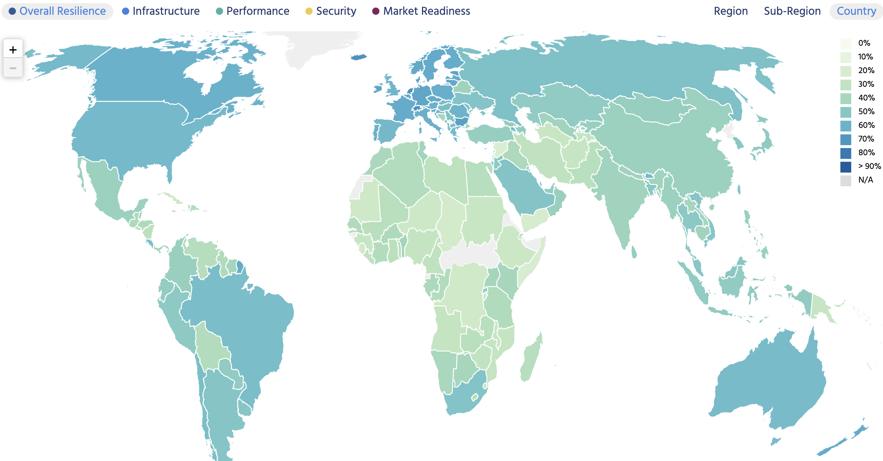
Global outlook

Slide 6
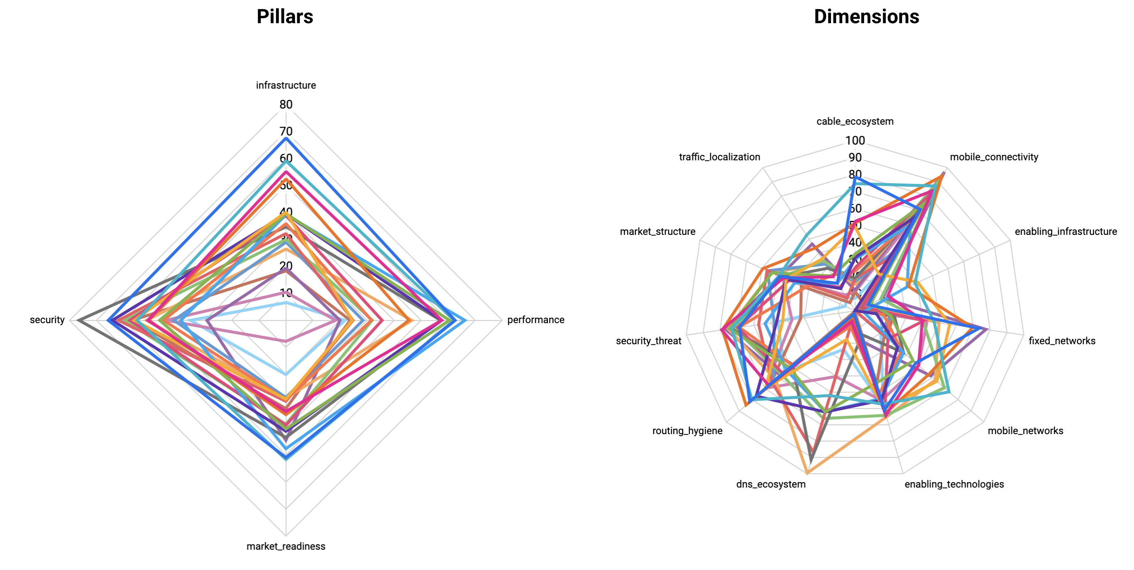
Internet Resilience in MENA

Slide 7
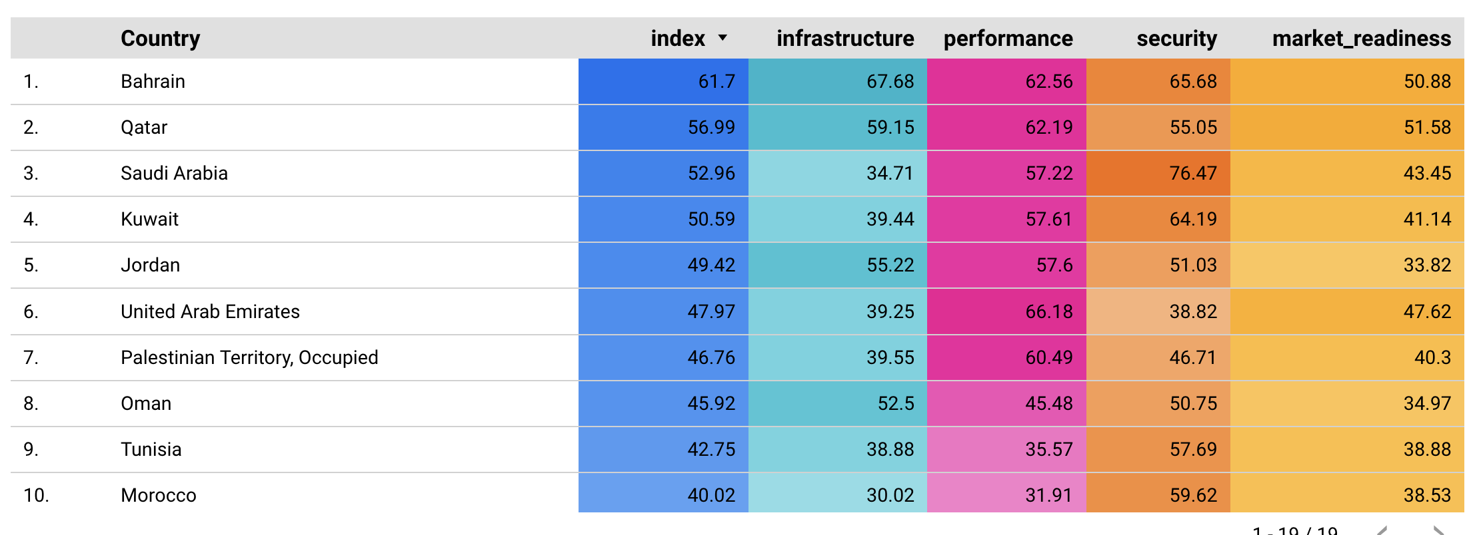
Top 10 countries in MENA

Slide 8
Top 5 countries by pillar

Slide 9
Top 5 countries by pillar

Slide 10
KSA: A Role Model for Internet Resilience in the MENA region

Slide 11
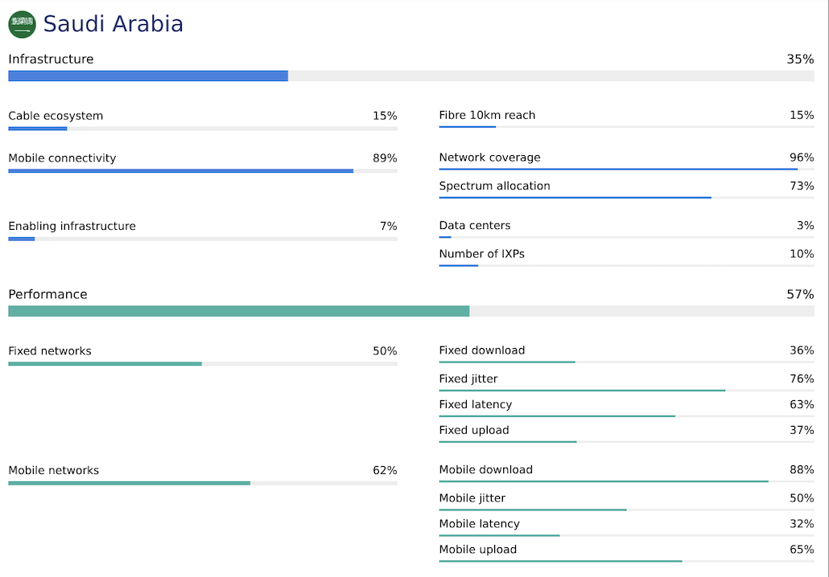
KSA– Internet Resilience Index

Slide 12
KSA– Internet Resilience Index

Slide 13
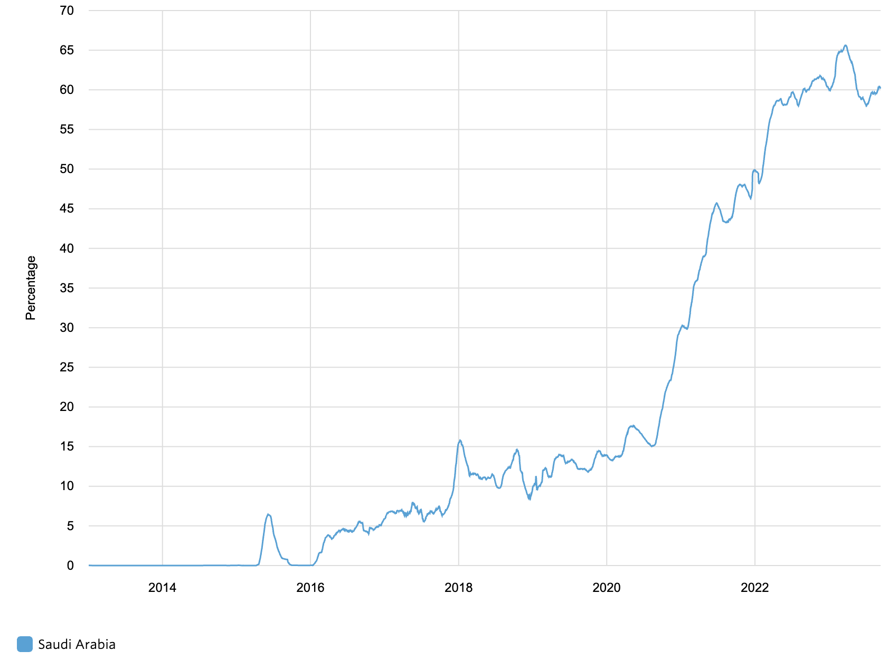
KSA– IPv6 capability
IPv6 Task Force for the last 15 years.
Clearly defined strategy
Key Performance Indicator (KPI) reporting has been adopted to track and maintain IPv6 deployment efforts.
Saudi mobile operators have identified solutions to their challenges, such as upgrading billing systems to support IPv6.

Slide 14
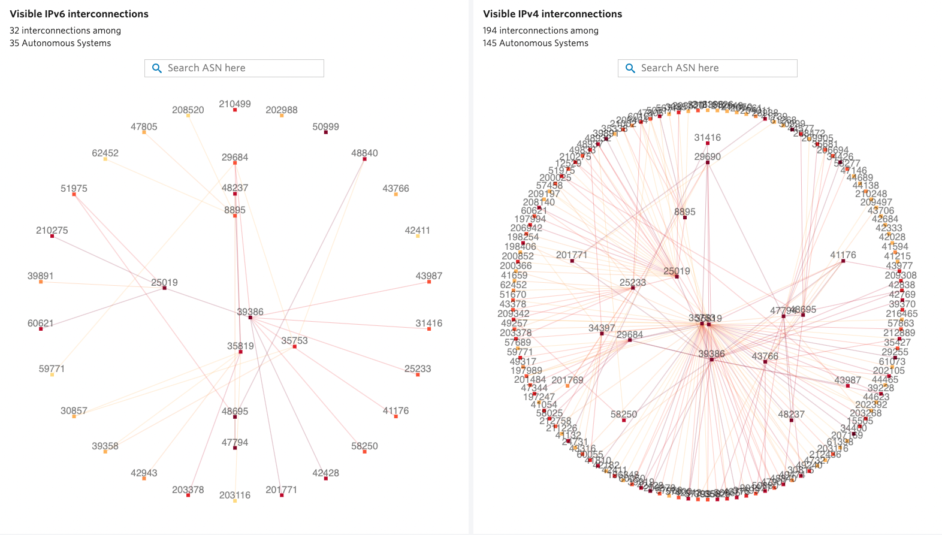
KSA – IPv4 and v6 Interconnection (APNIC REx)
https://rex.apnic.net/as-interconnections?allocationType=ipv4,ipv6&economy=SA

Slide 15
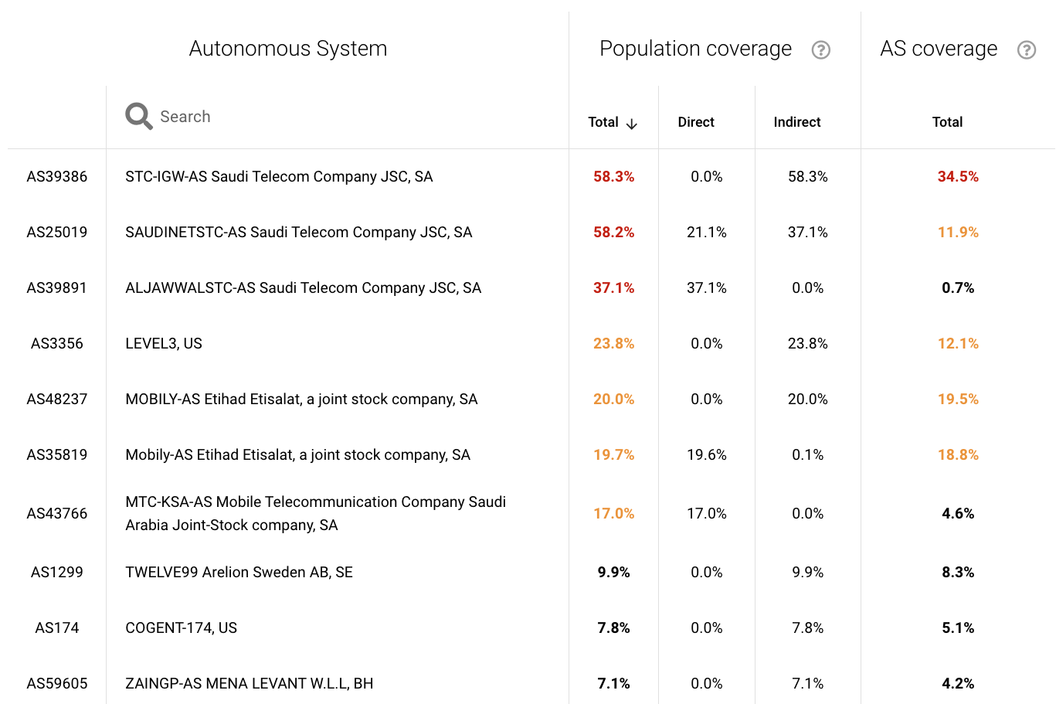
KSA – ASN Dependency (IIJ Internet Health Report)
Market just below the high concentration mark (~2500 HHI index)
Upstream provider diversity (Gini Coefficient (G) = 0.26032)
Relative equality
https://ihr.iijlab.net/ihr/en-us/countries/SA?af=4&last=3&date=2023-09-17&rov_tb=routes

Slide 16
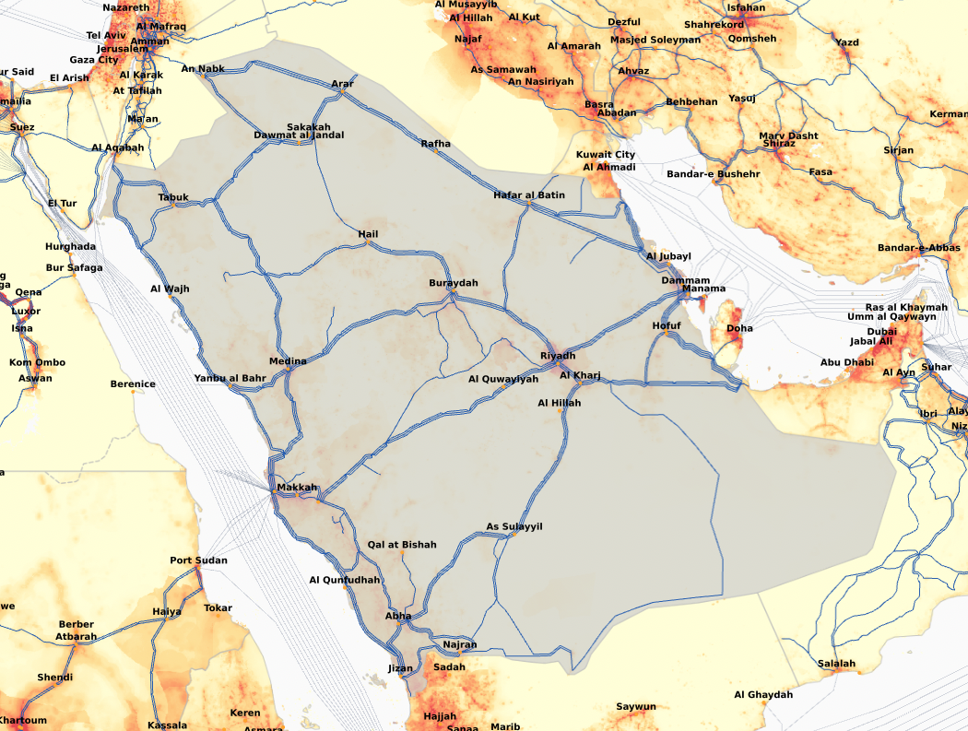
KSA – International Gateways
Balanced mixed of cable landing stations and cross-border exit points (Jordan, Iraq, Kuwait, Qatar)
Provides alternative routes to Yemen and Oman

Slide 17
Subscribe to the Pulse Newsletter
Robbie Mitchell
mitchell@isoc.org

