Slide 1
Vision 50/50
October 2023
Keeping half of Internet traffic local
Hanna Kreitem
Senior Advisor, Internet Technology and Development – MENA
kreitem@isoc.org

Slide 2
The fastest route from point A to point B is a straight line.

Slide 3
The 50/50 Vision
Faster, stronger and more affordable Internet

Slide 4
The 50/50 Vision for Internet Traffic
An ambitious plan to keep at least half of all internet traffic local in selected economies by 2025.
When we reach this goal, the people who need it most will have access to the Internet:
Faster.
Stronger.
Cheaper.

Slide 5
A Collaborative Approach
Public policy makers
Encourage a thriving and open connectivity market and foster strong technical communities.
Streamline policy and regulatory processes to encourage regional and international entities to participate in the local interconnection environment.
Support increasing local traffic and content.
Technical communities
Actively support knowledge exchange.
Events and peering forums that share best practices and serve to find peering partners.
Share this vision and contribute to ensuring at least 50 percent of local traffic remains local in their communities.

Slide 6
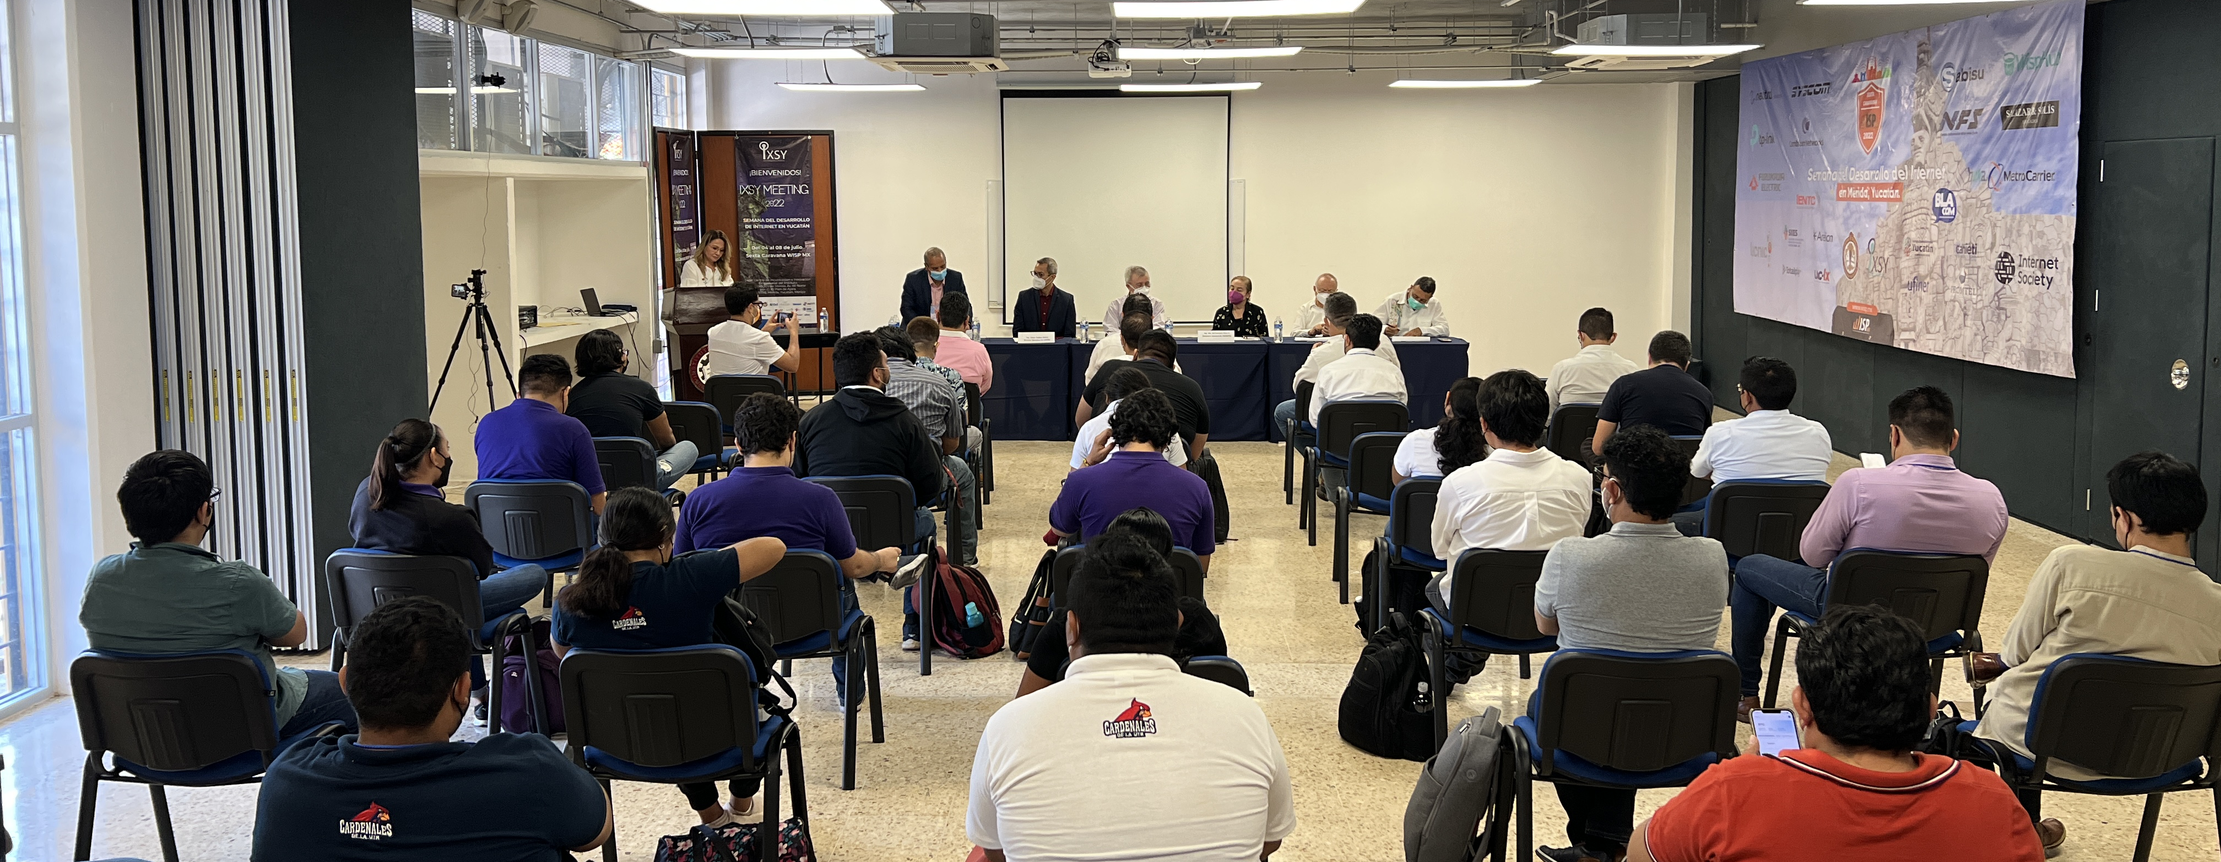
A Collaborative Approach
Internet Society Community
Taking training courses on the importance of IXPs and how to build and support them.
Defending peering and interconnection in their local communities.
Engaging with local IXPs to understand their impact on the local Internet ecosystem.

Slide 7
How Do We Measure Our Progress
Data for decision making

Slide 8
The methodology
Measuring local vs non-local traffic levels is often not straightforward .
Access providers often know the most used services, but they do not distinguish between local and non-local traffic, and the data they collect is rarely shared publicly.
To map traffic flows, we use data from two open source tools:
Open Observatory for Network Interference (OONI), RIPE Atlas, and BrightData.
Our methodology quantifies the level to which OTT services (video streaming, web browsing, social media, etc.) obtain their content from a local server/cache rather than outside the country.

Slide 9
50/50 in ME
Results and Measurements

Slide 10
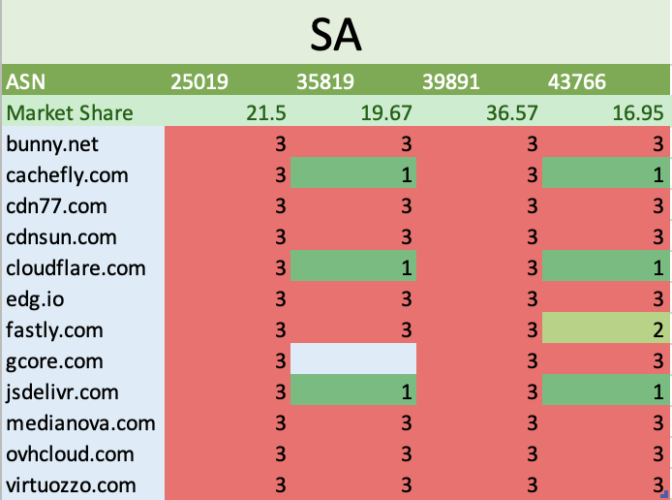
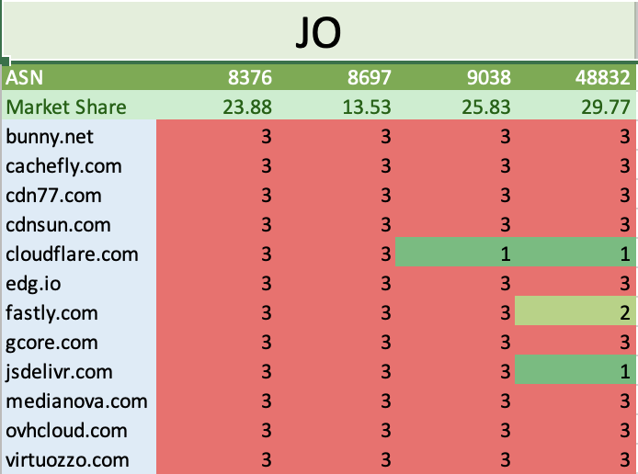
Measurements related to ME
1 = Local 2 = Regional 3 = Global

Slide 11
How to help
Achieving Our Goal Together

Slide 12
Join the Movement
Our goal is to understand how far your network traffic reaches when you access OTT services:
Deploy a RIPE Atlas and OONI probes
pulse.internetsociety.org
Participate at peering forums
Sign up for our IXP course
learning.internetsociety.org
Donate to our cause - 100% of your donation works towards achieving an Internet for all
internetsociety.org/donate

Slide 13
Thank you.
Hanna Kreitem
kreitem@isoc.org

