Slide 1
Be the exchange you want to see in this world
Ruben van den Brink (CTO)
MENOG22

Slide 2
One year ago, a AMS-IX senior network engineer asked me:
What kind of exchange do we want to be?
Notes:
The title of this talk is an answer, or a call to action, if you will! But what was the question?
How many kinds are there?
small, amateur, the best, the biggest, the cheapest (but according to what metric?)

Slide 3
AMS-IX Vision
Better society through better internet
Notes:
What’s our vision? Better society through better internet
But what is a better society?
And what is a better internet?

Slide 4
What constitutes a better society, is a matter of culture and politics.
What is a better Internet?
Notes:
Now I am not a sociologist, nor a cultural anthropologist, nor a politician, but it is easy to spot different answers to these questions in today’s world:
in a better society, people are protected from harmful information
in a better society, technology is used to control people
in a better society, people have equal opportunities to access the internet
in a better society, the internet enables digital services that contribute to the economic growth
in a better society, children learn to think for themselves
in a better society, science is trusted over conspiracy theories
etc…

Slide 5
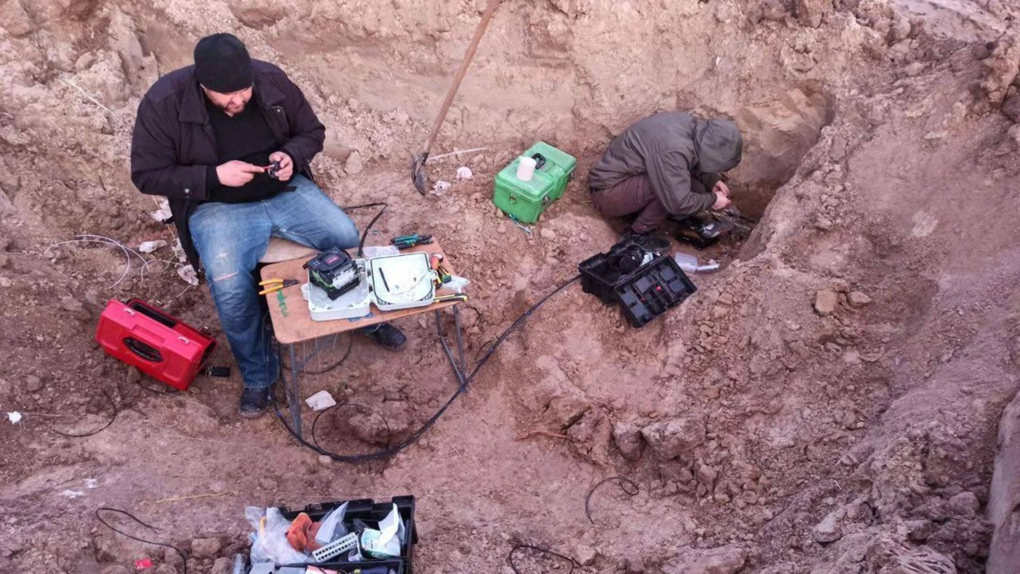
Connected fibers…
Photo: VICE

Slide 6


Slide 7


Free Internet… (?)
Photo: the Guardian

Slide 8

How is the Middle East doing?

Slide 9
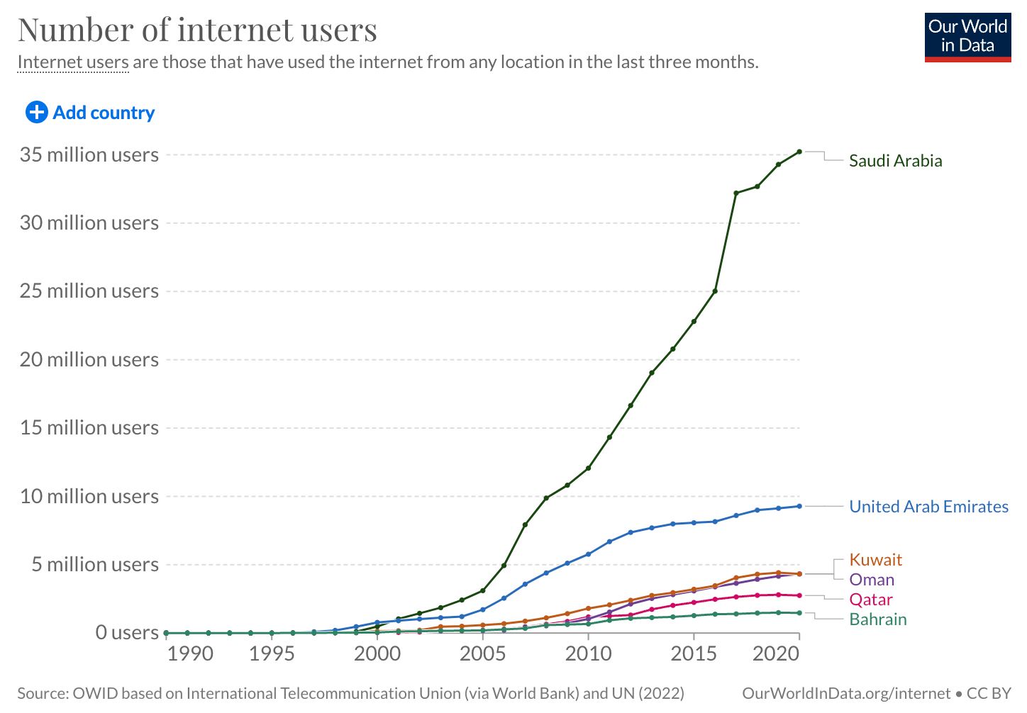
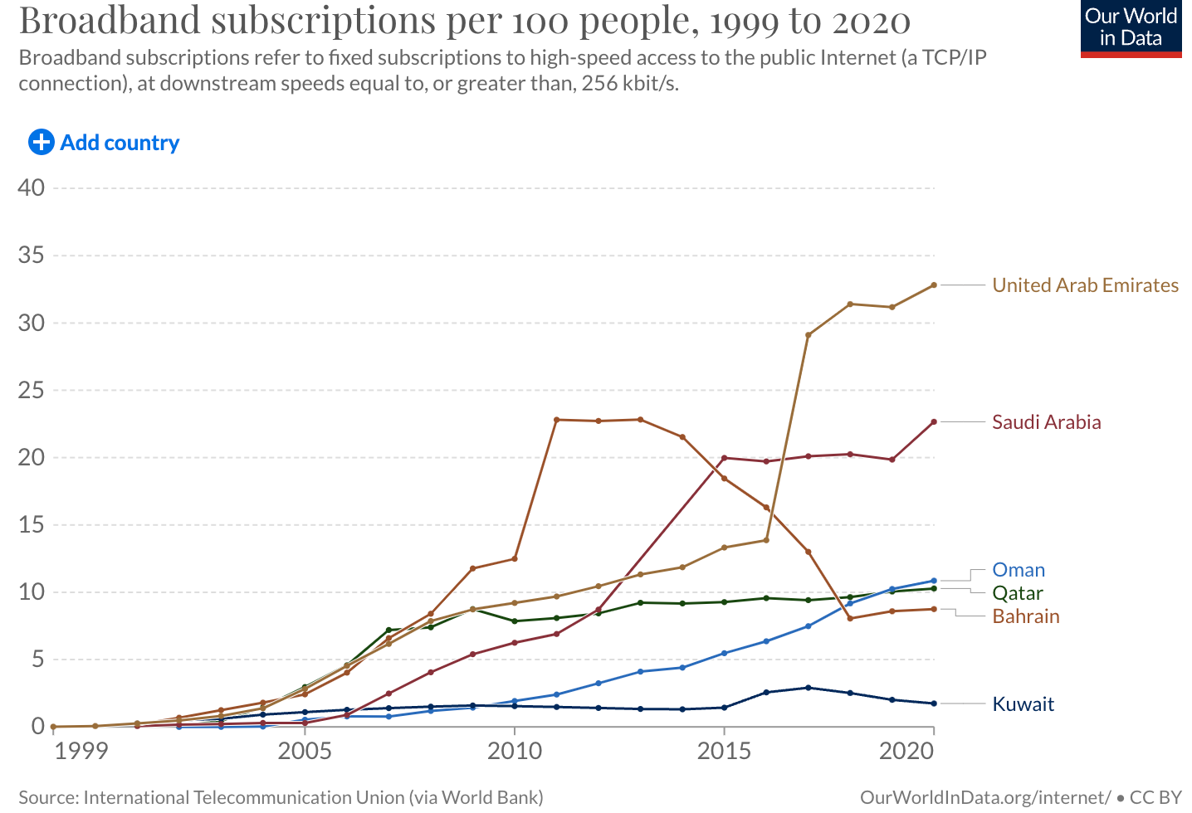
Growth in the Middle East
Tremendous bandwidth growth as a result of smartphone usages (5G rising) and cloud services.
IP transit is on average about 10 times more expensive than in Europe due to intra-regional traffic being uncommon, while ISPs need to access IP transit outside the region.
End-users in the Middle East can experience significant latency and performance issues associated with the long-haul routing that comes from connecting inefficiently to European cities before returning to the Middle East.
Content providers (AWS, Tencent) coming to the region (Bahrein, Qatar, KSA and UAE).
Notes:
https://www.mei.edu/publications/data-centers-industry-gccs-new-oil-fields (2021)
https://www2.telegeography.com/ (2022)
Gulf
Private/public cloud
Cloud computing (Covid as main driver)
Cloud spending $2.5b by 2025
SaaS becoming more popular after Covid
Forecasted to be the second in 5G subscription penetration after North America by 2026
At the end of 2020, the GCC countries had the highest monthly data traffic per smartphone in the world, exceeding 18GB
By the end of 2026, 5G will account for 73 percent of all mobile subscriptions in the GCC countries.
5G brings lower latency
Middle East
Major driver for internet bandwidth demand growth are mostly broadband subscribers, both mobile and fixed.
Mobile compound annual growth of 10% 2017-2021
Fixed compound annual growth of 6% 2017-2021
IP transit is more than 10 times more expansive than Europe (as comparison) due to intra-regional traffic being uncommon and ISPs need to access IP transit outside the region.
End-users in the Middle East can experience significant latency and performance issues associated with the long-haul routing that comes from connecting inefficiently to European cities before returning to the Middle East
This boosts governmental initiatives to expand interconnectivity (incl more terrestrial infra and subseas cables) in UAE, but also generally in the whole region.
IP transit prices keep decreasing but very slow, 9% annnually.
Healthy increase in nr of content providers nodes in the region especially in Oman and UAE
This way, local/regional ISPs are more efficient with fetching content compared to getting it from Europe via submarine cables
Also, intra-regional international bandwidth between countries in the ME, expands
UAE
Estimated 31,650 new jobs have been created in the DC market 2017-2022
Cloud computing spending estimated from $120m in 2017 to $411m by 2022
Saudi Arabia
Cloud computing estimated $10b by 2030
70% of rural houselds in remote areas to have wireless broadband networks by 2030
SA ranking 7th globally in internet speed and 5G technology
Qatar
Cloud computing from $24m in 2017 to $112m by 2022
Bahrain
Ranking 4th globally in telecommunications infrastructure

Slide 10
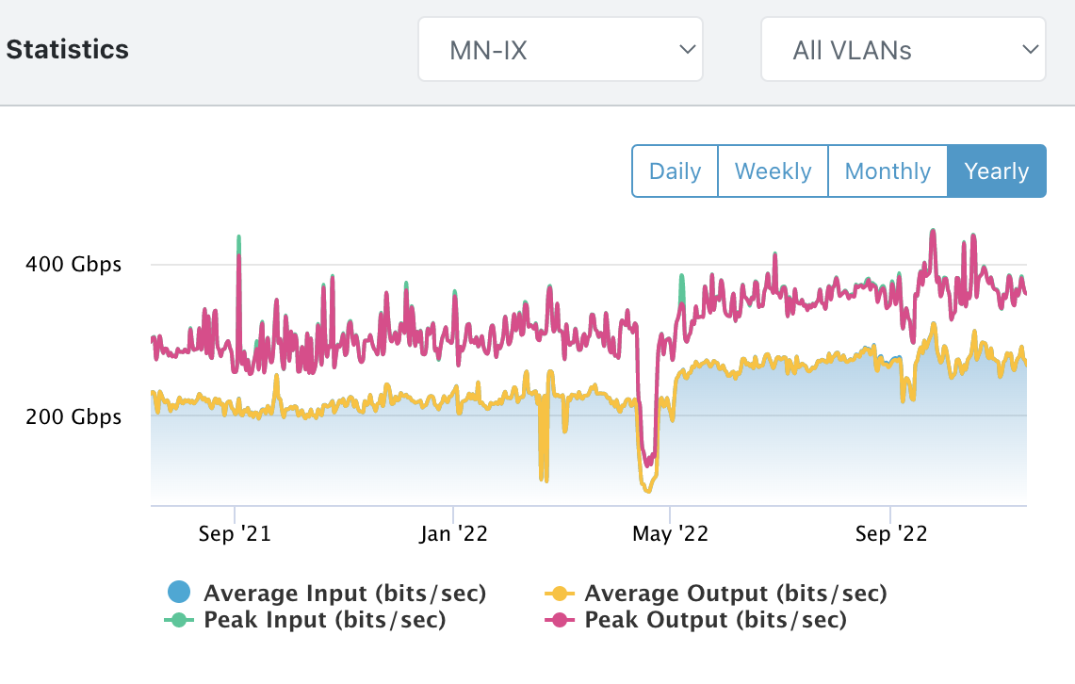
Manama-IX
Peers | Connections | Open Peers | Total Speed | % IPV6 | Peak Traffic
23 | 30 | 13 | 1 TB | 86% | 514 Gb/s
Notes:
With local networks and content providers being present in the region, IXP’s make sense! We’ve seen great growth at Manama-IX over the past few years and IP transit prices are dropping by 9% annually.

Slide 11
For AMS-IX, it’s about
Neutrality
Online Safety
Sustainability
Notes:
We care!
Neutrality: technology is never neutral
Online safety
Sustainability

Slide 12
Neutral internet exchanges around the world could provide an independent ecosystem of interconnectivity services
Notes:
Internet Peering is our core business today
but what about tomorrow, or the day after?
software defined
federated
GAIA-X
or should we compete for price and race to the bottom…?

Slide 13


Notes:
If latency is not the main concern, then together, IX’s can connect to become a large network with endless possibilities for connectivity

Slide 14
Notes:
If latency is not the main concern, then together, IX’s can connect to become a large network with endless possibilities for connectivity

Slide 15


Notes:
This requires automation, orchestration and CRM/portals for a seamless customer journey
But also: API’s and standards to integrate with other service providers.
usecase: a scale-up can deploy its services fast and at a global scale and optimise (for quality/latency) by getting more local presence if customer base grows in certain regions

Slide 16
Notes:
Internet Peering is our core business today
but what about tomorrow, or the day after?
software defined
federated
GAIA-X
or should we compete for price and race to the bottom…?

Slide 17
Data Exchanges

Slide 18

Notes:
Is data the new gold? Or rather the new oil?
In any case, it’s valuable…
Currently, no more than 1% of all the data that is being produced is ever re-used.
There is a market for sharing data, but the risks and regulations prevent organisations from doing so.
We need automation and a trusted party to oversee data sharing contracts; this is what a data exchanges aims to be.

Slide 19
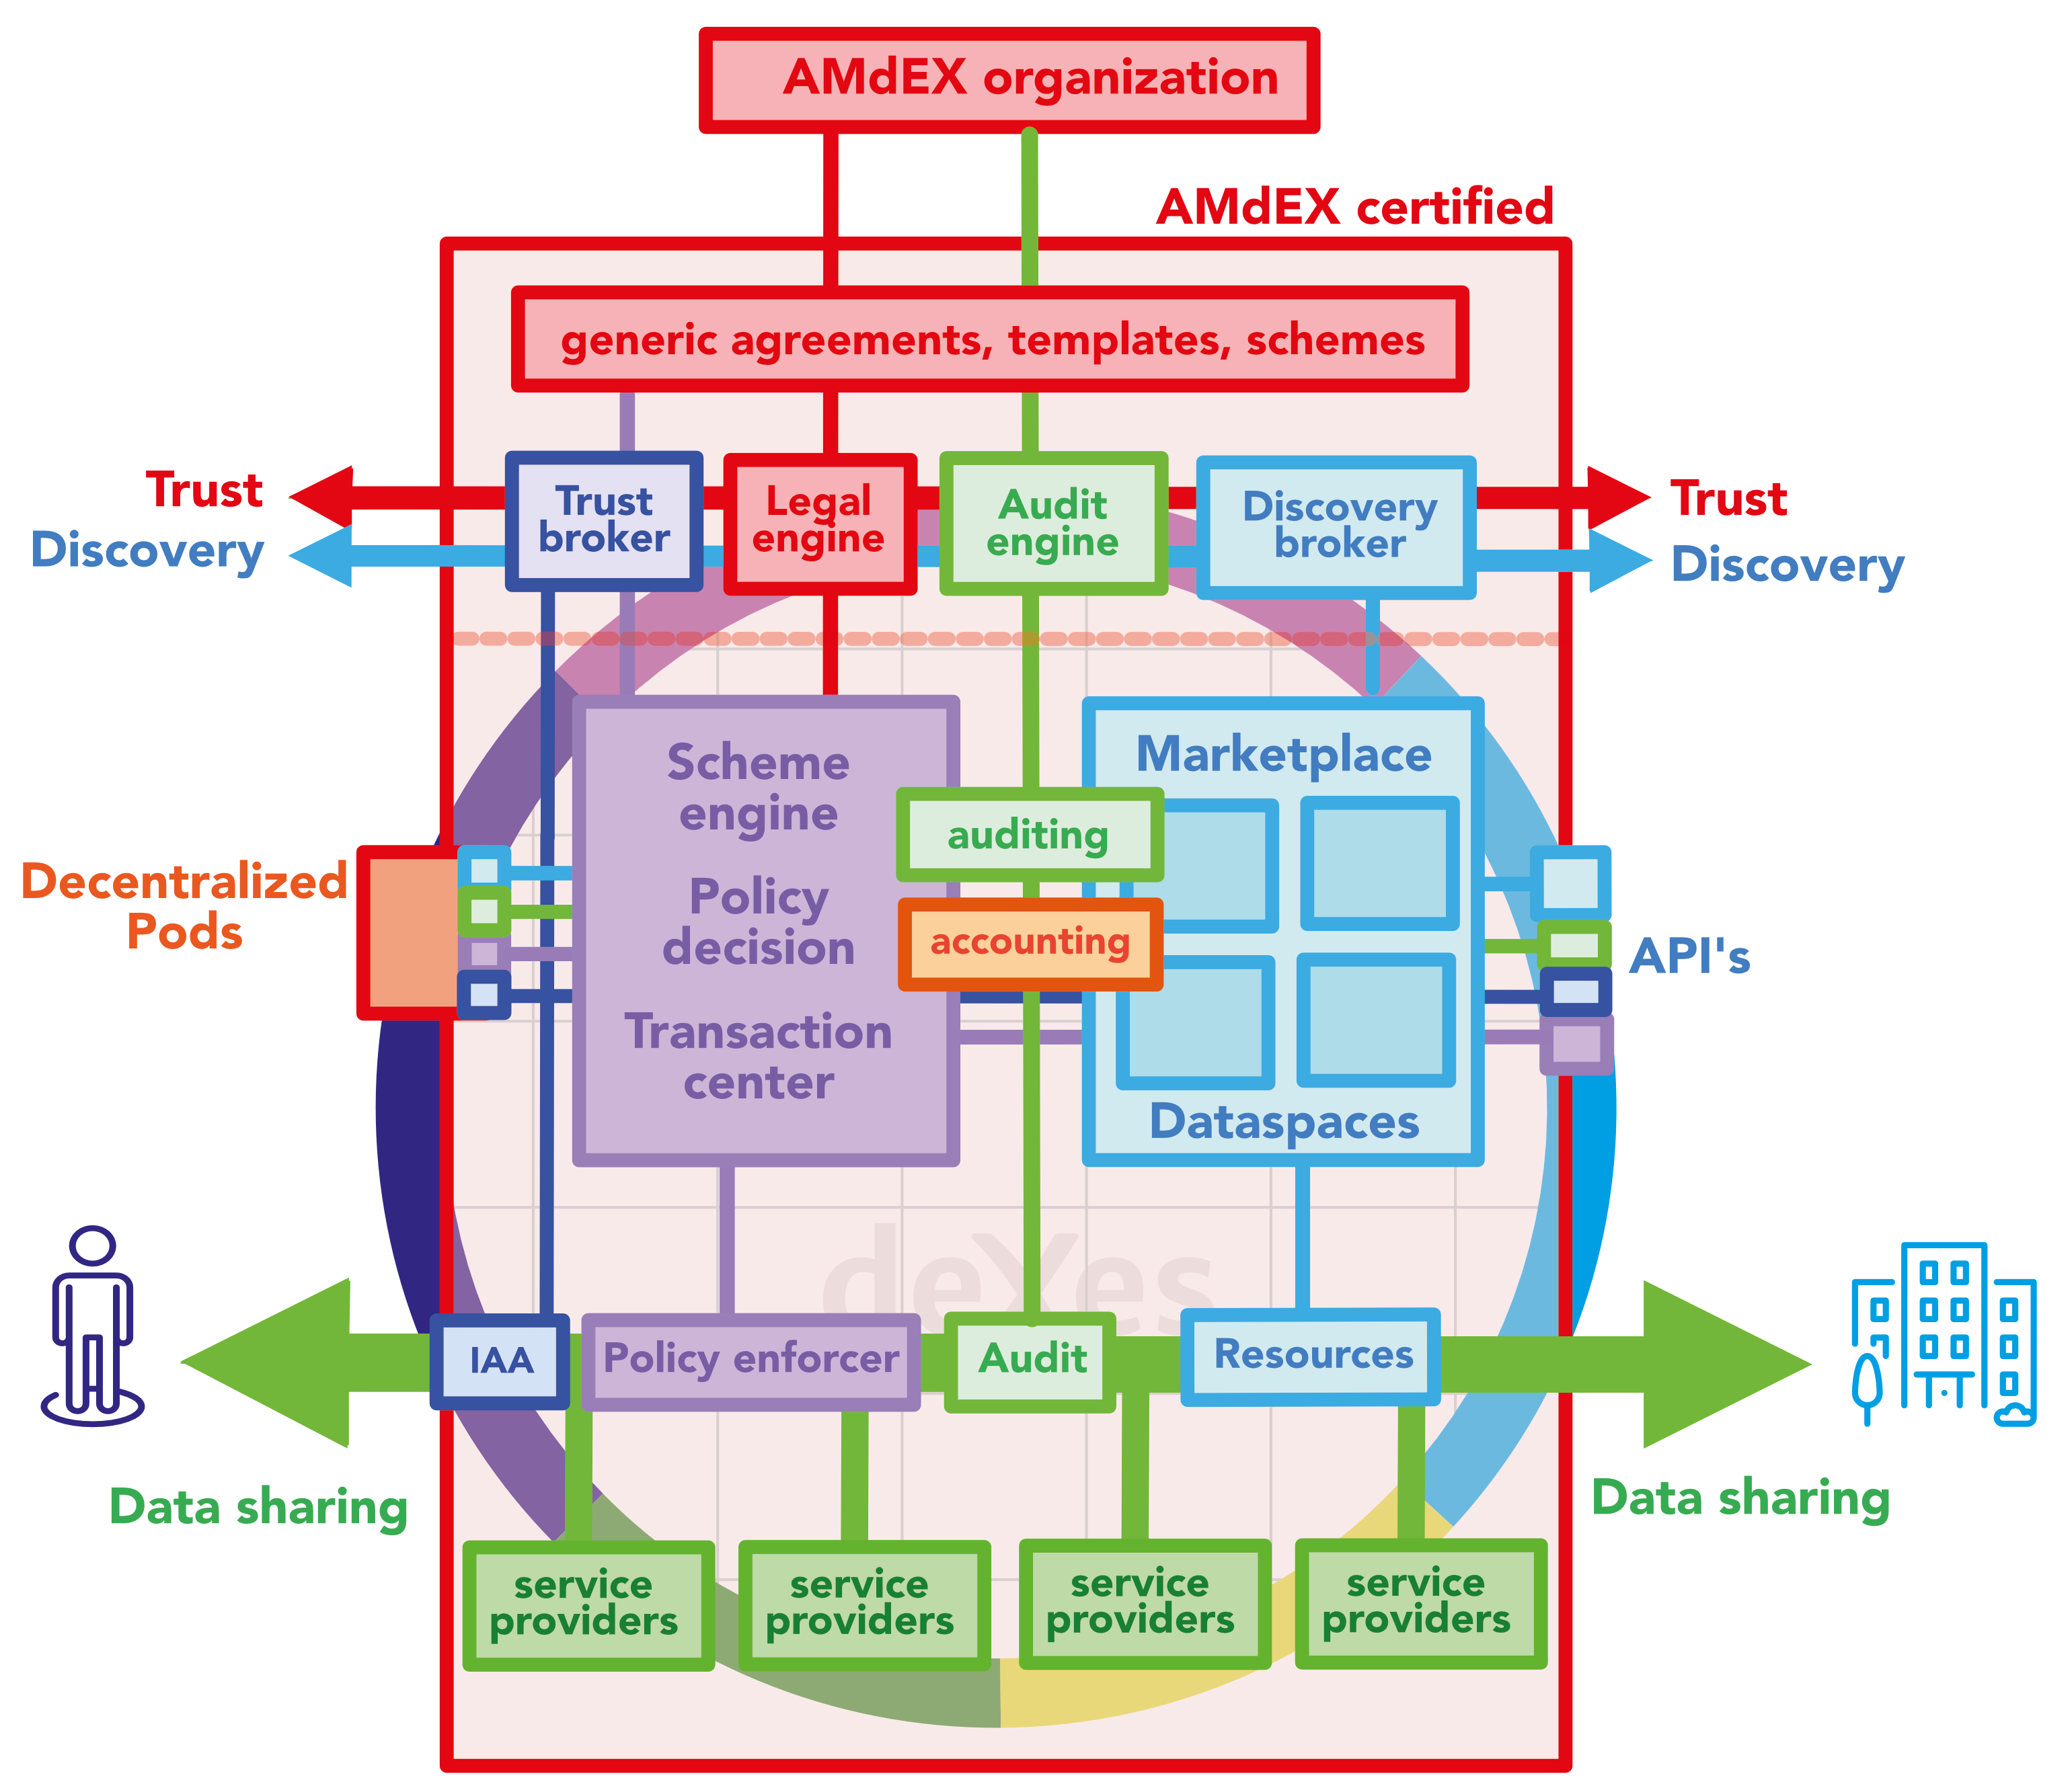
Notes:
AMS-IX is part of amdex
architecture, use cases and writing code in parallel.
picures of use-cases

Slide 20

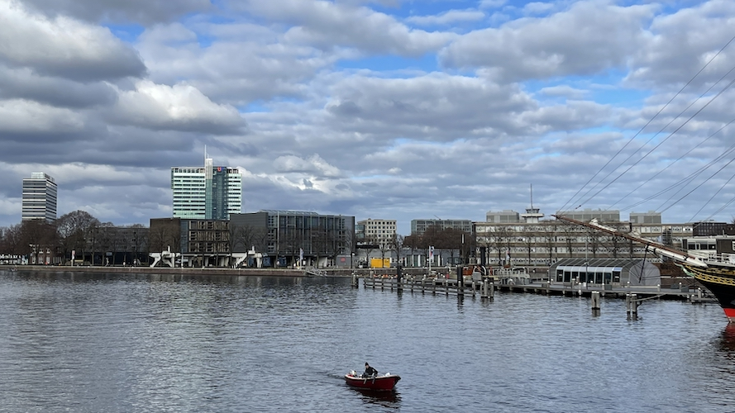



Notes:
AMS-IX is part of amdex
architecture, use cases and writing code in parallel.
picures of use-cases

Slide 21
Quantum Internet

Slide 22
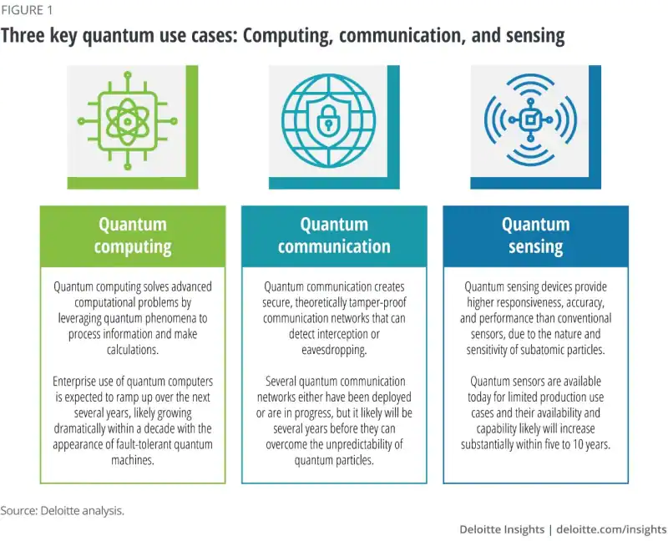
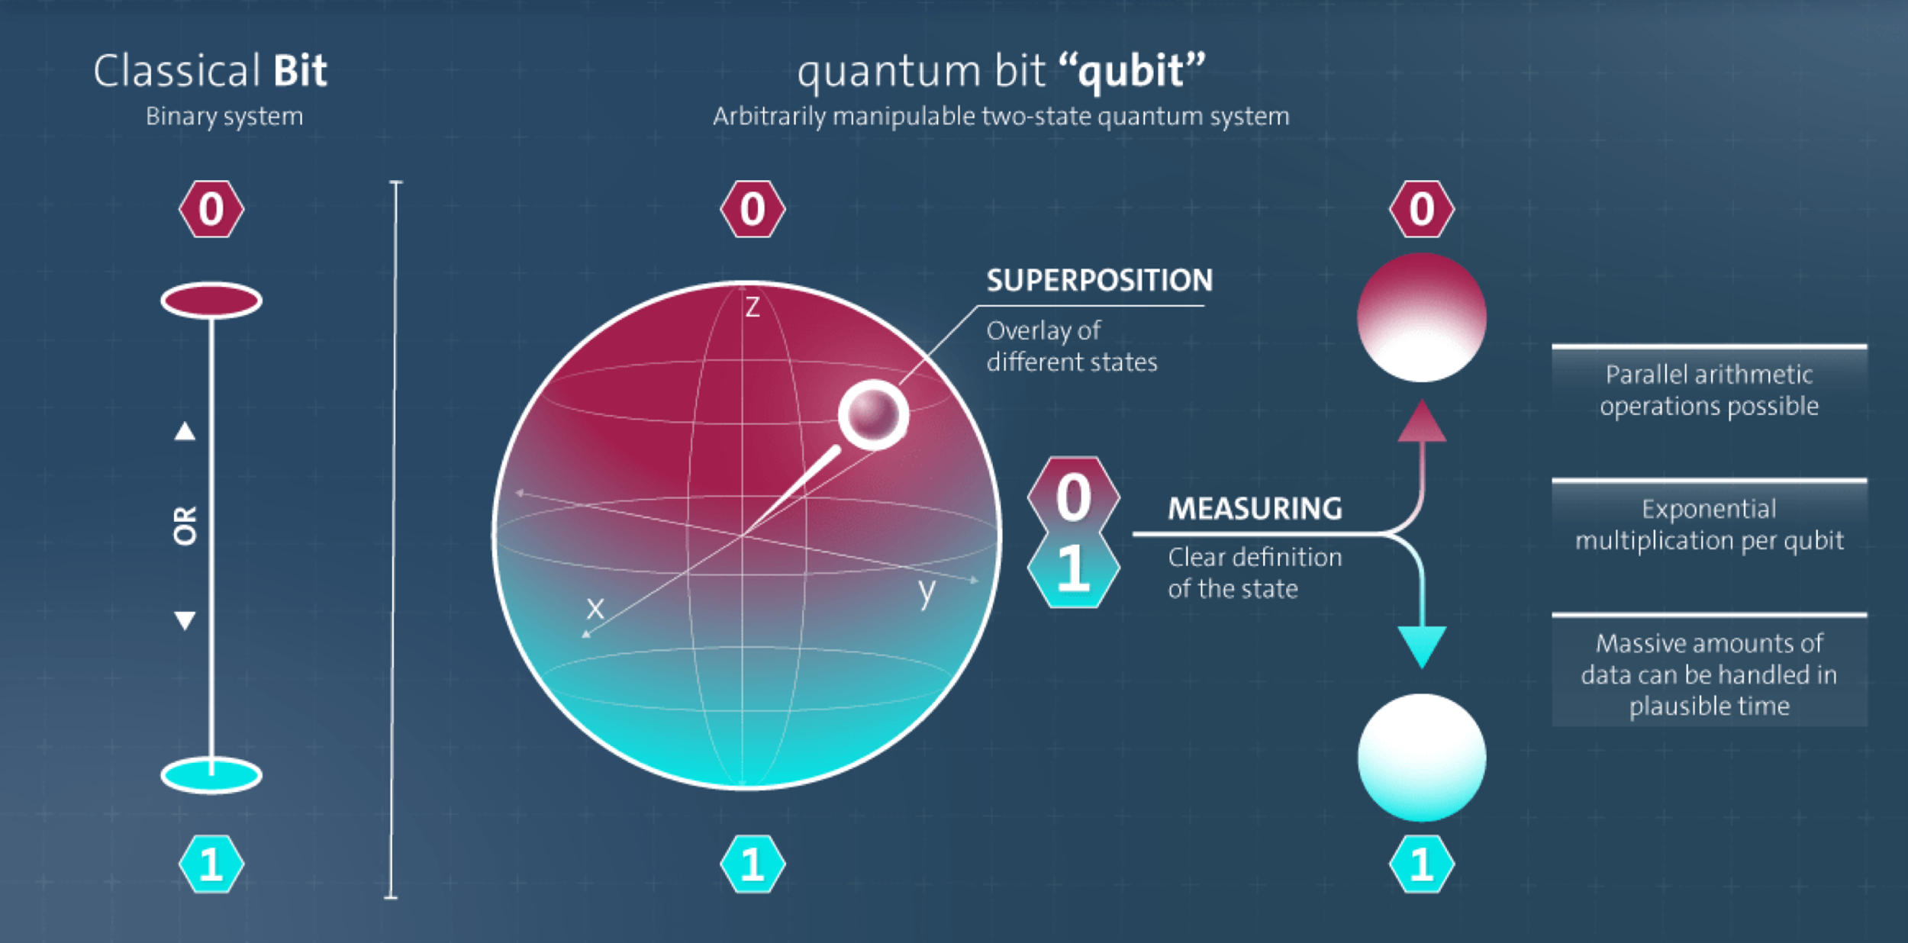
Notes:
online safety
Quantum Internet is coming….
Quantum Internet Alliance: EU project

Slide 23

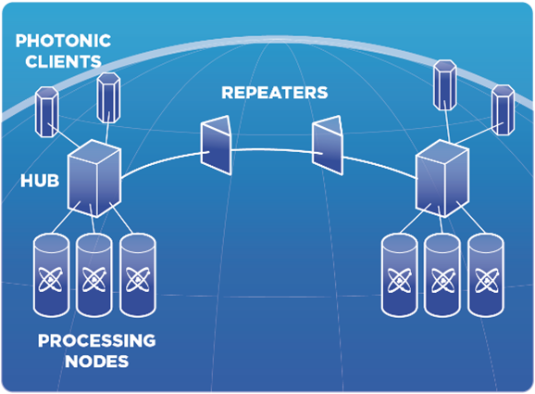
What’s a Quantum Internet Exchange?
Notes:
online safety
Quantum Internet is coming….
Quantum Internet Alliance: EU project

Slide 24
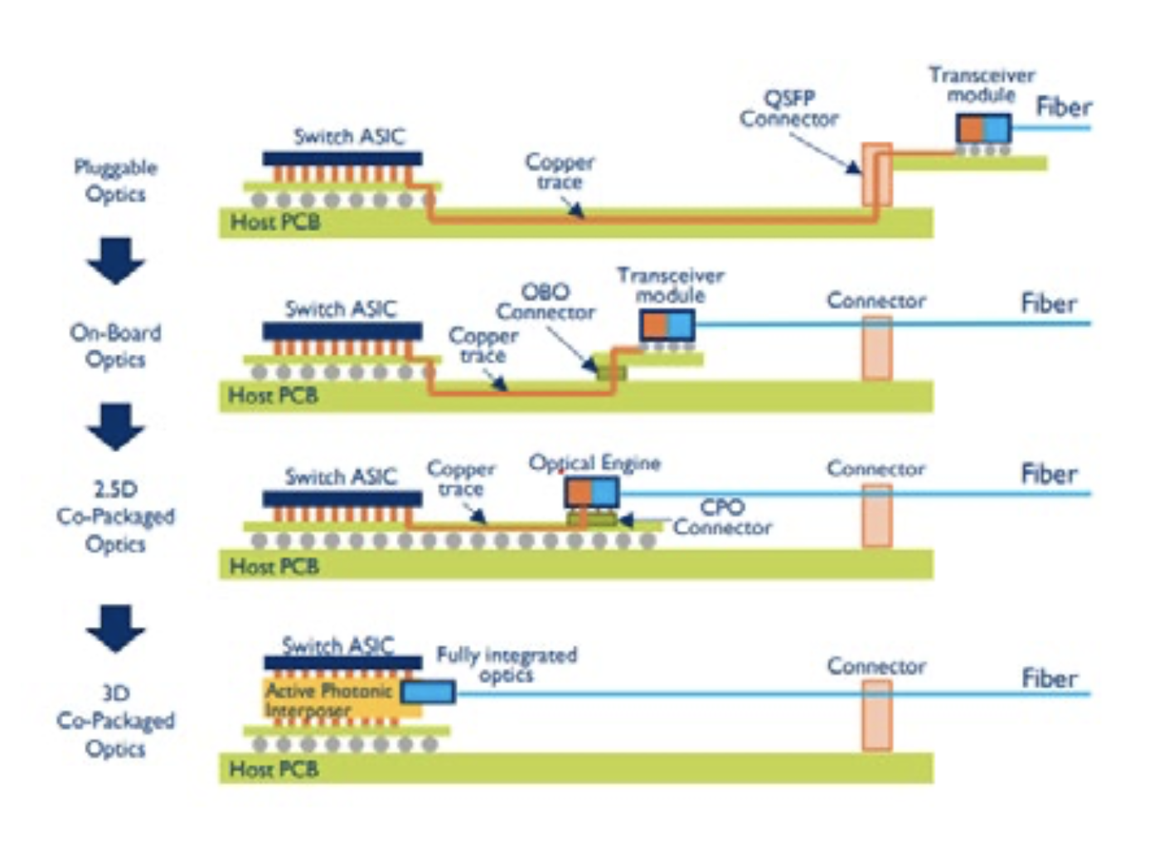

Integrated Photonics
Improve energy efficiency by
shortening the electrical path
Notes:
sustainability
numbers on energy use intenet searches and video consumption
What technologies can provide a step-change in becoming more sustainable as an industry?

Slide 25
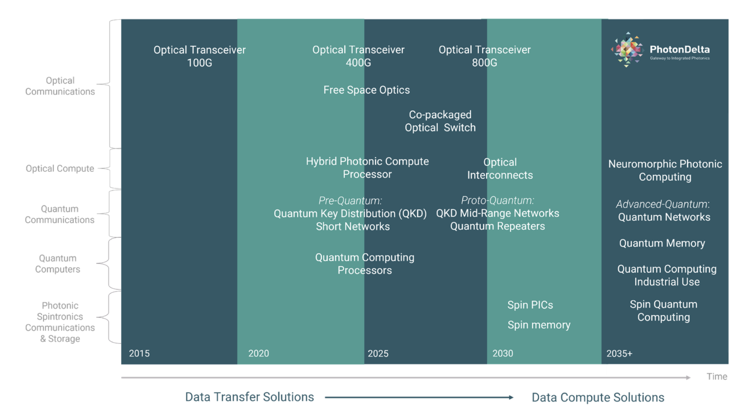
Integrated Photonics
100x
less power comsumption
125x
higher transmission capacity
200x
lower end-to-end latency
Notes:
sustainability
numbers on energy use intenet searches and video consumption
What technologies can provide a step-change in becoming more sustainable as an industry?

Slide 26
How will the internet improve societies in the Middle East?
Notes:
So, with this in mind, I ask you:
How do you believe the internet can/will/should improve societies in the Middle East?

Slide 27
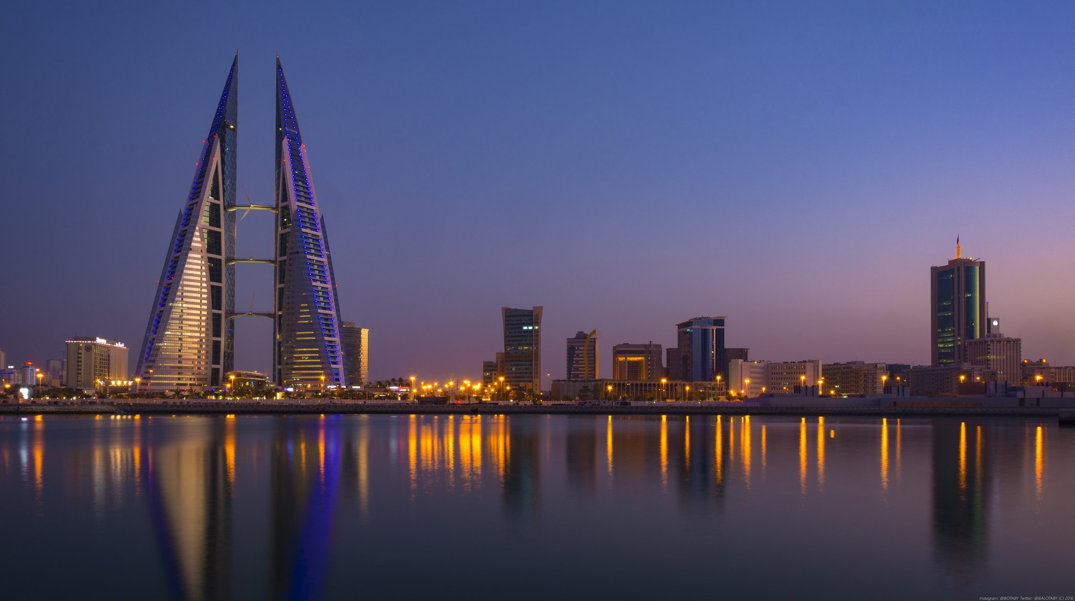
Be the exchange you want to see in this world!

Slide 28
شكرا لك
Notes:
shokran

