Slide 1
Multipath TCP: Revolutionizing Internet Connectivity
Ehsan Ghazizadeh
CAPIF4

Slide 2

In loving memory of Dave Täht

Slide 3
Agenda
Introduction to TCP & Its Limitations
Key Problems with Traditional TCP
What is Multipath TCP (MPTCP)?
How MPTCP Solves These Problems + Real-World Use Cases
Conclusion & Future Outlook
Q&A
Notes:
"We’ll start by understanding TCP’s limitations, then introduce MPTCP, and finally examine real-world deployments by Apple, Google, and cloud providers."

Slide 4
What is TCP?
Brief definition: Transport Layer Protocol.
Provides reliable, ordered, and error-checked delivery.
Used in web browsing, video streaming, file transfers, etc.
Notes:
"TCP is the backbone of the internet—used in web browsing, video streaming, and file transfers. However, it was designed in an era where devices had only one network interface. The 3-way handshake is key because it ensures both the client and server are ready to communicate reliably before data transfer begins."

Slide 5
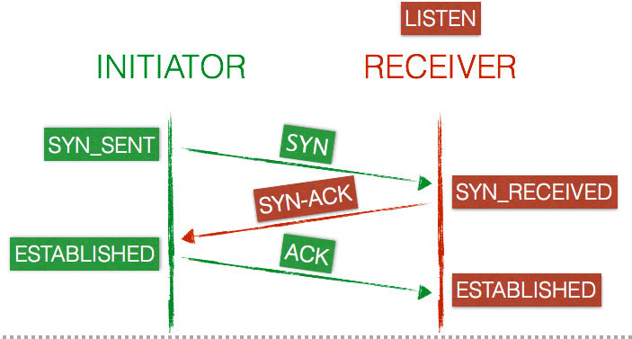
How Traditional TCP Works?
Brief definition: Transport Layer Protocol.
Provides reliable, ordered, and error-checked delivery.
Used in web browsing, video streaming, file transfers, etc.
Notes:
"TCP uses just one path, even if your phone has both Wi-Fi and LTE. If that path fails, your connection drops."

Slide 6
TCP Performance Issue
We are in the era of 5G, DWDM and 800G Transceivers
Why do we still need to use download manager to utilize the Internet link?
Why a single TCP connection is not capable of reaching like 10Gbps?
Where is the bottleneck?

Slide 7
TCP BDP Limitation
Assuming there is no packet loss
Assuming there is no CPU or NIC bottlenecks
BDP = Bandwidth × Round-Trip Time (RTT)
For 1 Gbps with 50 ms RTT:
  → BDP = 1 Gbps × 0.05 s = 62.5 MB
  → TCP must have at least a 62.5 MB congestion window and buffer space.

Slide 8
Limitations of Traditional TCP
Single-Point Failure: Connection drops if the single path fails (e.g., Wi-Fi disconnects) - Lack of Resilience.
No Bandwidth Aggregation: Cannot combine bandwidth from multiple interfaces (Wi-Fi + LTE can’t combine) - Underutilization of Resources.
Inefficient for Modern Devices: Not optimized for multi-interface smartphones, laptops, IoT - Designed for a Bygone Era.
Notes:
"Imagine driving a car with two engines but only using one—that’s how TCP wastes available bandwidth today."

Slide 9
Problem 1 – Single Path
Example: Video call drops when Wi-Fi disconnects.
Impact: Interrupted services, frustration.
Statistic: "In 2023, 42% of remote workers reported dropped calls due to network issues."
Notes:
"In 2023, 42% of remote workers reported dropped calls due to network issues. MPTCP fixes this by seamlessly switching paths."

Slide 10
Problem 2 – Wasted Bandwidth
Device with Wi-Fi (50 Mbps) + LTE (30 Mbps).
Traditional TCP uses only one path (e.g., 50 Mbps Wi-Fi).
Result: Only 50 Mbps used, 30 Mbps wasted for that connection.
Notes:
"With traditional TCP, even if you have multiple active connections like Wi-Fi and LTE, a single application connection can only use one. With MPTCP, your phone could potentially use both its Wi-Fi and LTE simultaneously, giving you a combined speed, for instance, 80 Mbps instead of just 50."

Slide 11
Problem 3 – No Load Balancing
Use case: Cloud servers with multiple ISP links.
Problem: Cannot easily distribute traffic intelligently across multiple links for a single connection or multiple connections
Inside DCs we have ECMP paths
Each TCP connection uses only 1 single path based on 5tuple hash
Notes:
"Data centers and large enterprises often pay for multiple high-bandwidth ISP links but struggle to balance traffic efficiently across them for a single connection or even multiple connections intelligently. Traditional TCP doesn't provide the native ability to do this smart distribution. MPTCP solves this by allowing traffic from a single logical connection to flow over multiple physical links."

Slide 12
Introduction to MPTCP
An extension to the TCP protocol.
IETF Standard: RFC 6824, RFC 8684 (MPTCPv1).
Works at the Transport Layer (Layer 4).
Allows a single logical TCP connection to use multiple physical network paths.
Backward-compatible with existing TCP applications.
Notes:
"MPTCP is like giving TCP a superpower—it extends the standard TCP capabilities to enable a single application connection to use multiple network paths at the same time. It does this at the transport layer, meaning applications like your web browser or video streaming app don't necessarily need to be rewritten to benefit from it. It manages the complexity below the application level."

Slide 13
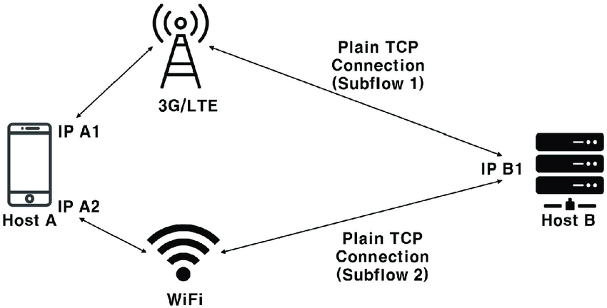
How MPTCP Works?
Notes:
"Instead of being limited to one path, MPTCP establishes a single logical connection which is then managed over multiple subflows, each potentially using a different network interface and path. Your phone can now potentially use both its Wi-Fi and LTE connections simultaneously to send and receive data for the same download or video call. If one path experiences issues, the data can be rerouted over the other path seamlessly, and the connection remains alive."

Slide 14
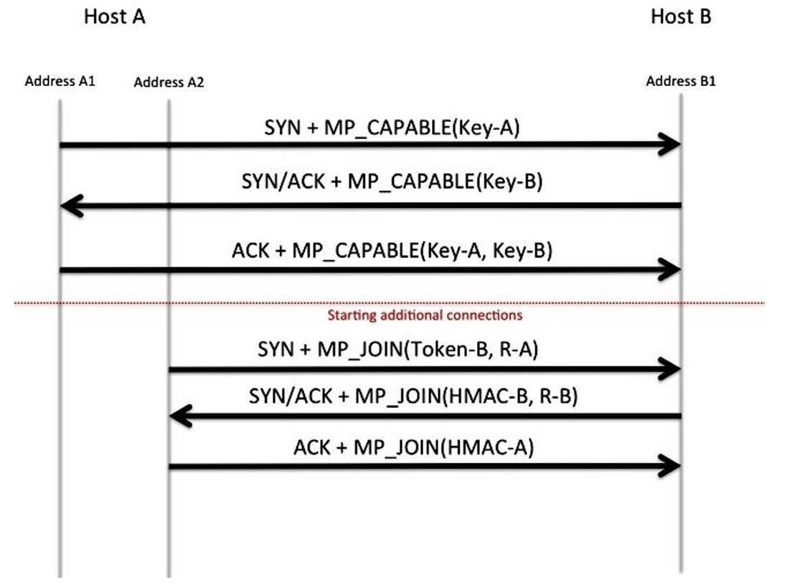
How MPTCP Works?
Notes:
"Instead of being limited to one path, MPTCP establishes a single logical connection which is then managed over multiple subflows, each potentially using a different network interface and path. Your phone can now potentially use both its Wi-Fi and LTE connections simultaneously to send and receive data for the same download or video call. If one path experiences issues, the data can be rerouted over the other path seamlessly, and the connection remains alive."

Slide 15
Key Features of MPTCP
Seamless Handover/Failover: Prevents connection drops when a path fails - Stay Connected.
Bandwidth Aggregation: Utilizes capacity of multiple paths for higher speed - Get Faster Speeds.
Intelligent Resource Pooling: Distributes data across paths based on characteristics - Optimize Performance.
Congestion Control per Path: Manages congestion independently for each subflow - Ensure Stability.
Notes:
"These features directly address the limitations of traditional TCP. Seamless handover means your critical applications stay connected. Bandwidth aggregation means faster performance. Intelligent resource pooling ensures optimal use of available networks, and per-path congestion control makes it robust in diverse network environments. This isn’t just theory—Apple already uses MPTCP in iOS for Siri and FaceTime to prevent call drops when network conditions change."

Slide 16
Real-World Use Cases
How MPTCP Solves Problems

Slide 17
No More Dropped Connections
Real-World Example: Apple iOS
Used for Siri, FaceTime, and iCloud.
Benefit: Seamless transition between Wi-Fi and Cellular.
Result: Reports of significantly fewer call drops/interruptions.
Notes:
"Apple was an early adopter. By using MPTCP for services like FaceTime, when your Wi-Fi connection weakens or fails as you walk away from your router, MPTCP can seamlessly switch the traffic to your cellular connection without interrupting your call. This provides a much more reliable user experience."

Slide 18
Faster Speeds via Bandwidth Aggregation
Real-World Example 1: Tesla
Uses MPTCP for large over-the-air (OTA) software updates.
Benefit: Downloads updates faster by combining Wi-Fi and cellular.
Result: Reported update download times reduced significantly (e.g., 2x faster).
Real-World Example 2: Google QUIC
Notes:
"Beyond preventing drops, MPTCP can deliver faster speeds. Tesla vehicles use MPTCP for downloading large software updates. By aggregating both the owner's Wi-Fi and the car's cellular connection, they can download these updates significantly faster, improving the customer experience and efficiency. Google's work with QUIC also shows interest in similar multi-path capabilities at the transport level."

Slide 19
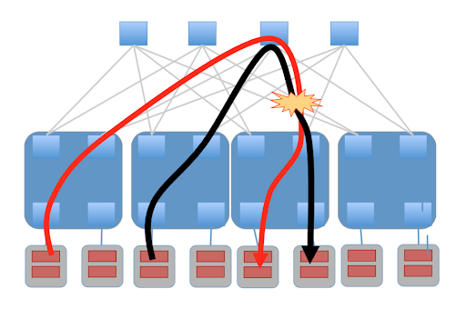
Data Center Efficiency
Notes:
"In the data center, where maximizing network utilization is critical, companies like Microsoft and Meta use MPTCP to improve efficiency. Instead of having idle backup links or underutilized connections, MPTCP allows them to distribute traffic more intelligently across all available paths, leading to reports of improvements like 40% better bandwidth utilization and increased resilience for critical internal communication."

Slide 20
Data Center Efficiency
Real-World Examples:
  Microsoft Azure: Used internally for VM migration, storage traffic.
  Facebook (Meta): Used for internal data center traffic, load balancing.
Benefit: Better utilization of network links, improved load balancing, enhanced redundancy.
Result: Reports of significant improvements in bandwidth utilization and resilience.
Notes:
"In the data center, where maximizing network utilization is critical, companies like Microsoft and Meta use MPTCP to improve efficiency. Instead of having idle backup links or underutilized connections, MPTCP allows them to distribute traffic more intelligently across all available paths, leading to reports of improvements like 40% better bandwidth utilization and increased resilience for critical internal communication."

Slide 21
Other Real-World Deployments
5G Networks: Faster, smoother handovers between cells/technologies.
Satellite Communication: Improves reliability for combined satellite and terrestrial links.
Military & Drones: Provides robust communication in challenging/unstable environments.
Notes:
"MPTCP's benefits extend to many other areas. In the evolving landscape of 5G, it can help manage traffic across diverse access technologies. It's crucial for ensuring reliable connections in demanding environments like satellite communication or military applications where maintaining a link, even at reduced capacity, is paramount. For instance, the U.S. military is reportedly using MPTCP in drone communication to prevent signal loss during critical missions."

Slide 22
Summary of Benefits
Feature | Traditional TCP | MPTCP
Reliability | Single-Point Failure | Seamless Failover/ Handover
Performance | Wasted Bandwidth | Bandwidth Aggregation
Efficiency | No Load Balancing | Intelligent Resource Pooling
Notes:
"In summary, MPTCP addresses the fundamental limitations of traditional TCP in a multi-interface world. It transforms a single point of failure into a resilient, multi-path connection, turns wasted bandwidth into aggregated speed, and enables efficient use of multiple network resources. MPTCP isn’t just a patch—it’s a fundamental upgrade to TCP designed for today's and tomorrow's connected world."

Slide 23
Challenges & Adoption
Middlebox Interference: Legacy firewalls, NATs, load balancers may block or interfere.
OS Support: Core support in Linux, iOS, macOS; evolving/limited in Windows/Android.
Application Awareness (Optional): Apps can be optimized for better MPTCP leverage.
Notes:
"Despite its advantages and growing adoption by major players, MPTCP faces challenges. The biggest hurdle is often interference from legacy network equipment, particularly enterprise firewalls and NAT devices, which need updates to correctly identify and allow MPTCP traffic. Also, while server-side Linux support is strong and Apple has led mobile adoption, widespread default client-side support in other major operating systems is still catching up. However, as more vendors update their equipment and OS support grows, these challenges are diminishing."

Slide 24
The END
Contact me on: Ehsan.ccsp@gmail.com

