Slide 1
IXP Tracker and Content Locality
Measuring the Health and Resilience of the Internet with Internet Society Pulse and the role of IXPs.
CAPIF 3
September 2024
Hanna Kreitem
Senior Advisor, Internet Technology and Development
kreitem@isoc.org

Slide 2
Pulse tracks
Shutdowns: Where do Internet shutdowns take place?
Net Loss: Estimate the economic impacts of Internet shutdowns.
Technologies: Tracking the deployment of technologies critical for the evolution of the Internet.
Concentration: How much are services concentrated in the hands of a few?
Resilience: How robust is the Internet ecosystem?
IXP Tracker: monitors the growth of IXPs globally

Slide 3
IXP Tracker

Slide 4
IXP Tracker (now and future)
Monitors growth and development
Tracks key growth metrics of IXPs globally
Evaluates performance and reliability
Provides information on the performance and resilience of networks at the IXP.
Facilitates network optimization
Provides up-to-date information to enable data-driven peering decisions.
Foster community engagement
Provides a platform for IXP members to connect, share knowledge, and collaborate.
Notes:
This flexibility ensures that the insights are tailored and meaningful, facilitating more informed decisions and strategic planning.

Slide 5
Components
  Collects data on more than 1000 IXPs globally from PeeringDB/PCH.
  Provides information about capacity and membership growth.
  Shows a country and an IXP view.
PCH
PeeringDB
Members, capacity, reachability
IXP Tracker
API
(soon)
RIPE
Atlas
IXP
Looking glasses
Live measurements (coming soon)

Slide 6
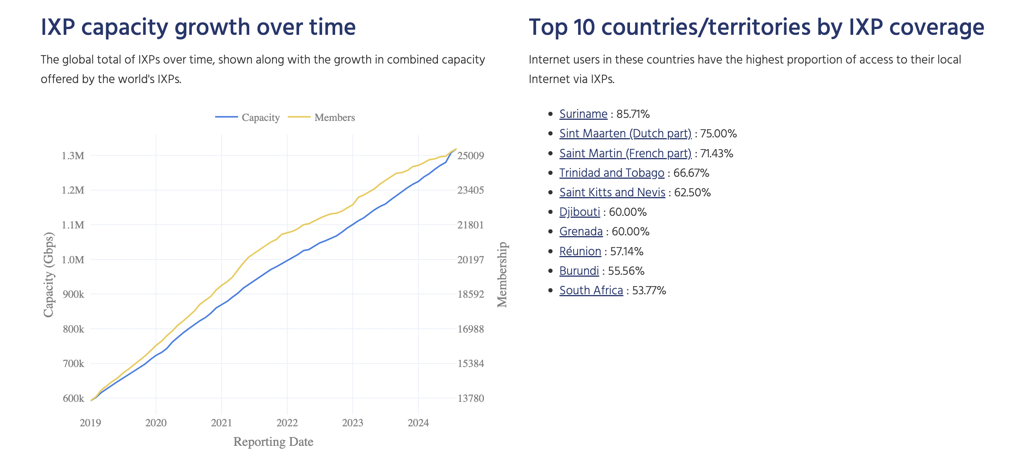
Global view

Slide 7
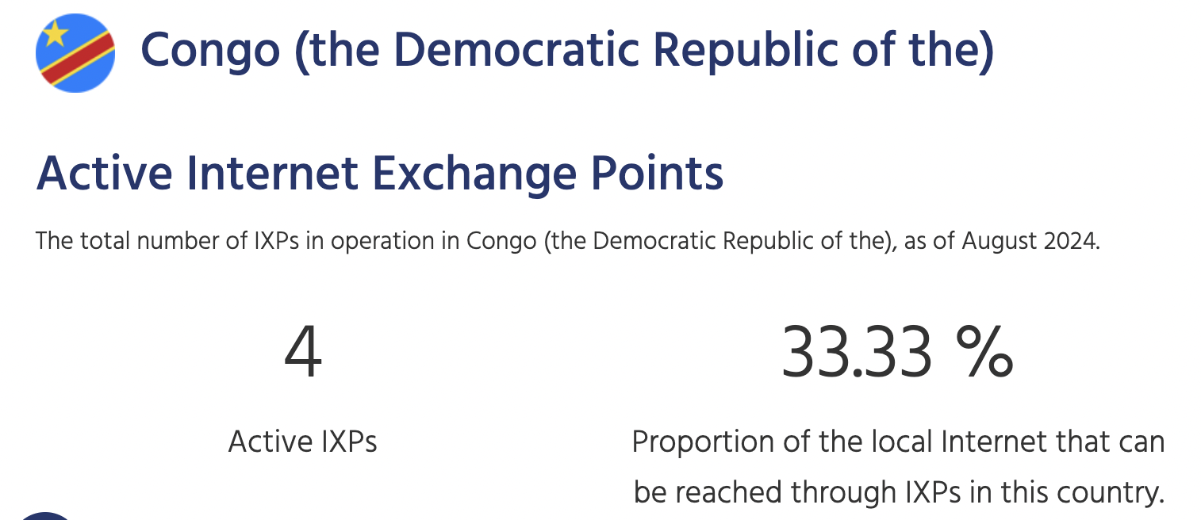
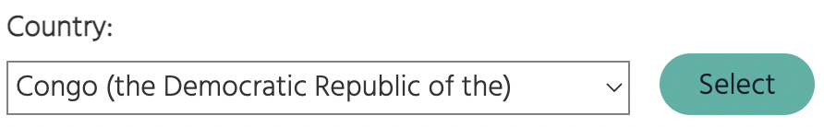
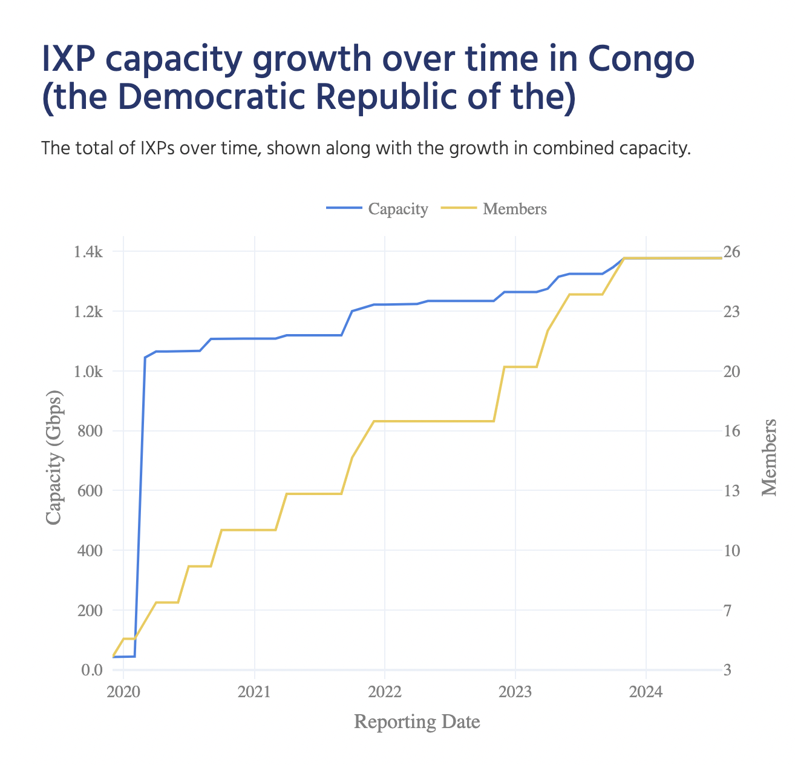
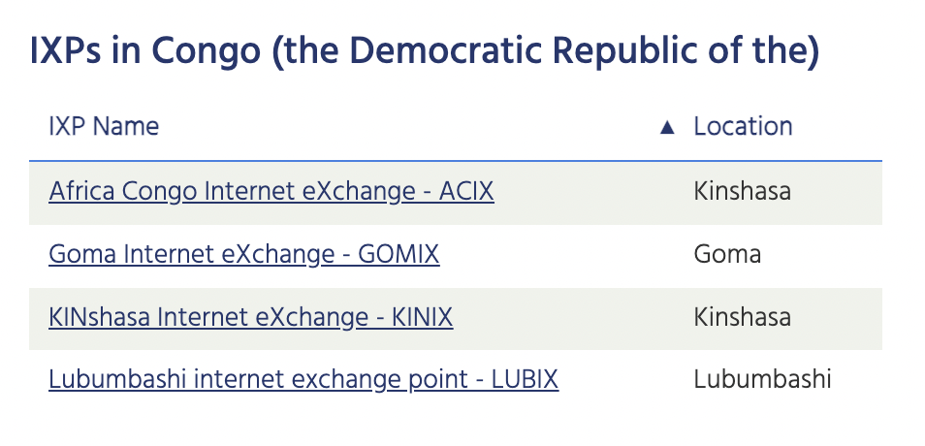
Country view

Slide 8
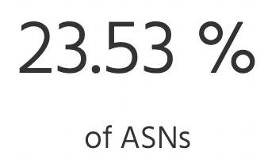
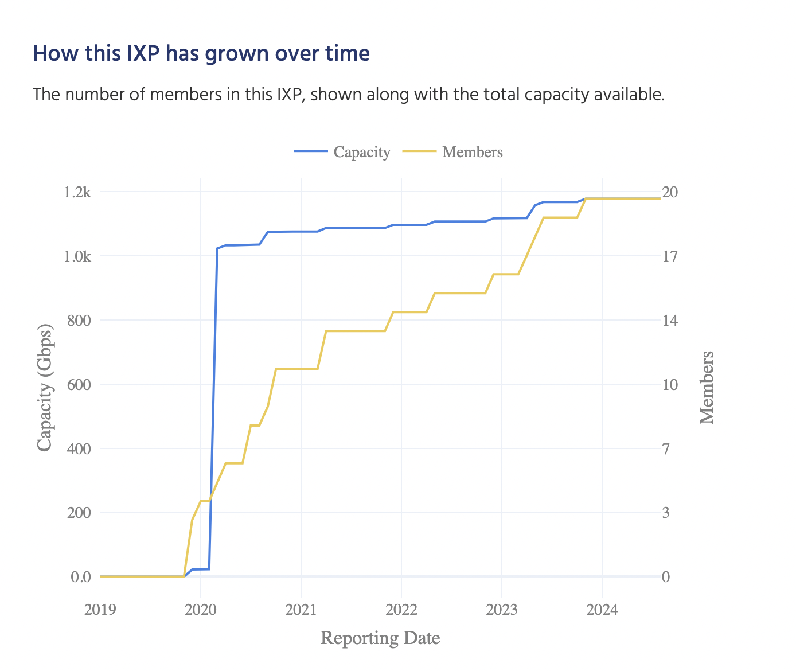
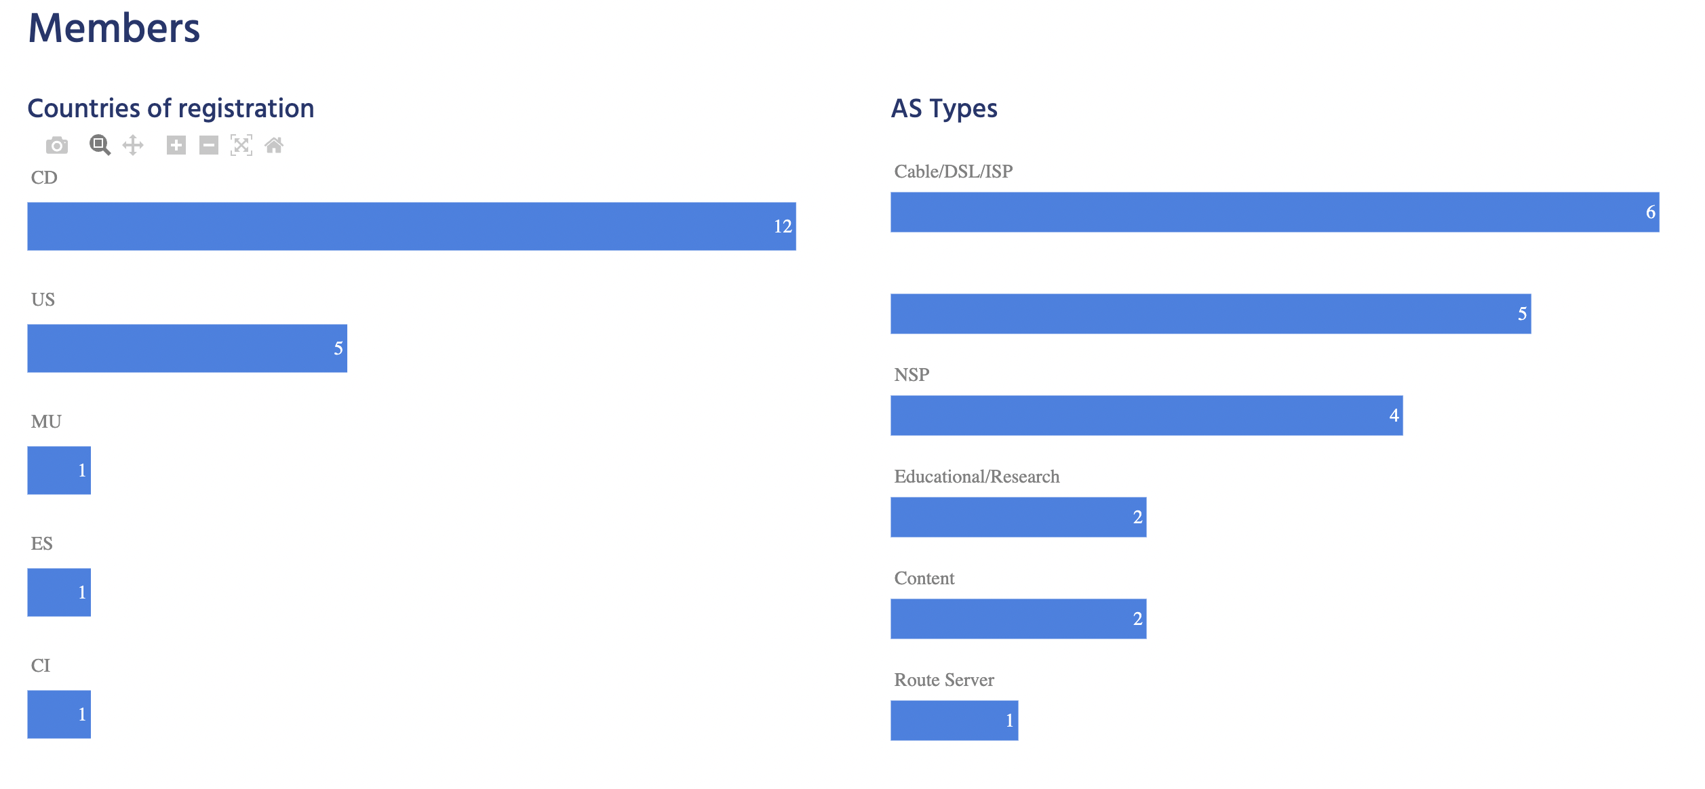
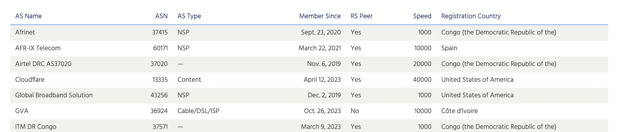
IXP view - KINIX

Slide 9
IXP Tracker 2.0

Slide 10
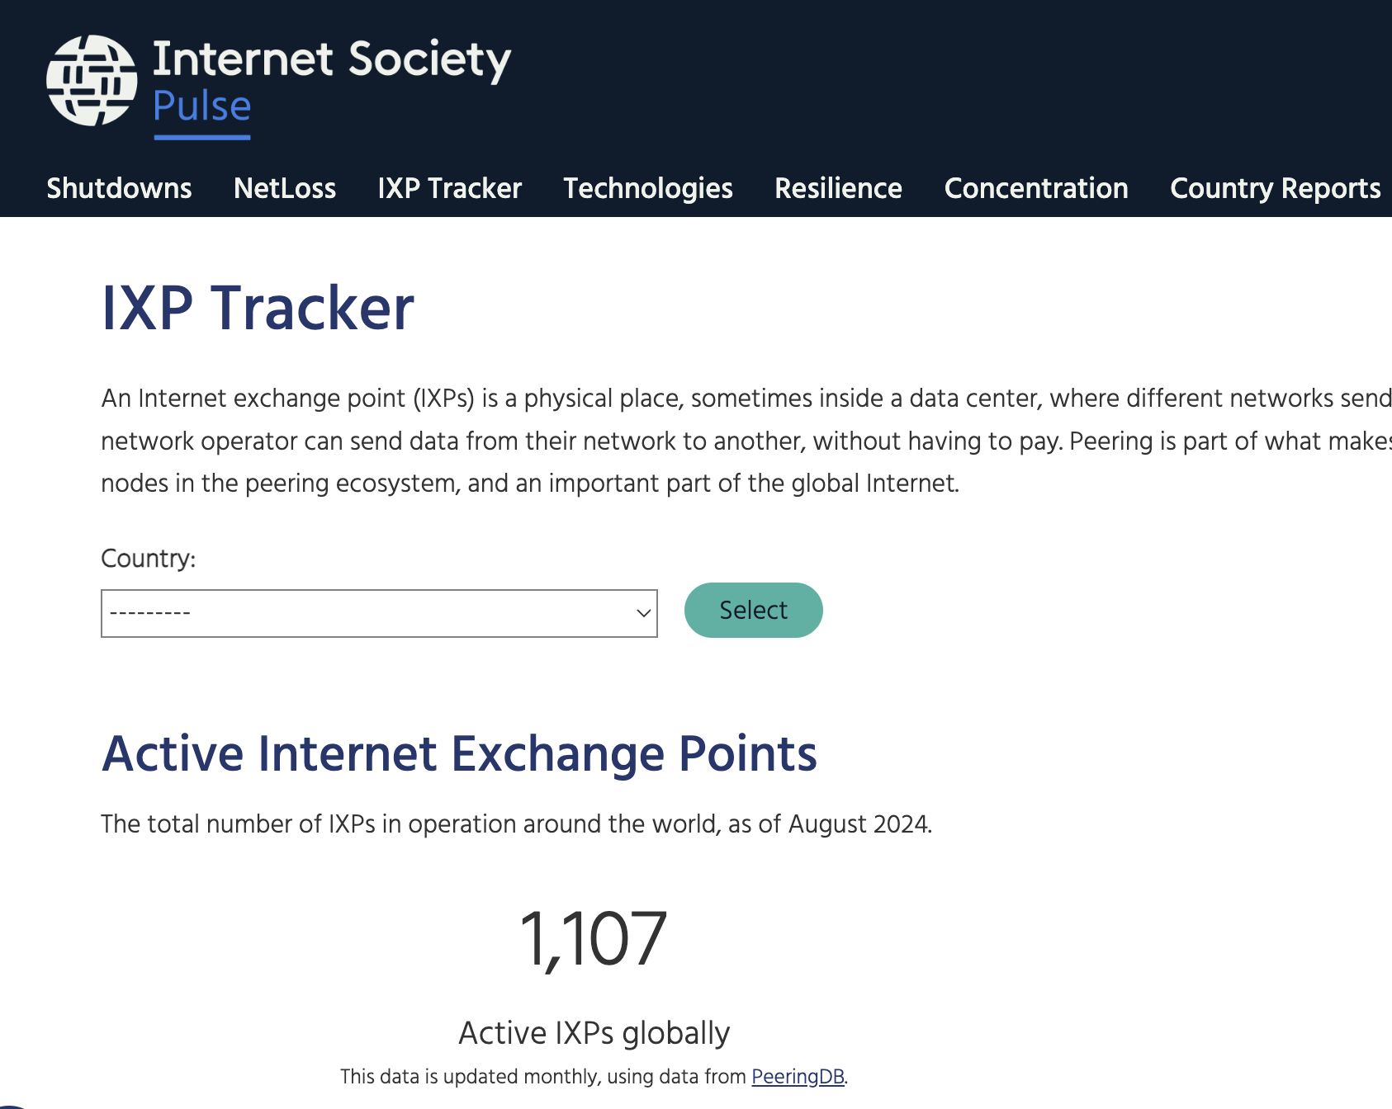
Additional features
AS level: shows details about IXPs where a given AS is connected, including prefixes, address space and customer cone.
Prefix level: displays information about all the IXPs a given prefix is reachable, including AS Path length metrics.
Compare two IXPs: reachability (prefixes and networks reachable), customer cone, AS Path length.
Network benefits calculator: We can ask an AS to upload its routing table into the IXP Tracker and select an IXP to see the networking benefits.

Slide 11
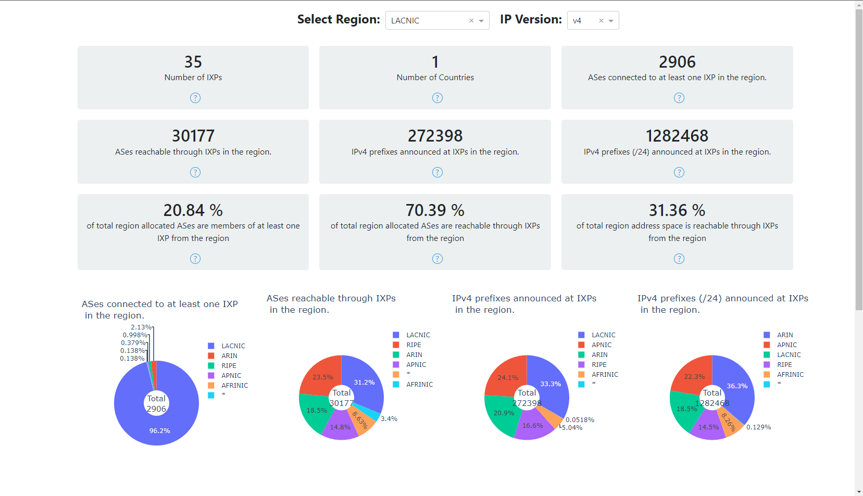
Region view - Statistics
Notes:
Cost
Reachable ASes
AS Path lengths
Routing stability
Traffic detours

Slide 12
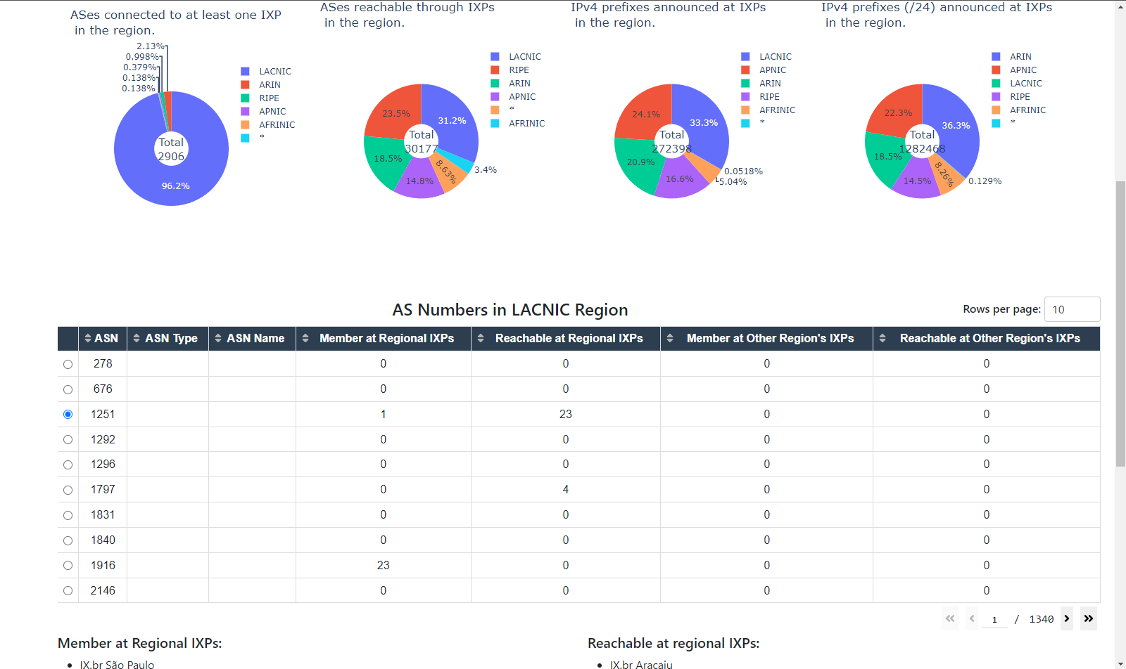
Region view - Table (ASes)

Slide 13
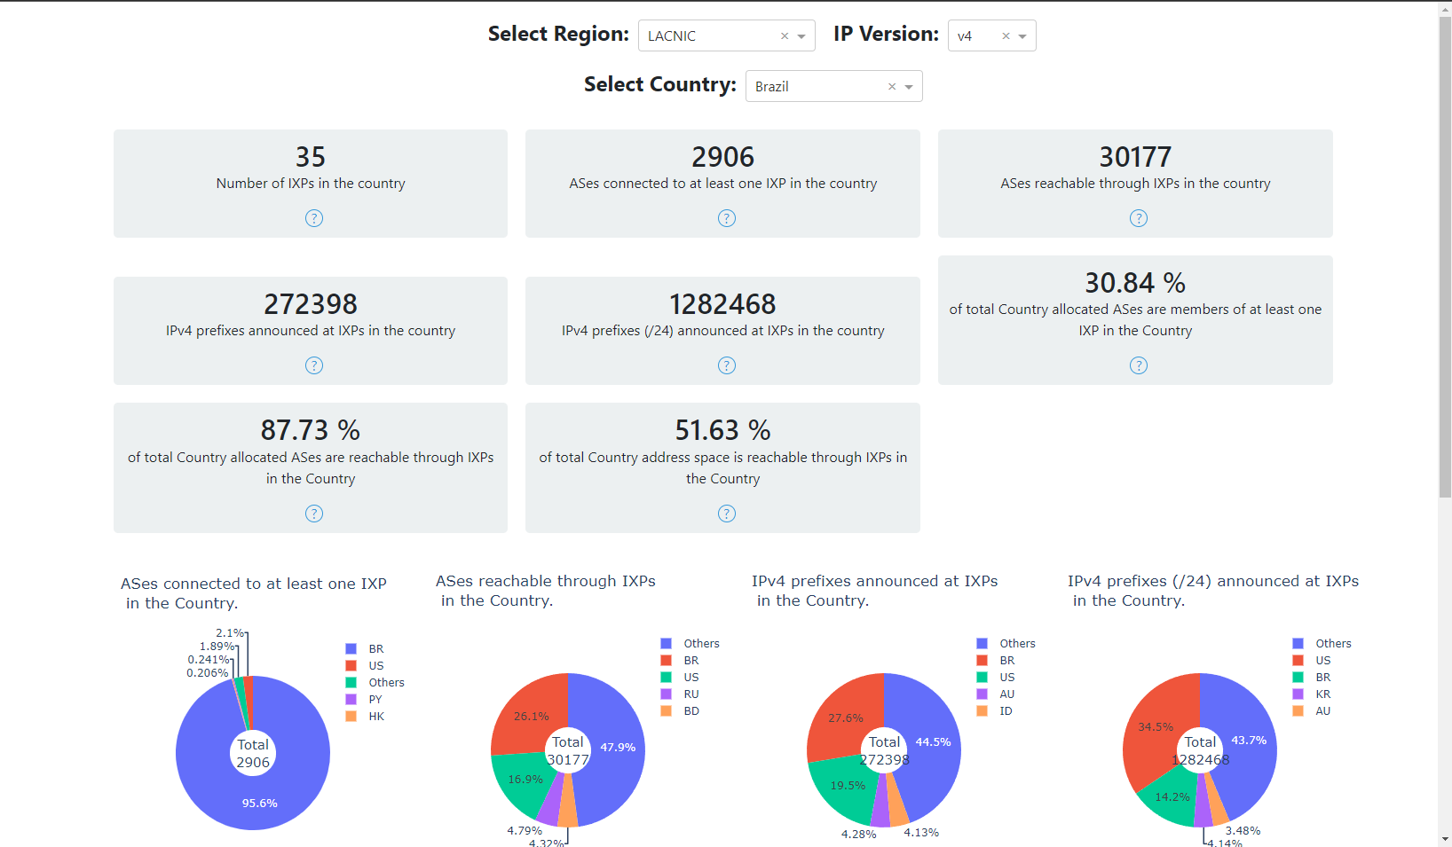
Same analysis for Country view…

Slide 14
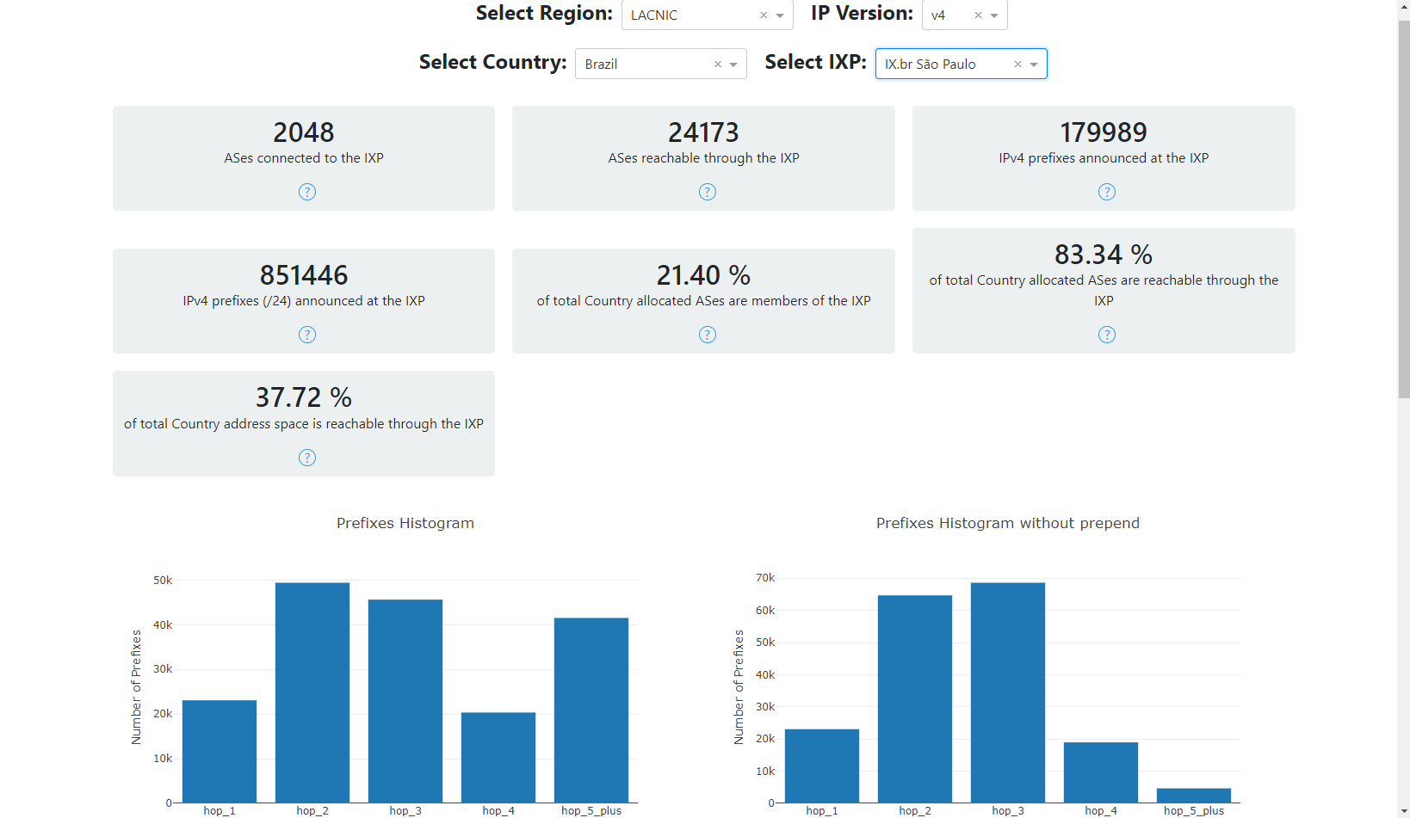
IXP view - Statistics

Slide 15
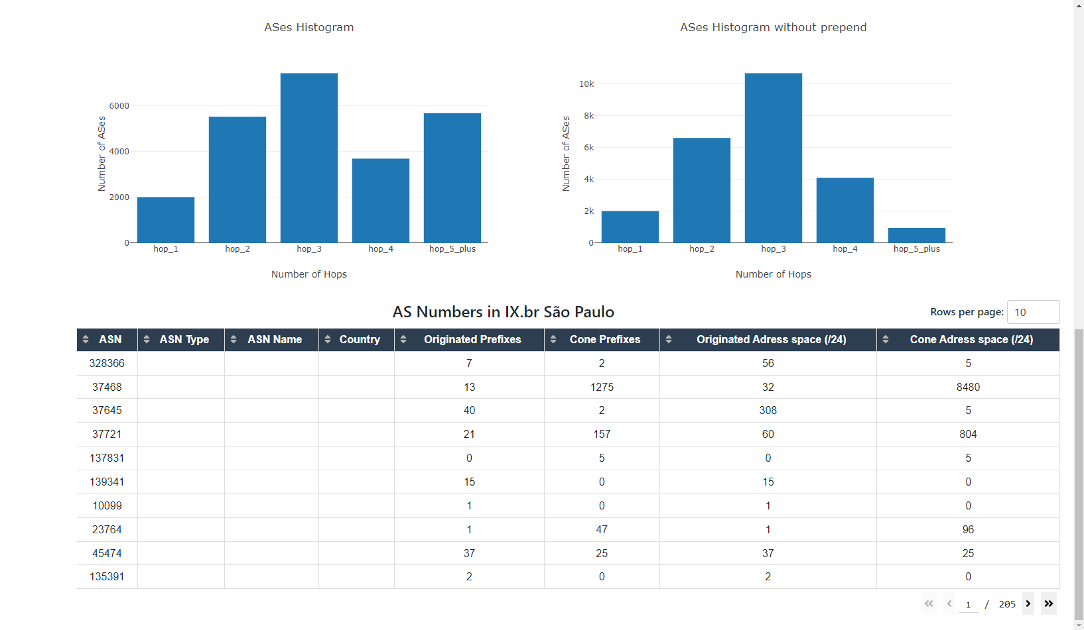
IXP view - Table

Slide 16
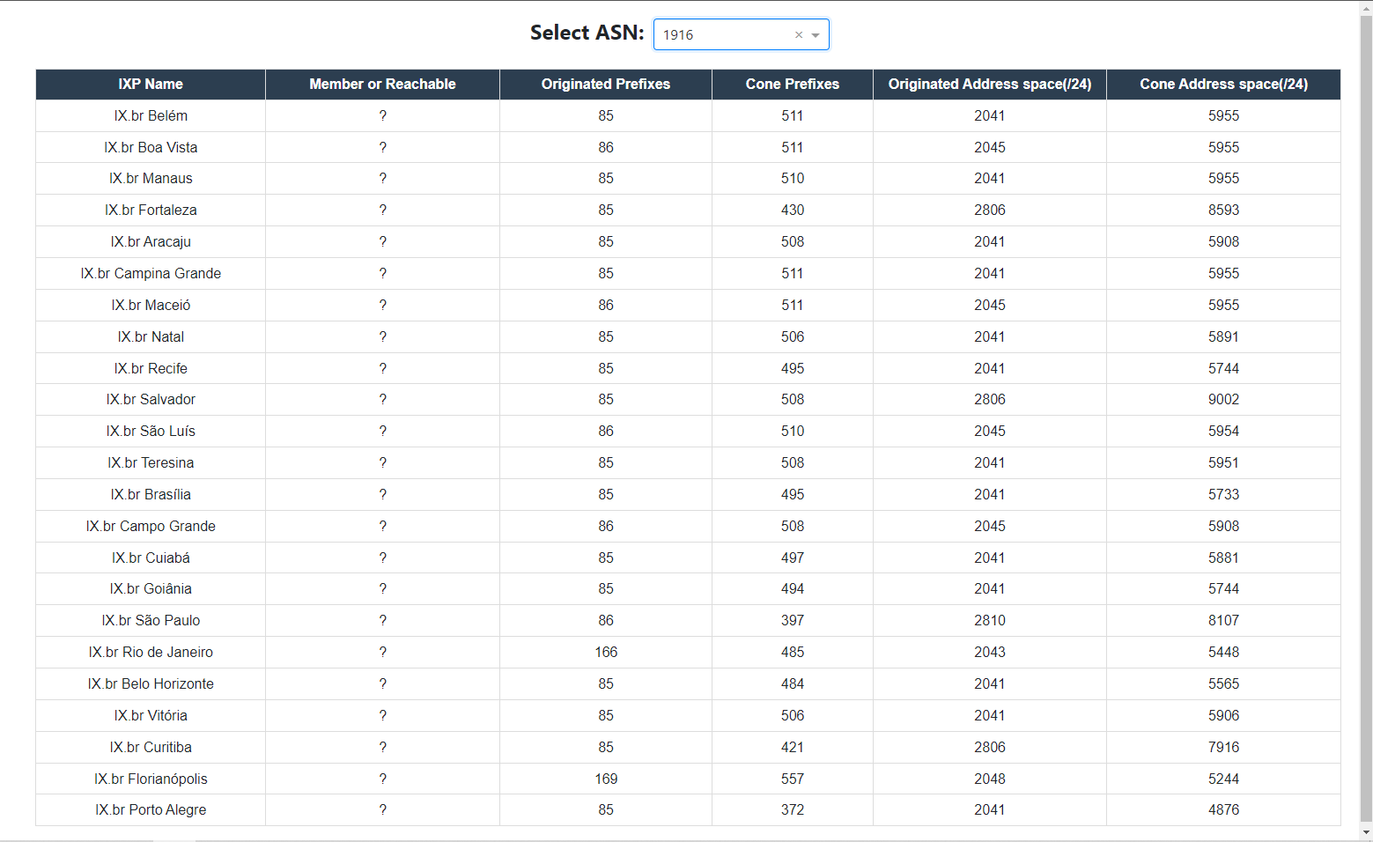
AS view

Slide 17
Research Study
Benefits of peering

Slide 18
Network benefits of peering
Let’s suppose a new network wants to join an IXP. We want to understand the benefits to the incoming network and the benefits to other networks?
Number of hops to other networks
Number of networks reachable
Route stability and redundancy
Latency to other peers
Latency to content providers and CDNs (present at the IXP)
Reachability over transit vs reachability over peering
Expected outcome: A “calculator” that network operators can use to estimate their networking benefits.

Slide 19

Economic benefits of peering
Cost-benefit analysis: Estimate the “financial” benefit of using a peering link instead of a transit link, using existing datasets on pricing.
Economic impact of IXPs: Estimate the longer-term impact of IXPs on the local Internet ecosystem. (E.g. affordability, Internet penetration, infrastructure).

Slide 20
The 50/50 Vision
Notes:
As the cornerstone of day-to-day life, things like businesses, government, education, healthcare have all become reliant on the Internet
But every day, there are actors working to undermine it……and over 3 billion people remain unconnected.
We work to build, promote, and defend the Internet for everyone.

Slide 21

The 50/50 Vision
Our 50/50 Vision is our ambitious, yet achievable, vision to keep at least half of all Internet traffic local in selected economies.
When we reach this goal, the people who need it most will have faster, stronger, and cheaper Internet access.
Notes:
Economic benefits: Supports local ISPs, content providers, infrastructure providers
Cost benefits: Save on expensive international links, free-up bandwidth.
Quality and performance benefits: Improved Internet speeds, higher reliability, improved user experience.
Security benefits: Improve data security and privacy by keeping data in local jurisdictions.
Community building: Enhance technical community engagement through local platforms.
Importance of Consuming Local Content

Slide 22
50/50 Vision Partners
With technical communities, we seek engagement between local stakeholders to support knowledge exchange and organize events and peering forums to share best practices.
For policymakers, we seek policies that promote open markets, foster strong technical communities, and streamline regulatory processes.
The Internet Society’s organization members, individual members, chapters, special internet groups, and partners play an integral role by taking training courses and defending peering in their communities.

Slide 23
Cache Locality and
Popular Content Locality
Metrics for the 50/50 Vision

Slide 24
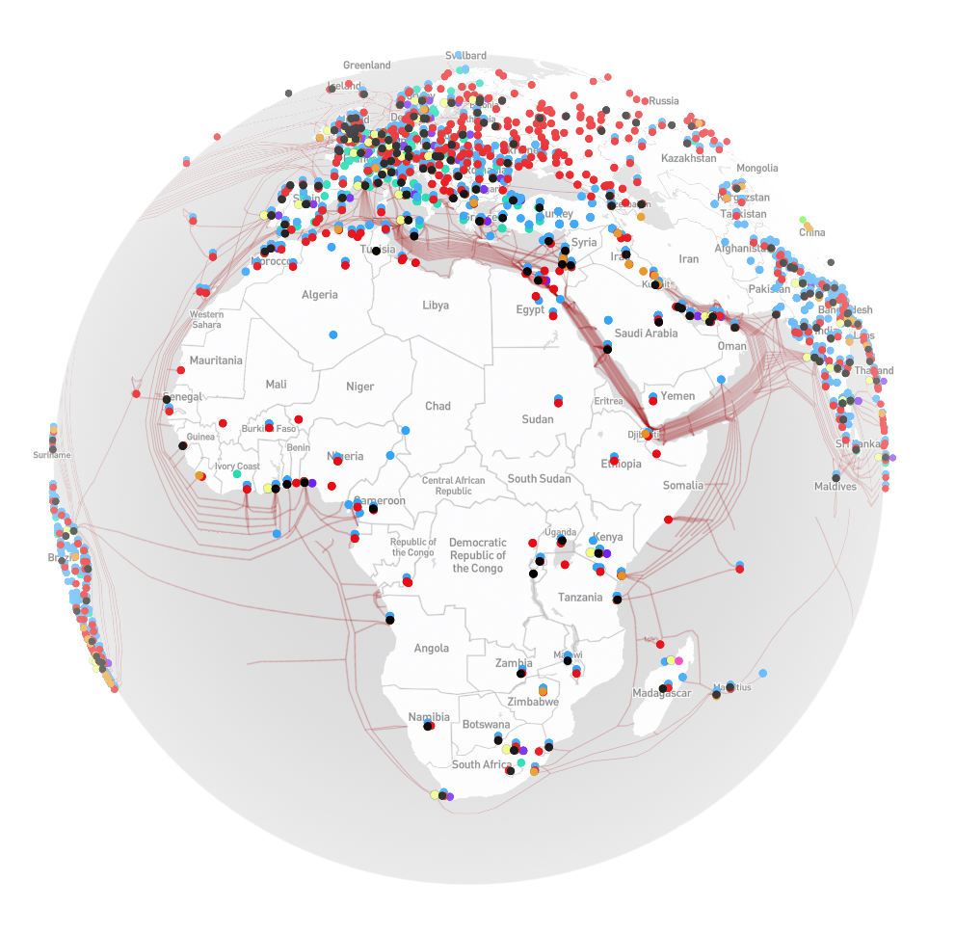
Locality definitions
Local traffic: Sourced locally from an in-country server.
External traffic: Sourced from a remote (out-of-country) server.
Content Delivery Networks: operators responsible for delivering content to the edge.
Content caches: content hosting equipment placed by a content provider close to the end-users.
Edge Network: access network where eyeballs (consumers) are located.
https://opentelecomdata.org/cdns/

Slide 25
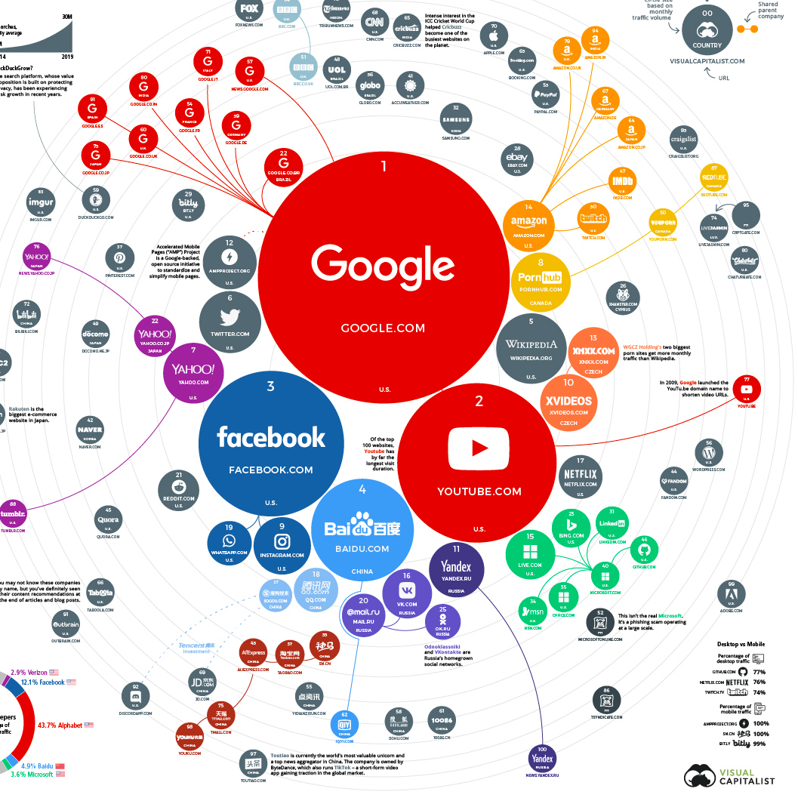
Proxy: Top 1000 websites by country
https://www.visualcapitalist.com/ranking-the-top-100-websites-in-the-world/
Google Chrome Report (CrUX)
Google Chrome has a ~70% market share (https://gs.statcounter.com/)
Data collected from real browsers around the world
Popularity determined by the number of visitors.
Source: Wikimedia Commons

Slide 26
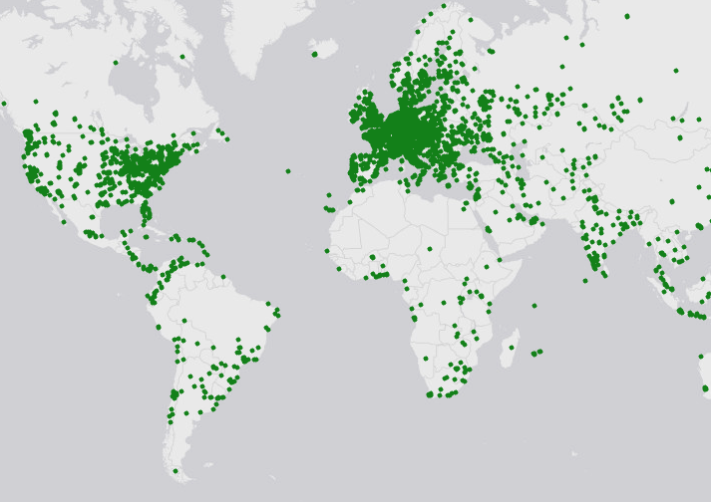
Vantage points
Residential Proxies
Can be used to run HTTP measurements
Much larger coverage than physical probes (RIPE Atlas, OONI, etc)
Real user experience (residential networks)
Source: RIPE Atlas

Slide 27
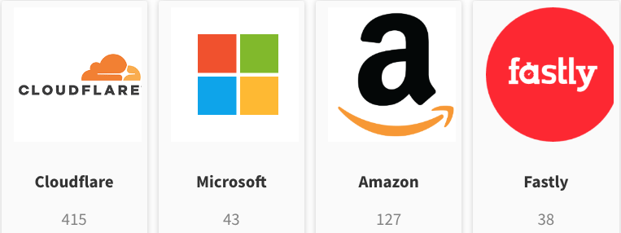
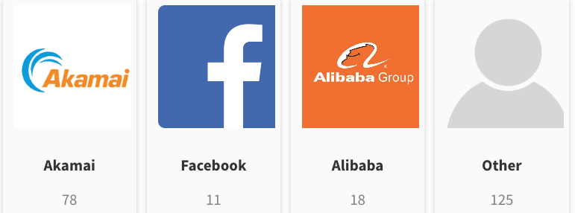
Hosting mode: CDN or Native?
Website hosting in ZA
For all 1000 websites (by country), we run a test to determine the CDN provider.
We extract CDN information from WHOIS, CNAME, HTTP Header.
We categorize by CDN provider or ”other” for natively hosted websites.
Source: Pulse

Slide 28
Aggregation
Weighted
%
Local
Regional
External
∑
ASN
market
share
Local
Local
External
Local
*
=
External
Local
External
Number of websites

Slide 29
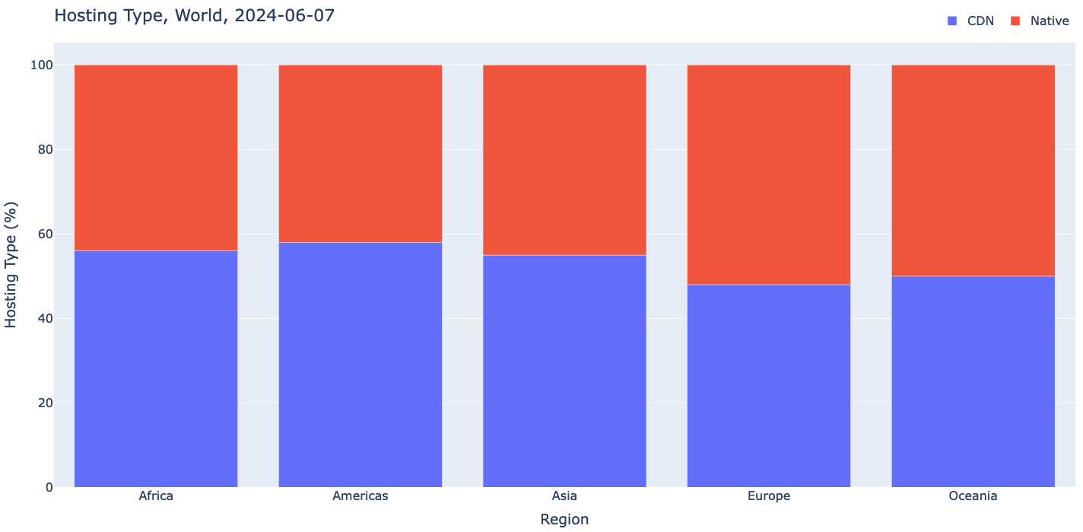
Hosting type (85k unique websites)
Source: Pulse

Slide 30
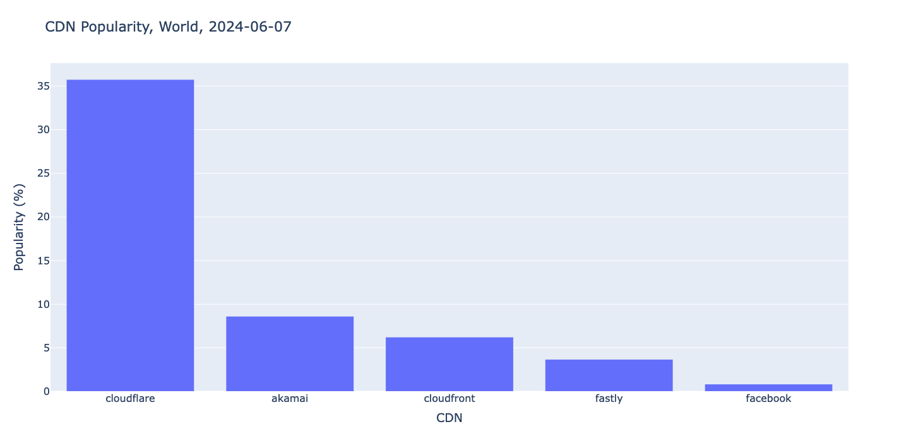
Most popular CDNs (World)
Source: Pulse

Slide 31
Cache Locality

Slide 32
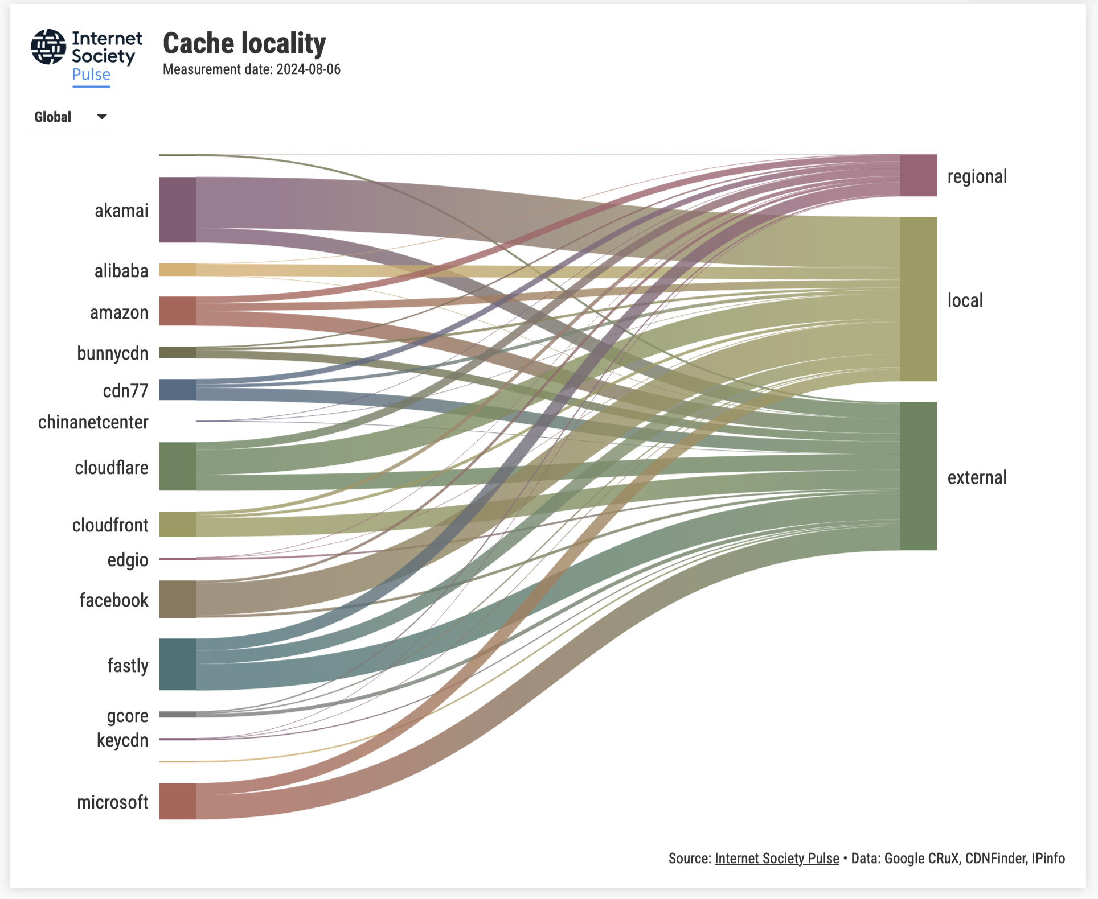
Source: Pulse

Slide 33
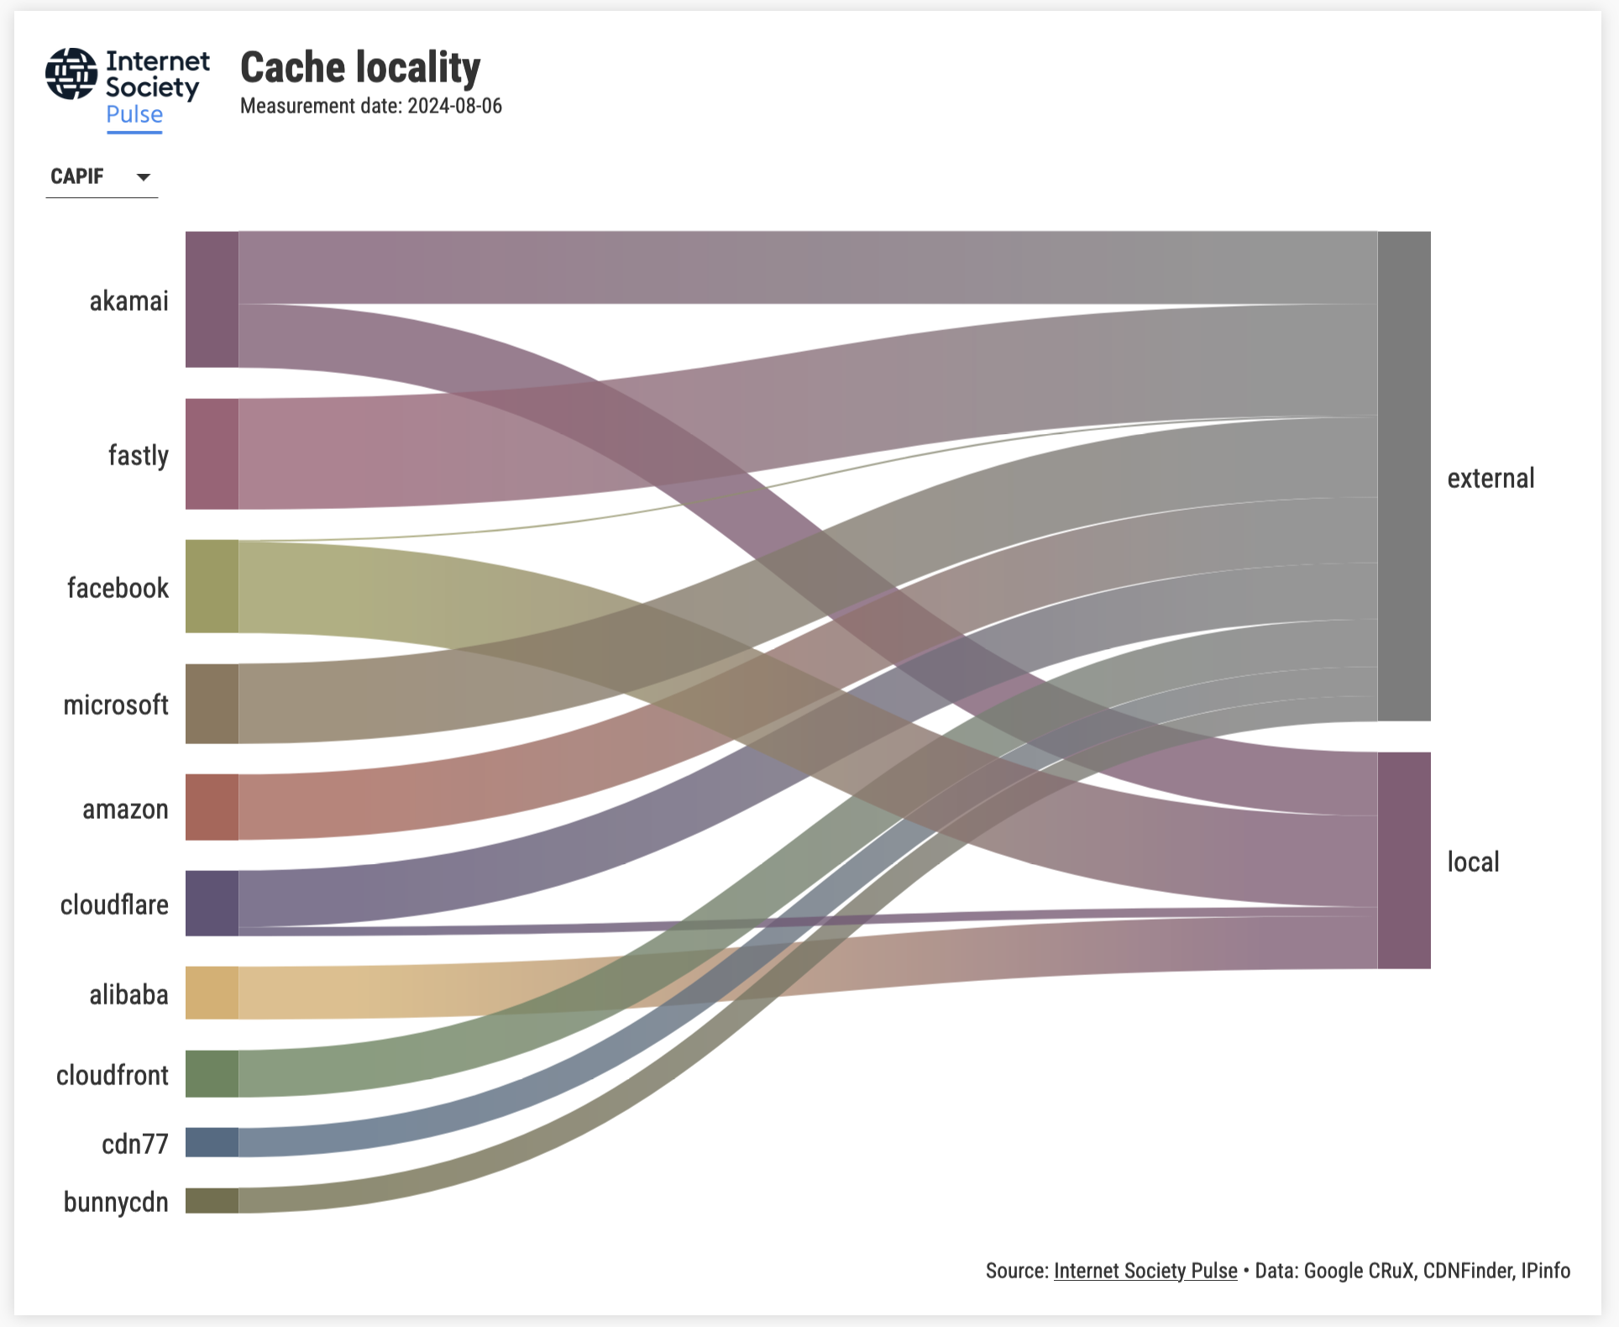
Source: Pulse

Slide 34
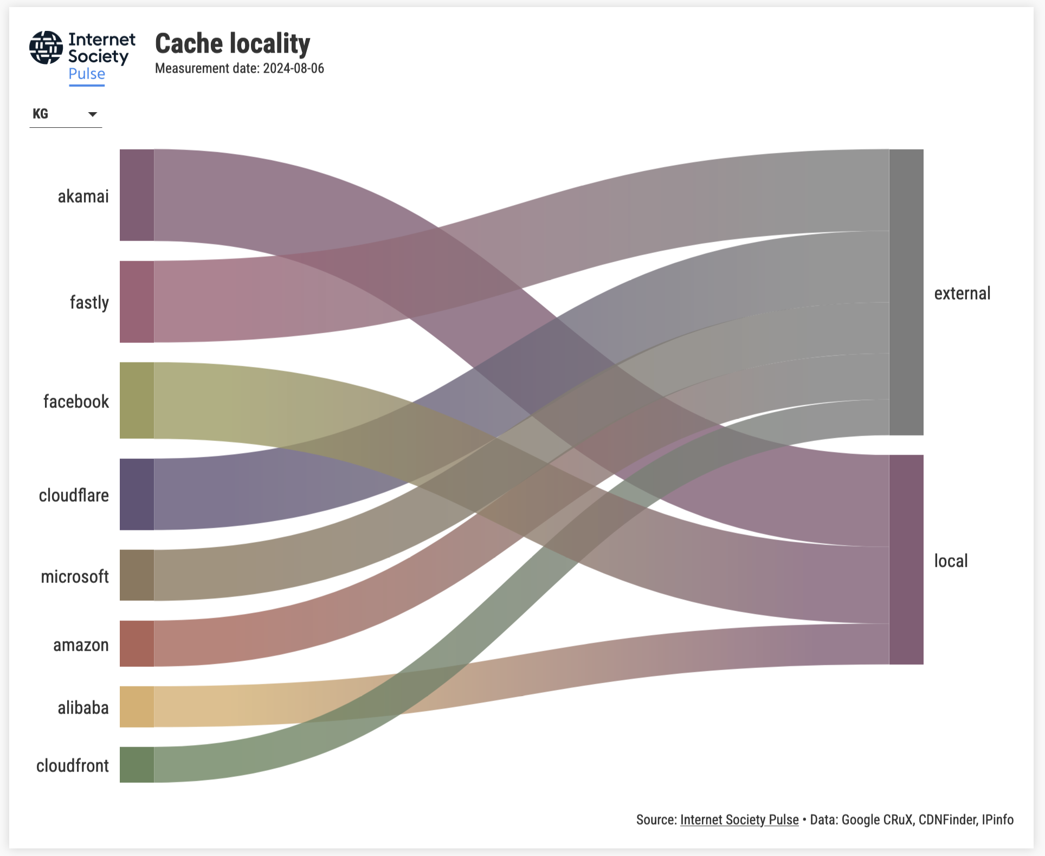
Source: Pulse

Slide 35
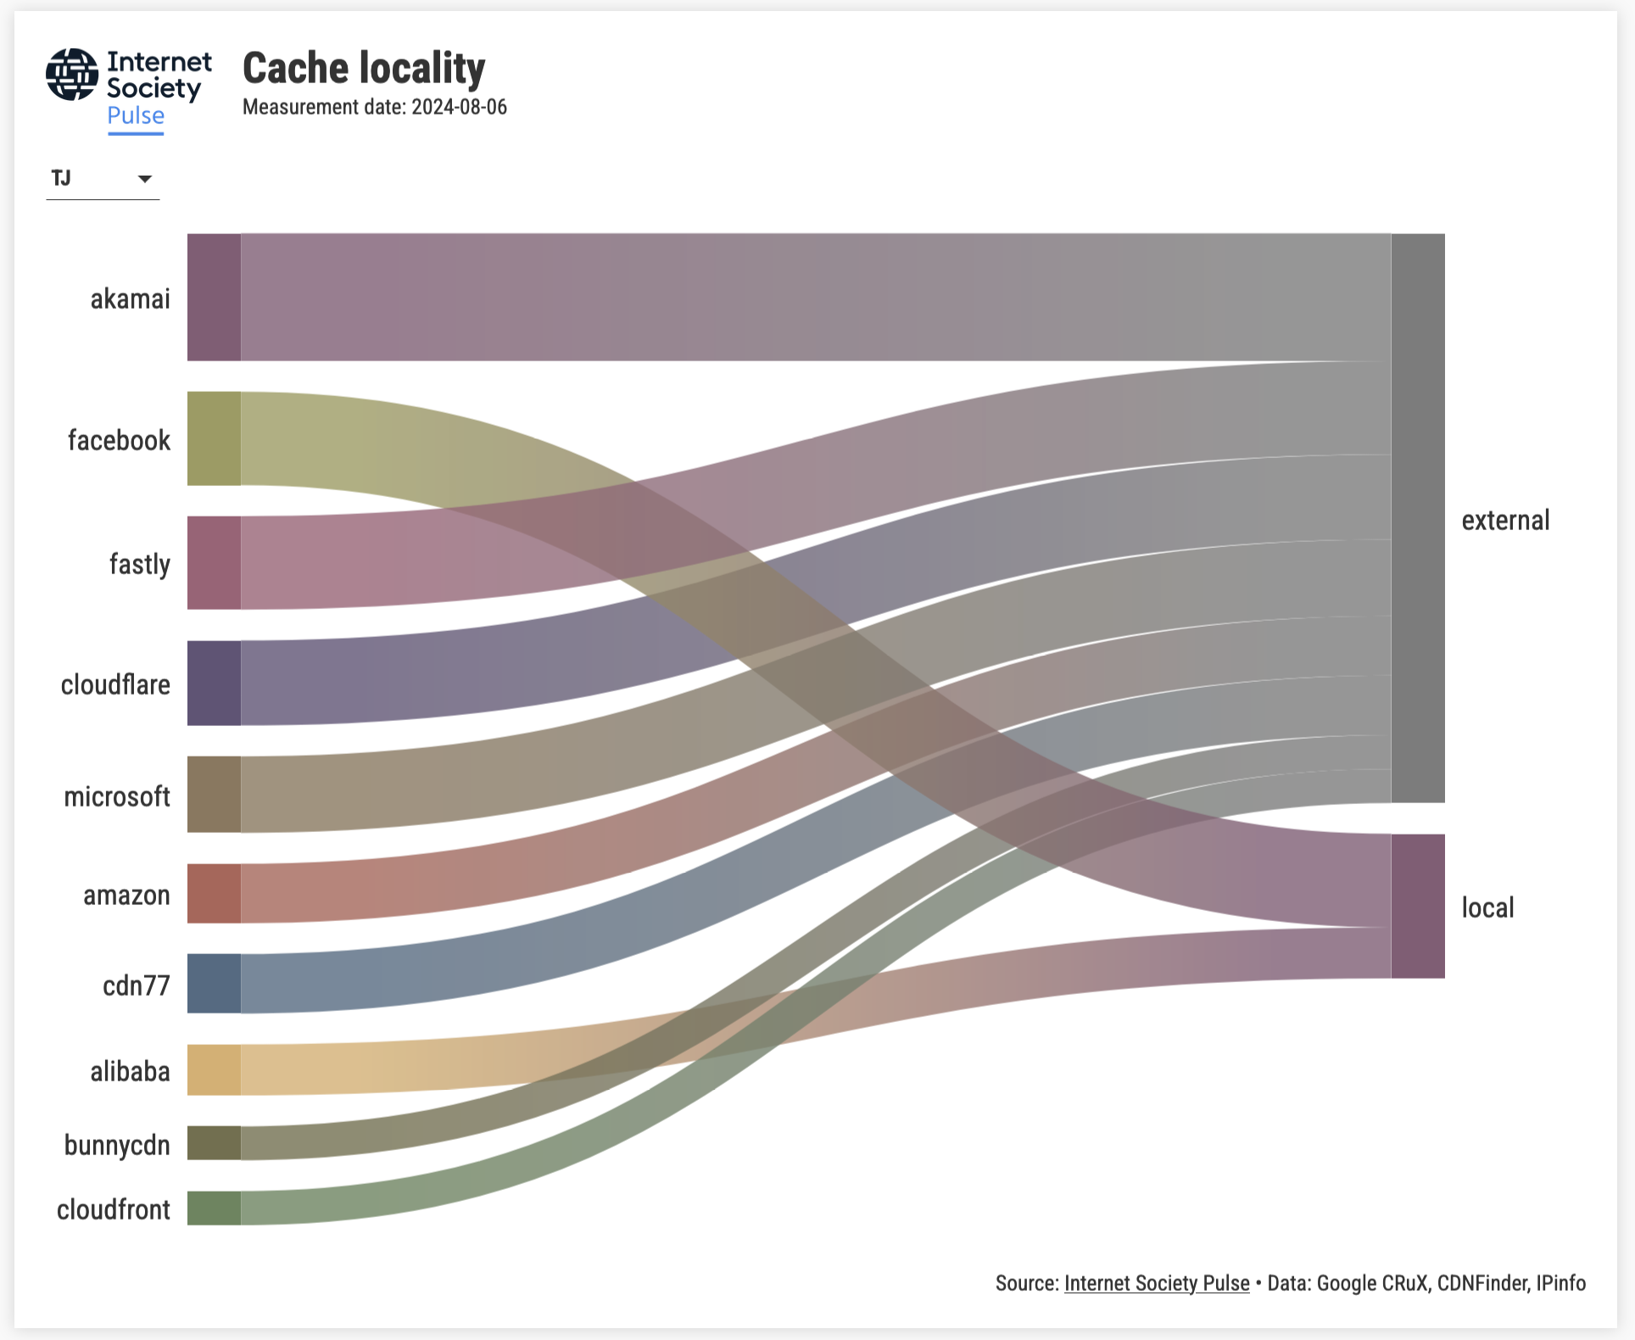
Source: Pulse

Slide 36
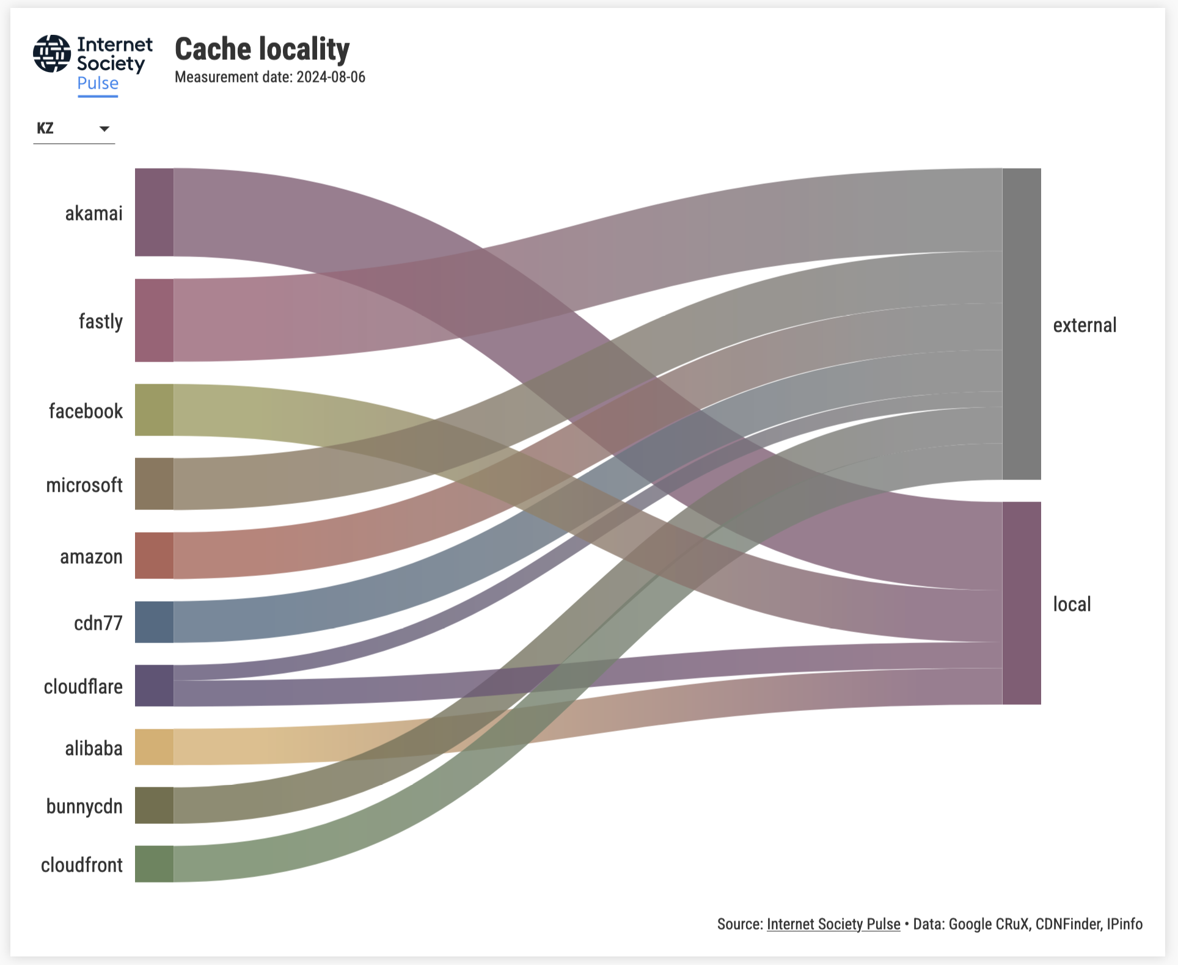
Source: Pulse

Slide 37
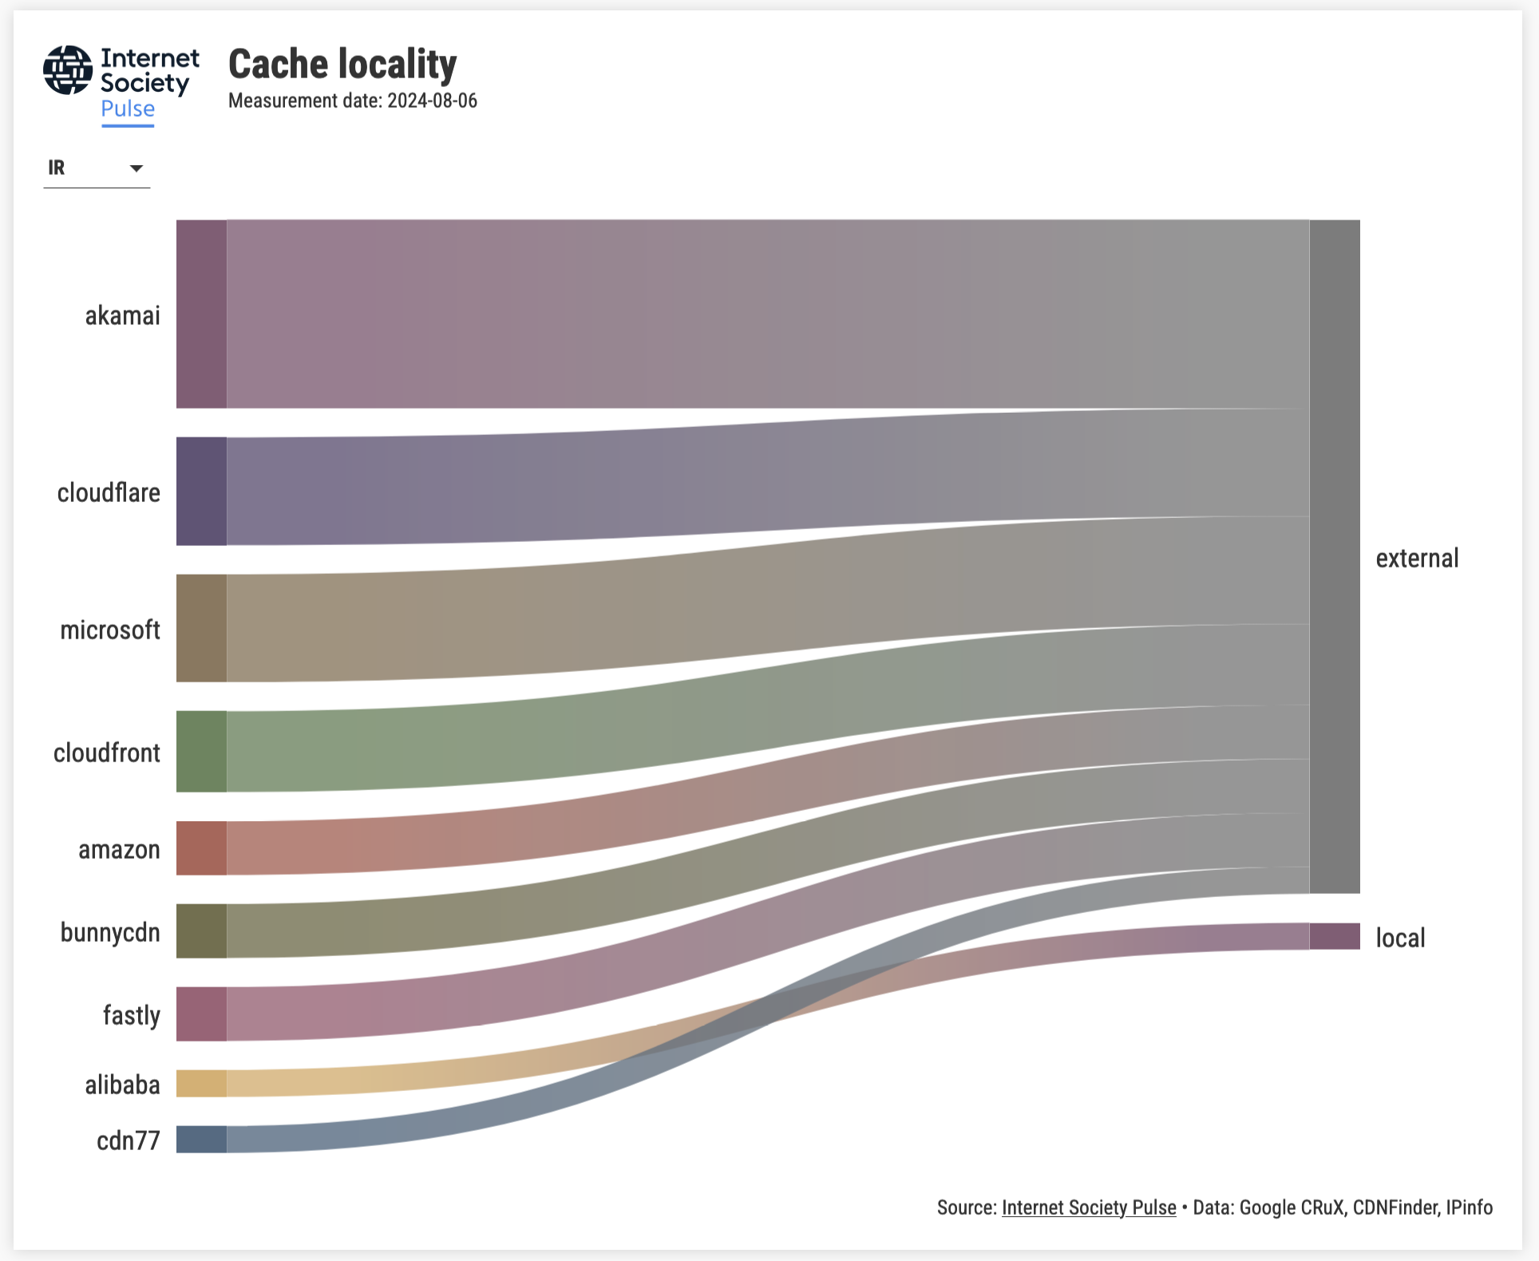
Source: Pulse

Slide 38
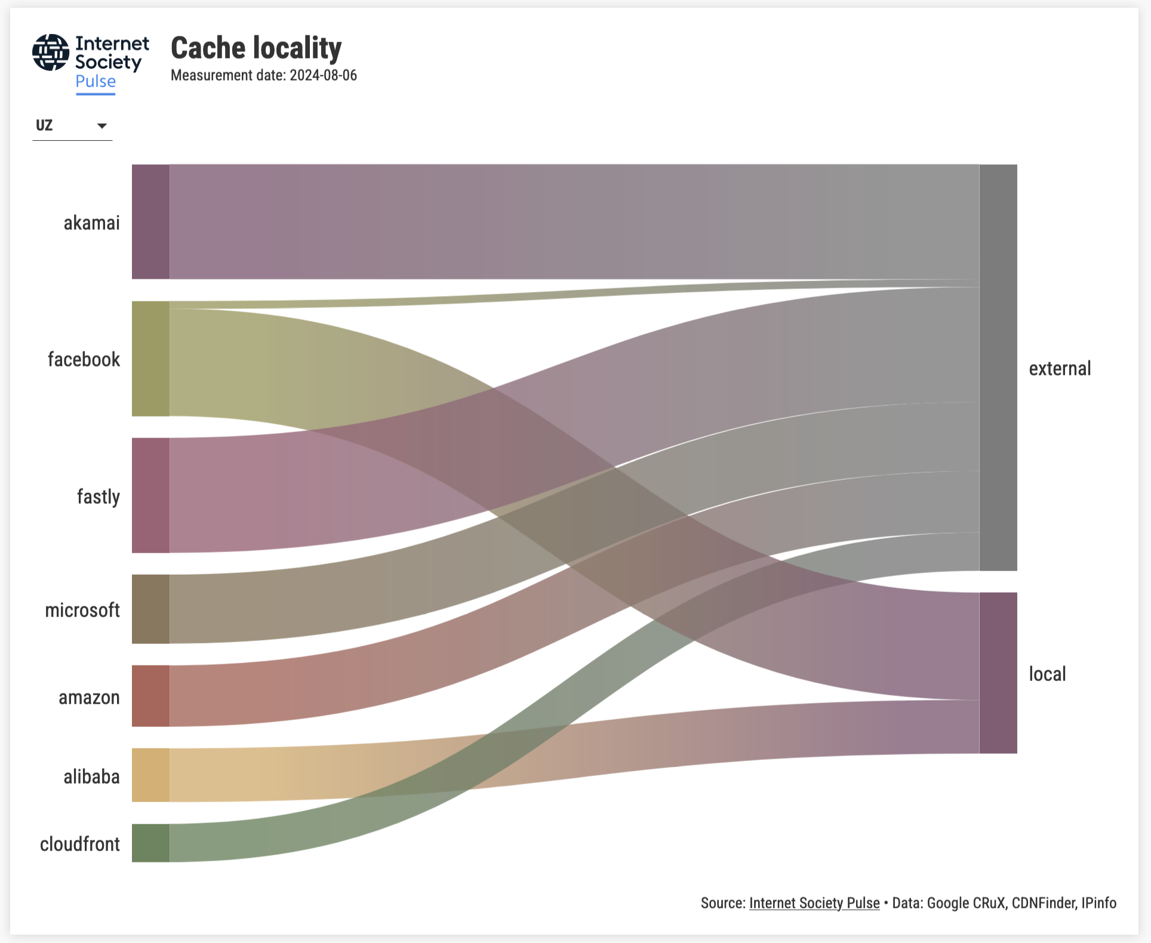
Source: Pulse

Slide 39
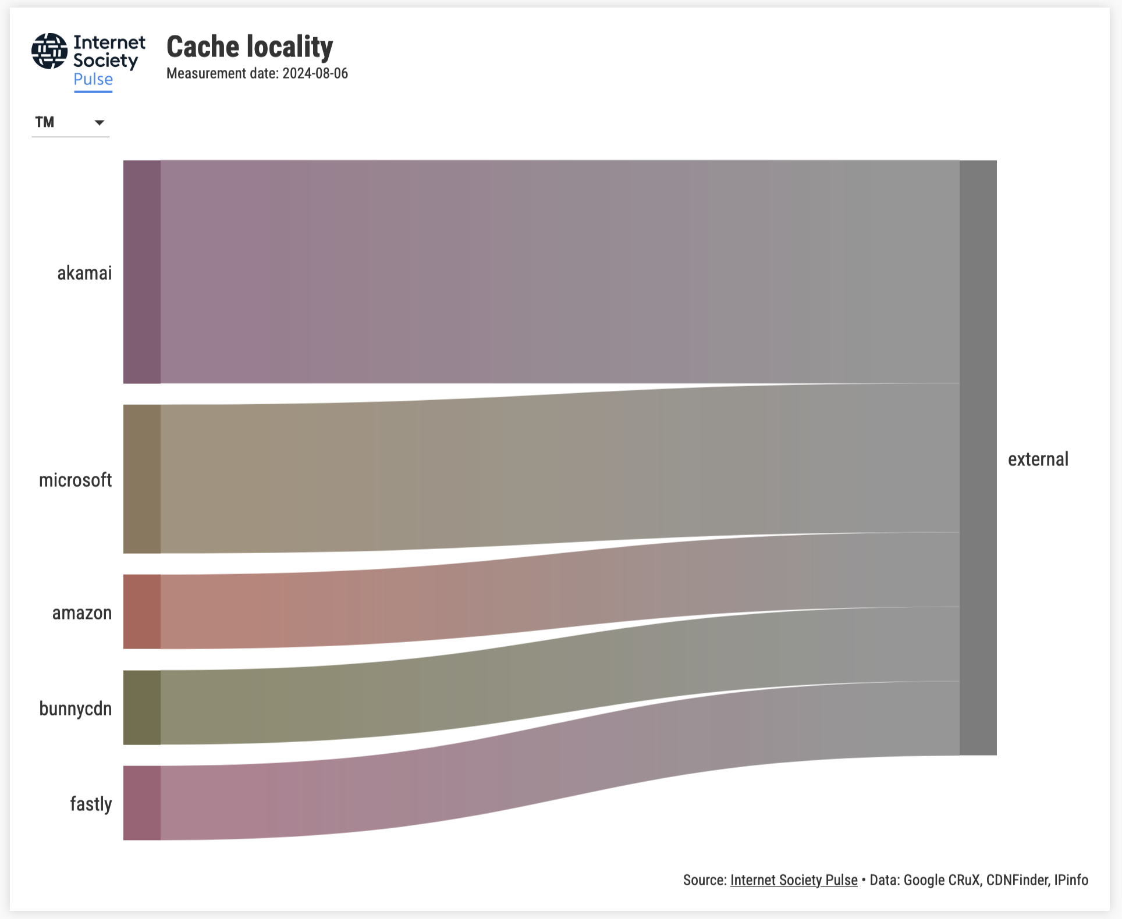
Source: Pulse
Notes:
Next is the Popular content locality

Slide 40
Popular Content Locality

Slide 41
Locality by region
July 2024
Source: Pulse

Slide 42
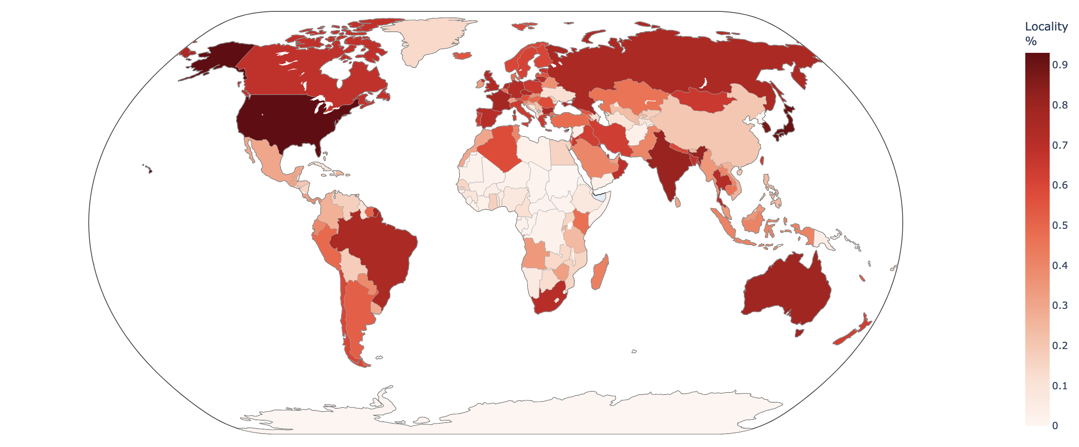
Locality (World)
July 2024, Source: Pulse

Slide 43
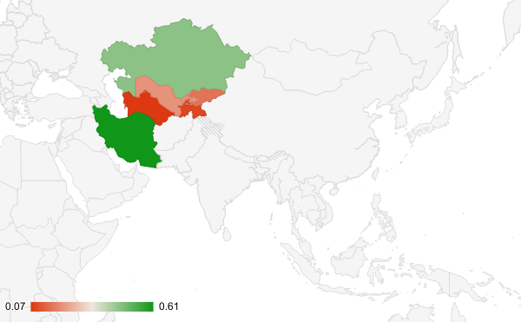
Locality (Region)
Source: Pulse

Slide 44
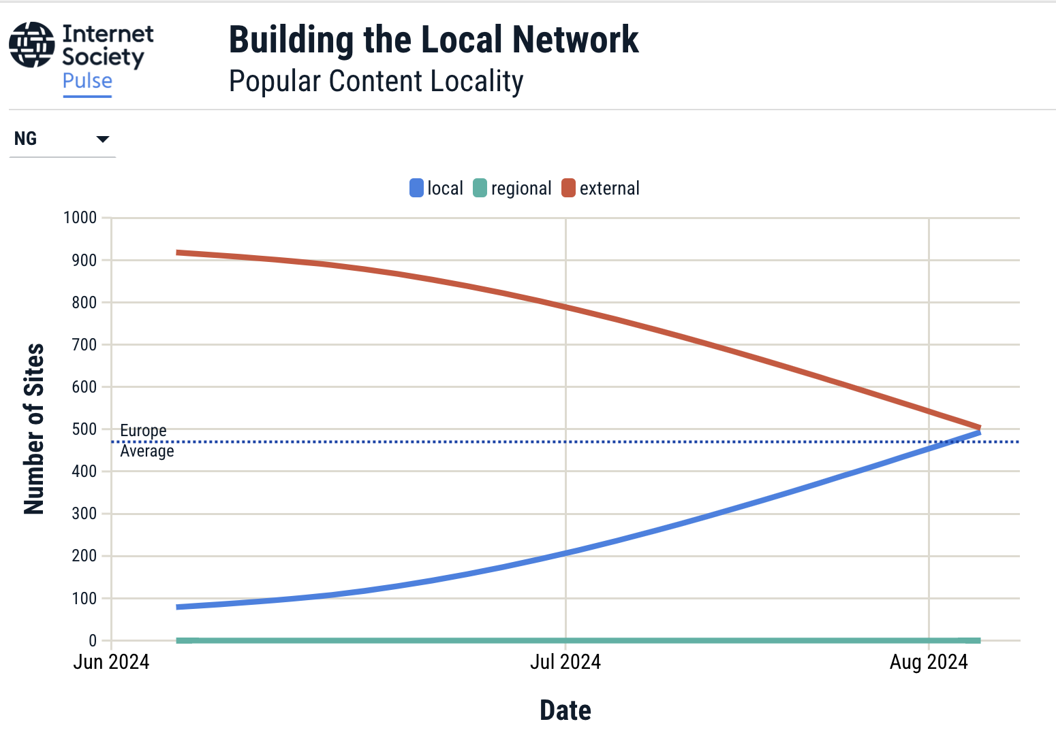
Source: Pulse
Notes:
It is also possible to track Popular Content Locality over time.

Slide 45
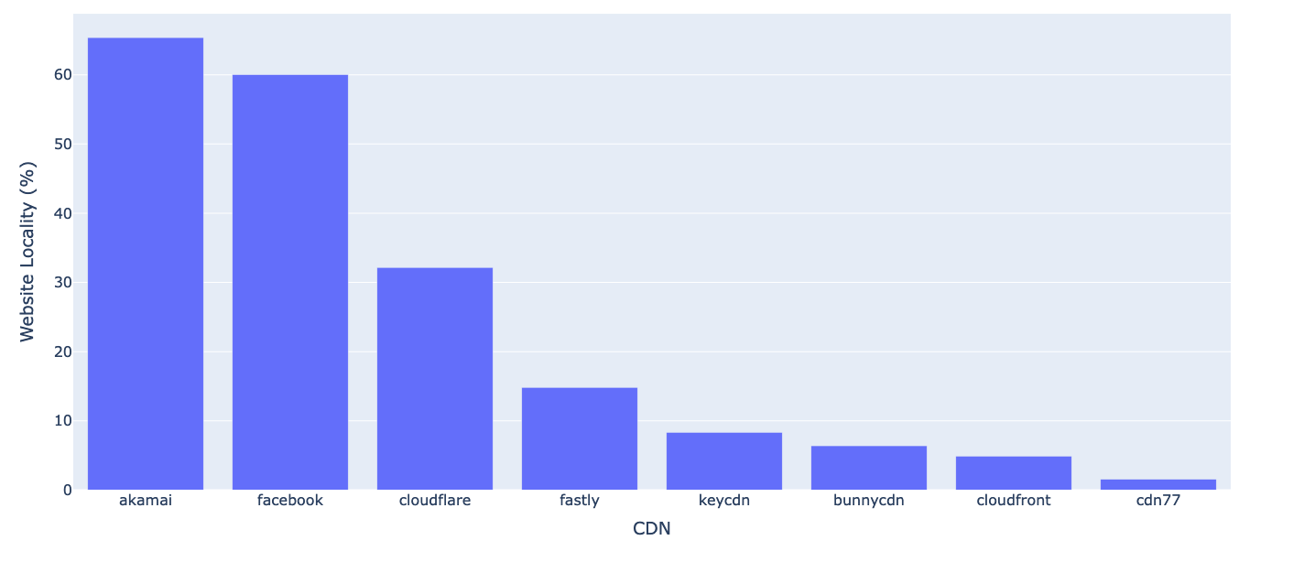
Locality ranking of CDNs
July 2024, Source: Pulse

Slide 46
Achieving Our Goals Together

Slide 47

Grant Program
We fund local communities to:
Build IXPs in markets where they are needed
Level-up existing IXPs to realize their full potential
Develop regional organizations and communities that support peering and interconnection.
Grants assist in training, capacity building, community development, and equipment purchases.
https://www.internetsociety.org/
funding-areas/sustainable-peering-ixp/

Slide 48



Our Grant Partners
The Internet Society’s work is partially funded by generous grants from Meta, ICANN, and AMS-IX.
Our peering and interconnection work endeavors to:
Further our 50/50 Vision
Strengthen our collaboration with regional partners on IXP development

Slide 49


Subscribe, Review, Contribute
Subscribe to the Pulse newsletter
Review the Pulse IRI methodology
Contribute to Pulse
pulse@isoc.org
Notes:
Finally, if you’re interested in keeping abreast of our project, please subscribe to our monthly newsletter.
Or email us to discuss opportunities to partner or contribute to our Blog.
I’ve also shared a link to the methodology of the IRI for those interested in the sources and calculations.

Slide 50
Hanna Kreitem
kreitem@isoc.org

