Slide 1
Indexing Internet Resilience in Central Asia
May 2024
Robbie Mitchell
mitchell@isoc.org
Notes:
Good afternoon.
First, thank you to the organizers for putting on and inviting us to present and to everyone here who are participating.
Today, I will talk about the Internet Society’s efforts to understand the global Internet's health, availability, and evolution and gain your feedback on how we can empower the measurement community as well as decision makers and civil society groups to use this information in your and their research, development and advocacy efforts.
What I hope you leave here today with is that it is worth keeping abreast of the resilience of your and your neighboring country’s Internet ecosystems, as there is plenty to learn from the strengths and weaknesses and plenty of insight that you can offer to improve the overall health and security of the Internet.

Slide 2
What We'll Discuss Today
Internet Resilience
What is it?
Tools to measure it
What is the situation in Central Asia
Internet Fragmentation
Threats
What we can learn from other countries
Discussion
What data are you collecting and sharing?
What data can help you in your advocacy efforts?
How can we collaborate to improve the health of the Internet in your countries?
Notes:
Some of the concepts and tools I’ll discuss have been touched on already by the presenters already but I want to first take a step back and put this into some context and discuss what Internet resilience is and how we at the Internet Society are making sense of it.
I’ll then walk through the resilience profiles of countries in Central Asia and talk more specifically about one impeding threat that has the potential to isolate Central Asia from the global Internet or at the very least seriously jeopardize its redundancy.
Finally, I’d like to get your feedback on our and other organizations efforts to make sense of the health of the Internet and discuss potential opportunities to collaborate to improve the resolution of the picture we currently see.

Slide 3
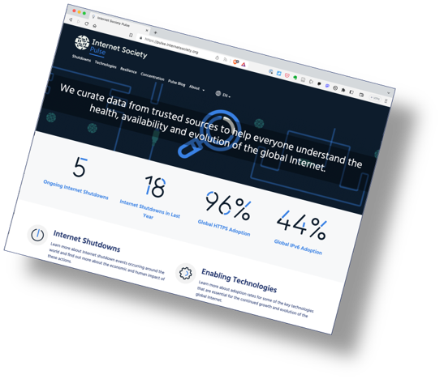
Launched December 2020.
We curate Internet measurement data from trusted sources to help everyone gain deeper, data-driven insight into the Internet.
Trusted data from multiple sources:
Benefit: Helps to assess whether efforts to ensure that the Internet remains open, globally connected, secure, and trustworthy are working.
Benefit: Allows policymakers, researchers, journalists, network operators, civil society groups, and others to better understand the health, availability, and evolution of the Internet.
pulse.internetsociety.org​
Notes:
The Internet Society has been running its Measuring the Internet project for three years. The outward-facing product of this is the Pulse platform, which curates open-source data to examine Internet trends and tell data-driven stories.

Slide 4
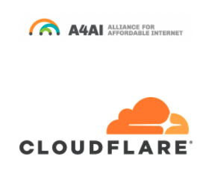
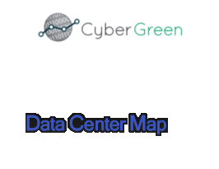
Pulse Data Partners
Data is provided by our trusted data partners
Notes:
It’s important to note that the Internet Society does not generate any data for Pulse, rather it consolidates trusted third-party Internet measurement data from various sources into a single platform.
These are some of those sources and partners.

Slide 5
Pulse tracks
Shutdowns: Where do Internet Shutdowns take place and what is the economic cost?
Technologies: What is the state of deployment of technologies critical for the evolution of the Internet?
Concentration: How much are services concentrated in the hands of a few?
Resilience: How robust is the Internet ecosystem?
Notes:
Our current focus areas are tracking:
Internet shutdowns
The state of deployment of critical technologies such as IPv6, DNSSEC, TLS1.3, and HTTPS
The concentration of infrastructure, services, and markets
And, finally, the resilience of the Internet in more than 170 countries

Slide 6
What I’ll cover today
Shutdowns: Where do Internet Shutdowns take place and what is the economic cost?
Technologies: What is the state of deployment of technologies critical for the evolution of the Internet?
Concentration: How much are services concentrated in the hands of a few?
Resilience: How robust is the Internet ecosystem?
Country Reports: Consolidate and illustrate critical Internet health metrics
Notes:
As mentioned, I'm going to focus on our Resilience work.
I'll also showcase our Country Reports, which seek to provide a high-level summary of the critical Internet metric for each country.

Slide 7
What's impacting the health of the Internet?
Notes:
So, what’s impacting the health of the Internet, specifically in Central Asia.

Slide 8
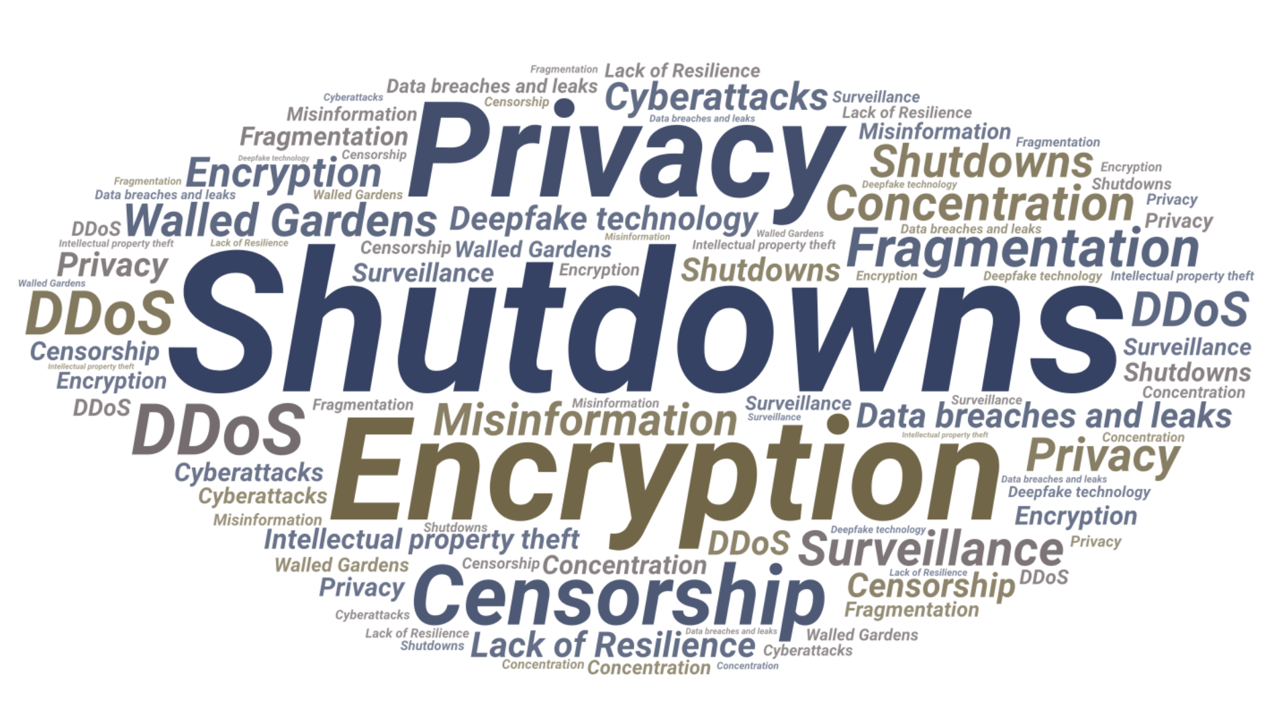
Where to start
Notes:
Well there’s a lot of different facets not just technical but more so socio economical. This is ultimately a limitation of whatever tool or tools we use to try to measure the Internet — they just wont capture the whole picture.

Slide 9
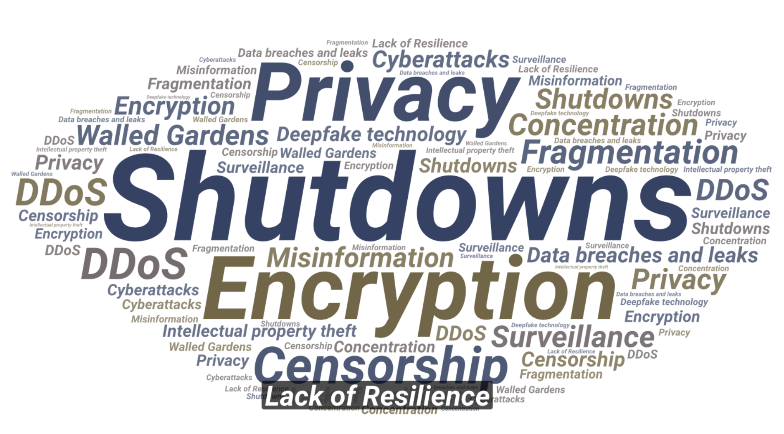
Where to start
Notes:
That said, measuring Internet resilience can provide us with a broader picture that can go some way to providing a snap shot.

Slide 10
Resilience
A resilient Internet connection maintains an acceptable level of service despite faults and challenges to normal operation.
Notes:
When measuring Internet resilience we are looking at factors that help with maintaining an acceptable level of service in the face of faults and challenges to normal operation.

Slide 11
The Internet Resiliency Index (IRI)
pulse.internetsociety.org/resilience​
The framework collates around 30 sets of public metric data that relate to four pillars of a resilient Internet:
Infrastructure
The existence and availability of physical infrastructure that provides Internet connectivity.
Performance
The ability of the network to provide end-users with seamless and reliable access to Internet services.
Security
The ability of the network to resist intentional or unintentional disruptions through the adoption of security technologies and best practices.
Market Readiness
The ability of the market to self-regulate and provide affordable prices to end-users by maintaining a diverse and competitive market.
Methodology: https://pulse.internetsociety.org/wp-content/uploads/2023/07/Internet-Society-Pulse-IRI-Methodology-July-2023-v2.0-Final-EN.pdf
Notes:
In this Pulse focus area we track resiliency metrics using the Internet Resilience Index to help support the development of policies and infrastructure to improve Internet resilience at the local, regional, and global level.
The IRI draws upon more than 20 open data sources and uses best practice methodologies to calculate a snapshot of a country’s Internet resilience in terms of its:
Infrastructure
Performance
Security
Market Readiness

Slide 12
Types of indicators
Relevance: The indicator should work towards showing an increase or decline in the resilience of the Internet in a selected country.
Accuracy: The indicator should correctly estimate or describe the quantities or characteristics they are designed to measure.
Coverage: The data should cover as many countries as possible, as the Index is intended to be a global index. An indicator is not included if there is missing data on more than 25% of countries in the Index.
Freshness: Any dataset should be at most two years old. Some datasets such as performance or network coverage should be recent. Some other datasets such as number of exits points do not change considerably over years, so it is acceptable to use a dataset which is a year or two old.
Continuity: To objectively compare the index over the years, it is important to work with a stable list of indicators, which will provide data consistently over time.
Notes:
The following criteria are used when selecting the datasets:

Slide 13
Types of indicators
Direct indicator: A direct indicator is a direct measure of an aspect of resilience e.g., percentage of HTTPS adoption, latency, bandwidth, etc. They have a specific unit of measurement, and the raw value can be on different scales depending on what is being measured.
Composite indicator: A composite indicator provides a score, which itself has been derived from multiple other variables. Examples are the MANRS score, EGDI index, Market Concentration, etc. The scale of a composite indicator is usually between 0 and 100.
Proxy indicator: A proxy is used where it is difficult to find a specific metric to measure an aspect of resilience. Proxies can be either direct or composite indicators. For example, the IRI uses “Number of IXPs” and “Number of data centers”, together to quantify the robustness of the local infrastructure.
Notes:
There are three main types of indicators that have been used to calculate the IRI:
Direct indicator
Composite indicator
Proxy indicator

Slide 14
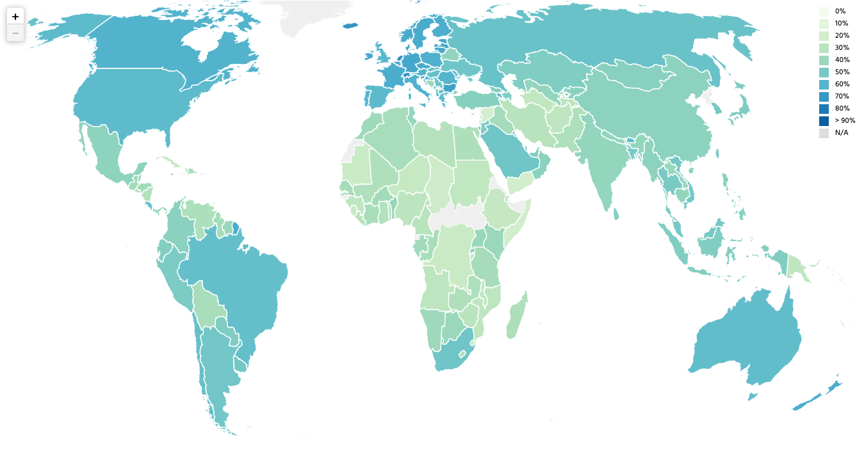
Internet Resilience — Globally
pulse.internetsociety.org/resilience​
Notes:
So as I mentioned, the IRI provides an overview of global Internet resilience, which you can navigate to each of the 170 countries it measures via the map or you can filter by region.

Slide 15
Overall Internet Resilience — By Region
Notes:
If we look at each region we can see Asia collectively has the second most resilient ecosystem of the five regions in the world.

Slide 16
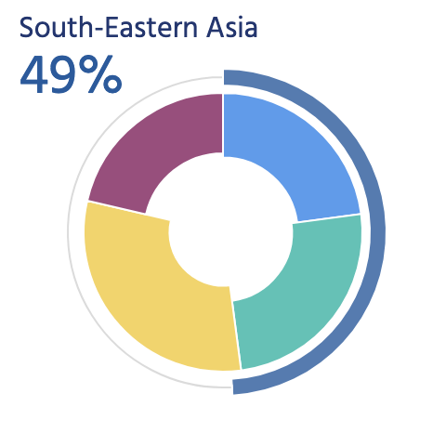
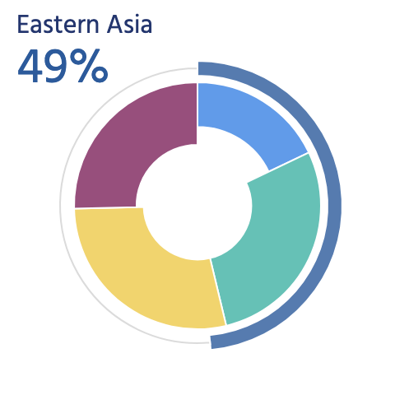
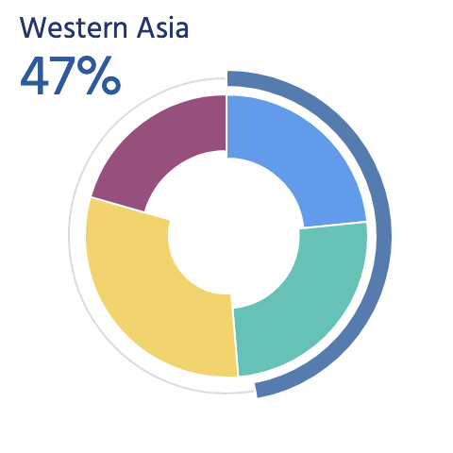
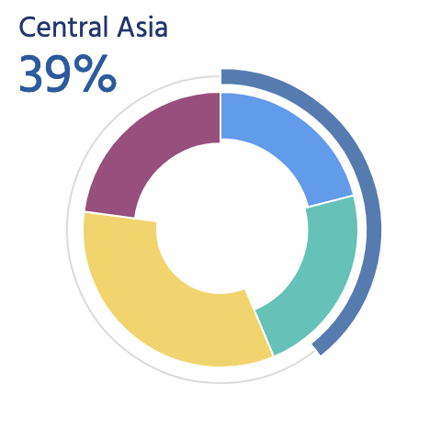
Overall Internet Resilience — Asia
Notes:
And if we drill down into Asia’s sub-regions, Central Asia is lagging behind its neighbours.

Slide 17
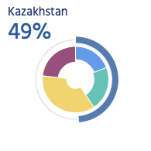
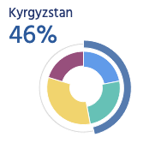
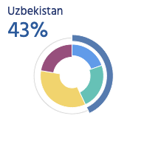
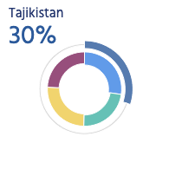
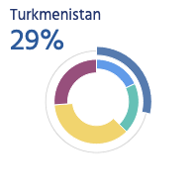
Overall Internet Resilience — Central Asia
Notes:
This is attributed to it having the equal smallest collection of countries, two of which rank well below the average for the rest of Asia. Let’s take a look at each countries profile to understand how we get to these figures.

Slide 18
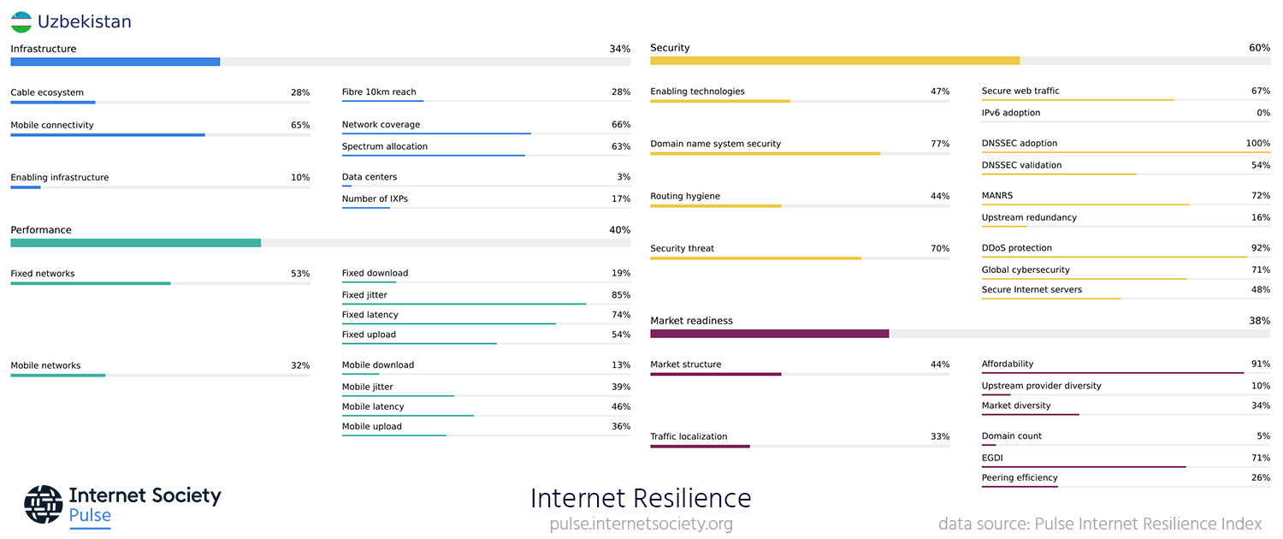
Uzbekistan – Internet Resilience Index
Notes:
If we look at Uzbekistan’s profile, we can see it has been doing a great job at securing the resilience of its Internet but the it's been let down in other areas, predominantly the resilience of it cable ecosystem and enabling infrastructure the later of which affecting traffic localization which I’ll go into more detail shortly.

Slide 19
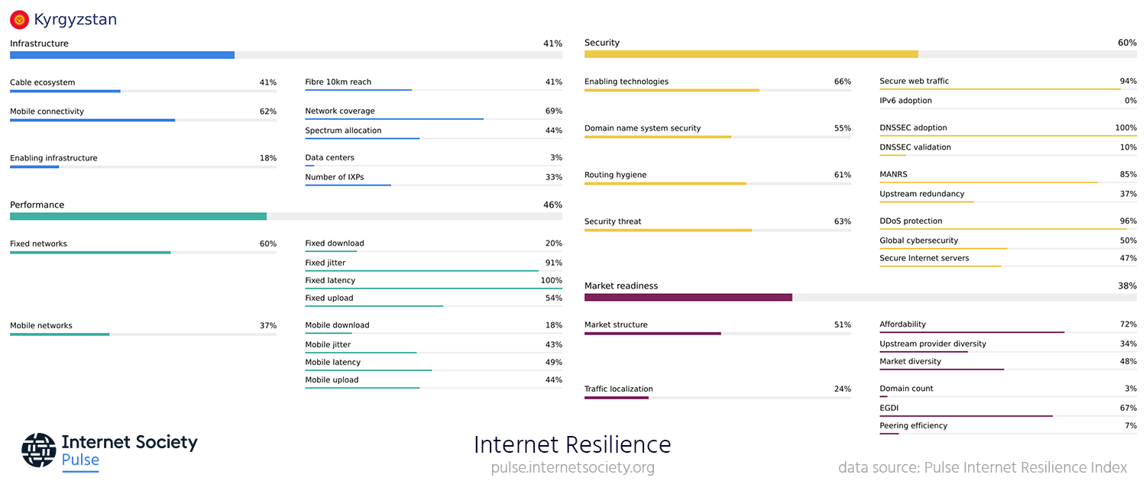
Kyrgyzstan – Internet Resilience Index
Notes:
Kyrgyzstan similarly is doing a reasonable job maintaining its security resilience, sans IPv6 and DNSSEC adoption.
It’s cable ecosystem is among the strongest in the region from both an infrastructure and performance perspective, though more needs to be done to improve its mobile performance.
Kyrgyzstan currently has 2 IXPs which 14 networks connect with and very few local websites using local ccTLDs.

Slide 20
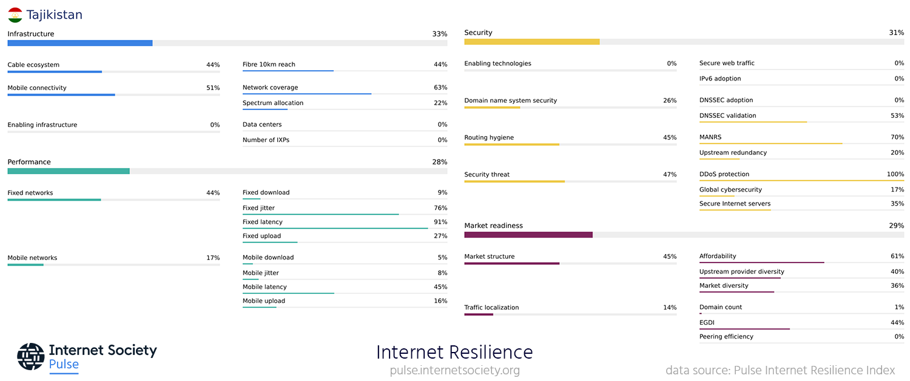
Tajikistan – Internet Resilience Index
Notes:
Tajikistan really doesn’t have any consistent sub pillar and its overall resilience score if reflective outside of its improving cable ecosystem and performance, mobile connectivity, routing hygiene and market structure scores.
One thing to call out is that Tajikistan ccTLD registery is the only registry in central asia to not have adopted DNSSEC.

Slide 21
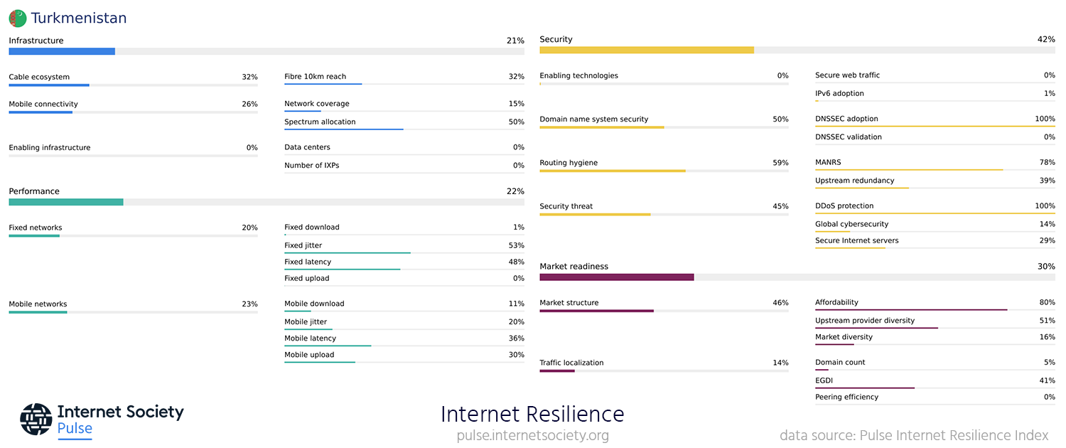
Turkmenistan – Internet Resilience Index
Notes:
Turkmenistan similarly doesn’t have any consistently well performing sub pillars though its worth noting their DNSSEC adoption and DDoS protection, and relatively high MANRS scores.

Slide 22
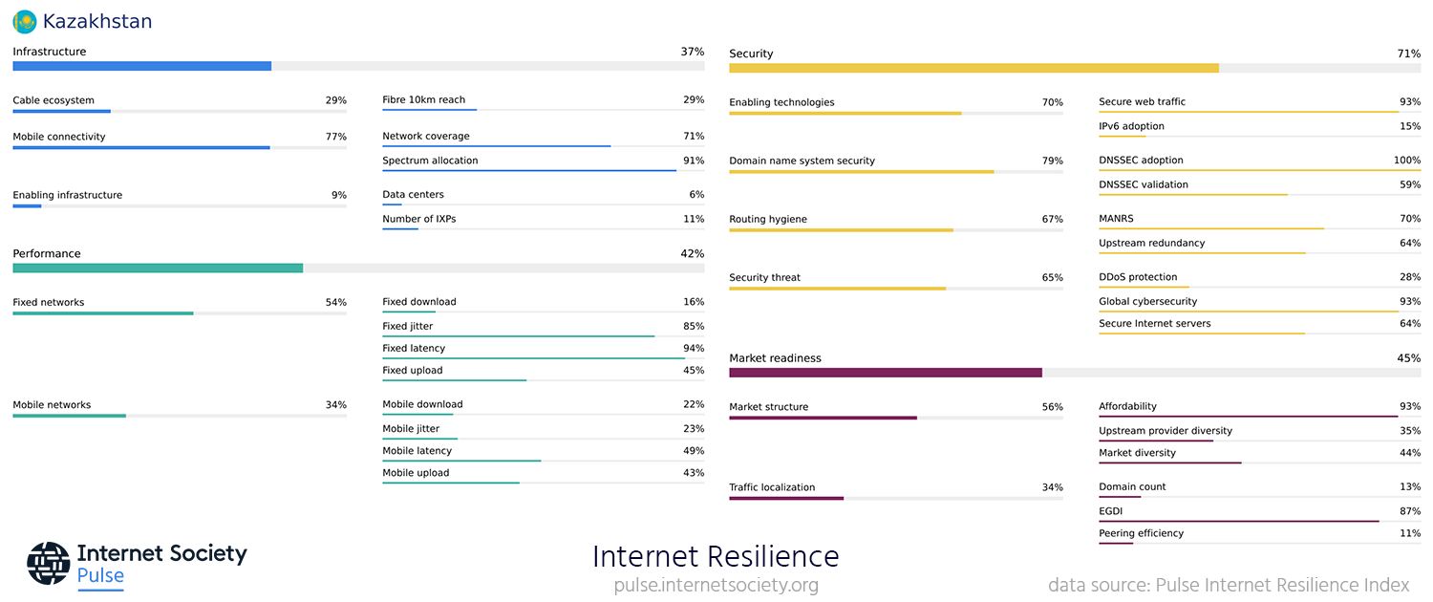
Kazakhstan – Internet Resilience Index
Notes:
Finally if we look at Kazakhstan's profile, it shares a lot of similar characteristics as higher scoring countries, Uzbekistan and Kyrgyzstan though it has the highest scores for market structure and traffic localization.

Slide 23
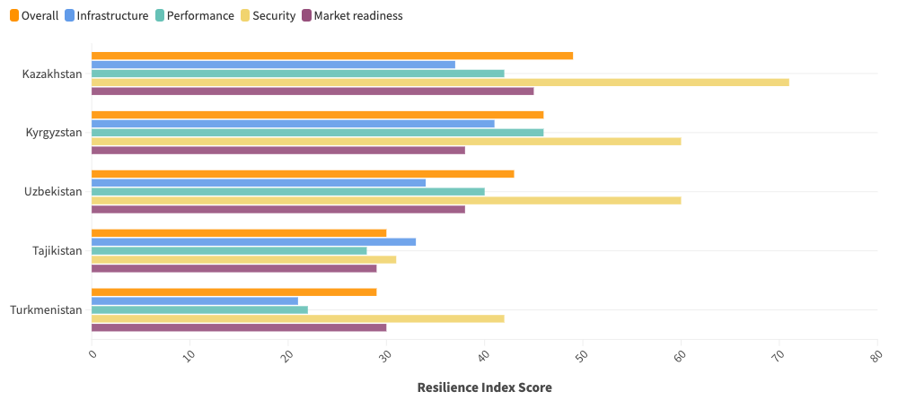
Comparison of Overall/Pillar scores
Notes:
I must note here that the strength of the IRI is in the holistic view it provides of the whole Internet ecosystem for each country instead of just focusing on one or a few metrics associated with one of the four main pillars. However, there is worth in using it to identify specific weaknesses which you can develop a campaign around and use the index as tool to measure the impact.

Slide 24
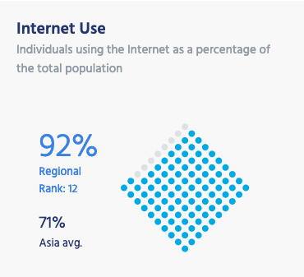
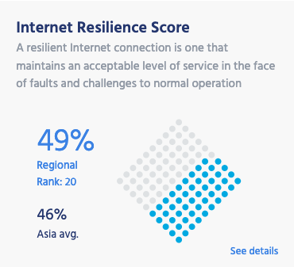
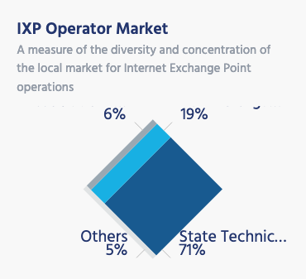
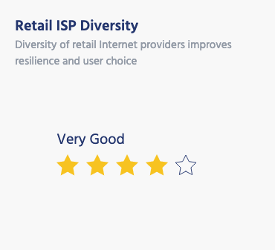
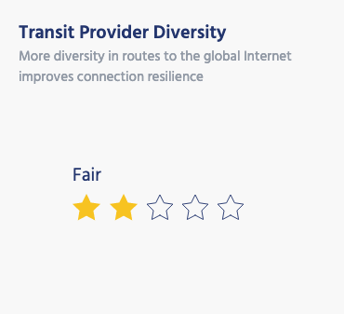
Open Internet Environment, Kazakhstan
An open Internet is an accessible Internet – it is easy to connect to the open Internet and use its services.
https://pulse.internetsociety.org/reports/kz
Notes:
The other tool that can help provide this holistic overview is the Pulse Country Reports, which provides more context in relation to metrics that align with the Internet Society's goal for an open, globally connected, secure and trustworthy Internet.

Slide 25
Open Internet Environment, Kazakhstan
An open Internet is an accessible Internet – it is easy to connect to the open Internet and use its services.
https://pulse.internetsociety.org/reports/kz
Notes:
You can see, the IRI score and how it compares to the regional average, and we've rated some of the metrics from the IRI on a scale of poor to excellent. Kazakhstan's very good retail ISP diversity has been instrumental to its high affordability score in the IRI and is also a good indication that there is plenty of redundancy in place at a local level when one ISP suffers an outage. Though there is a lack of resilience further up the line which has the potentially to severly impact connectivity to the country — I’ll go into more detail on this soon.

Slide 26
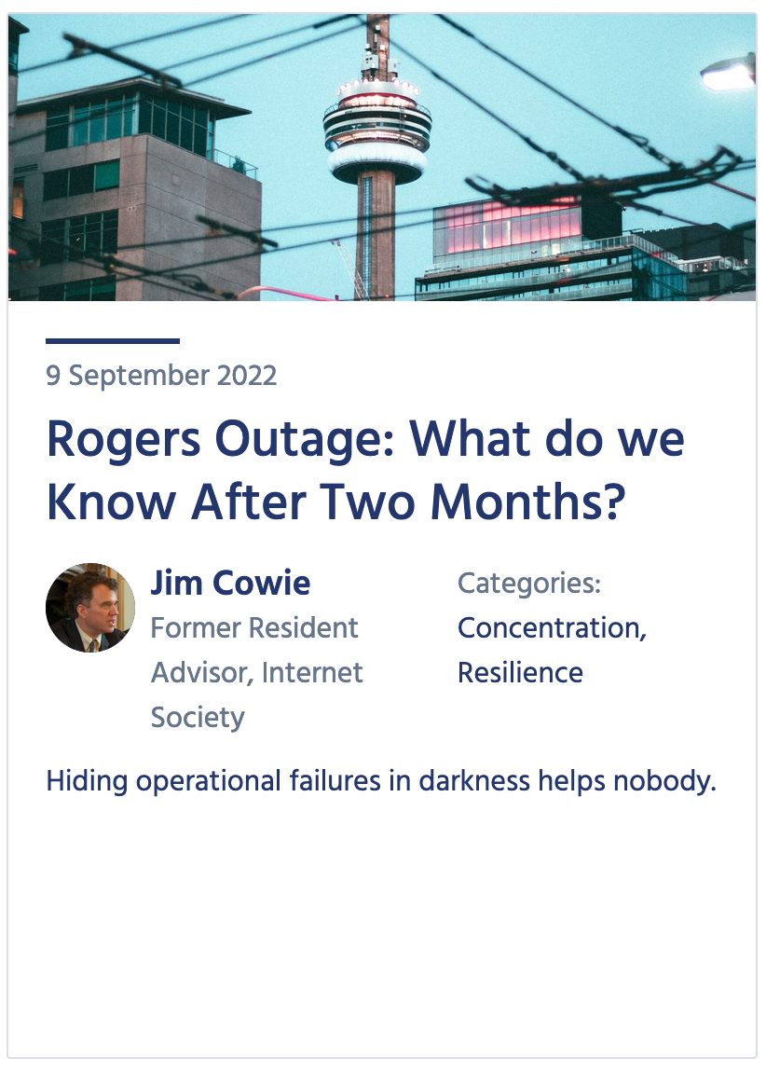
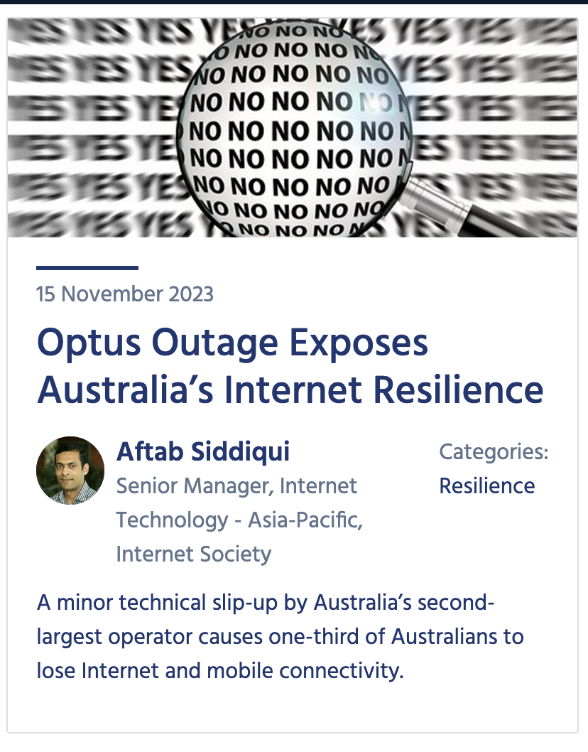
Not if, but when
Who’s next?
Canada, July 2022
Australia, November 2023
Notes:
Notice I said when an ISP or transit provider goes down. It doesn't matter how big a network is it will face an outage. Most are planned to conduct upgrades but the ones that aren't can not only impact the customers of a network but a whole country, as was the case with infamous outages in Canada and Australia where major operators went off line and in the process this also impacted emergency services calls, customs and payment systems.

Slide 27
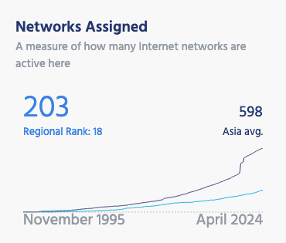
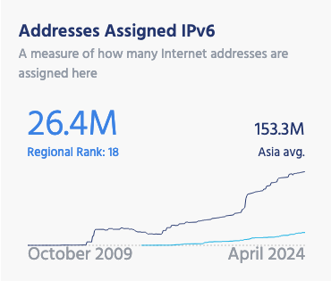
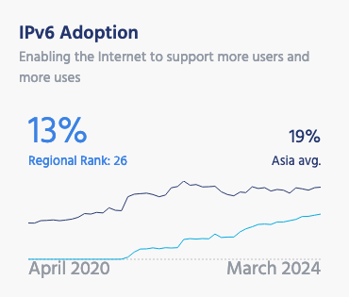
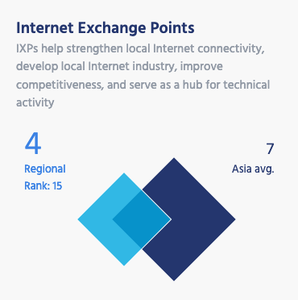
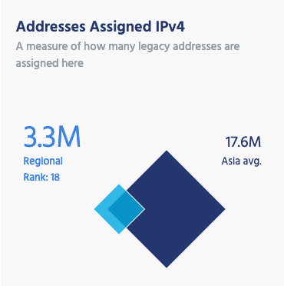
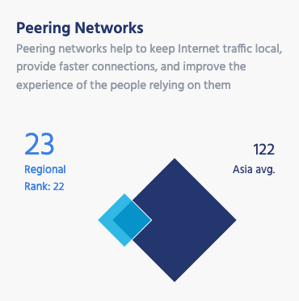
Globally Connected Infrastructure​
https://pulse.internetsociety.org/reports/kz
Notes:
Returning to the country reports, when we talk about a globally connected Internet we are talking about interconnectivity without geographical restrictions. These metrics provide a snapshot of this connectivity. The number of networks assigned indicates how diverse the industry is. The more networks, the less concentrated the Internet in a country is. Compared to early Internet adopters, you'll note that most developing countries will have far fewer networks assigned and far fewer IPv4 addresses.
This is also the reason why IPv6 was developed and why it's an important indicator for resilience and connectivity as it will be the future of the Internet. Countries with rapidly expanding Internet ecosystems, such as India, Malaysia and Viet Nam are currently among the top 6 IPv6 adopters.

Slide 28
Globally Connected Infrastructure​
https://pulse.internetsociety.org/reports/kz
Notes:
In the case of Kazakhstan, there hasn't been that demand yet, which is why it and all other central asia countries are lagging behind SE Asia countries.
I've highlighted these other two metrics as they offer a really interesting insight into the interconnectivity within a country.
As a refresher Internet Exchange Points (commonly known as IXPs) are infrastructure that allow local traffic to remain local. An example of local traffic is if you send an email to a colleague or family member on the other side of town. Now you might think that surely that should just go through the local cables but in many cases it doesn't. Sometimes it will travel outside or a country to a server thousands of kilometers away and then make its way back to your colleague of family member. This is obviously not ideal as it increases latency and there's a cost associated with sending that message via sometimes several different carriers. What IXPs do is they provide a central point in country for this sort of traffic to transit via, similar to a city or regional bus terminal. The more networks that peer with these IXPs the more chance that your content isn't transiting outside the country.
So in the case of Kazakhstan, it has 4 IXPs, which is good but below the average of 7 for the region.

Slide 29
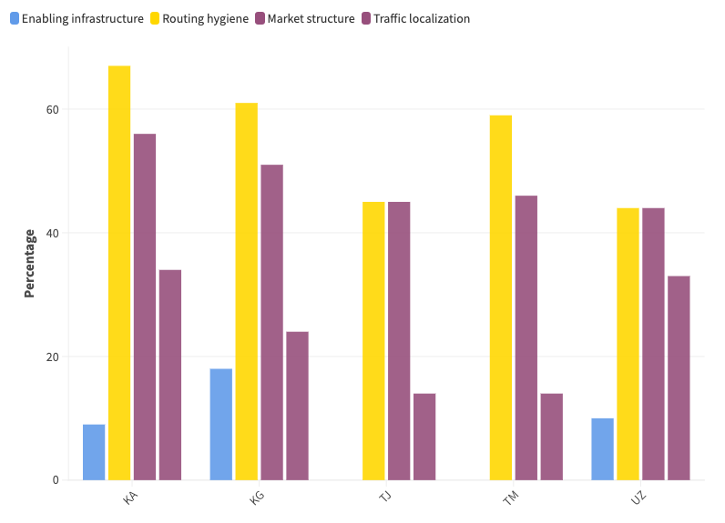
Traffic localization
Notes:
And although this is the most of any of the countries in Central Asia, there is still room for improvement not just for Kazakhstan but…

Slide 30
Traffic localization
Notes:
All countries.

Slide 31
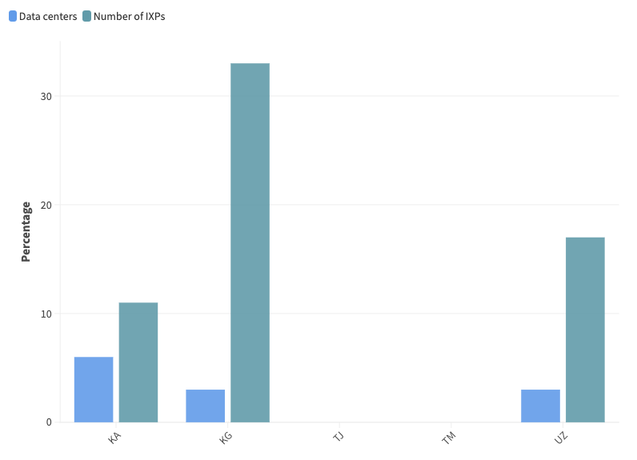
Enabling Technologies
Notes:
The IRI calculates the number of IXPs based on the number of major cities in a country, which is why Kyrgzstan and Uzbekistan score better.
The other factor that enabling technologies takes into consideration is the number of data centers per 10M population, which is near non-existent in the region.

Slide 32
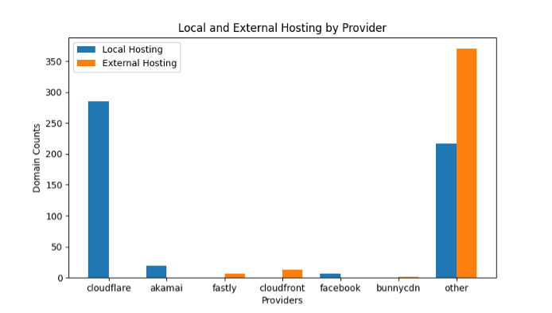
Local vs External Content
Kazakhstan
 | % of top 1,000 domains hosted locally
KZ | >50%
KG | <20%
TJ | <10%
TM | <10%
UZ | <25%
Read report: https://pulse.internetsociety.org/blog/reviewing-internet-resilience-and-efficiency-in-central-asia
Notes:
This is reflected in the percentage of content that is also served locally in each country. This graph shows the number of top 1,000 domains in KZ that are hosted locally or externally by the top CDNs. Kazakhstan is the outlier in this respect with no other country hosting more than 25% of its most popular content. You can read more about this in a report we recently published on the Pulse blog.

Slide 33
Traffic localization
Notes:
The other side of this traffic localization picture that I said I’d come back to relates to this local hosting and also takes into consideration local peering.

Slide 34
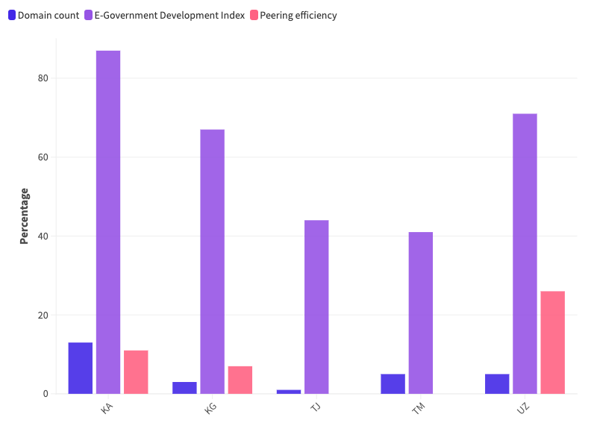
Traffic localization – domain count
Notes:
So if we look at the breakdown for this sub pillar we can see that most countries have in place varying forms of e Government services but most have very few # of domains per ccTLD per 1000 population.
Further the ratio of ASes peering at IXPs vs allocated ASes in a country is very low, meaning what little content that is being hosted locally is not being shared locally.
Traffic localization is a focus that Internet Society is currently advocating for and working towards improving to have at least 50% of content served locally by 2025.

Slide 35
50/50 Vision
Top 1000 websites (Google CrUX)
Categorize websites CDN or “Native”
IP geolocation local, regional or external
https://www.internetsociety.org/issues/access/50-50-vision/
Notes:
Traffic localization is a focus that Internet Society is currently advocating for and working towards improving to have at least 50% of content served locally by 2025 in select countries.
We’ve devised a methodology to understand where content is served from so that we can measure our progress toward the 50/50 Vision.
But measuring local versus non-local traffic levels is often not straightforward. Access providers are usually aware of the most-used services, but don’t delineate between local and non-local traffic, and the data they do collect is rarely shared publicly.
To map traffic flows, we’re using the data from two open-source tools, Open Observatory of Network Interference (OONI) and the RIPE NCC (the Regional Internet Registry for Europe, the Middle East and parts of Central Asia).
Our methodology quantifies the level at which Over The Top (OTT) services (video streaming, web surfing, social media, etc.) fetch their content from a local server/cache rather than externally (out of the country).

Slide 36
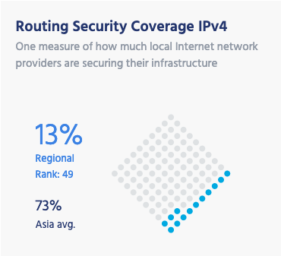
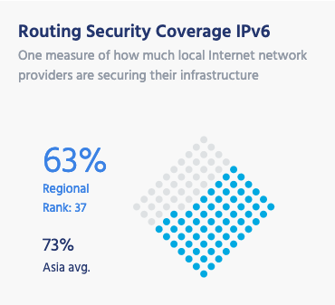
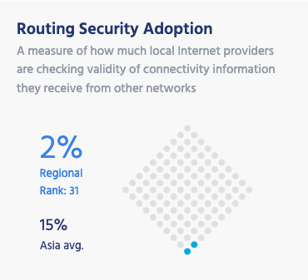
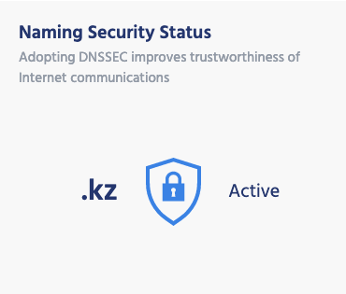
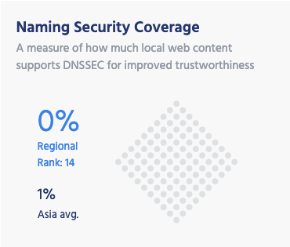
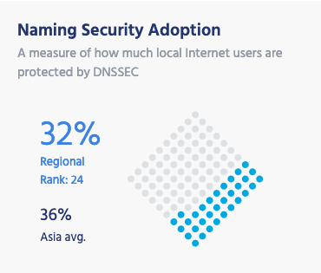
Secure and Trustworthy Internet​
https://pulse.internetsociety.org/reports/kz
Notes:
Returning to the country reports, the last section relates to security and trustworthiness.
We present two main technologies here: DNSSEC and RPKI.
DNS Security Extensions (DNSSEC) was developed to provide an additional level of security using cryptographic techniques to validate the authenticity of DNS information.
Resource Public Key Infrastructure (RPKI) also employs cryptography to secure the routes between you and the networks you are communicating with.
It’s important to note that the Internet wasn’t developed with security in mind so these technologies have been developed only in the last 10-15 years to add this layer of security.

Slide 37
Secure and Trustworthy Internet​
https://pulse.internetsociety.org/reports/kz
Notes:
If we were to analyse the security and trustworthiness of the Internet in Kazakhstan, we would commend their local ccTLD registry for adopting DNSSEC, which protects websites that have local domain name extensions.
Outside of this there is plenty of opportunity for networks to increase their adoption of RPKI and DNSSEC technologies to secure their networks.

Slide 38
Limitations
Notes:
What I’ve shown you here is merely a guide and some of you may have scoffed at some of the scores and sources, and you may have your own data that shows something different.

Slide 39
Limitations
The data is pulled from external public sources, not always up-to-date.
An indicator is not included if data is missing on more than 25% of countries in the Index.
Regional shutdown and outage data difficult to source/validate
Without in-country measurements, it’s difficult to validate the data.
RIPE Atlas and OONI are doing great work in this area, but more is needed.
Some of the data undergoes processing, normalization, and weighing, we use a methodology that is reproducible.
You can see raw numbers via API. Email us for access pulse@isoc.org
Ultimately, the Index benchmarks countries with one another and helps decision makers recognize gaps and weaknesses to conduct further study into validating these and work towards addressing them.
Notes:
What we’re trying to do with Pulse is to make these open data sources more readily available to decision-makers so they can make sense of them in demonstrating the various aspects that make up the health of the Internet.
By no means do we say use this as the source of truth. But it does provide a digestible view of what is going on to help you, and especially decision makers, identify weaknesses and then hopefully do your own research to validate if what these measurement systems are seeing is accurate.
To this point, we advocate for greater localized data sourcing and sharing, which provides greater resolution to what is really happening at the edge.
This is also the first version of this Index framework, and we plan to expand it to include new metrics, including how resilient countries' Internet ecosystems are to climate and natural disasters. We’re also looking at how to incorporate cross-border connectivity, as this can highlight another concerning threat to the Internet…

Slide 40
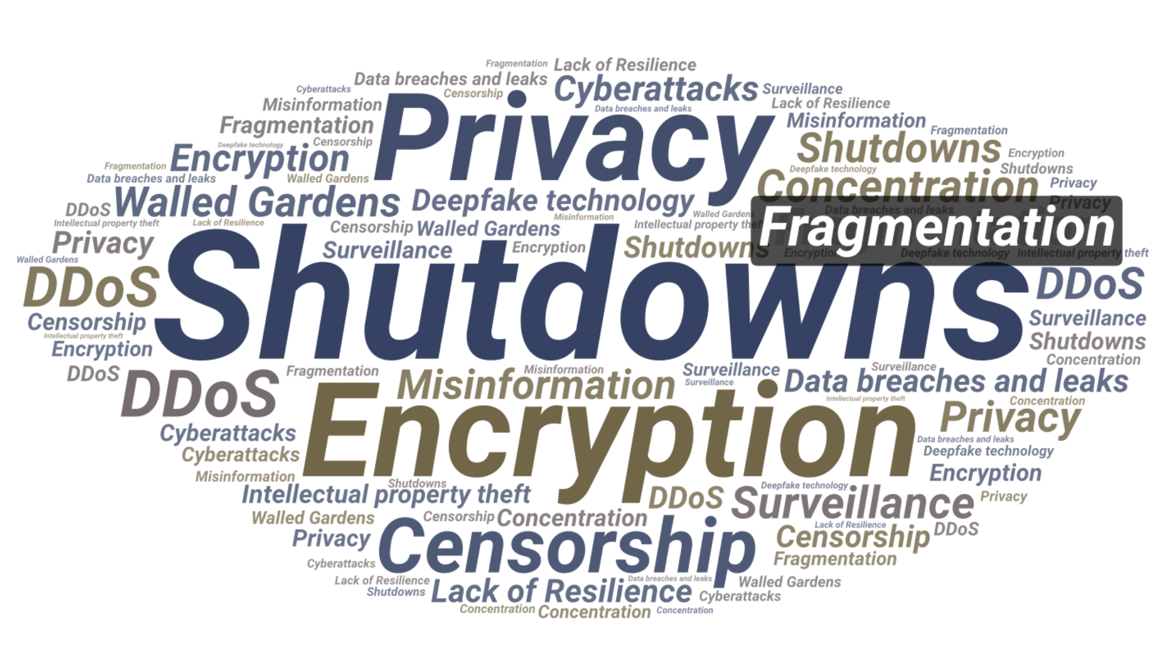
Where to start
Notes:
Fragmentation.
So, while researching the region for this presentation and the aforementioned report we recently published we looked at ITU’s bbmaps to look at the interconnectivity of the region.

Slide 41
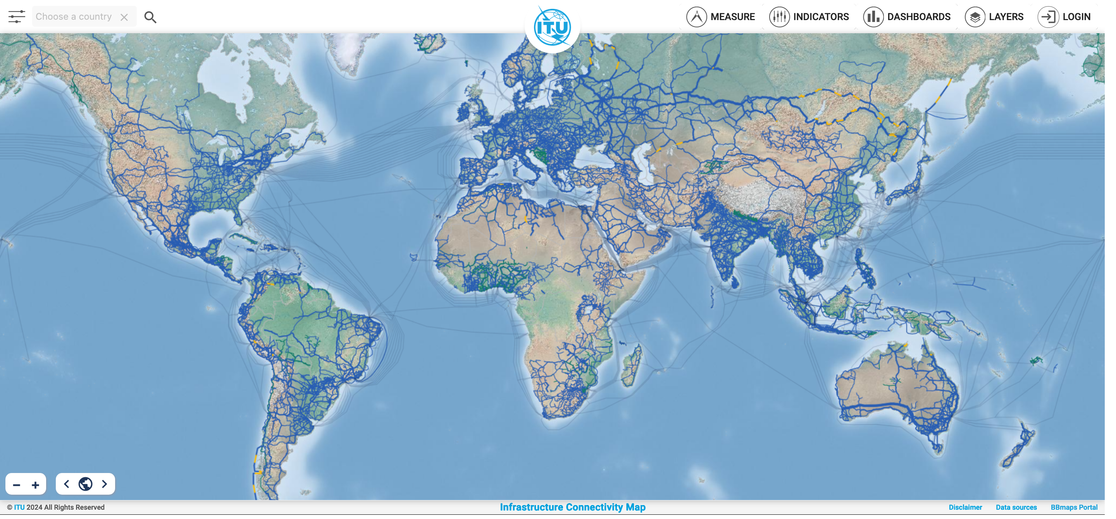
https://bbmaps.itu.int/bbmaps/
Notes:
For those not aware of bbmaps, it maps terrestrial and submarine cable infrastructure.

Slide 42
https://bbmaps.itu.int/bbmaps/
Notes:
Being a landlocked region, we don’t need to concerning ourselves with submarine cables, though it’s worth noting from this global view how sparse terrestrial cable infrastructure is in the region.

Slide 43
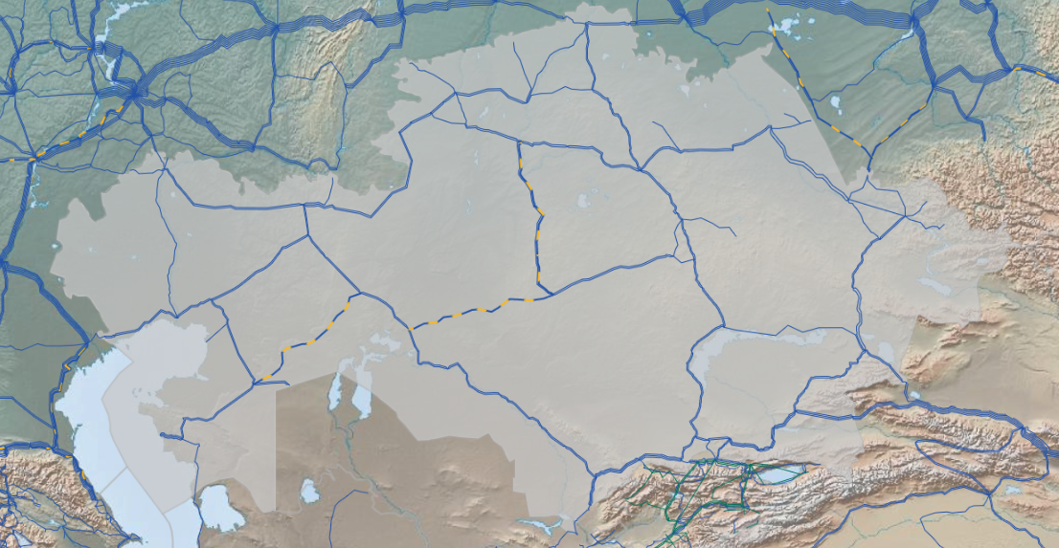
Kazakhstan – Exit Points
Russia
China
Kyrgyzstan
Turkmenistan
Uzbekistan
https://bbmaps.itu.int/bbmaps/
Notes:
If we zoom in on each country we can see that in the case of Kazakhstan, they rely on Internet connectivity from Russia, China, Kyrgyzstan, Uzbekistan and Turkmenistan.

Slide 44
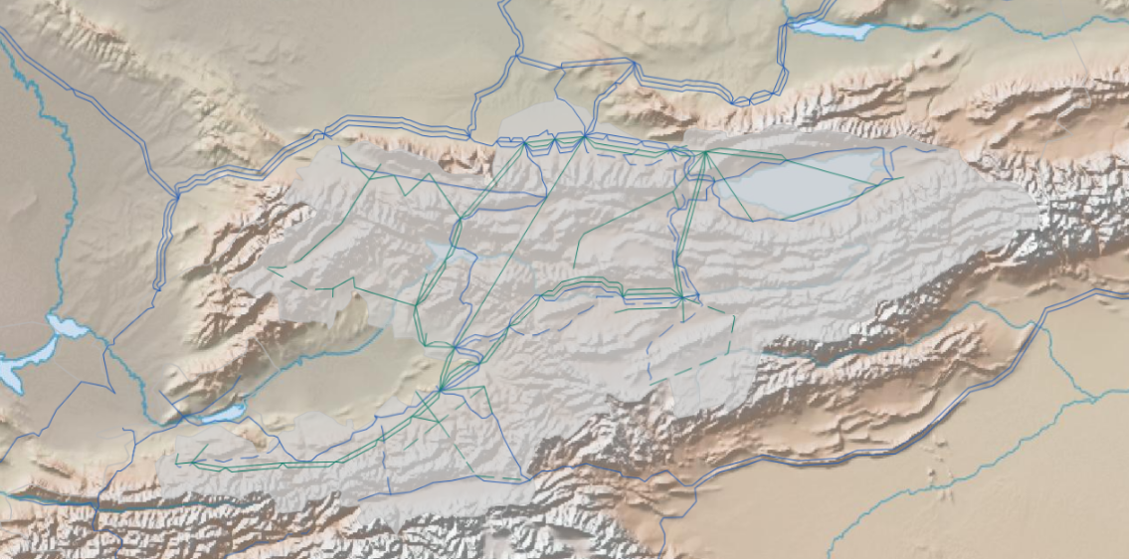
Kyrgyzstan– Exit Points
Kazakhstan
Uzbekistan
China
Tajikistan
https://bbmaps.itu.int/bbmaps/
Notes:
For Kyrgyzstan, they get their Internet predominantly via Kazakhstan, Uzbekistan and Tajikistan. Though there have been reports that local conflict between Kyrgyzstan and Tajikistan has resulted in the cross border line between these two countries going dark.
It’s worth noting the backbone infrastructure they have in place.

Slide 45
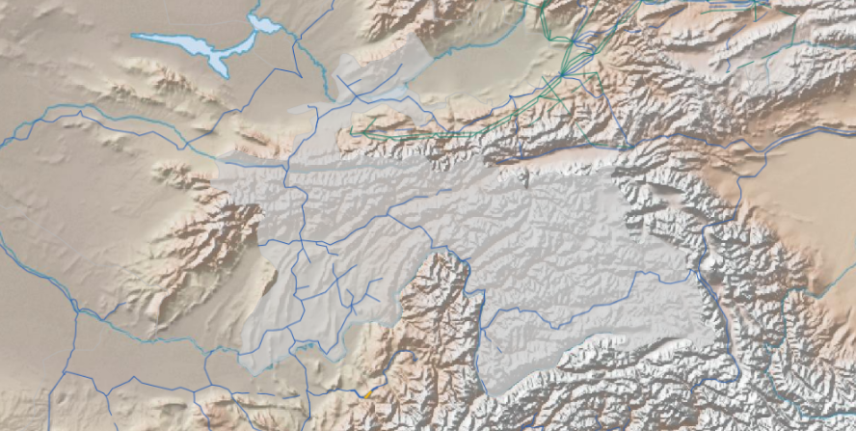
Tajikistan
Kyrgyzstan
Uzbekistan
China
Afghanistan
https://bbmaps.itu.int/bbmaps/
Notes:
If these rumors are true then in the case of Tajikistan they are predominantly getting their connectivity via Afghanistan and Uzbekistan.

Slide 46
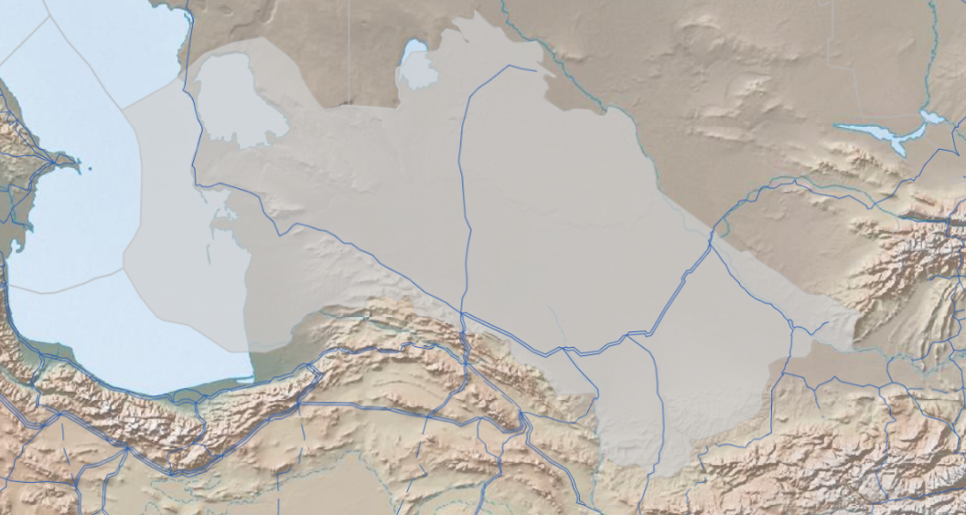
Turkmenistan– Exit Points
Uzbekistan
Iran
Afghanistan
https://bbmaps.itu.int/bbmaps/
Notes:
As is Turkmenistan which also has links with Iran, though its questionable how much traffic is provided by these.

Slide 47
Turkmenistan– Exit Points
https://bbmaps.itu.int/bbmaps/
Notes:
So to recap, the region is connected to the rest of the Internet via Russia, China, Afghanistan and Iran. Now we’re all aware of the questionable nature of the Internet in three of these countries, which have the potential to either stop connectivity or serving their own form of Internet.

Slide 48
"Myanmar’s Twitter block [Feb 2021] had accidentally cut Twitter access to at least half a billion internet users.
The same dynamic was repeated in March 2022, when Russia inadvertently cut access to Twitter across Europe with a block designed for its own people."
https://www.theguardian.com/technology/2022/aug/29/when-internet-shutdowns-spill-over-borders
https://twitter.com/Liveuamap/status/1478709807569850372
Notes:
Ultimately, the mechanics of the internet mean that blocks on access imposed by one country may leach over the borders on to neighbouring populations, or even be felt half a world away by users in different continents.

Slide 49
Ukraine – Exit Points
Belarus
Poland
Russia
Slovakia
Hungary
Moldova
Romania
https://bbmaps.itu.int/bbmaps/
Notes:
This is why I’m sure you’re all, like we are, watching the outcomes of the Russia Ukraine war as this is serving as a test case of not just the importance of redundancy but also the resilience its networking community established and continues to maintain and improve on.

Slide 50
Ukraine– Internet Resilience Index
Notes:
And if we look at two of the sub pillar indicies that I highlighted earlier, we can see that Ukraine is faring better than all CA countries which has gone a long way towards insulating local connectivity in many ways from the targeted attacks that Russia has made on Ukraine’s infrastructure.

Slide 51
Ukraine – IPv4 and v6 Interconnection (APNIC REx)
https://rex.apnic.net/as-interconnections?allocationType=ipv4,ipv6&economy=UA
Notes:
As can be seen here, it has a strong local peering fabric. Importantly, this has changed little, even as nearly 100 ASNs have transferred out of the country, most to Russia.

Slide 52
Ukraine – ASN Dependency (IIJ Internet Health Report)
https://ihr.iijlab.net/ihr/en-us/countries/UA?af=4&last=3&date=2023-08-24&rov_tb=routes
Notes:
While Kyivstar is the dominant ISP in the country, multiple other providers provision more than three-quarters of the remaining traffic. This has been especially important given that Kyivstar has experienced increased latency and decreased throughput.
Notably, 71% of networks are implementing best current routing security practices, 99% of which have documented their routing announcements in the IRR and 40% in RPKI.

Slide 53
We all have a role to play
Notes:
To wrap things up, we all have a role to play to advocate for a healthy Internet and data is critical to each of these roles. Whether its collecting data, making sense of the data or making decisions based on the data.

Slide 54
Advocating for a healthy Internet
What data are you collecting and sharing?
What data can help you in your research/advocacy/decision making efforts?
How can we collaborate to improve the health of the Internet in your countries and as a region?
Notes:
The Internet Society, RIPE, ICANN, we’re merely three of many organization seeking to collect and make sense of this data and as my colleagues have already mentioned, we have our limitations, which is why we need to approach this collectively.

Slide 55
Subscribe, Review, Contribute
Subscribe to the Pulse newsletter
Review the Pulse IRI methodology
Contribute to Pulse
pulse@isoc.org
Notes:
Finally, if you’re interested in keeping abreast of our project, please subscribe to our monthly newsletter.
Or email us to discuss opportunities to partner or contribute to our Blog.
I’ve also shared a link to the methodology of the IRI for those interested in the sources and calculations.

Slide 56
Thank you
Robbie Mitchell
mitchell@isoc.org

