Slide 1
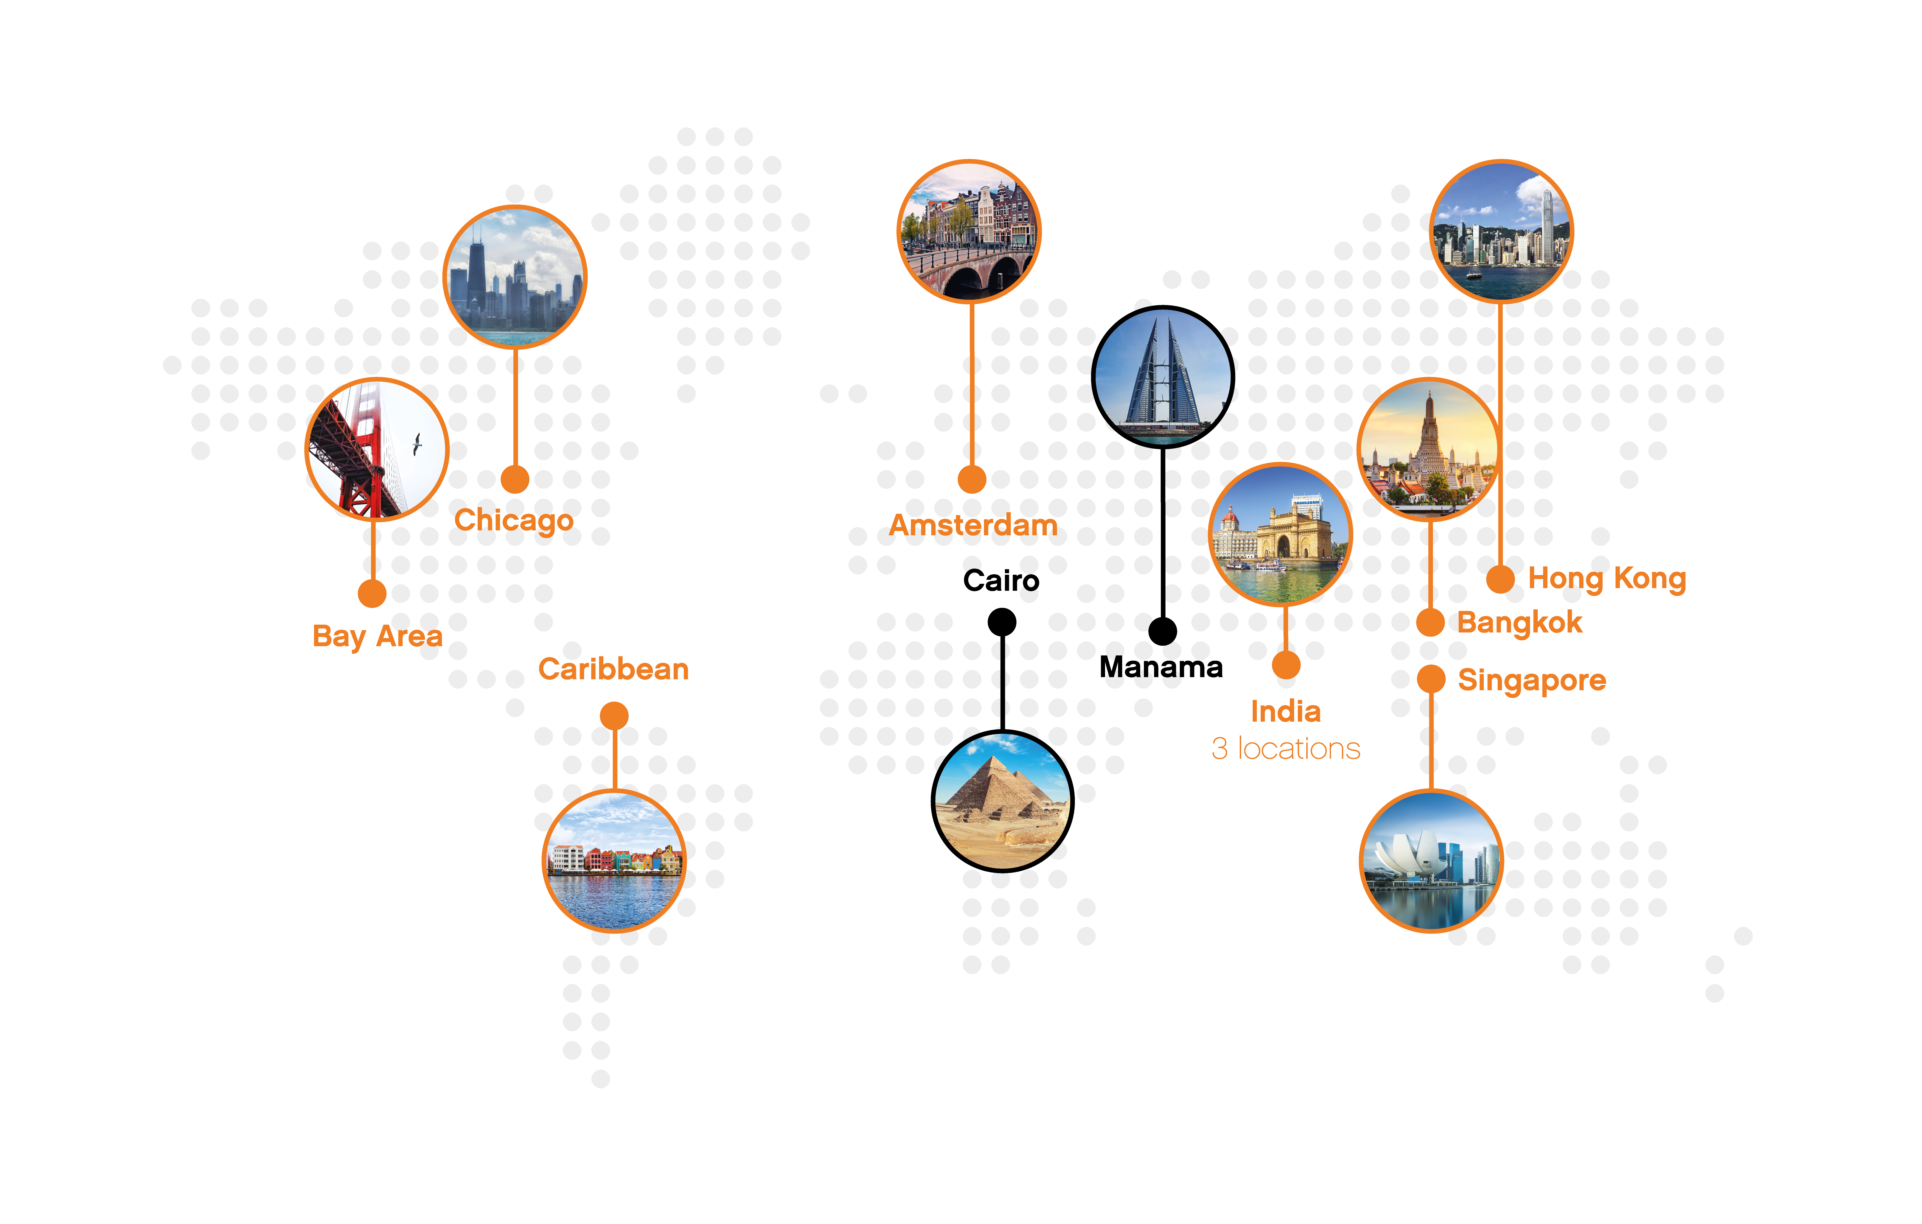
AMS-IX
AS 1200
Neutral and
independent
11.6 Tbps
Peak traffic
1100+ connected
networks worldwide
12 Internet Exchanges
+ more coming soon:
Kuching, Chennai,
Noida, Lagos, Philippines, Oman
Contact us: sales@ams-ix.net
AMS-IX locations
Powered by AMS-IX

