Slide 1

Navigating the ME
Internet Landscape
RIPE NCC Government Roundtable
Jad El Cham | RIPE NCC | 04 December 2025

Slide 2


Hello!
I’m Jad El Cham!
Regional Manager for Public Policy and Technology Adoption, Middle East
jelcham@ripe.net

Slide 3
What is our NCC - ME region like?
Some
Context

Slide 4
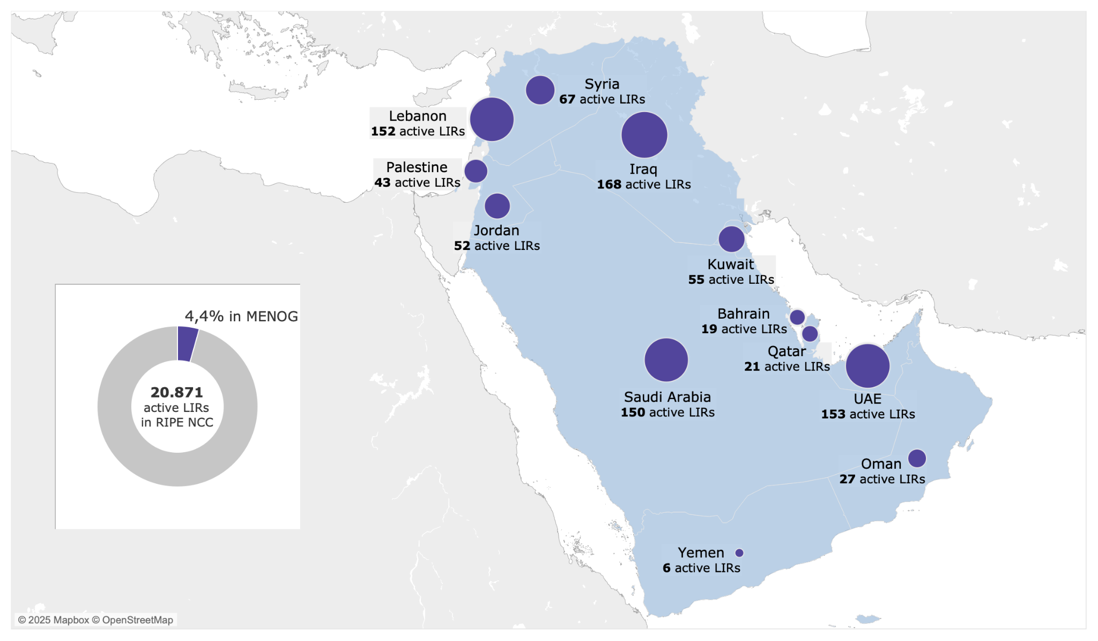
Our members in the region

Slide 5
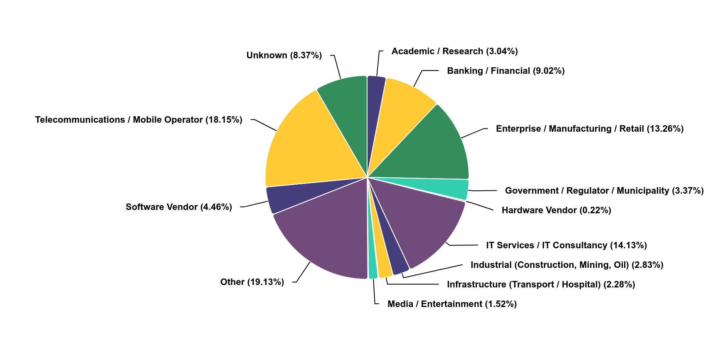
All industries are represented

Slide 6
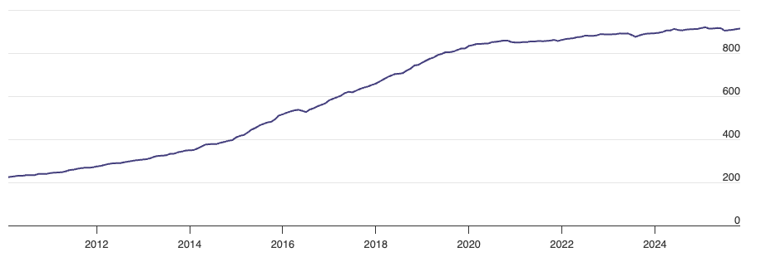
Is the membership growing?
Membership growth in the ME

Slide 7
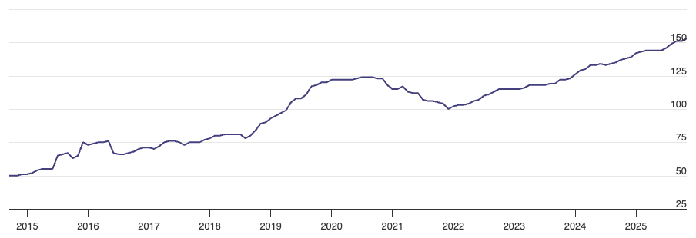
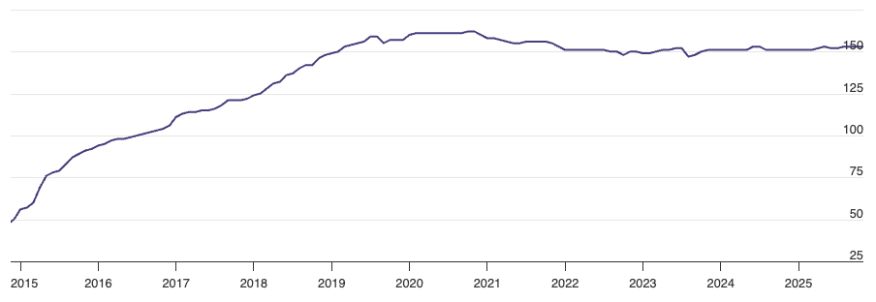
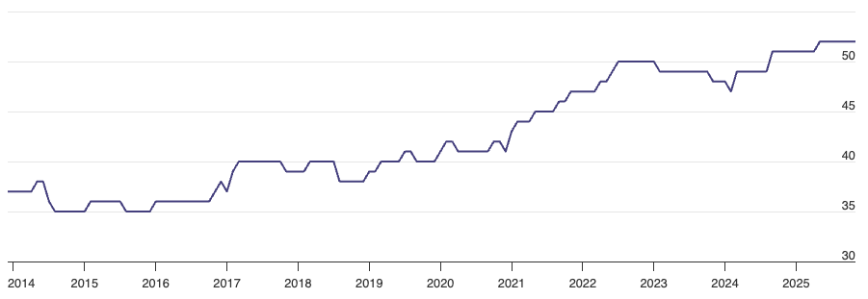
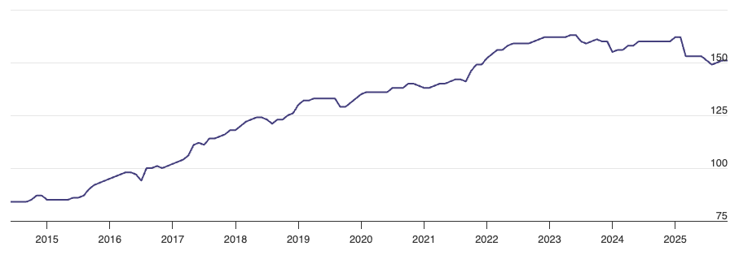
Zooming in
UAE
LEBANON
JORDAN
SAUDI ARABIA

Slide 8
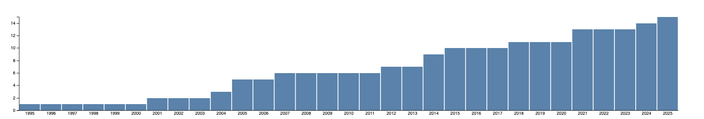
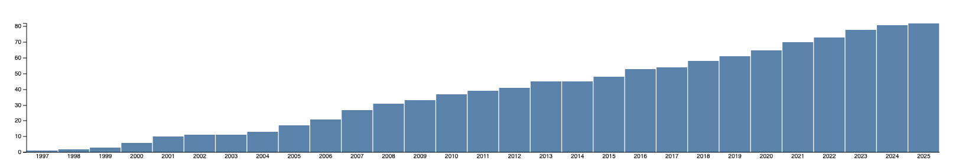
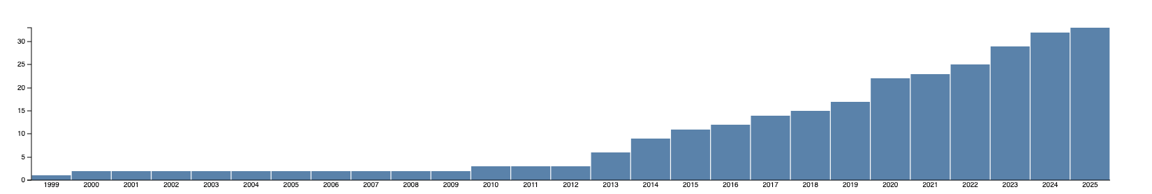
What about the Arab countries in Africa?
ALGERIA
15
EGYPT
82
LIBYA
33

Slide 9
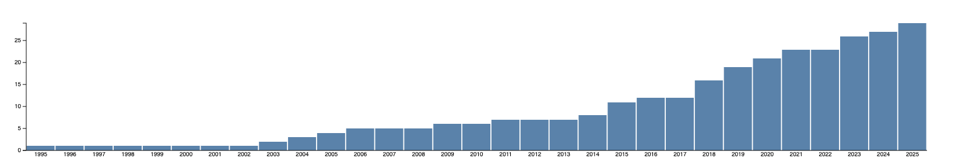
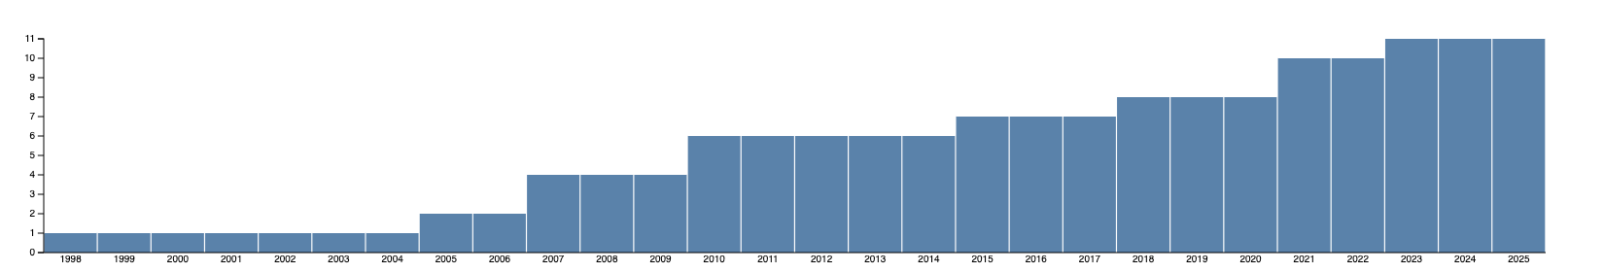
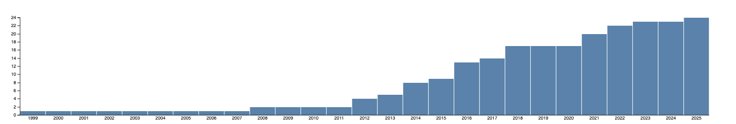
What about the Arab countries in Africa?
MOROCCO
29
SUDAN
11
TUNISIA
24

Slide 10
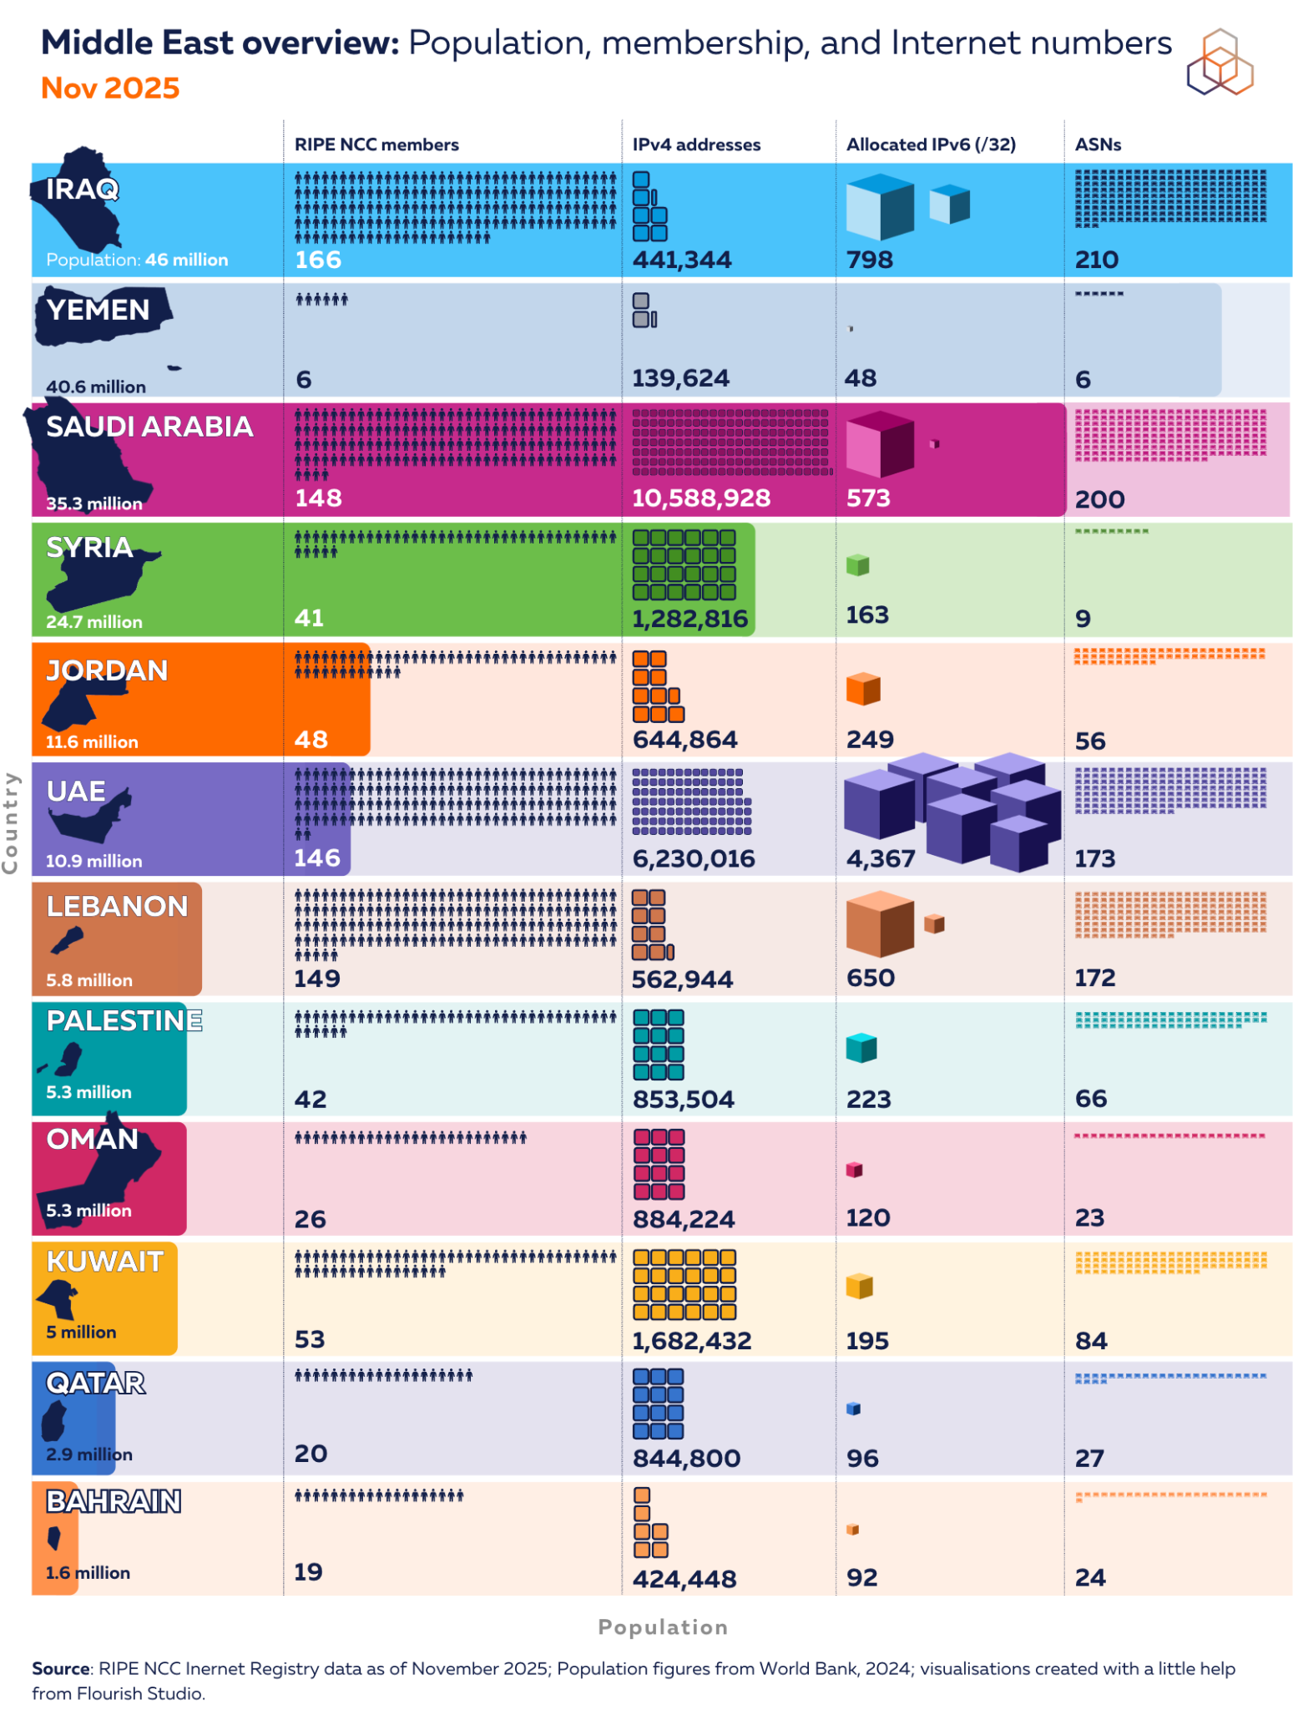
Does the size of the country matter?

Slide 11
SCALABILITY

Slide 12
Problem Statement
What are we
trying to solve?

Slide 13
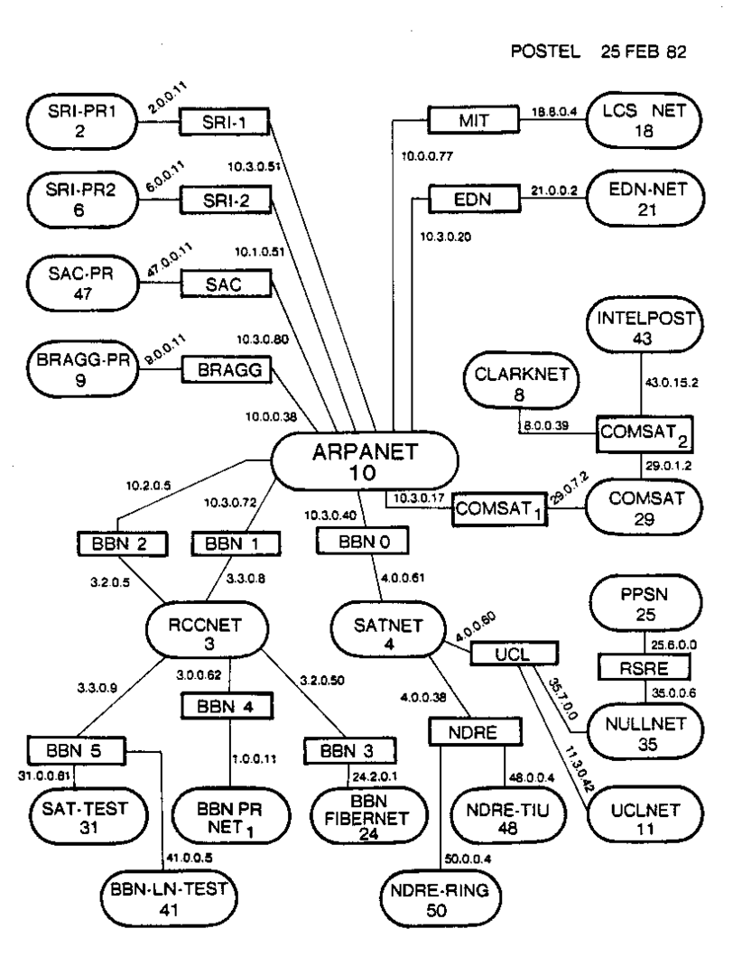
The Internet was once small…
Credit: Wikimedia

Slide 14
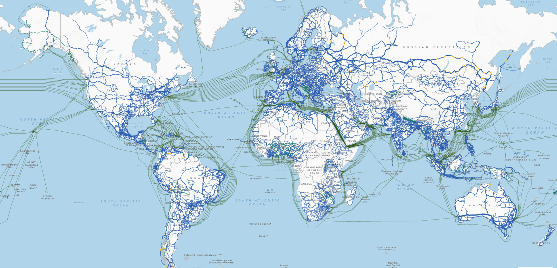
… And then it blew up!
Credit: ITU

Slide 15
But it is not
only the number of
networks growing

Slide 16
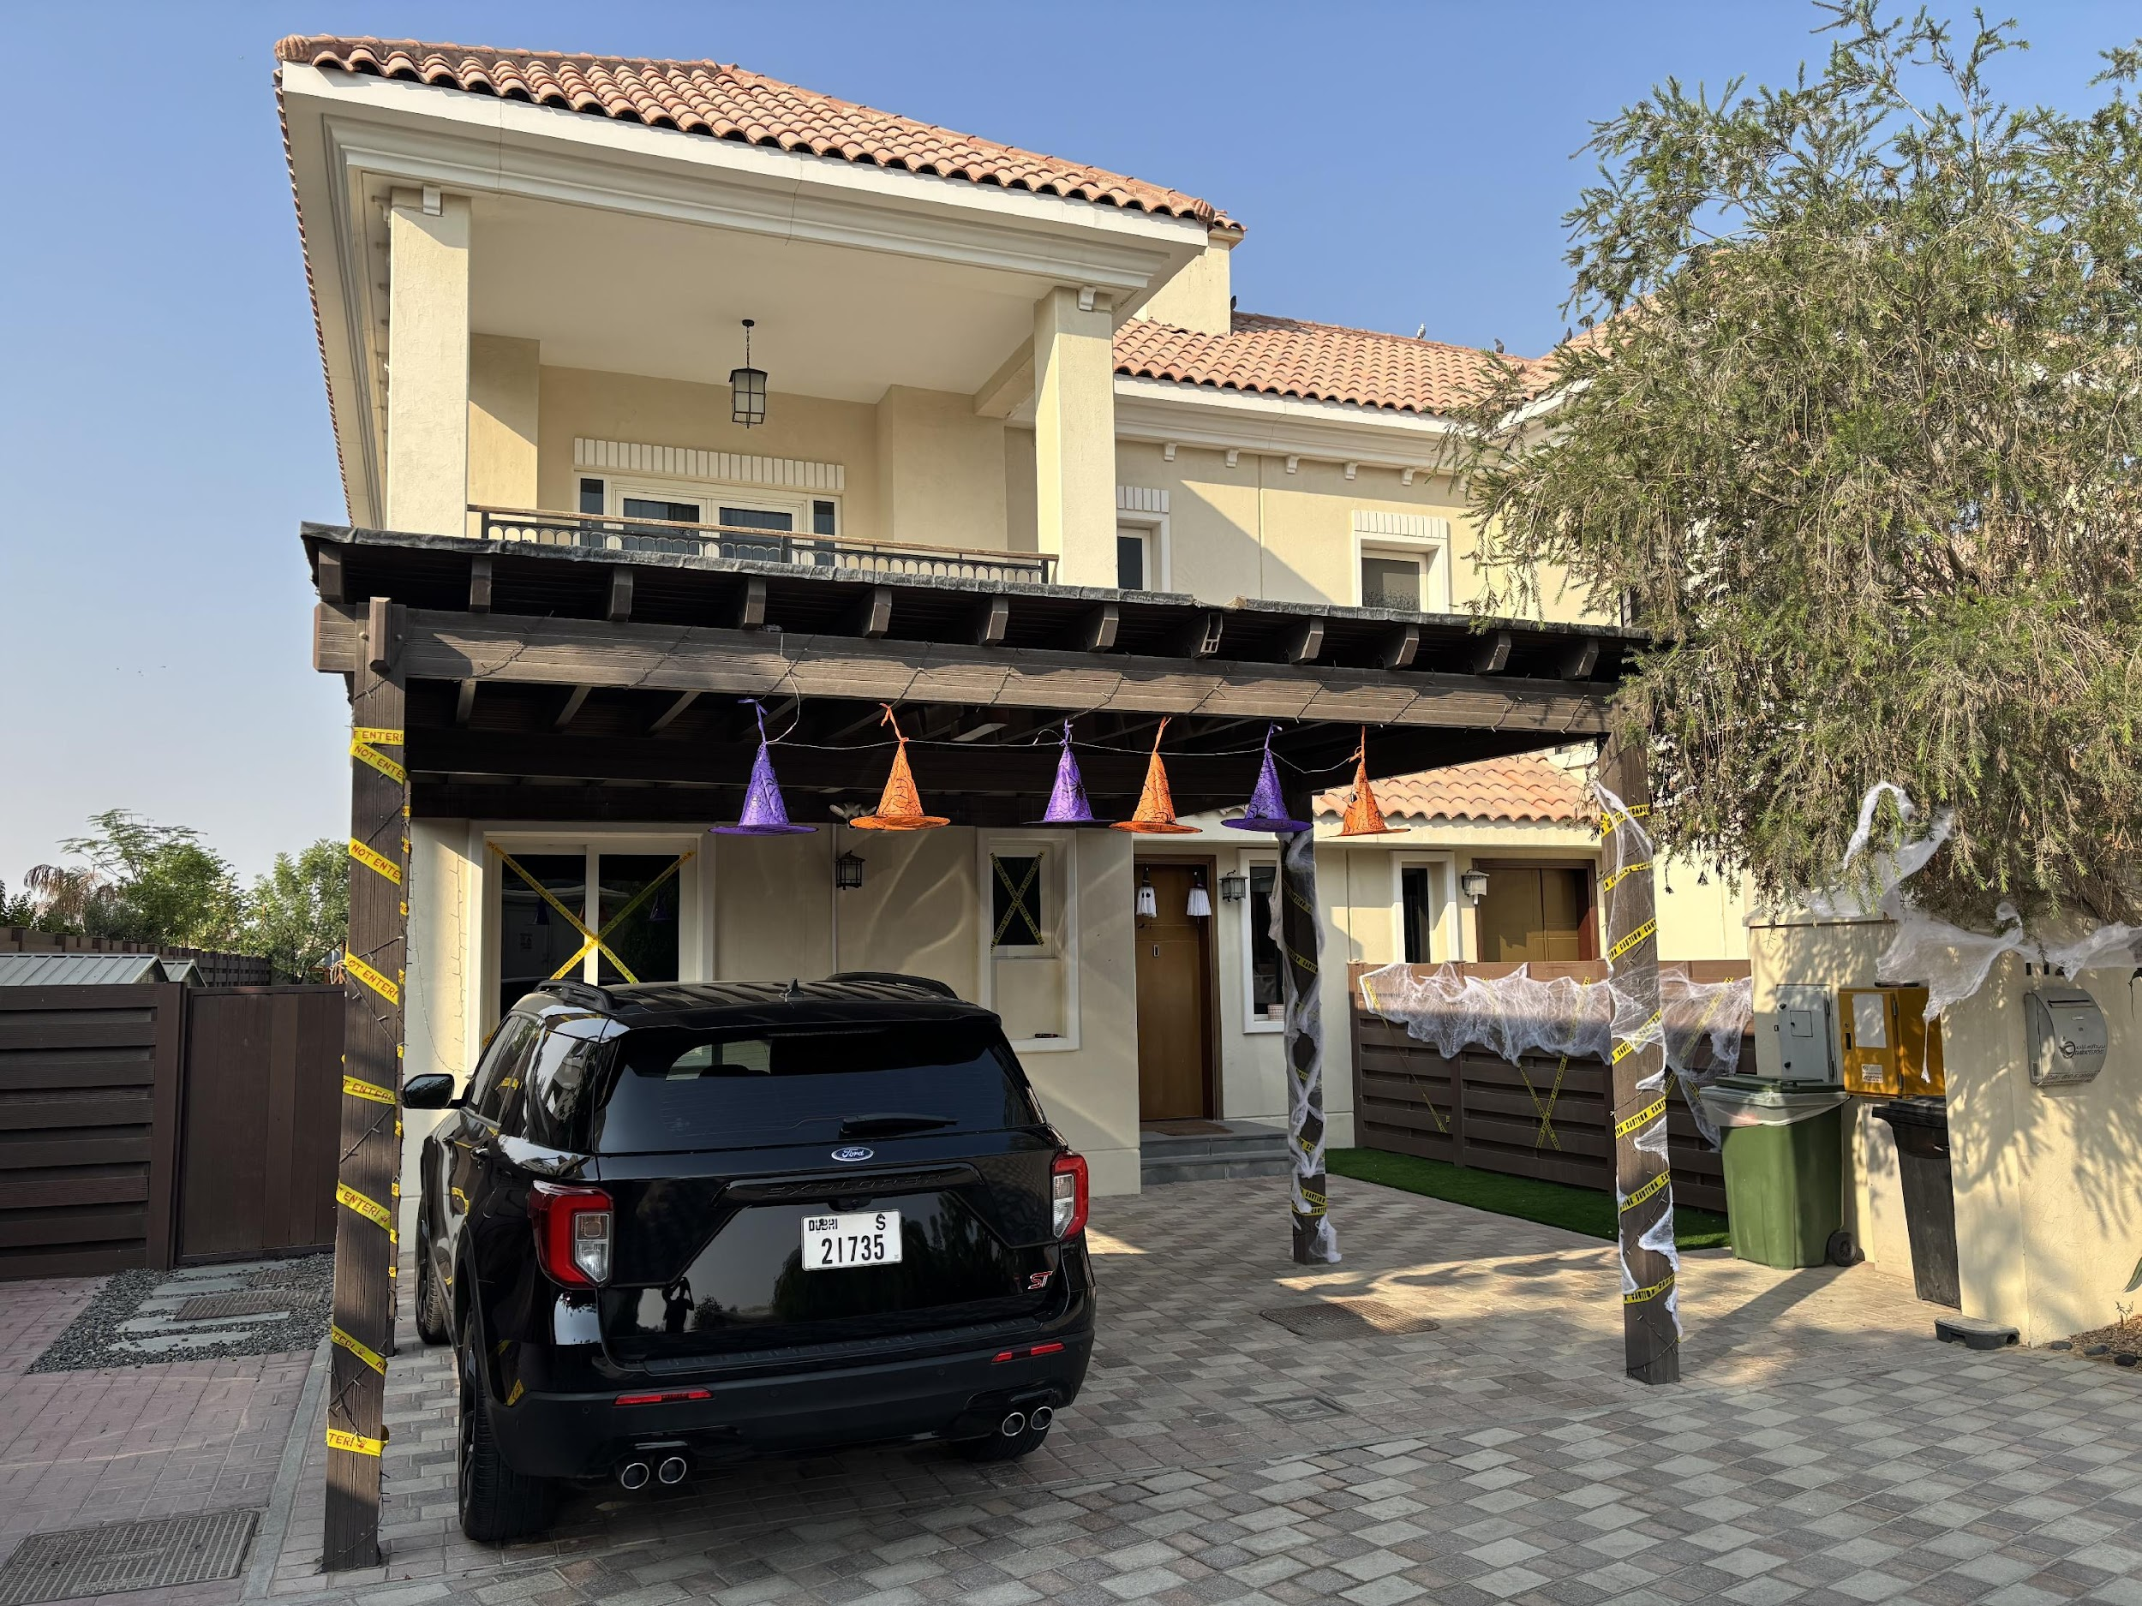
Ahla w Sahla
  12 IP Cameras
  8 Phones
  5 Laptops
  4 Tablets
  4 Air Purifiers
  3 Wireless Routers
  3 TVs + Decoder
  2 Apple Watches
  1 Alexa
  1 Printer
  1 IoT Gateway
  1 Car!
  1 Baby monitor!
  1 Christmas Tree?

Slide 17
All these devices need
IP Addresses
to connect to the Internet

Slide 18
The case of
IPv4

Slide 19
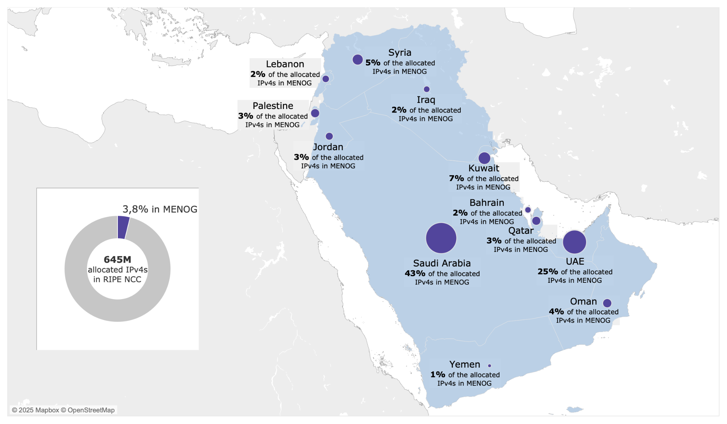
IPv4 in the NCC - ME region

Slide 20
Most of it is already used
Country | IPv4 Addresses Allocated | IPv4 Addresses Used | IPv4 Addresses % Used
KSA | 10,964,032 | 10,248,960 | 93.48
UAE | 6,316,736 | 5,969,920 | 94.51
Kuwait | 1,907,456 | 1,742,848 | 91.37
Syria | 1,284,864 | 1,197,568 | 93.21
Oman | 950,272 | 828,416 | 87.18
Palestine | 875,520 | 819,712 | 93.63
Qatar | 845,440 | 836,864 | 98.99
Jordan | 646,912 | 628,736 | 97.19
Lebanon | 568,640 | 531,968 | 93.55
Iraq | 444,736 | 384,000 | 86.34
Bahrain | 425,216 | 412,160 | 96.93
Yemen | 233,472 | 231,168 | 99.01
Algeria | 4,765,184 | 4,755,968 | 99.81
Egypt | 24,150,528 | 23,727,616 | 98.25
Libya | 454,912 | 439,552 | 96.62
Morocco | 12,273,664 | 12,225,280 | 99.61
Tunisia | 7,877,632 | 7,876,352 | 99.98
Sudan | 1,891,072 | 790,016 | 41.78

Slide 21
IPv4 worked OK-ish till now
*** BUT ***
Almost Impossible to scale

Slide 22



So we are in a situation where we have more:
Users
Networks
Services
People
Machines
± 80 000 ASNs
Geo diversity
5G + IoT
6G

Slide 23
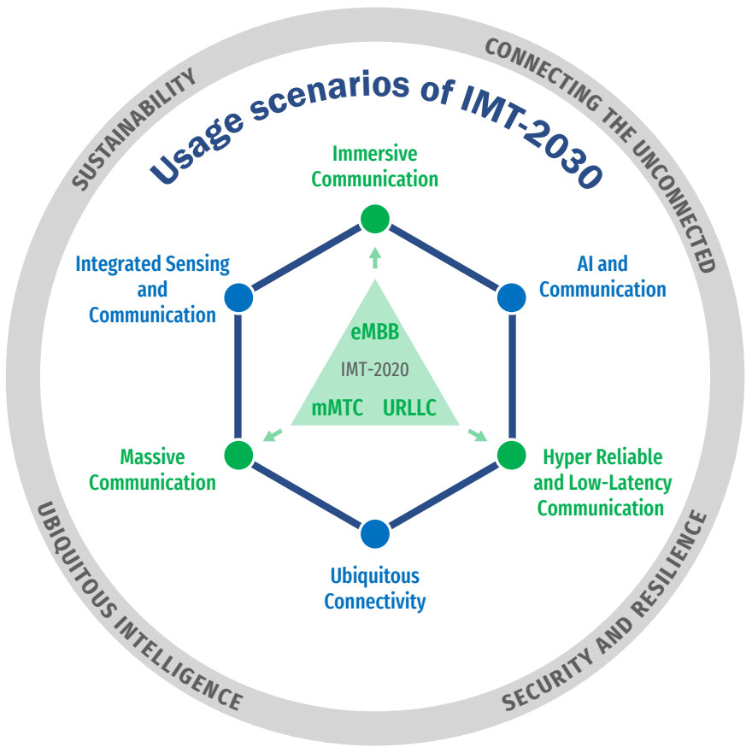
Keeping an eye on tomorrow

Slide 24
Keeping an eye on tomorrow

Slide 25


How do you expand your networks today?
No Action / I don’t care
No longer a choice
Extend life of IPv4
You’ve already done this
Concerns regarding NAT
Is it possible to keep acquiring IPv4 space from the market?
Deploy IPv6
That’s where we are now

Slide 26
The case of
IPv6

Slide 27
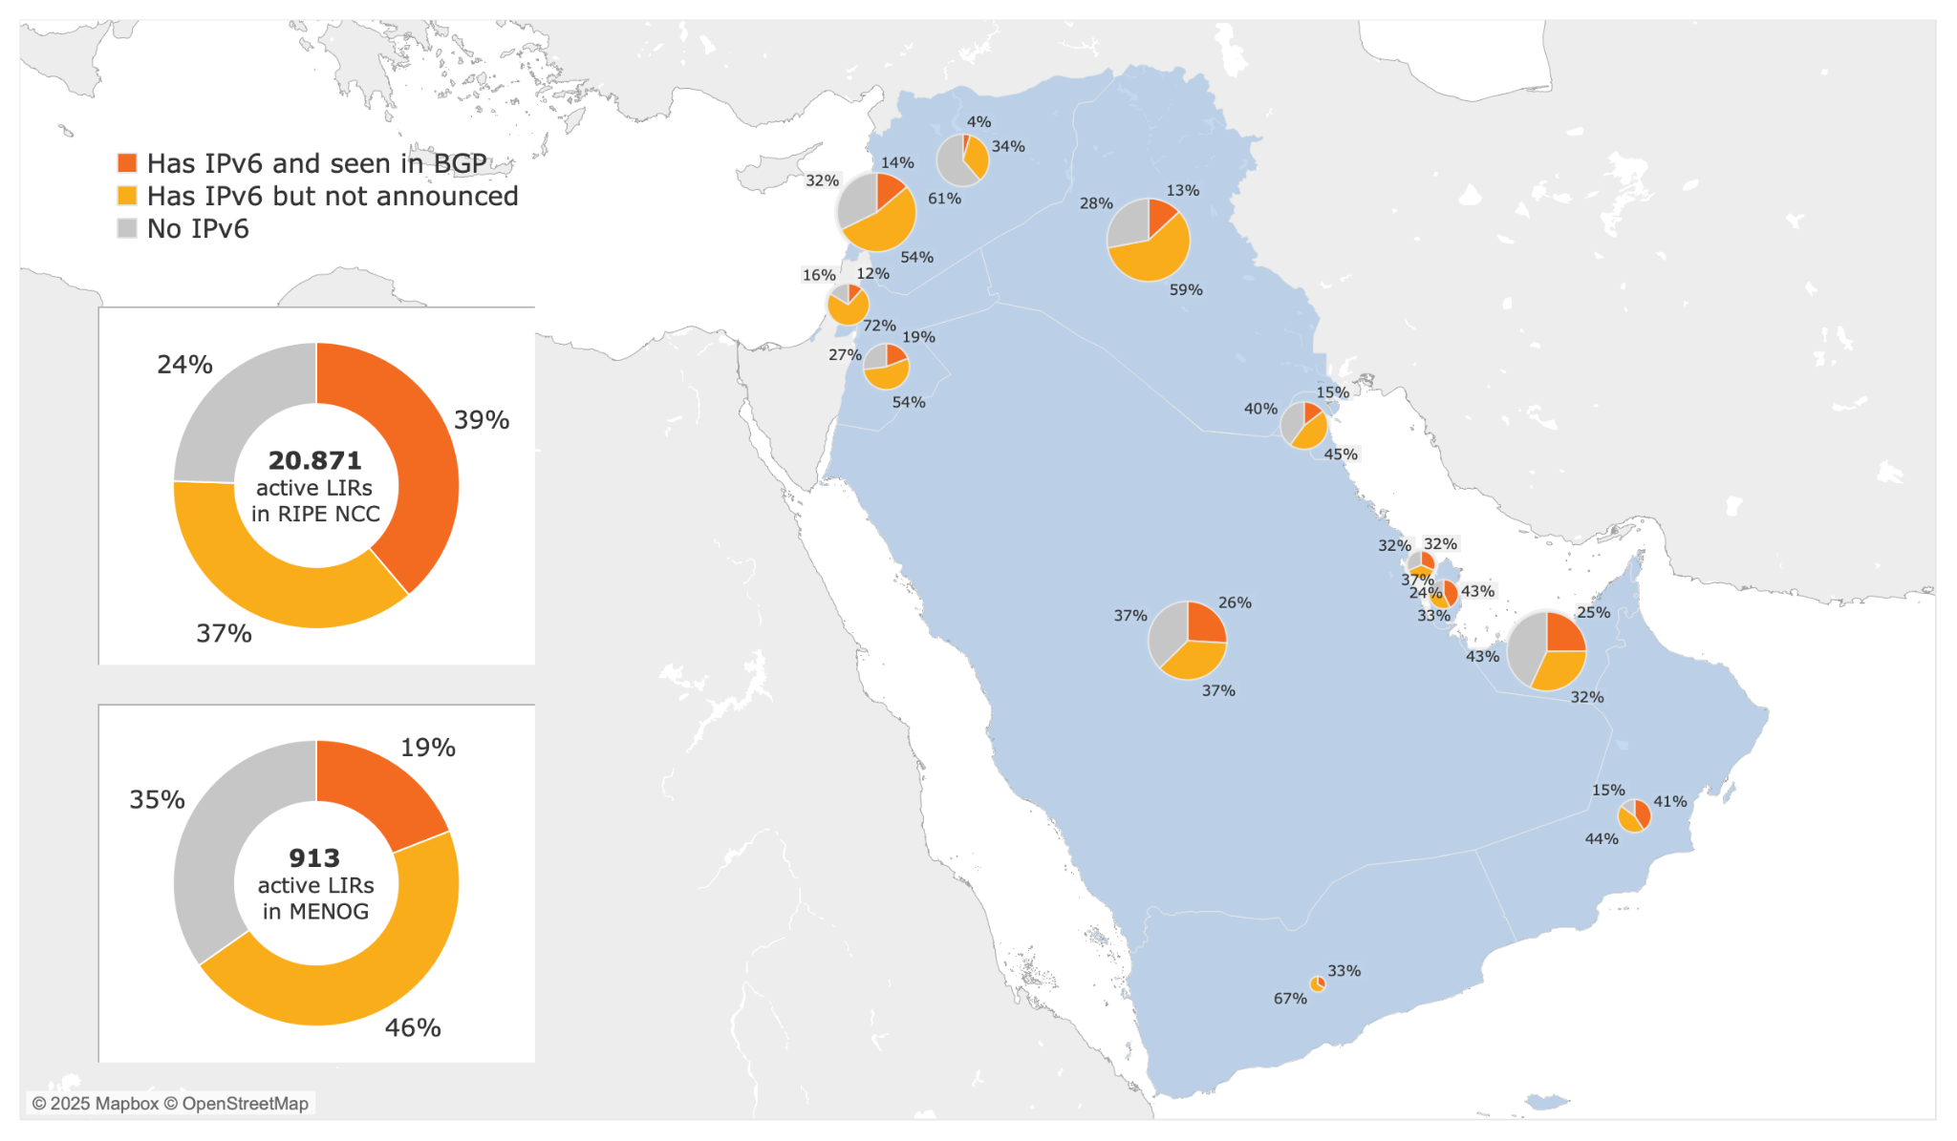
IPv6 in the NCC - ME region

Slide 28
Is it moving in the right direction?
Country | % IPv6 Capable 2025 | % IPv6 Capable 2024 | % IPv6 Capable 2023
KSA | 70.25 | 66.28 | 62.24
UAE | 51.26 | 51.73 | 49.31
Qatar | 39.74 | 32.79 | 3.36
Kuwait | 27.42 | 25.1 | 22.39
Oman | 23.29 | 22 | 22.26
Bahrain | 20.39 | 23 | 0.17
Jordan | 17.86 | 16.54 | 14.97
Yemen | 1.24 | 0.35 | 0.13
Iraq | 0.7 | 0.35 | 0.33
Lebanon | 0.36 | 0.5 | 0.66
Syria | 0.22 | 0.47 | 0.7
Palestine | 0.11 | 0.12 | 0.07
Algeria | 0.16 | 0.06 | 0.07
Egypt | 4.69 | 4.47 | 5.1
Libya | 1.02 | 1.9 | 0.24
Morocco | 0.52 | 0.05 | 0.05
Tunisia | 25.32 | 17.7 | 7.3
Sudan | 3.9 | 0.06 | 0.07

Slide 29

Why are we doing this in the first place?
The ultimate goal is IPv6
not
not
Guarantee continuity, growth and innovation/new services

Slide 30






Some of the obstacles in the way of massive adoption
$
Budget
Prioritisation
Regulatory
Knowledge
Technical
Use Case
Size?

Slide 31
Discussion Time

Slide 32
SECURITY

Slide 33
Problem Statement
Why do we need
Routing Security for?

Slide 34
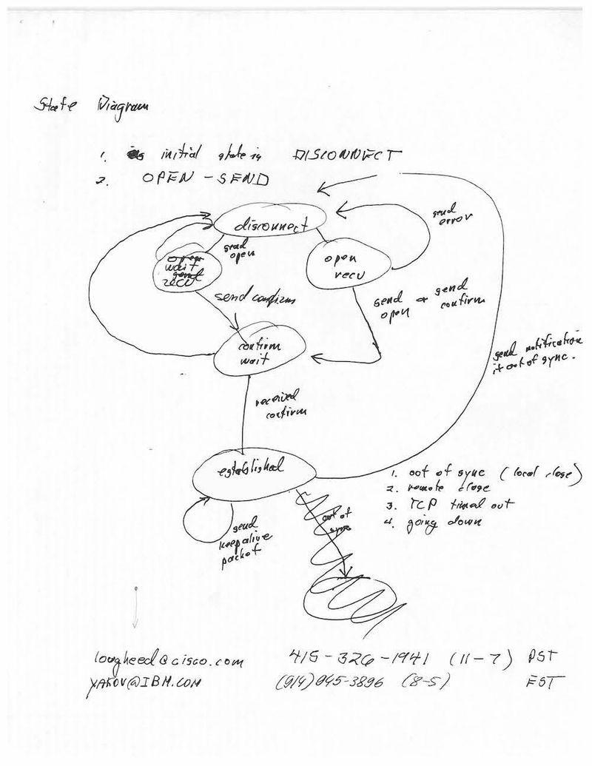
Simple Networks lead to ….
Simple Protocols
Credit: Wikimedia
Credit: CHM

Slide 35
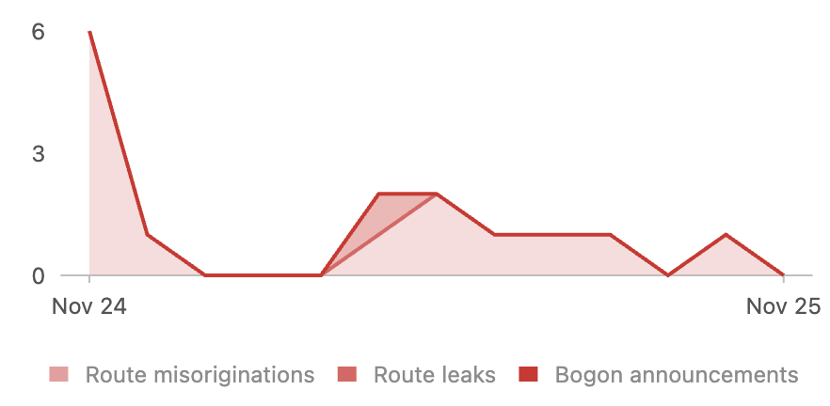
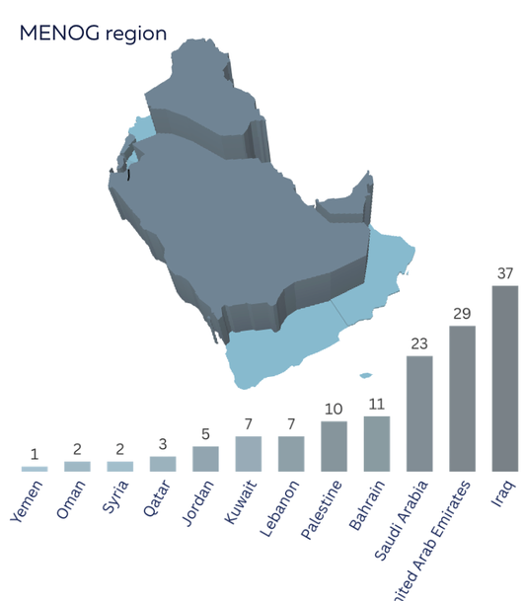
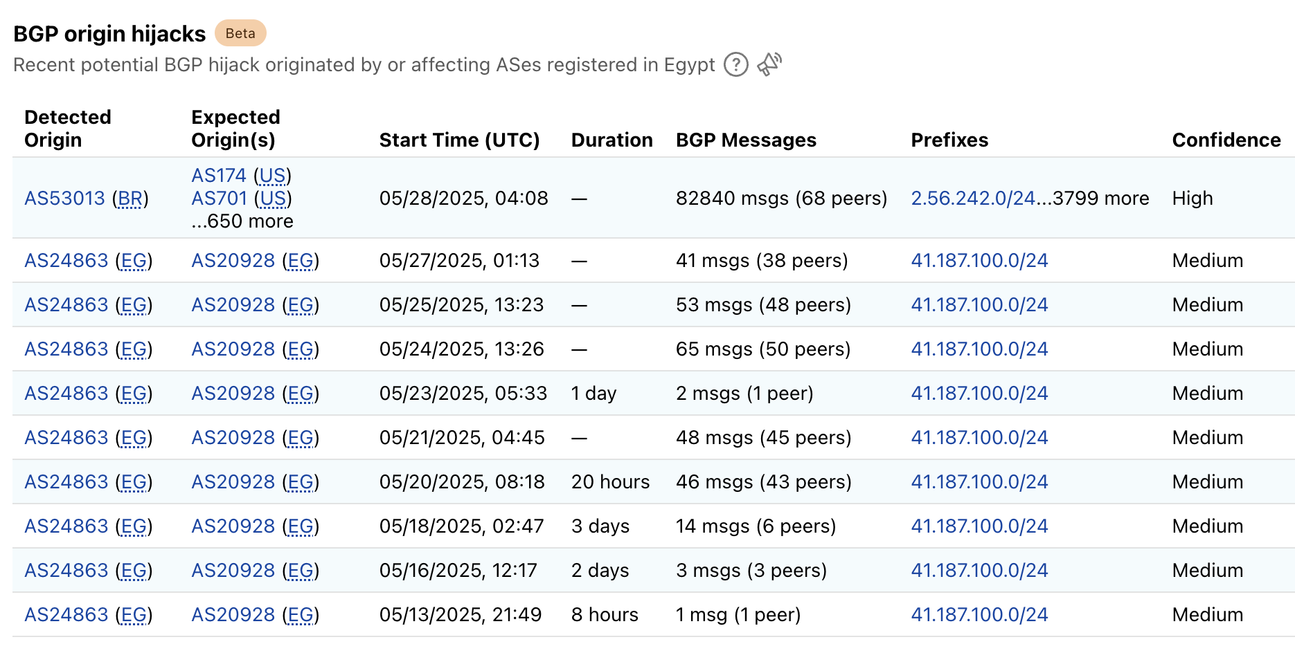
They cause issues in today’s “complex” world
Credit: MANRS
Credit: Cloudflare

Slide 36
The case of
RPKI

Slide 37
RPKI Can fix things
  RPKI is a security framework to secure routing on the Internet
  RPKI prevents IP hijacking, route leaks
  Protects your IP space
  Free*, Fast to deploy and Globally used

Slide 38
RPKI has 2 parts

Slide 39
Signing

Slide 40
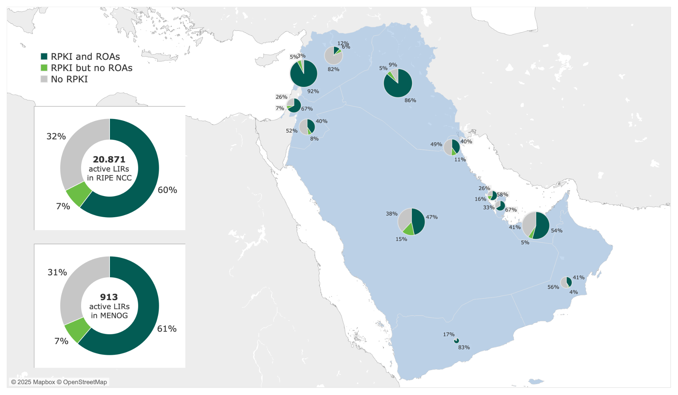
ROA Signing in the NCC - ME region

Slide 41
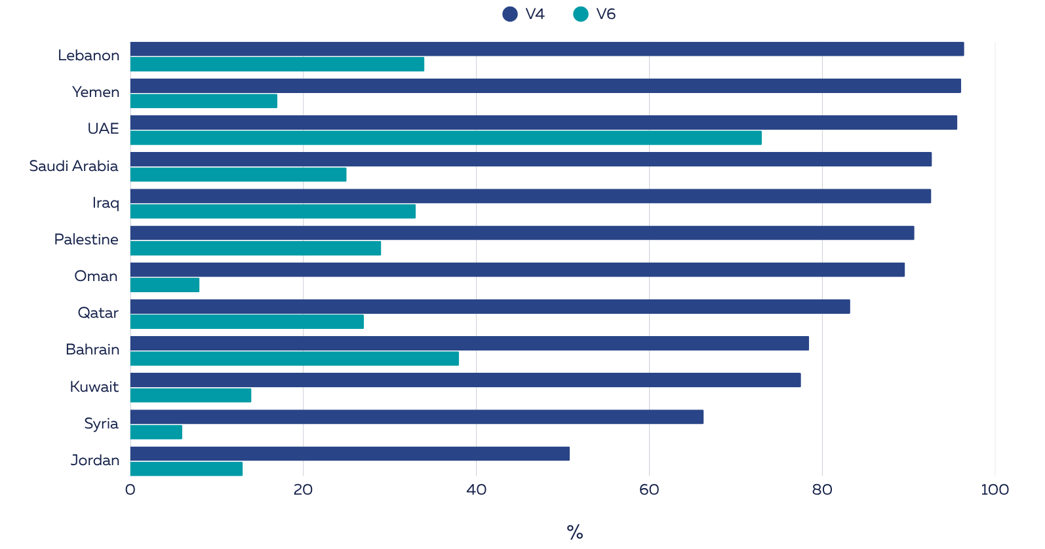
What does that mean for the IP space in NCC - ME?

Slide 42
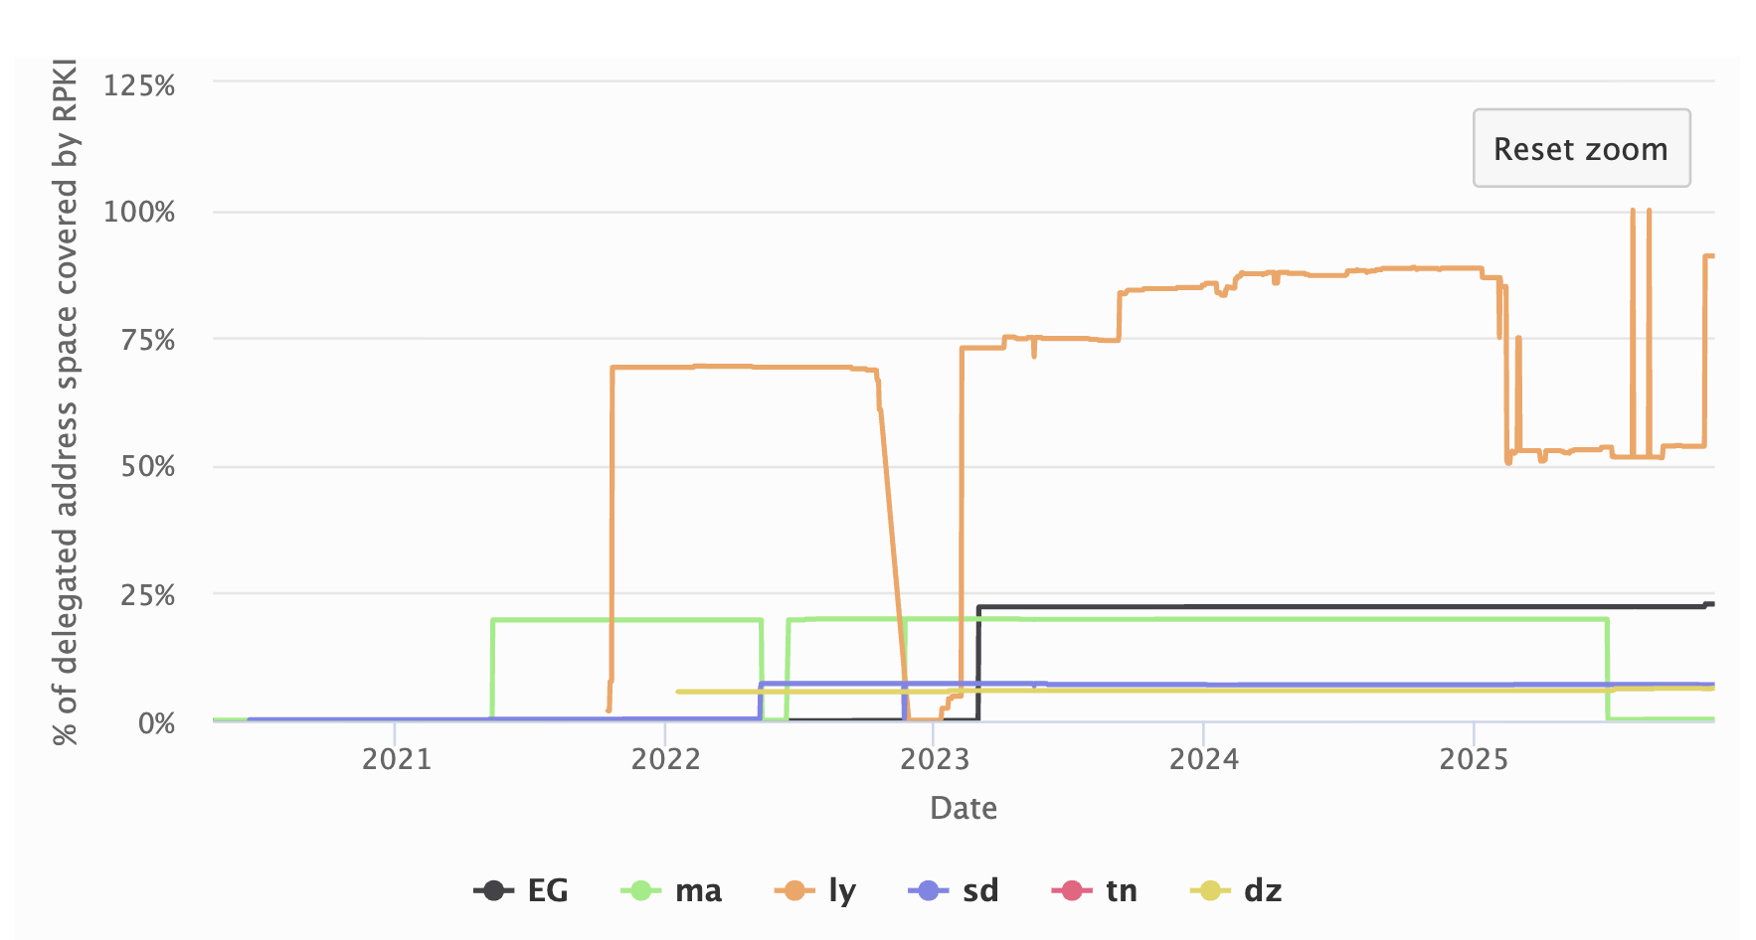
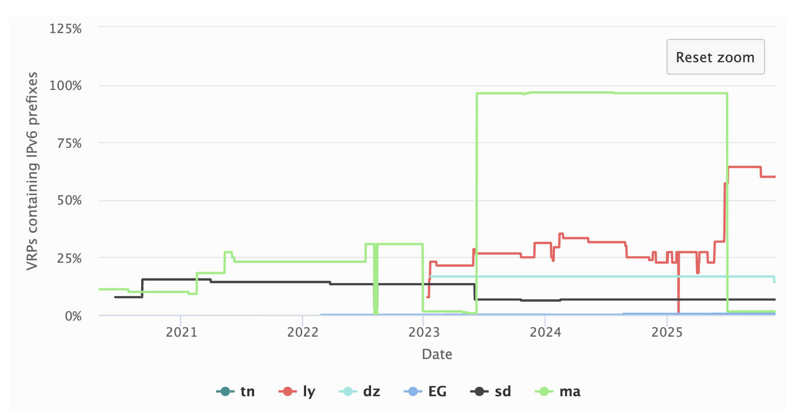
And what does that mean for the IP space in NA?
v4
v6

Slide 43
Validating

Slide 44
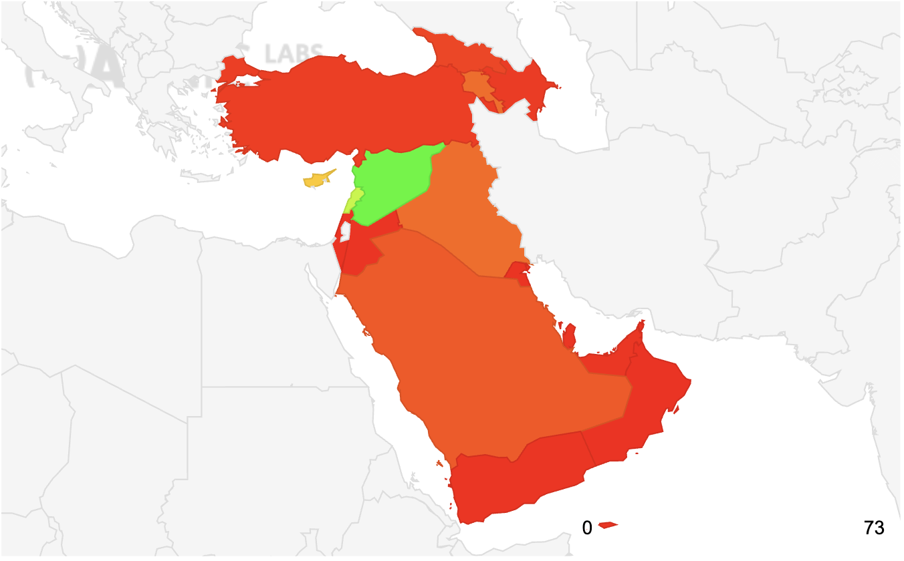
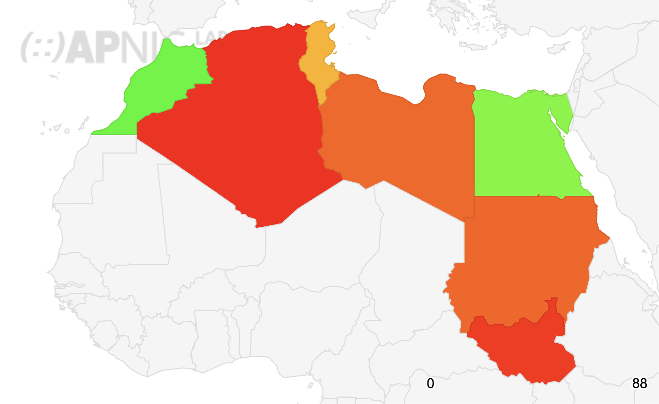
Are our networks protected by ROV?
Middle East
North Africa

Slide 45
Discussion Time

Slide 46
RESILIENCY

Slide 47
Problem Statement
Is the connectivity in our region “immune” to
Political crisis or natural disasters?

Slide 48
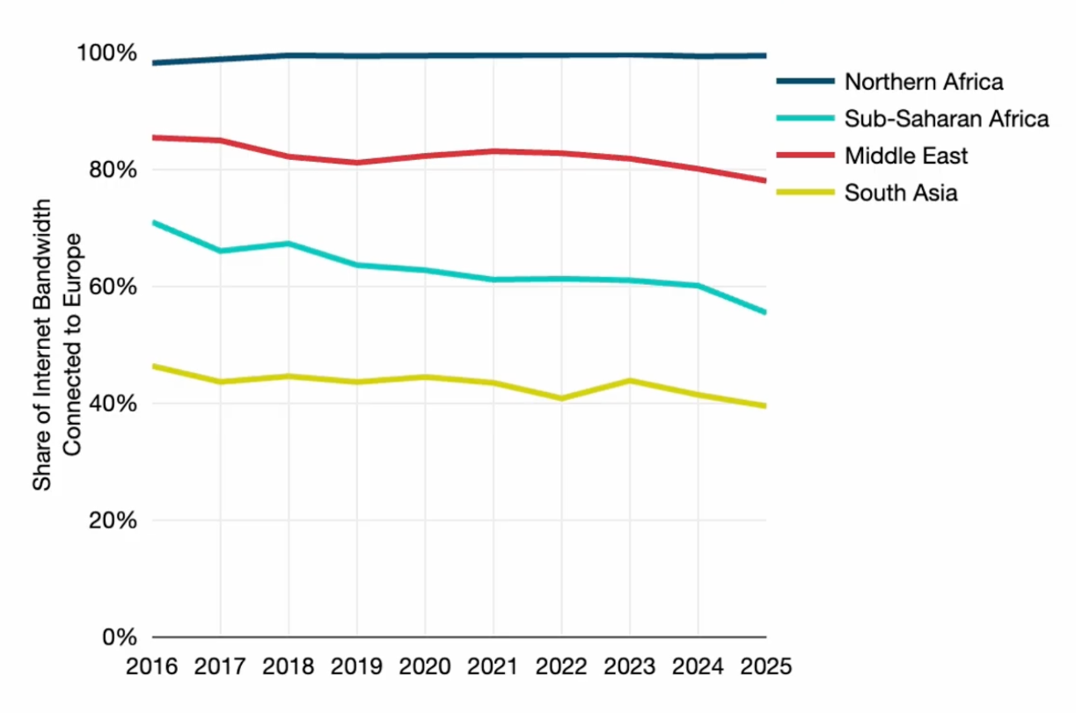
ME and NA rely heavily on Europe as a Data Hub
  Almost all of North African international traffic flows through Europe
  78% of international traffic in the Middle East flows through Europe
Credit: TeleGeography

Slide 49
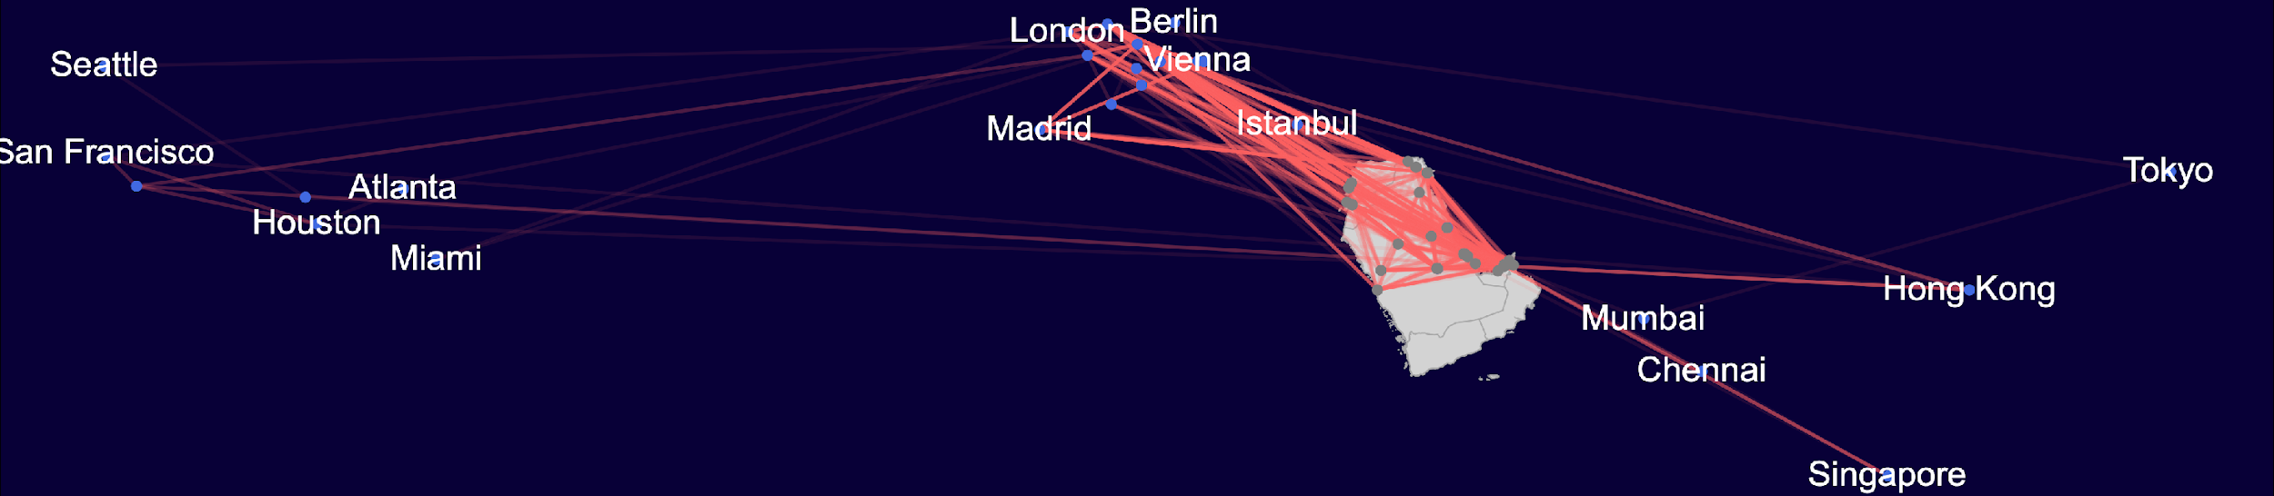
Inter-region traffic in ME can take scenic routes far away

Slide 50
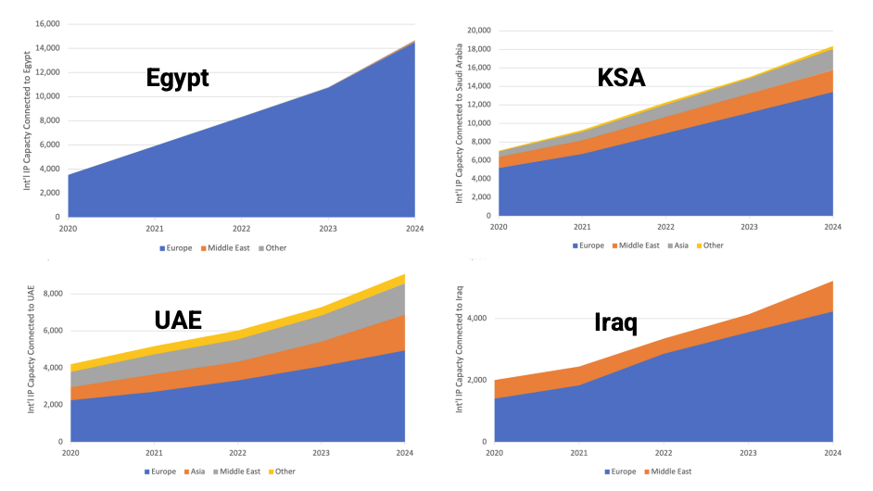
A closer look on some countries
What happens if Europe goes dark or become unreachable?
Credit: TeleGeography

Slide 51
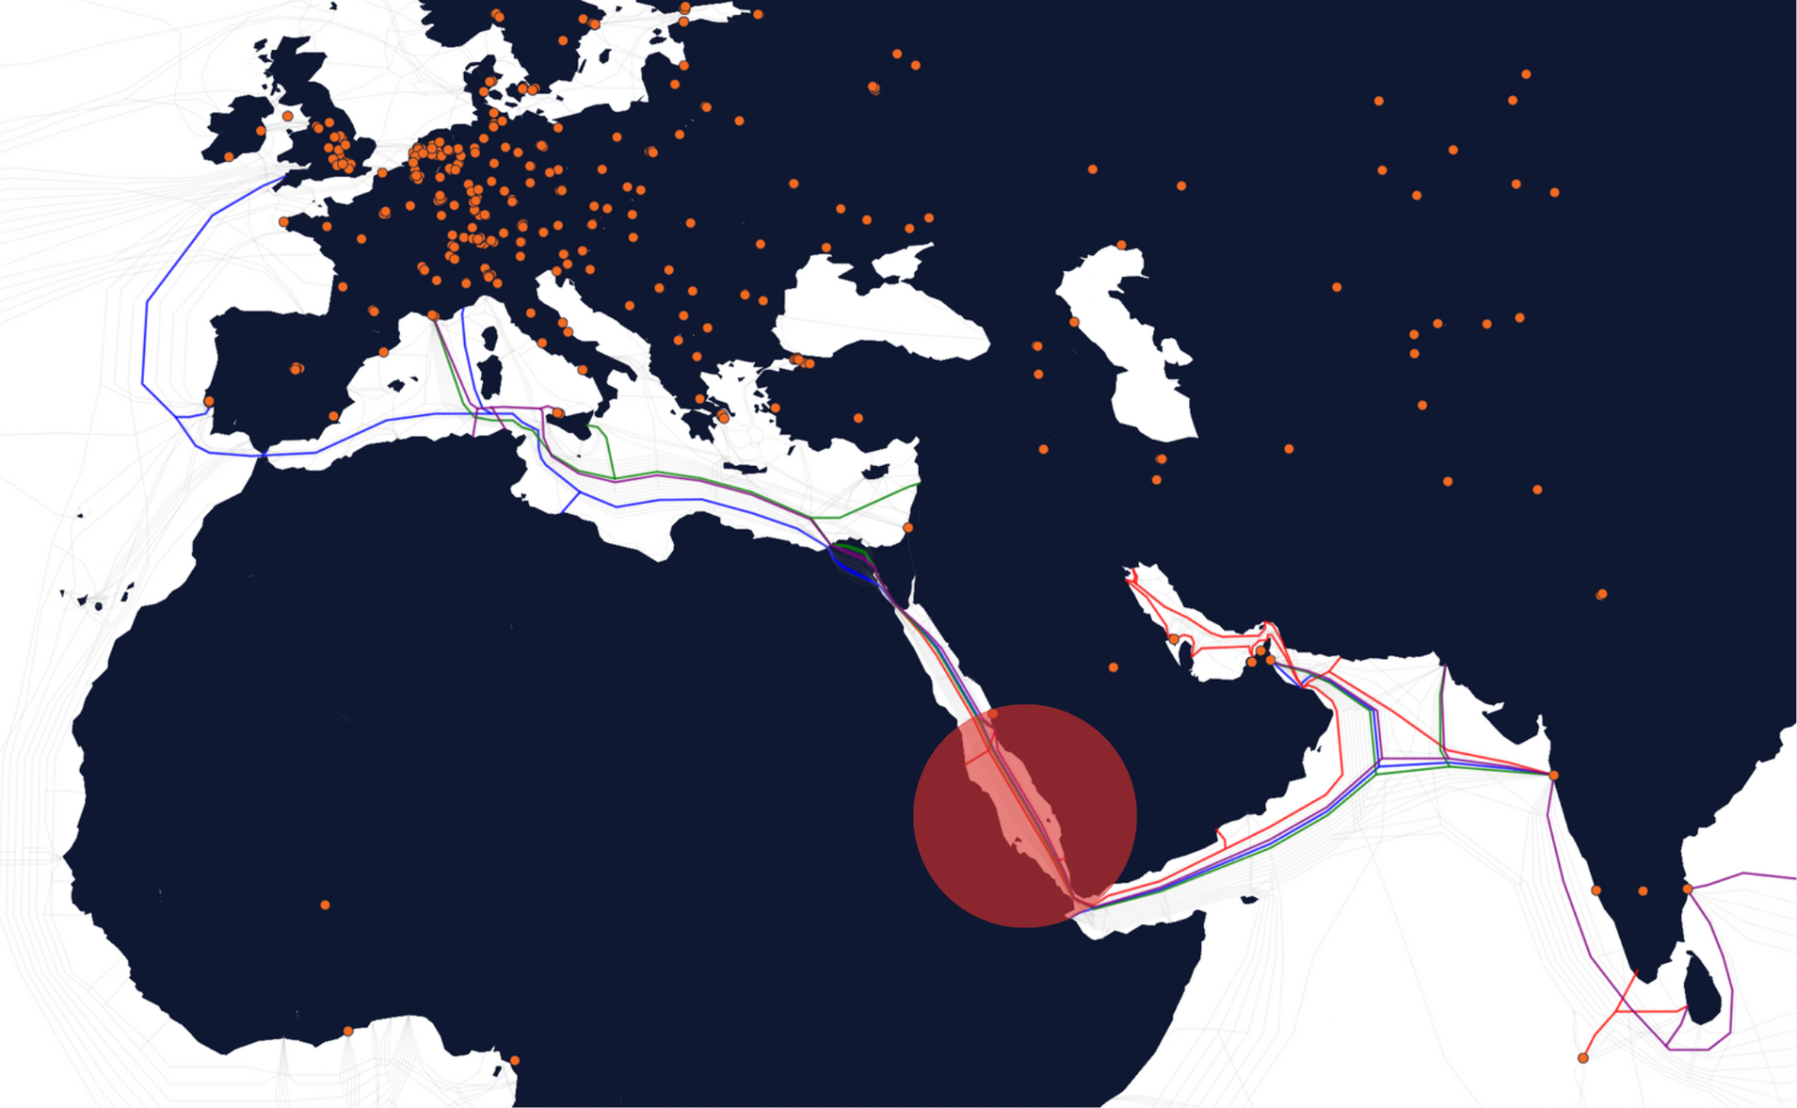
But things can go wrong, and they did go wrong
Cable damage in the Red Sea
5 September 2025: Reports emerge of cable outages in the Red Sea affecting:
FALCON
SeaMeWe-4
IMEWE
Europe India Gateway (EIG)

Slide 52
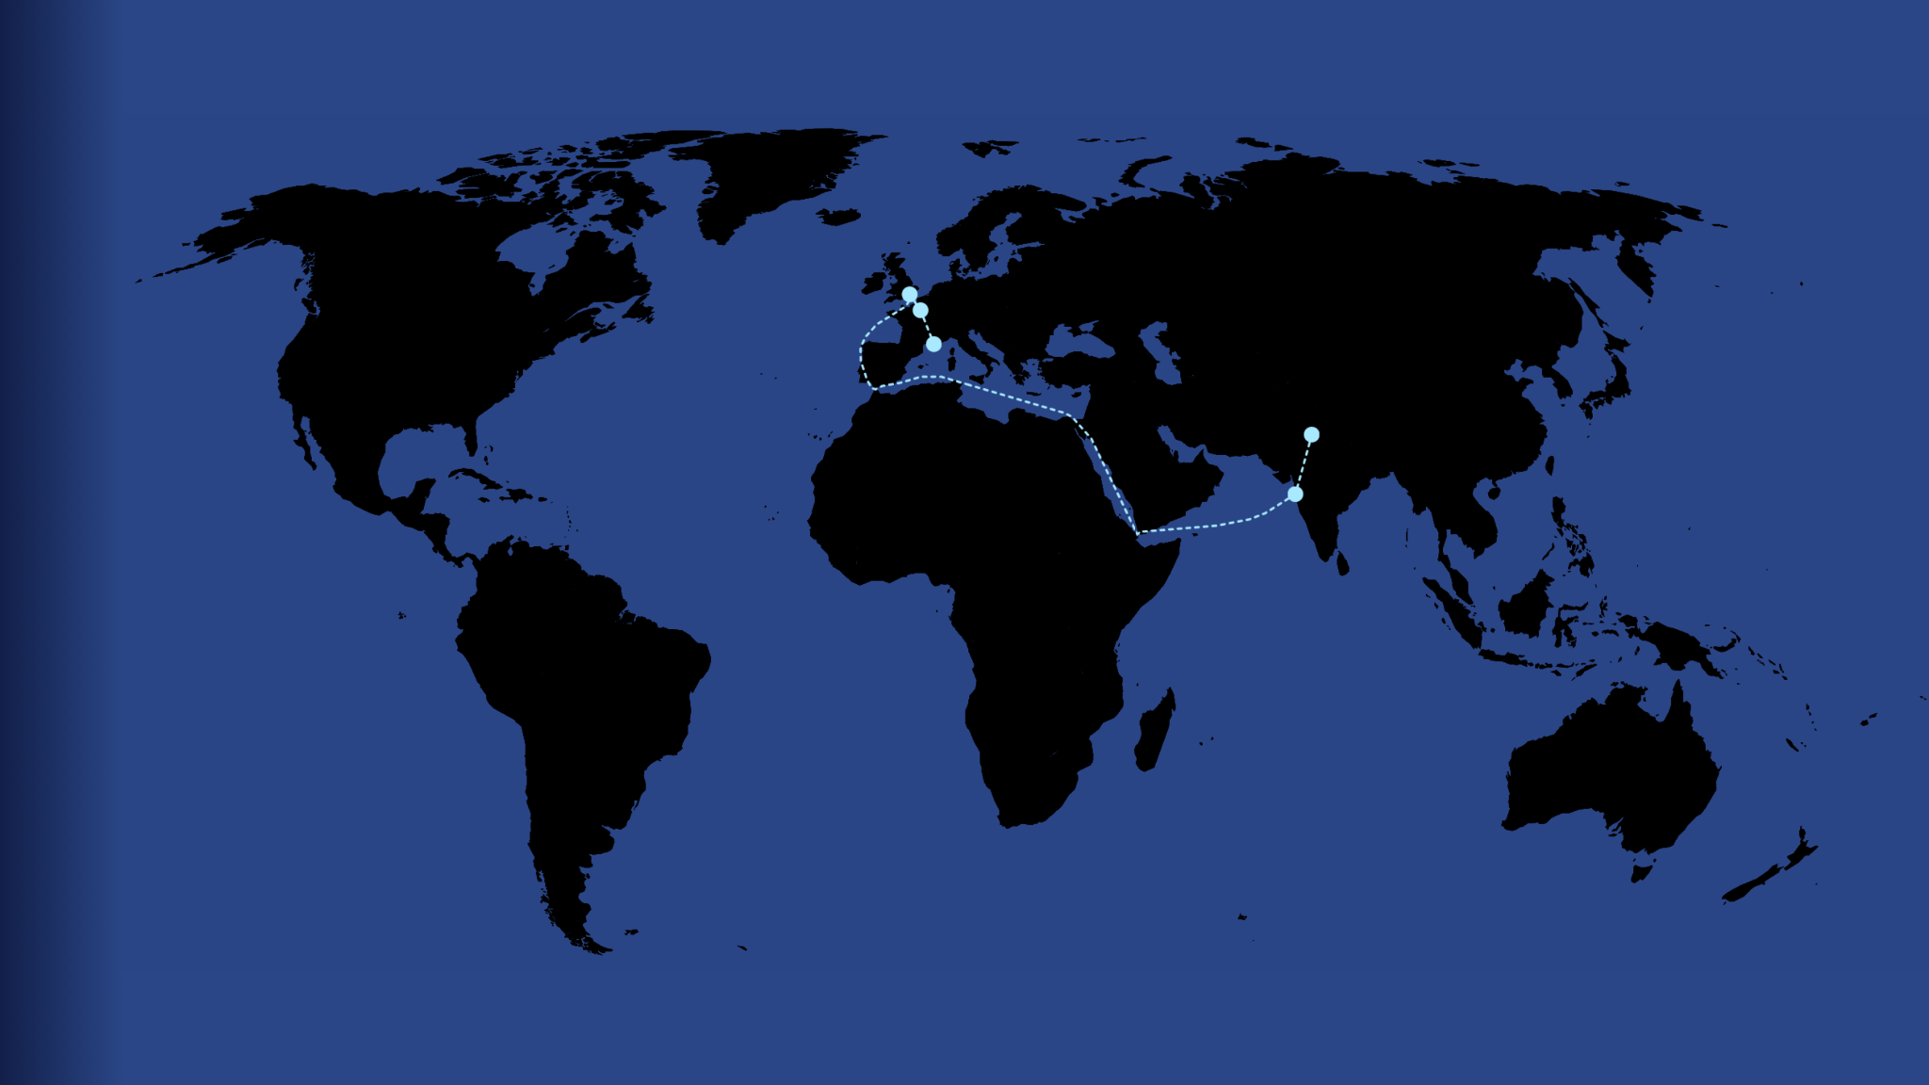
How would things look like normally?
Focus on a path between India and France - before the Red sea cable outages
We can infer that the path travelled the middle east corridor

Slide 53
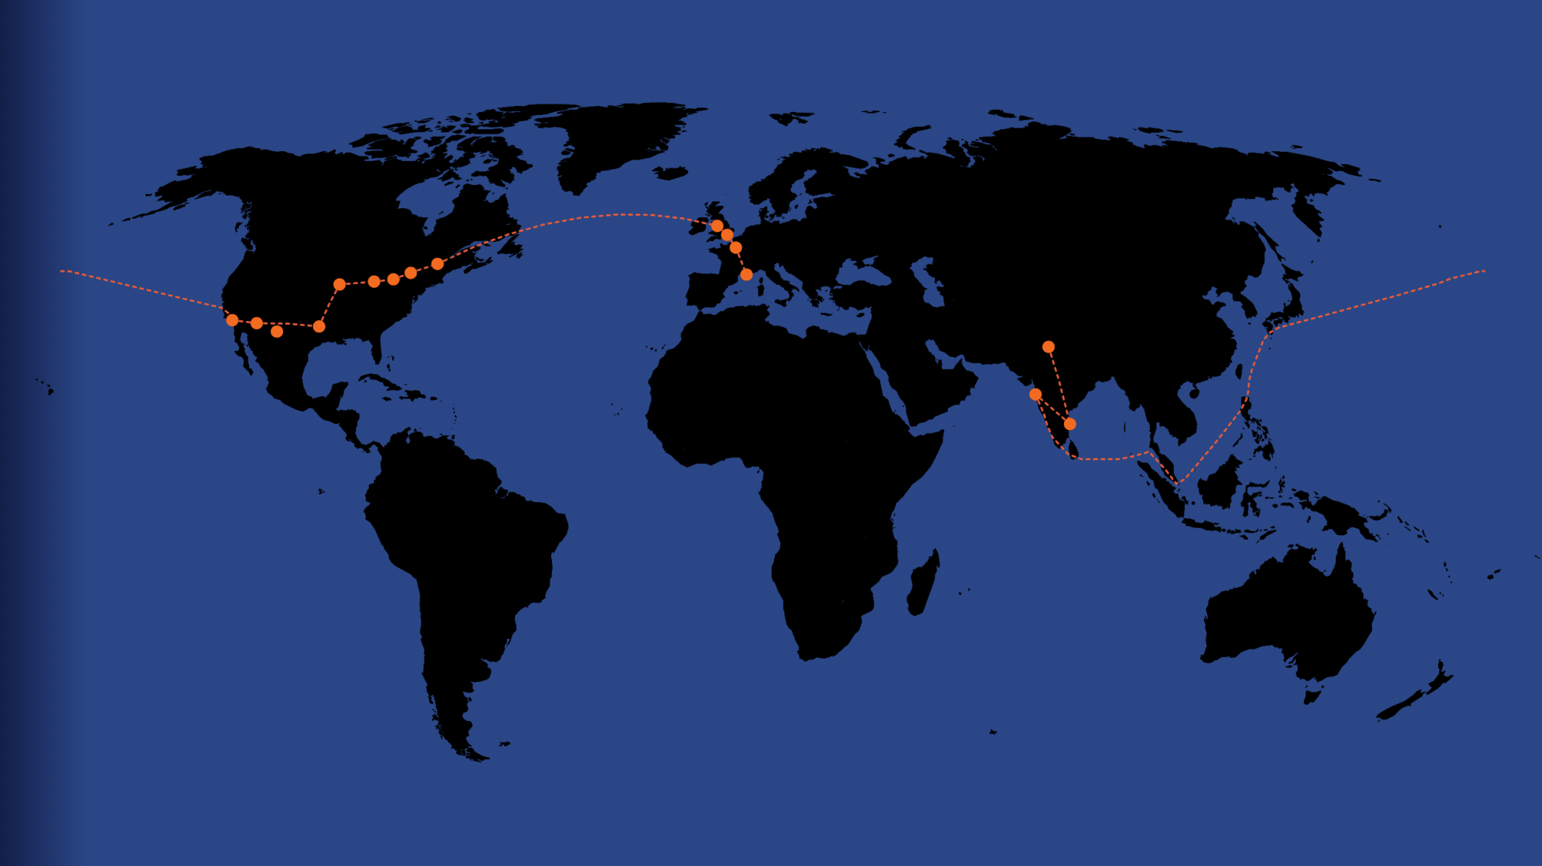
The Red Sea Outage had drastic impact
After the outage, we can infer that packets took the Mumbai-US-Europe path instead
Detours like these suggest possible gap in redundancy - missed business opportunities with regards affordable capacity in this area

Slide 54
The case of
RIPE Atlas

Slide 55
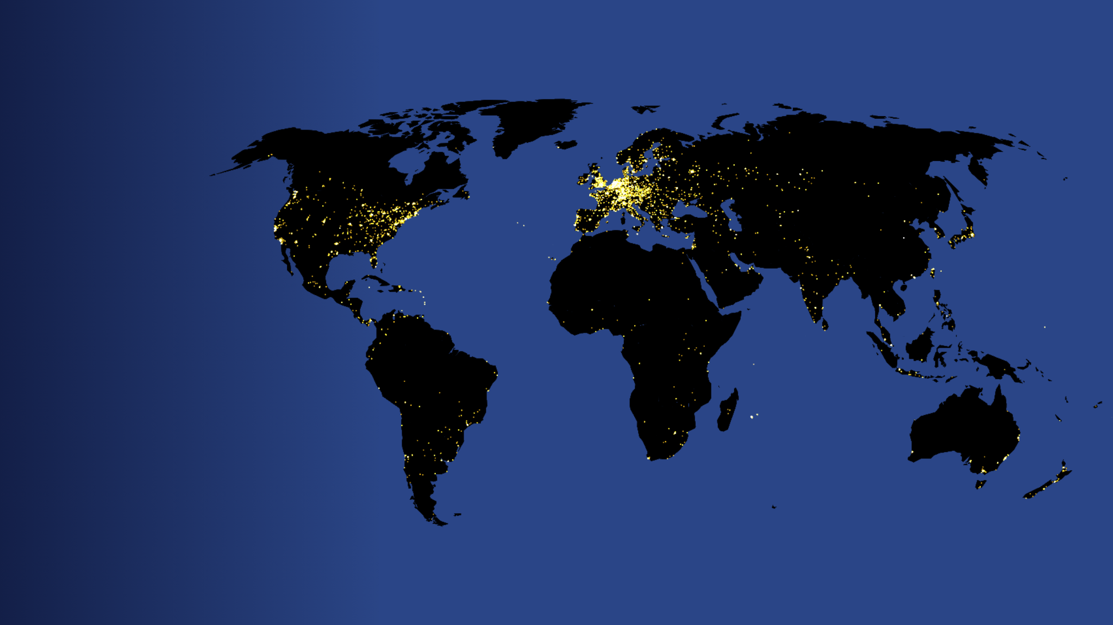
What is it?
RIPE Atlas
A global network of probes measuring the Internet in real time
13,400+ probes connected
900+ anchors deployed
35,000+ daily measurements on average (both user-defined and built-in)

Slide 56
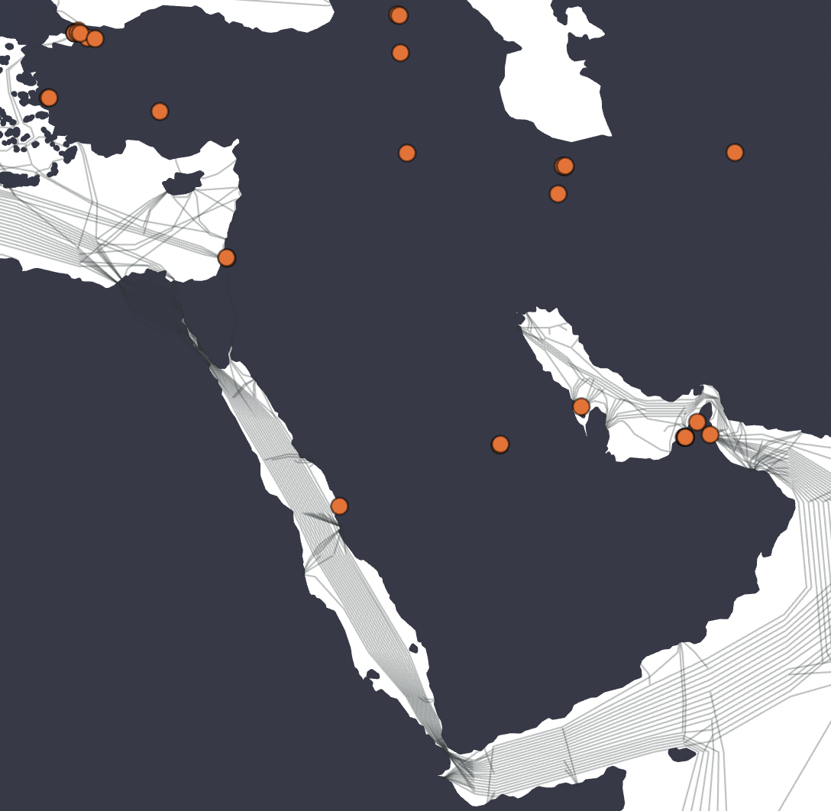
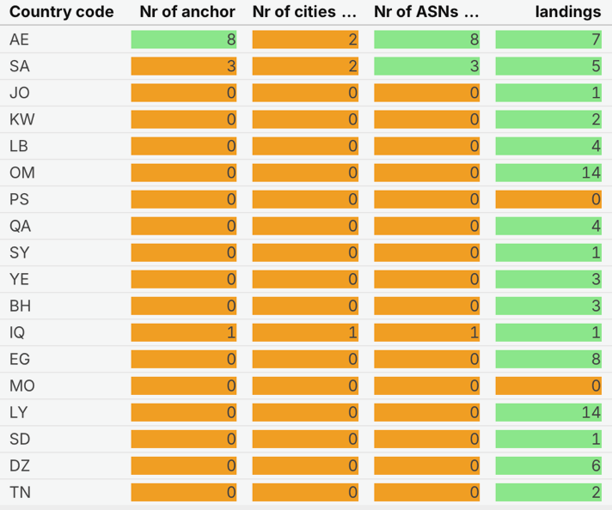
Do we have enough Anchors to measure the Internet?

Slide 57
What about the Atlas probes???
  503 Probes distributed in ME
73 Connected only
  190 Probes distributed in NA
13 Connected only
Country | Probes Total | Probes Connected
KSA | 113 | 19
Lebanon | 74 | 3
UAE | 71 | 25
Jordan | 44 | 1
Bahrain | 40 | 5
Kuwait | 34 | 3
Iraq | 29 | 9
Qatar | 28 | 3
Oman | 26 | 3
Palestine | 21 | 1
Yemen | 15 | 1
Syria | 8 | 0
Tunisia | 61 | 8
Algeria | 40 | 0
Egypt | 30 | 2
Sudan | 29 | 0
Morocco | 28 | 3
Libya | 2 | 0

Slide 58
The case of
Internet Exchange Points

Slide 59
What does success look like for an IXP?
Keeping the local traffic local
Fostering local interconnection for developing a digital economy
Attract global Cloud and Content players
Becoming a hub for exchanging regional traffic

Slide 60
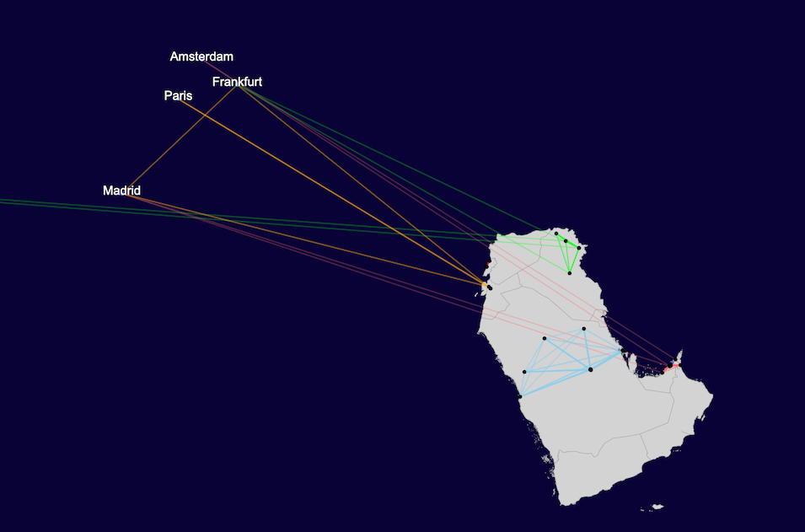
Keeping local traffic local
RIPE Atlas

Slide 61
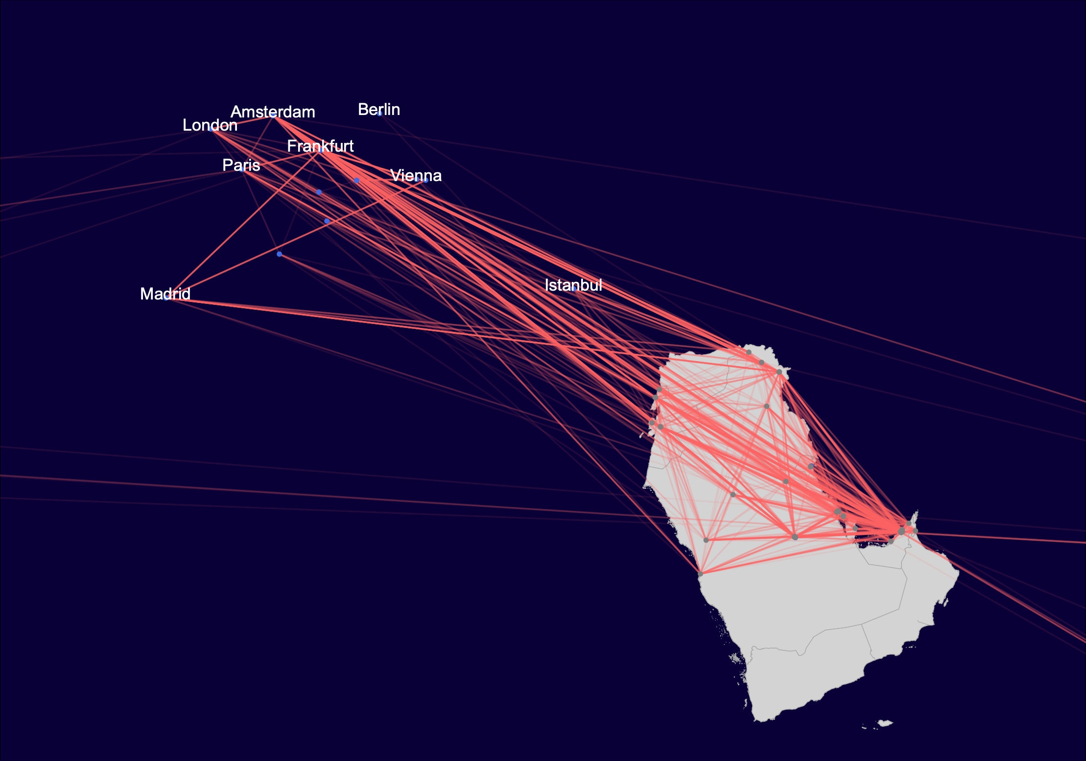
4. Inter-regional communications
RIPE Atlas

Slide 62
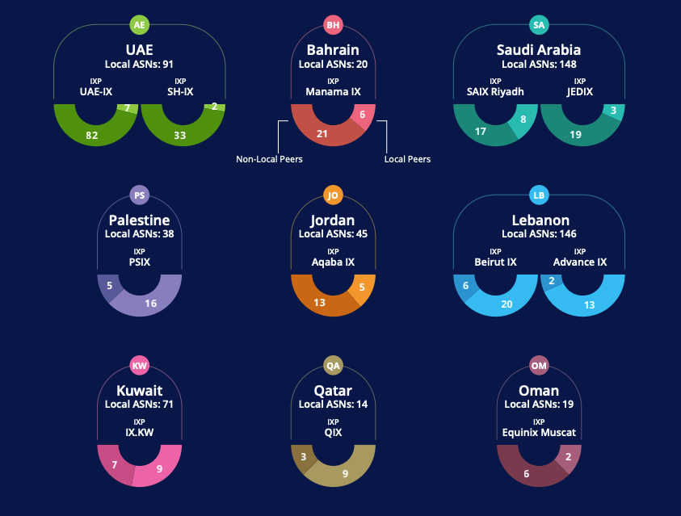
2. Fostering a digital ecosystem in the country
RIPE Atlas

Slide 63
Discussion Time

Slide 64

THANK YOU!

Slide 65


?
Questions
& Comments
jelcham@ripe.net

Slide 66
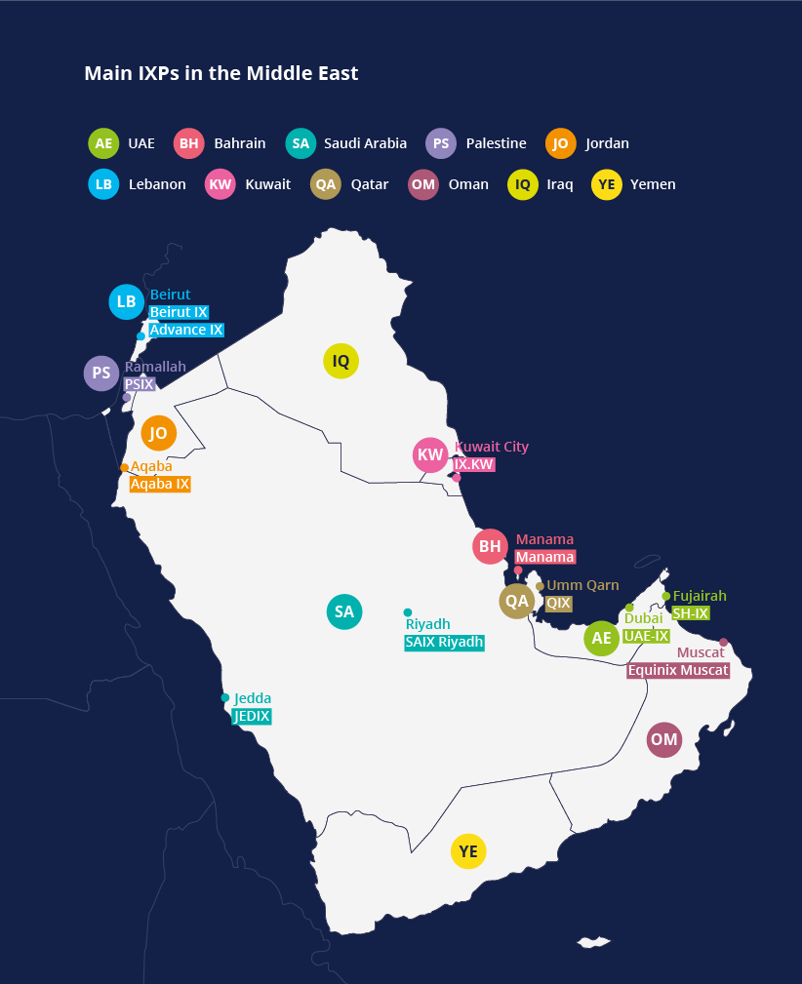
RIPE NCC IXP Report: Initial Findings
Considerable growth in the number of IXPs in the region
Multiple governance structures
Challenges on several fronts (Regulatory, cross-border connections, addressable market, etc.)
When can an IXP be considered a success?

Slide 67
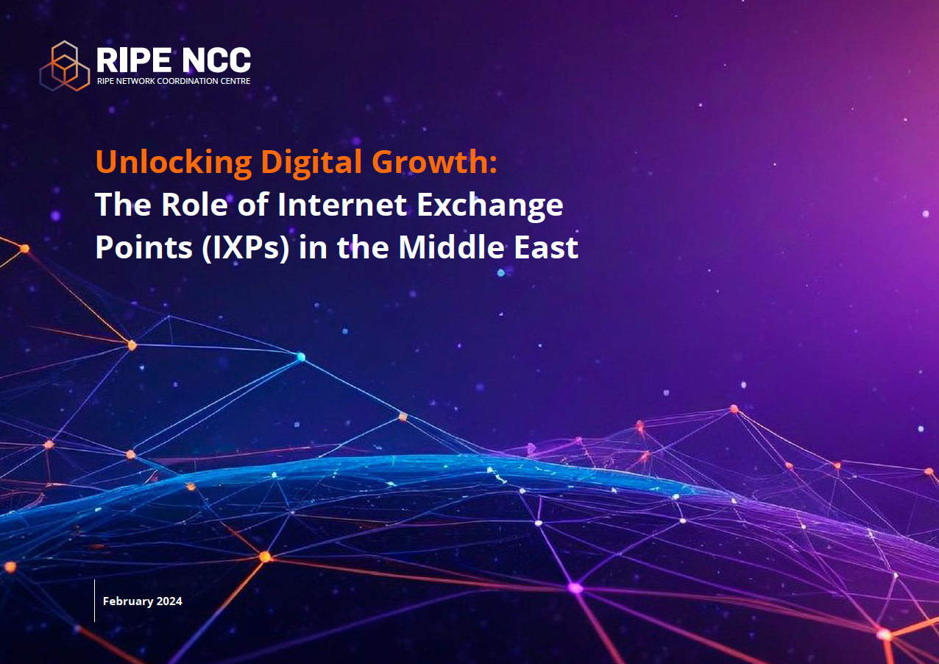

Download the IXP Report
Download the report for free on RIPE Labs:
    https://labs.ripe.net/author/jadelcham/unlocking-digital-growth-the-role-of-ixps-in-the-middle-east/
SCAN TO DOWNLOAD THE REPORT

Slide 68
RIPE NCC IXP Report
A successful IXP might fulfil one or more roles:
  (1) Keep the local traffic… local!
  (2) Fostering local interconnection for developing a digital economy
  (3) Attract global Cloud and Content players
  (4) Becoming a hub for exchanging regional traffic

Slide 69
(2) Economy Digitalisation?

Slide 70
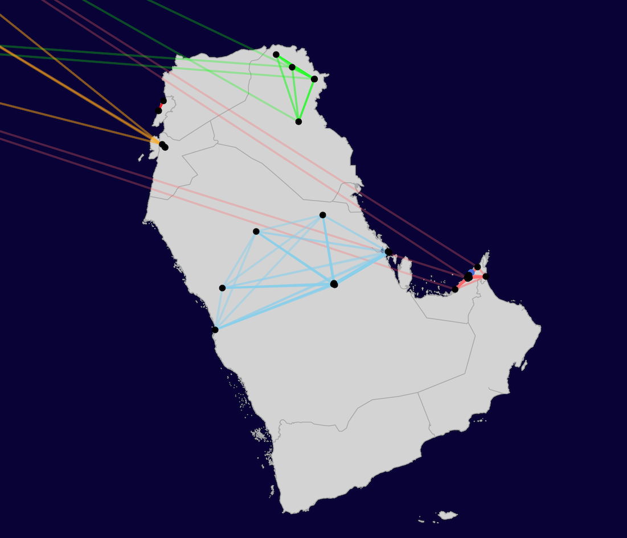
(1) In-Country Connections

Slide 71
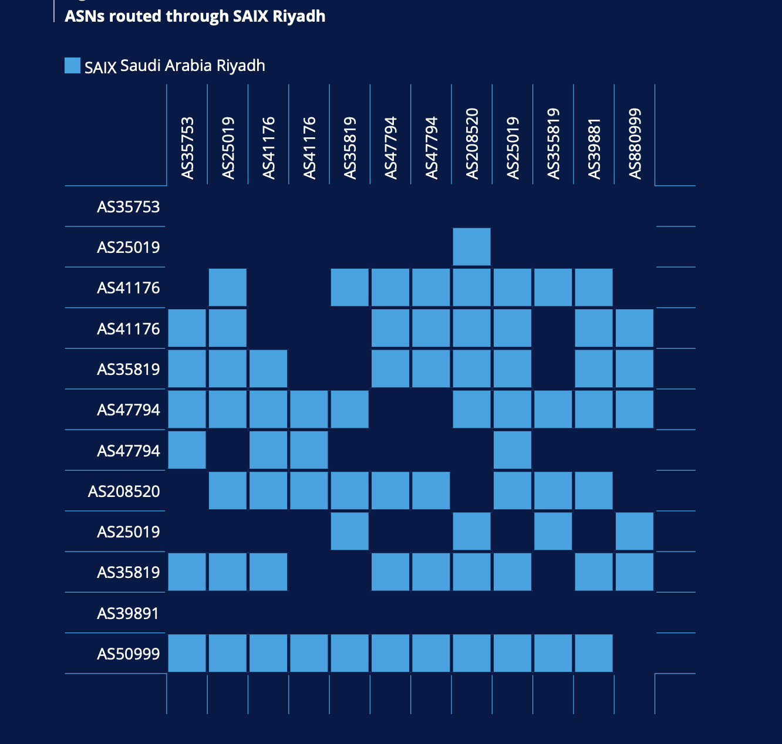
(1) In-Country Connections

Slide 72
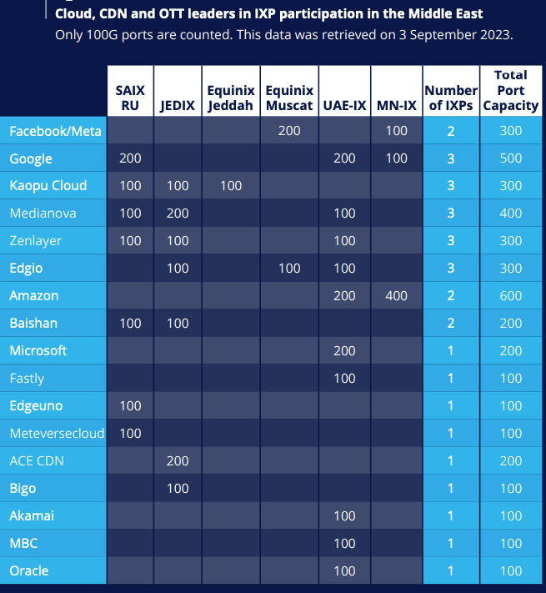
(3) Global Players

Slide 73
(4) Inter-Region Connections

Slide 74
(4) Inter-Region Connections

Slide 75
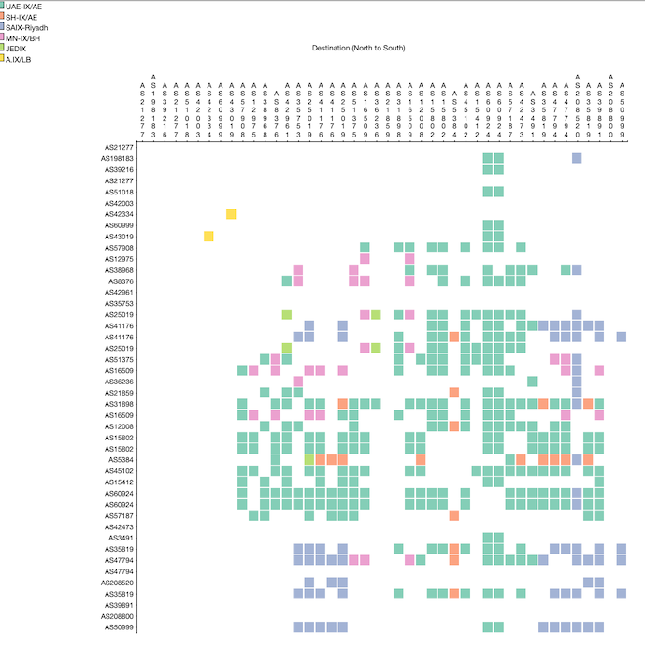
(4) Inter-Region Connections

Slide 76
(4) / (1) Differences?
Inter-Region
In-Country

Slide 77
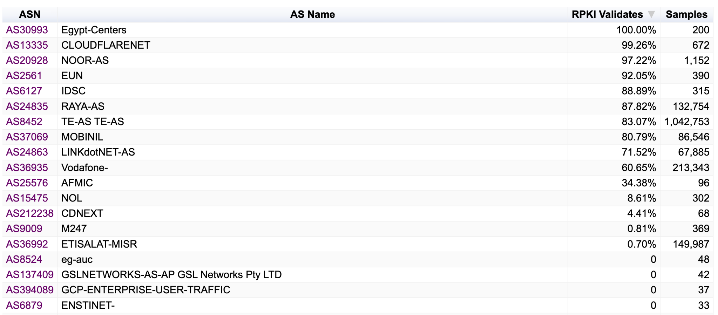
ROV - MA - Egypt

Slide 78
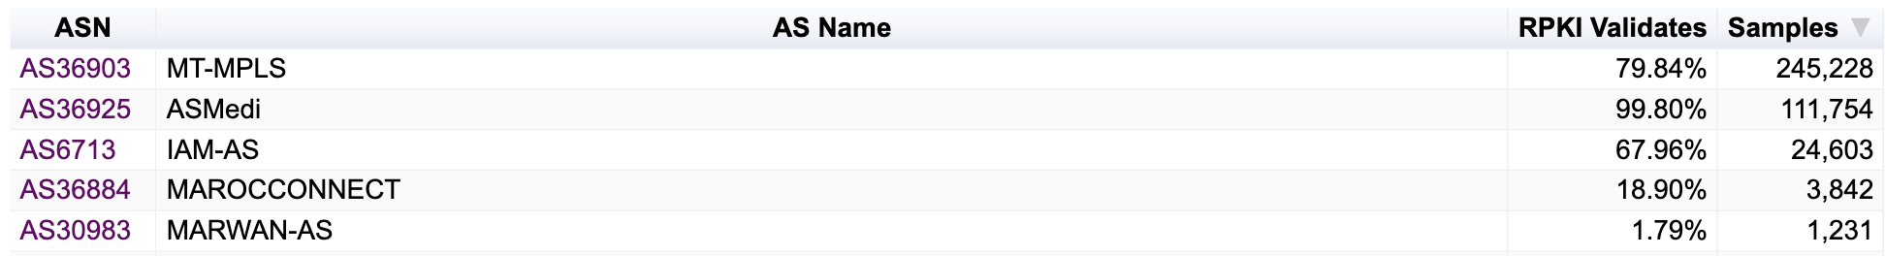
ROV - MA - Tunisia

