Slide 1
Internet Resilience Index Reading Romania
October 2024
Hanna Kreitem
kreitem@isoc.org
Notes:
Good morning.
Today, I will talk about the Internet Society’s efforts to help decision-makers understand the global Internet's health, availability, and evolution and gain your feedback on how we can improve this as an industry.

Slide 2
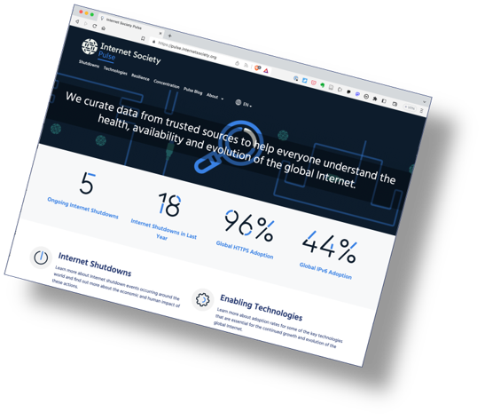
Internet Society Pulse
Launched December 2020.
We curate Internet measurement data from trusted sources to help everyone gain deeper, data-driven insight into the Internet.
Trusted data from multiple sources:
Benefit: Helps to assess whether efforts to ensure that the Internet remains open, globally connected, secure, and trustworthy are working.
Benefit: Allows policymakers, researchers, journalists, network operators, civil society groups, and others to better understand the health, availability, and evolution of the Internet.
pulse.internetsociety.org​
Notes:
The Internet Society has been running its Measuring the Internet project for three years. The outward-facing product of this is the Pulse platform, which curates open-source data to examine Internet trends and tell data-driven stories.

Slide 3
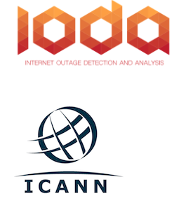
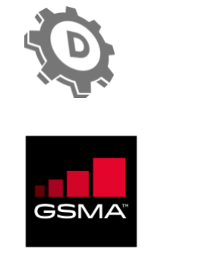
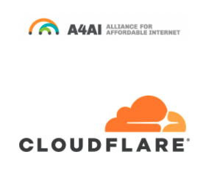
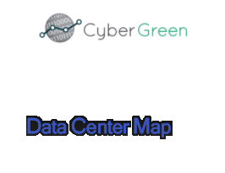
Pulse Data Partners
Data is provided by our trusted data partners

Slide 4
Pulse tracks
Shutdowns: Where do Internet shutdowns take place?
Net Loss: Estimate the economic impacts of Internet shutdowns.
Technologies: Tracking the deployment of technologies critical for the evolution of the Internet.
Concentration: How much are services concentrated in the hands of a few?
Resilience: How robust is the Internet ecosystem?
IXP Tracker: monitors the growth of IXPs globally

Slide 5
Where to Start?

Slide 11
Internet Resilience Index

Slide 12
The Internet Resiliency Index (IRI)
pulse.internetsociety.org/resilience​
The framework collates around 30 sets of public metric data that relate to four pillars of a resilient Internet:
.
Infrastructure
The existence and availability of physical infrastructure that provides Internet connectivity.
Performance
The ability of the network to provide end-users with seamless and reliable access to Internet services.
Security
The ability of the network to resist intentional or unintentional disruptions through the adoption of security technologies and best practices.
Market Readiness
The ability of the market to self-regulate and provide affordable prices to end-users by maintaining a diverse and competitive market.
Methodology: https://pulse.internetsociety.org/wp-content/uploads/2023/07/Internet-Society-Pulse-IRI-Methodology-July-2023-v2.0-Final-EN.pdf
Notes:
The IRI draws upon more than 20 open data sources and uses best practice methodologies to calculate a snapshot of a country’s Internet resilience in terms of its:
Infrastructure
Performance
Security
Market Readiness
I’ll speak to these pillars and the metrics contributing to them as I go along. But before I do…

Slide 13
The Internet Resiliency Index — Performance
Infrastructure
Cable Infrastructure
10 km Fiber reach
Performance
Network Coverage
Mobile connectivity
Spectrum allocation
Security
Enabling infrastructure
Number of IXPs
Datacenters
Market Readiness
Notes:
To Before I dig into this further, here are the metrics currently contributing to our picture of security resilience. I say currently, as we are always looking at adding new metrics that relate to resilience.
And I’ll use this opportunity to shout out to the sources that make their data open. To reiterate, we don’t produce data on Pulse; we merely collate it and are thus reliant on all the great work of all these and other organizations that are doing to measure the health, availability, evolution, and, in this instance, security of the Internet.
Ok, so let's step through these sub-pillars and metrics to understand where each country in SE Asia is excelling or lagging.

Slide 15
The Internet Resiliency Index — Infrastructure
Latency
Infrastructure
Fixed networks
Upload
Download
Performance
Jitter
Security
Latency
Mobile networks
Upload
Market Readiness
Download
Jitter
Notes:
To Before I dig into this further, here are the metrics currently contributing to our picture of security resilience. I say currently, as we are always looking at adding new metrics that relate to resilience.
And I’ll use this opportunity to shout out to the sources that make their data open. To reiterate, we don’t produce data on Pulse; we merely collate it and are thus reliant on all the great work of all these and other organizations that are doing to measure the health, availability, evolution, and, in this instance, security of the Internet.
Ok, so let's step through these sub-pillars and metrics to understand where each country in SE Asia is excelling or lagging.

Slide 16
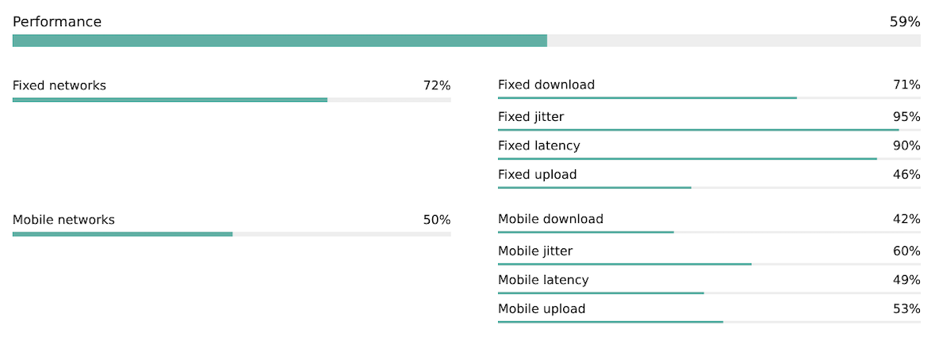

Slide 17
The Internet Resiliency Index — Security
Enabling technologies
Secure web traffic (Webpage loads using HTTPS. Source Mozilla
IPv6 adoption. Source APNIC Labs
Infrastructure
DNSSEC adoption, i.e., is ccTLD signed. Source: ICANN
DNSSEC
Performance
DNSSEC validation, i.e., Users validating DNSSEC.
Source: APNIC Labs
Routing hygiene
MANRS score.. Source: MANRS
Security
Upstream redundancy i.e., Avg # of upstream providers.
Source: CAIDA
Market Readiness
DDoS Protection.. Source: Cybergreen
Security Threat
Global cybersecurity index score.
Source: ITU
Secure Internet Servers
Source: World Bank
Notes:
Before I dig into this further, here are the metrics currently contributing to our picture of security resilience. I say currently, as we are always looking at adding new metrics that relate to resilience.
And I’ll use this opportunity to shout out to the sources that make their data open. To reiterate, we don’t produce data on Pulse; we merely collate it and are thus reliant on all the great work of all these and other organizations that are doing to measure the health, availability, evolution, and, in this instance, security of the Internet.
Ok, so let's step through these sub-pillars and metrics to understand where each country in SE Asia is excelling or lagging.

Slide 19
The Internet Resiliency Index — Market Readiness
Infrastructure
Affordability
Market structure
Market concentration
AS Hegemony
Performance
Security
Peering efficiency
Traffic Localization
Domain count
Market Readiness
E-Government Development Index
Notes:
To Before I dig into this further, here are the metrics currently contributing to our picture of security resilience. I say currently, as we are always looking at adding new metrics that relate to resilience.
And I’ll use this opportunity to shout out to the sources that make their data open. To reiterate, we don’t produce data on Pulse; we merely collate it and are thus reliant on all the great work of all these and other organizations that are doing to measure the health, availability, evolution, and, in this instance, security of the Internet.
Ok, so let's step through these sub-pillars and metrics to understand where each country in SE Asia is excelling or lagging.

Slide 21
Historical Data
pulse.internetsociety.org​
Notes:
The Internet Society has been running its Measuring the Internet project for three years. The outward-facing product of this is the Pulse platform, which curates open-source data to examine Internet trends and tell data-driven stories.

Slide 27
Next Steps

Slide 28
Where to go next with the data?
Prioritize areas of engagement.
For Romania, key issues that need to be addressed are:
Market Diversity
Peering Efficiency
DNSSEC Validation
IPv6 Adoption
Mobile data speed and latency
Fixed access upload speed
Compare current performance with National strategies and plans.
Develop plans to achieve better results.
Notes:
Finally, if you’re interested in keeping abreast of our project, please subscribe to our monthly newsletter.
Or email us to discuss opportunities to partner or contribute to our Blog.
I’ve also shared a link to the methodology of the IRI for those interested in the sources and calculations.

Slide 29
Subscribe, Review, Contribute
Subscribe to the Pulse newsletter
Review the Pulse IRI methodology
Contribute to Pulse
pulse@isoc.org
Notes:
Finally, if you’re interested in keeping abreast of our project, please subscribe to our monthly newsletter.
Or email us to discuss opportunities to partner or contribute to our Blog.
I’ve also shared a link to the methodology of the IRI for those interested in the sources and calculations.

Slide 30
Thank you
Hanna Kreitem
kreitem@isoc.org

