Slide 1
IPv6 prefix assignment for end-customers - persistent vs non-persistent, and what size to choose. …known as… RIPE-690
(Best Current Operational Practice for operators)
Jan Žorž, Internet Society

Slide 2
What is this document all about?
This document discusses the main issues related to the operational practices for the assignment of IPv6 prefixes for end-customers.
Making wrong choices when designing your IPv6 network will sooner or later have negative implications on your deployment and require further effort such as renumbering when the network is already in operation. The temptation to take “easy” approaches for quicker deployment should therefore be resisted.

Slide 3
Co-authors
Jan Žorž <zorz@isoc.org>,
Sander Steffann <sander@steffann.nl>,
Primož Dražumerič <Primoz.Drazumeric@telekom.si>,
Mark Townsley <townsley@cisco.com>,
Andrew Alston <andrew.alston@liquidtelecom.com>,
Gert Doering <gert@space.net>,
Jordi Palet <jordi.palet@consulintel.es>,
Jen Linkova <furry@google.com>,
Luis Balbinot <lbalbinot@brfibra.com.br>,
Kevin Meynell <meynell@isoc.org>,
Lee Howard <lee.howard@retevia.net>

Slide 4
Table of Content

Slide 5
A generic set of recommendations:
a) IPv6 is not the same as IPv4.
In IPv6 you assign a number of “n” /64 prefixes to each end-customer site, so they are able to have as many subnets as they wish. You should not be concerned with exhausting the IPv6 addressing space, and you should think big when planning future requirements. If you need more space, you can go back to your Regional Internet Registry and providing your addressing plan justifies it, you can obtain more IPv6 addresses.

Slide 6
A generic set of recommendations:
b) If you want a simple addressing plan, you should consider these three options:
1) /48 for each end-customer. This will work very well for customers coming from other ISPs, those that have their own ULA, or have been using transition mechanisms. This will also be easier when you have a mix of customers using the same infrastructure, whether they are residential customers, SMEs or even large corporates.
2) Differentiate amongst types of customers, even if this will increase the complexity of your network and those of your customers, by offering /48 for business customers and /56 for residential customers.
3) A trade-off amongst the previous two options by reserving a /48 for residential customers, but actually just assigning them the first /56.
There a specific case for cellular phones to be assigned a single /64 per each PDP context, but this is out of scope of this document.

Slide 7
A generic set of recommendations:
c) In order to facilitate troubleshooting and have a future proof network, you should consider numbering the WAN links using GUAs (Global Unicast Addresses), using a /64 prefix out of a dedicated pool of IPv6 prefixes. If you decide to use /127 for each point-to-point link, it is advisable to allocate a /64 for each link and just use one /127 out of it.

Slide 8
A generic set of recommendations:
d) Non-persistent prefixes are considered harmful in IPv6 as you can’t avoid issues that
may be caused by simple end-customer power outages, so assigning persistent prefixes is a safer and simpler approach. Furthermore, this avoids the need for expensive logging, increases your chances to offer new business to customers, and decreases your customer churn.

Slide 9
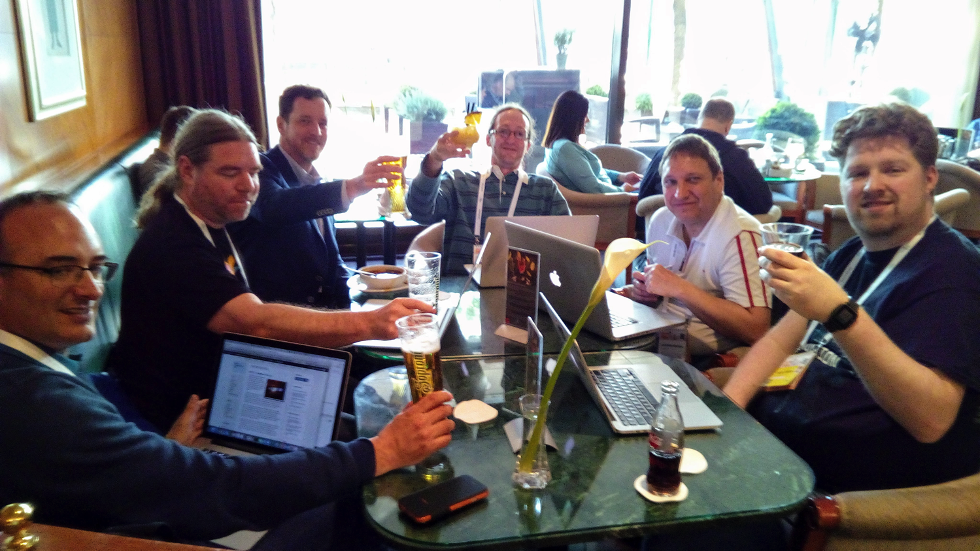
Editing draft v.2

Slide 10
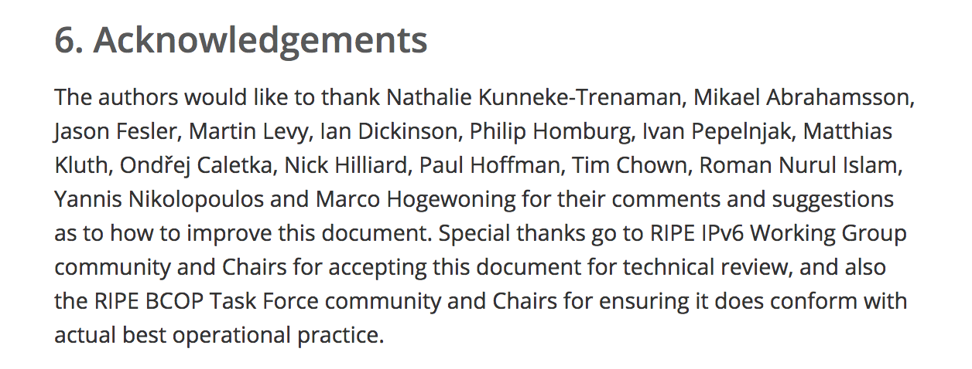
ACK’s

Slide 11
Where to find the doc…
https://www.ripe.net/publications/docs/ripe-690

Slide 12
Future work and ideas
Operators say: “Mail server on IPv6? No, thnx!”
Anti-spam mechanisms? IP reputation?
How to survive on IPv6 when it comes to incoming email server and protecting from the spam?
So how about writing a BCOP document that describes the solutions and best current practice on the above topic?

Slide 13
Q&A
Suggestions?
Comments?
Ideas?
zorz@isoc.org

