Slide 1
National Technical University of Athens
School of Electrical and Computer Engineering
Division of Communication, Electronic and Information Engineering
Network Management and Optimal Design Laboratory
Enabling Privacy-Aware Zone Exchanges
Nikos Kostopoulos
nkostopoulos@netmode.ntua.gr
RIPE SEE 12, Athens, April 2024

Slide 2
Contributions
A privacy-aware schema relying on hashed names stored within probabilistic data structures
Efficient DNS zone distribution to Recursive DNS Servers and scrubbing service providers that may support DNS attack mitigation closer to attack sources
Design Requirements: → Privacy-aware, efficient zone mapping → Support for existing DNS request types (AXFR – full zone transfer, IXFR – incremental zone transfer) → Dynamic (incremental) updates
Zones mapped within privacy-aware Cuckoo Filters (CF’s), which support element deletions

Slide 3
Background: Cuckoo Filters (CF’s)
Elements inserted as fingerprints in entries of a 2D array
- Fingerprints are calculated using the function fgp(x), e.g. Mmh3 hash function
CF’s are characterized by:
- Number of available buckets m
- Fingerprint entries b per bucket
- Fingerprint size f
Partial-key Cuckoo Hashing technique: Each element x is assigned a pair of buckets $h_{1}$ and $h_{2}$
$h_{1}\left(x\right)=hash\left(x\right)$, $\left.h_{2}\left(x\right)=h_{1}\left(x\right)⊕hash(fgp\left(x\right)\right)$

Slide 4
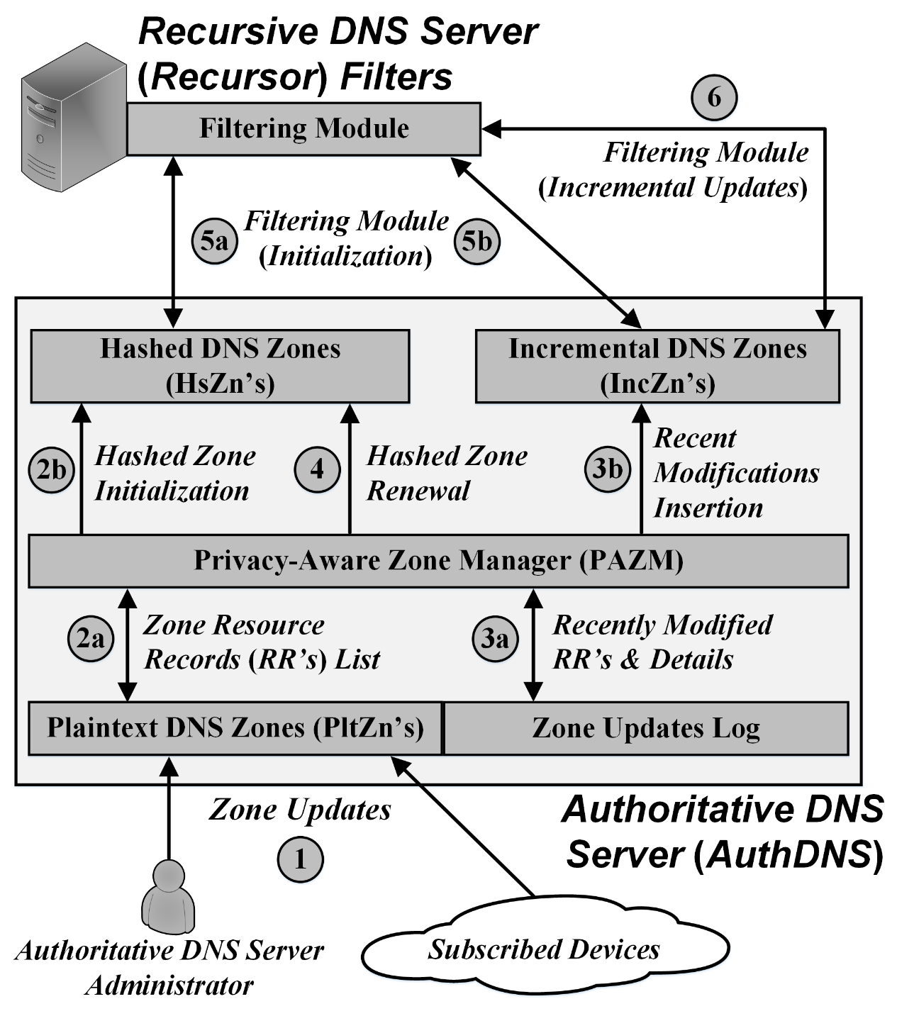
Proposed Baseline Design
Privacy-Aware Zone Manager - Builds privacy-aware zones (Hashed & Incremental Zones) based on Cuckoo Filters (CF’s) - Coordinates zone management
Plaintext DNS Zones - Unhashed domain names
Hashed DNS Zones - Entire hashed zone contents - Retrieved via AXFR DNS queries
Incremental DNS Zones - Hashed recent zone updates - Retrieved via IXFR DNS queries

Slide 5
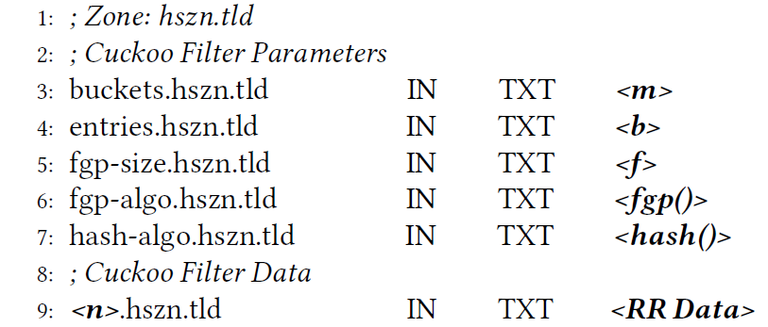
Hashed DNS Zones
These zones hold the FQDN’s of the Plaintext DNS Zones hashed and mapped in Cuckoo Filters (CF’s)
Serialization format (zone hszn.tld):
CF parameters & algorithms:
# buckets m, fingerprint size f, # entries b
Algorithms $fgp()$ and $hash()$ for fingerprint & candidate buckets calculation

Slide 6
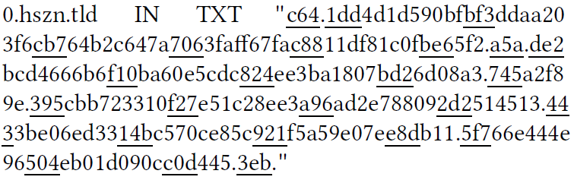
Hashed DNS Zone Resource Record (RR): Example
RR of a Hashed DNS Zone after building the CF
CF parameters:
12-bit fingerprints
b = 4 entries / bucket
Mmh3 hash functions
Mapping Specifications:
Equally sized fingerprints of $\left\lceil f/4\right\rceil$ hexadecimal digits
Fingerprints requiring less than $\left\lceil f/4\right\rceil$ digits are prepended with 0’s
The fingerprints of multiple CF buckets are mapped sequentially within a single TXT type RR
Buckets with vacant entries require a trailing dot as they do not have explicit boundaries
TXT type RR limit: 255 Bytes

Slide 7
Prototype Evaluation: CF Privacy Properties (1/2)
Attacks to Cuckoo Filter (CF) privacy:
Looking up all possible name combinations and measuring:
True Positives (TP’s): Positive lookups for names stored in the CF
False Positives (FP’s): Positive lookups for names not stored in the CF
If FP’s >> TP’s:
Discovery of zone names becomes next to impossible
Hashed CF contents are protected with high certainty

Slide 8
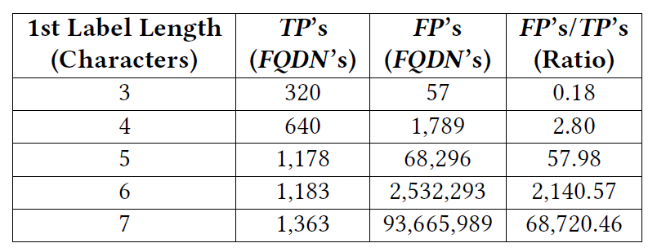
Prototype Evaluation: CF Privacy Properties (2/2)
Use case:
CF lookups for all permitted name combinations with 1st label (prefix) lengths of 3-7 characters
Permitted characters: Letters, digits, hyphens
Considered zone: ntua.gr (8,294 names)
CF False Positive (FP) probability: 0.3%
For prefixes longer than 5 characters: FP’s >> TP’s → Hashed names are protected with high certainty
Longer prefixes or multiple labels result into more FP’s

Slide 9
Thank you!
Nikos Kostopoulos
nkostopoulos@netmode.ntua.gr

